Slide 1
Advanced Cybercrime and Electronic Evidence Training Course for Prosecutors and Judges
Session 3
Technology and Cybercrime Updated
Notes:
This session is 90 minutes in length

Slide 2

Agenda
Digital society overview
Recent attacks
Contemporary mass scale financial and other frauds
Internet of the things challenges
Darknet/Deep Web aspects
Snapshot on Virtual Currencies
Notes:
Session agenda. Delegates should have a copy of it in their possession.

Slide 3

Objectives
To provide a technology and cybercrime update
To examine trends and developments
To look at the impact changes in technology will have for Law Enforcement, Prosecutors and Judges
To identify investigative or regulatory requirements
Notes:
Session agenda. Delegates should have a copy of it in their possession.

Slide 4
Digital society overview
Digital society reflects the results of the modern society in adopting and integrating information and communication technologies at home, work, education and recreation.
There are four main levels of digital society that overarch a substructure of commercial, communications and technologies capabilities:
Notes:
The structure of digital society reflects the structure of digital technology as people, technology, business, culture and social interactions have evolved and emerged.

Slide 5
Digital society overview
Digital Business: New business models and designs connecting people, businesses and things to drive revenue, greater efficiency, improved safety and higher quality.
Digital Platforms: Collections of digital businesses that form global value chain systems. Platforms attract buyers and sellers to transact on a specific collection of digital services.
Digital Society Infrastructure: The institutions and foundational elements of the physical and digital worlds, including critical physical infrastructure and cyberinfrastructure.
Digital Society: The sum of the interactions, information, value and priorities generated between people, organizations and things in a digital and physical connected world
Notes:
There are 4 recognised components

Slide 6
Digital society overview
Digital innovations are reshaping our society, economy and industries with a scale and speed like never before.
Mobile and cloud technologies, Big Data and the Internet of Things offer unimaginable opportunities, driving growth, improvement of citizens’ lives and efficiency to many areas including health services, transportation, energy, agriculture, manufacturing, retail and public administration.
They can also improve the governing process by helping policy-makers take better decisions and engage citizens.
The Internet has considerable potential to promote democracy, cultural diversity and human rights like the freedom of expression and freedom to information.

Slide 7
Threat from cyber attacks
Ransomware remains the most dominant threat as criminals increase pressure by threatening publication of data if victims do not pay.
Ransomware on third-party providers also creates potential significant damage for other organisations in the supply chain and critical infrastructure.
The threat potential of DDoS attacks is higher than its current impact in the EU.

Slide 8

Recent cyber attacks
Cyber-based threats are growing in scale and complexity globally. Countries, such as the United Kingdom, USA, Australia and Singapore, as well as multinational corporations, have been the target of a rising number of these increasingly sophisticated attacks.
Channel 9
Australian broadcaster Channel Nine was hit by a cyber attack on 28th March 2021, which rendered the channel unable to air its Sunday news bulletin and several other shows.
The attack also interrupted operations at the network’s publishing business as some of the publishing tools were also down.
Although the channel first claimed that the inconvenience was just due to “technical difficulties”, it later confirmed the cyber attack.

Slide 9
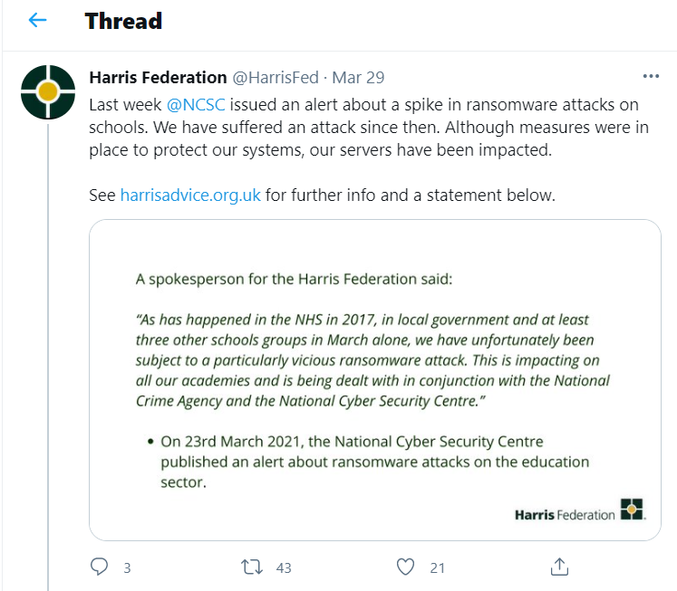
Recent cyber attacks
Harris Federation
In March 2021, the London-based Harris Federation suffered a ransomware attack and was forced to “temporarily” disable the devices and email systems of all the 50 secondary and primary academies it manages.
This resulted in over 37,000 students being unable to access their coursework and correspondence.

Slide 10
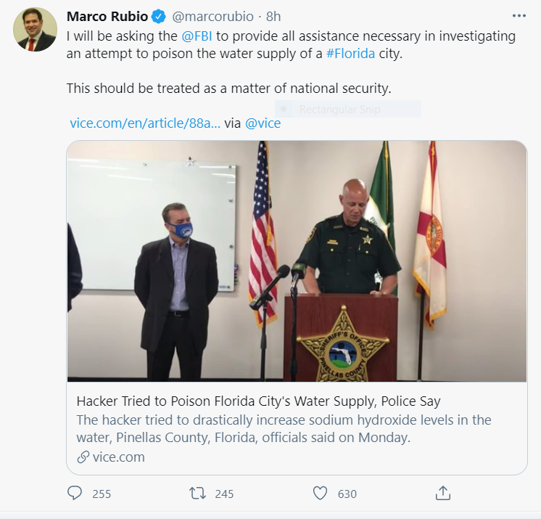
Recent cyber attacks
Florida Water System
A cyber criminal attempted to poison the water supply in Florida and managed by increasing the amount of sodium hydroxide to a potentially dangerous level.
The cyber criminal was able to breach Oldsmar’s computer system and briefly increased the amount of sodium hydroxide from 100 parts per million to 11,100 parts per million.

Slide 11

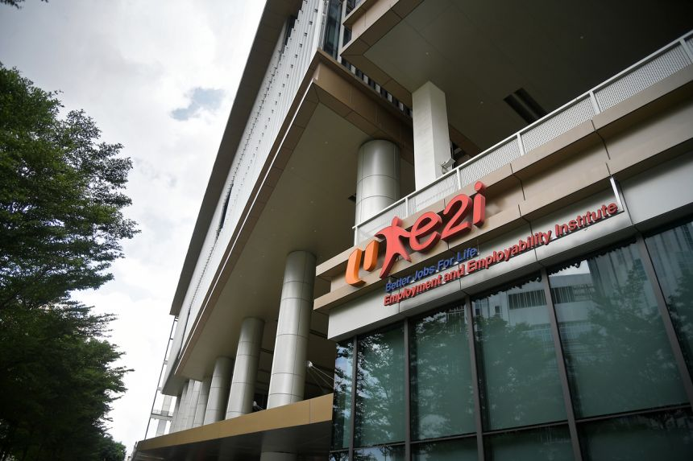
Recent cyber attacks
SINGAPORE
The personal data of about 30,000 people who have used the services of the National Trades Union Congress' Employment and Employability Institute (e2i) may have been accessed by cyber criminals.
FIJI
A cyber attack resulted in disruptions to some of Government’s online services and networks, including GovNet
Notes:
The structure of digital society reflects the structure of digital technology as people, technology, business, culture and social interactions have evolved and emerged.

Slide 12
Fraud
Investment Association reports 300 incidences of fraud with an estimated total loss to savers of approximately £4m.
Fraudsters have been convincing savers to purchase investment products that do not exist and to give away their personal details as part of “sophisticated” impersonation scam, the Investment Association has warned.
A number of investment companies reported that fraudsters have been impersonating their products, in particular investment bonds, and promoting them through fake price comparison sites in order to get their hands on savers’ cash, according to the IA.
The scammers are targeting victims through sponsored Google and Facebook links and also collect personal details via fake call centres.
Aviva is one of the firms who has become aware of sites, run by fraudsters, pretending to be part of its business. Among these websites are avivainvestorsholdings.com, avivauk.com and avivabonds.com.
Notes:
In some cases scammers have set up a range of email addresses and used the names of genuine members of staff in investment management firms to trick savers. Investment managers are now urging their customers and the public to be vigilant, and are working closely with regulators and law enforcement.

Slide 13
Fraud
SIM Swapping Attacks - Operation Smart Cash
An eight-month-long investigation between the Romanian National Police and the Austrian Criminal Intelligence Service with the support of Europol has led to the arrest of 14 members of a crime gang who emptied bank accounts in Austria by gaining control over their victims’ phone numbers.
Law enforcement arrested the suspects earlier in February in Romania. The gang perpetrated the thefts, which netted dozens of victims in Austria, in a series of SIM swapping attacks.
Once having gained control over a victim’s phone number, this particular gang would then use stolen banking credentials to log onto a mobile banking application to introduce a withdrawal which they then validated with an OTP sent by the bank via SMS allowing them to withdraw money at cardless ATMs.
It is estimated that this gang managed to steal over half a million euros this way from unsuspecting bank account owners.

Slide 14
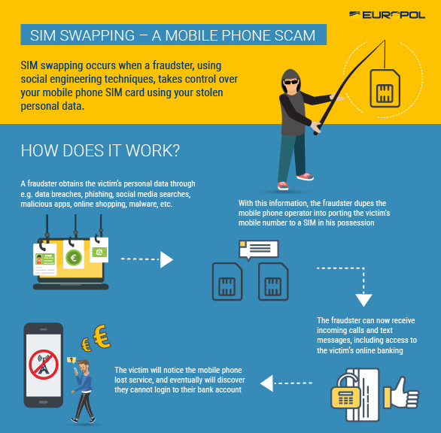
Fraud – SIM swapping

Slide 15
Fraud
BUSINESS EMAIL COMPROMISE REMAINS A THREAT AND
GROWING AREA OF CONCERN
Over the past twelve months, BEC has increased globally, with an additional increase as a result of the global outbreak of COVID-19.
This increase in volume coincides with a growing sophistication and a more targeted approach.
Criminals make use of technically advanced measures, such as compromising bank accounts, identifying the ideal time to strike, managing email conversations with complex man-in-the-middle attacks or even using Artificial Intelligence (AI) to mimic the voice of a company’s CEO
Notes:
We will see this in action later this week.

Slide 16
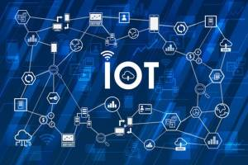
IOT
With billions of linked devices, The Internet of Things (IoT) has
quickly become a huge part of how people live, communicate and
do business.
All around the world, web-enabled devices are turning our world into a
more switched-on place to live.
From security challenges to the perils of high customer expectations,
these five factors are big concerns for the growth and development of
the Internet of Things.
Security - IoT devices greatly expand the “attack surface”.
March 2021 hackers broke into Verkada, a cloud-based video security service. Using authentic admin account credentials discovered on the internet, the attackers were able to browse live feeds of over 150,000 cameras installed in factories, hospitals, classrooms, prisons, and other locations, as well as access sensitive material belonging to Verkada software clients.
Recently parents have reported strangers accessing their IoT baby monitors through the internet and using them to talk to their children.
Notes:
Security - Ask any security expert about the biggest headaches of the 21st century and they’ll likely bring up IoT devices. The reason? In cybersecurity terms, IoT devices greatly expand the “attack surface,” or the amount of potential areas for cybercriminals to penetrate a secure network.

Slide 17
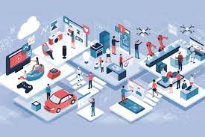
IOT
Outdated hardware and software
Since the IoT devices are being used increasingly, the manufacturers of these devices are focusing on building new ones and not paying enough attention to security.
A majority of these devices don’t get enough updates, whereas some of them never get a single one.
What this means is that these products are secure at the time of purchase but becomes vulnerable to attacks when the hackers find some bugs or security issues.
Notes:
When these issues are not fixed by releasing regular updates for hardware and software, the devices remain vulnerable to attacks. For every little thing connected to the Internet, the regular updates are a must-have. Not having updates can lead to data breach of not only customers but also of the companies that manufacture them.

Slide 18
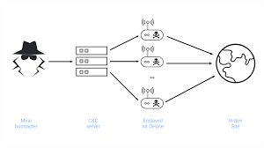
IOT
Use of weak and default credentials.
Many IoT companies are selling devices and providing consumers default credentials with them — like an admin username.
Hackers need just the username and password to attack the device. When they know the username, they carry out brute-force attacks to infect the devices.
The Mirai botnet attack is an example that was carried out because the devices were using default credentials.
Consumers should be changing the default credentials as soon as they get the device, but most of the manufacturers don’t say anything in the instruction guides about making that change. Not making an update in the instruction guides leaves all of the devices open to attack.

Slide 19
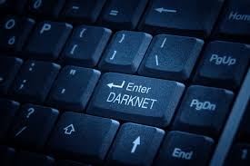
Darknet
The Darknet has become, in the last few years, one of the most discussed topics in cyber security circles.
The activities on the Darknet could be grouped into three main categories:
Activism, journalism, and whistle-blowing;
Criminal activities in virtual markets; and
Cyber security threats including botnets, malware, and ransomware.
The media depict it as a safe haven for criminals to undertake a range of criminal activities, such as the anonymous trading of illegal goods, including drugs, trading of weapons, credit card, other personal information, and exotic animals via cryptocurrencies (e.g. Bitcoin).
Notes:
To some, the hidden networks in the Internet are a means to achieve freedom; while to others these networks are no more than new outlets to express their criminal desires. In general, the Darknet tends to be portrayed by various news media as an environment wherein criminal activities flourish naturally.

Slide 20
CSAM - Darknet
Parallel to the activity of large offender communities through Darknet forums is a development involving smaller communities sharing CSAM directly with each other via encrypted messaging platforms in small invite only networks.
In response to law enforcement operations targeting these Darkweb communities and due to the need to select participants and ensure exchanges of information are strictly related to child sexual abuse, offenders tightly control their communities.
They use Darkweb forums as meeting places where participation is structured similarly to criminal organisations, with affiliation rules, codes of conduct, division of tasks and strict hierarchies. The purpose of the structure is to enforce rules and promote individuals based on their contribution to the community, which they do by recording and posting
Notes:
Following several high-profile law enforcement operations on the Darkweb, many offenders seem to believe they are more secure in such small networks, sometimes based on invite-only. Offenders are also known to have used encrypted communication channels to infiltrate existing child-aged groups and form break-off groups involving children and adults.

Slide 21
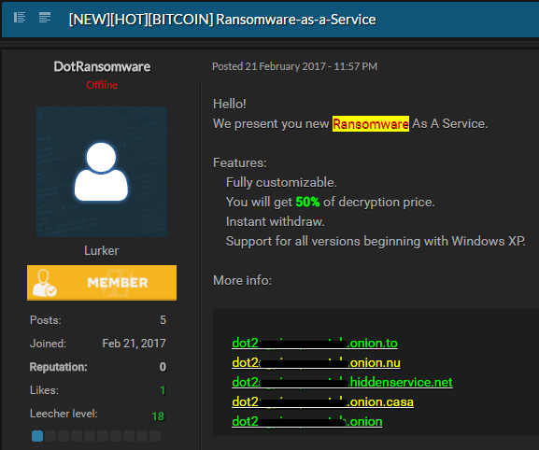
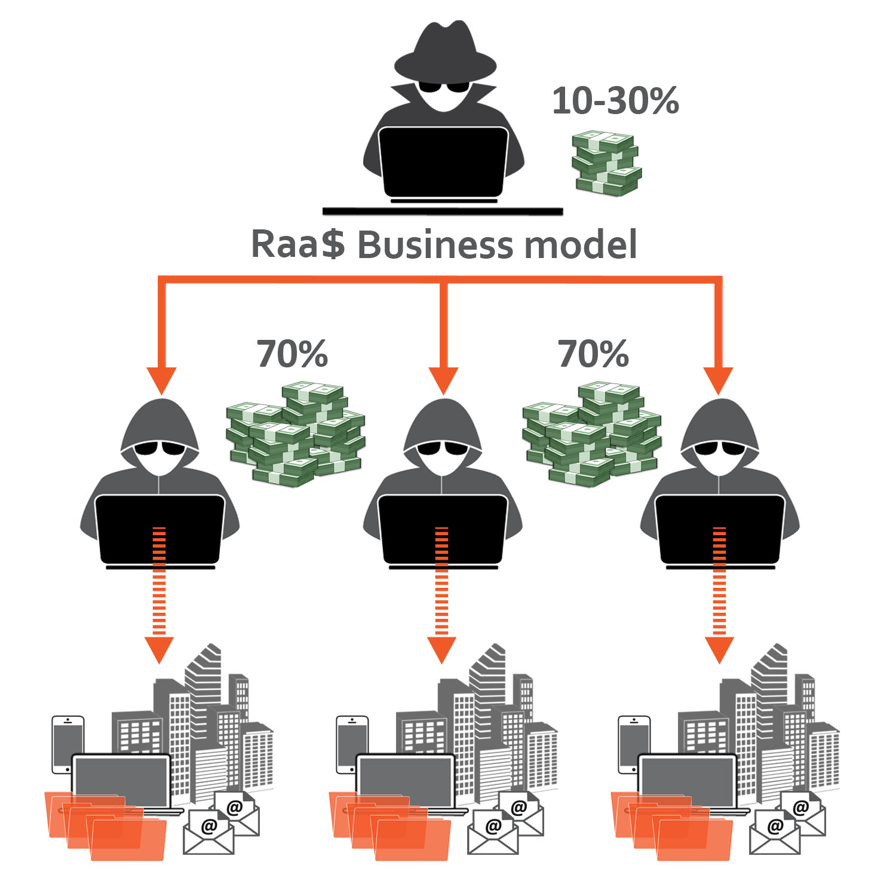
Darknet
The availability of Ransomware-as-a-Service (RaaS) on Darkweb marketplaces has also decreased the barrier of entry for new, less skillful criminal actors. Lockbit, for example, which emerged in January 2020, was brokered on underground forums for other cybercriminals to use, in return for payment.
Notes:
To some, the hidden networks in the Internet are a means to achieve freedom; while to others these networks are no more than new outlets to express their criminal desires. In general, the Darknet tends to be portrayed by various news media as an environment wherein criminal activities flourish naturally.

Slide 22
Ransomware
An alternative to the publication of data is its destruction. Some ransomware families, such as NotPetya have destructive wiper functionalities which may cause irreversible damage to the victim.
Europol observed a case of destructive malware which took place in 2020, in which attackers managed to rewrite the master boot record.
One case saw an IT service provider being attacked with Maze ransomware, which can sit on the victim’s servers for several months. This allows criminals to perform reconnaissance by monitoring internal communications in order to identify a key moment, such as merging, selling, big meetings with customers/sales, etc., for the deployment of the ransomware, placing the maximum pressure on the company to pay.
Notes:
This was a regular tactic for Ddos attacks on bookmakers, prior to a major sporting event.

Slide 23
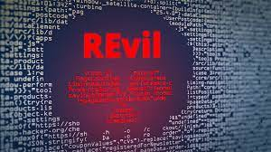
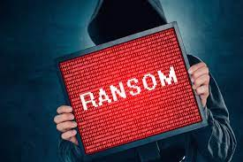
Ransomware
Attackers who launch ransomware attacks have requested ransom from anywhere between less than a thousand to millions of euros.
When targeting their victims, law enforcement found attackers surveying their victims and assessing both the victim’s capacity to pay (by reading e.g. financial reports) and the most effective way of infecting as many machines as possible during the attack.
Several ransomware families including Sodinokibi (also known as REvil), Maze, Doppelpaymer, Nemty and Snatch published data which criminals stole from their victims over the past year. In particular, the auctioning of the data by criminal groups marks a new step and demonstrates an escalation in methods aimed at coercing victims to pay the ransom.
Notes:
One case saw an IT service provider being attacked with Maze ransomware, which can sit on the victim’s servers for several months. This allows criminals to perform reconnaissance by monitoring
internal communications in order to identify a key moment, such as merging, selling, big meetings with customers/sales, etc., for the deployment of the ransomware.

Slide 24
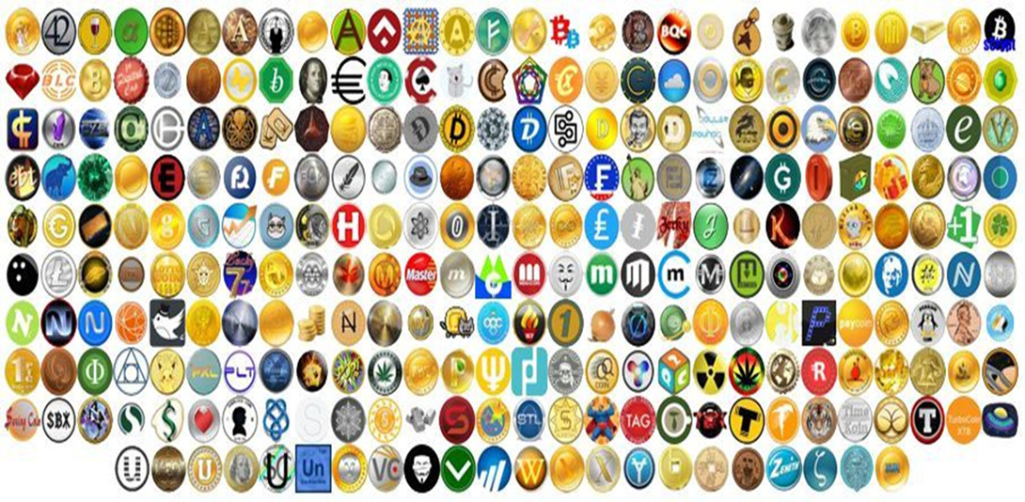
Cryptocurrencies
As of March 2022, there are over 18,000 different types
https://blockspot.io/coin/ provides a list of all cryptocurrencies and tokens
Notes:
Today there are thousands of different cryptocurrencies in the world, and while each is designed to provide some new feature or function, most are founded on principles similar to those of Bitcoin:
• Cryptocurrencies are not issued, regulated, or backed by a central authority like a bank or the government. They are decentralized, not centralized.
• Cryptocurrencies are created using a distributed ledger (blockchain) and peer-to-peer (P2P) review.
• Bitcoin and other coins are encrypted (secured) with specialized computer code called cryptography.
• As assets, cryptocurrencies are generally stored in digital wallets, commonly a blockchain wallet, which allows users to manage and trade their coins.
As of March 2022, there were more than 18,000 different types of cryptocurrencies, for a total market capitalization (market cap) for all cryptocurrencies of $2 trillion.

Slide 25



Cryptocurrencies
Initially, Darkweb markets relied solely on Bitcoin.
An increasing number of markets are recognizing the benefits of offering multiple coin alternatives, including Litecoin, Ethereum, Monero, Zcash, and Dash.
While Bitcoin still remains the most popular payment method (mainly due to its wide adoption, reputation and ease of use), the use of privacy-enhanced cryptocurrencies has increased.
Monero is gradually becoming the most established privacy coin for Darkweb transactions, followed by Zcash and Dash.
These privacy coins may present a considerable obstacle to law enforcement investigations, despite the competing altcoin communities favouring their implementation over the others.

Slide 26
Cryptocurrencies
The abuse of cryptocurrencies continue to play an important role in facilitating payments for transactions across all areas of cybercrime.
Reliability of transactions and a perceived anonymity have made cryptocurrencies the default payment method for victim-to-criminal payments in ransomware and other extortion schemes, as well as criminal-to criminal payments on the Darkweb.
In 2019, the overwhelming majority of bitcoin transactions were linked to investment and trading activity so, despite considerable abuse, criminal activity corresponds to only 1.1% of total transactions.

Slide 27
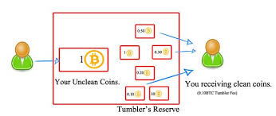
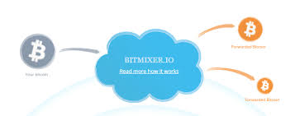
Cryptocurrencies
A number of factors have made cryptocurrency investigations more challenging and we can expect these to feature more prominently in future investigations.
These include centralised and decentralised mixing services, privacy coins, exchanges with insufficient KYC requirements, clandestine over-the-counter trading, nested services, where the exchange is incorporated within a wallet or another service and decentralised exchanges.
The obfuscation methods continue to develop. Centralised mixers troubled with exit scams and high fees seem to be gradually replaced by non-custodial mixing solutions where users do not need to send bitcoins to a third party.
Privacy-focused services aside, the bitcoin protocol itself is expected to soon implement features that will make it less transparent to casual observers and investigators alike.

Slide 28
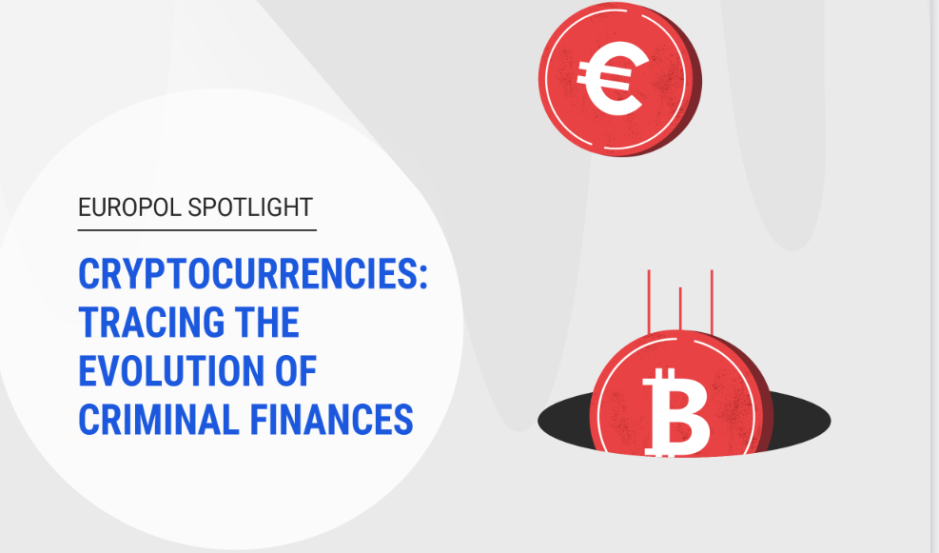
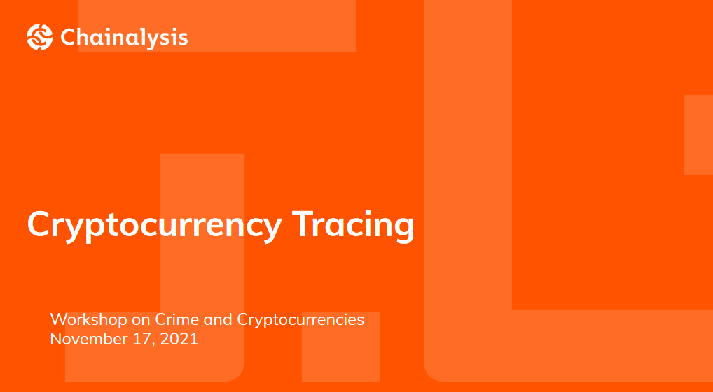
CRYPTOCURRENCIES: TRACING CRIMINAL FINANCES
Notes:
Information and tools available for tracing cryptocurrencies. The chain analysis course was run in conjunction with CoE C-PROC and Europol provides this document explaining the evolution of tracing cryptocurrencies.
Many people believe cryptocurrencies are completely anonymous. Transactions for Bitcoin and other virtual currencies are publicly reported on online blockchain ledgers that identify users solely by their cryptocurrency address – a long string of letters and numbers – without names, locations, or other personally identifying details., the next session will provide a more specific details of threats and methodology.

Slide 29

Questions

