Slide 1
Advanced Cybercrime and Electronic Evidence Training Course for Prosecutors and Judges
Session 4
Virtual Currencies Advanced
Notes:
This session is 90 minutes in length

Slide 2

Agenda
Introduction
Types of virtual currencies
Virtual goods and cybercrime
Identifying money trails
Investigative measures with respect to virtual currencies
Public-private cooperation with exchanges
Notes:
Session agenda. Delegates should have a copy of it in their possession.

Slide 3

Session Objectives
Refreshing what we have learned about virtual currencies
Understanding the different types of virtual currencies
Learning how to identify money trails involving virtual currencies
Understanding key players in the virtual currencies' ecosystem
Covering the seizure of centralised and decentralised virtual currencies
Exploring how to cooperate with virtual currency exchanges
Notes:
Session objectives. Delegates should be introduced with what is expected to be achieved by the end of the session.

Slide 4
Introduction TO VIRTUAL CURRENCY
Virtual Currencies Advanced

Slide 5
Digital Currencies
Definition
Digital currency is a form of currency that is available only in digital or electronic form, and not in physical form. It is also called digital money, electronic money, electronic currency, or cybercash.
Crypto-currencies are a form of digital currency, but not all digital currencies are crypto-currencies.
Digital currencies have many of the intrinsic properties of physical currency, and they allow for instantaneous transactions that can be seamlessly executed for making payments across borders when connected to supported devices and networks.
For instance, it is possible for a person in Europe to make payments in digital currency to a distant counterparty residing in Asia, provided that they both are connected to the same network required for transacting in the digital currency.
Notes:
https://www.bis.org/publ/othp33.htm
https://www.bbva.com/en/what-are-the-differences-between-a-digital-currency-and-a-cryptocurrency/

Slide 6
What is a virtual currency?
Virtual currency is a digital representation of value that can be digitally traded and functions as:
  a medium of exchange; and/or
  a unit of account; and/or
  a store of value,
  but does not have legal tender status.
  Source: FATF Report on Virtual Currencies
Notes:
This slide defines what is a virtual currency as per the FATF Report on Virtual Currencies available at https://www.fatf-gafi.org/media/fatf/documents/reports/Virtual-currency-key-definitions-and-potential-aml-cft-risks.pdf. The trainer should explain that virtual currencies are not issued by a specific jurisdiction nor are they guaranteed by any particular jurisdiction. The functions listed on the slide are only fulfilled by agreement within the community of users of the virtual currency.

Slide 7
Virtual currency vs fiat currency
Virtual currency is different from “fiat currency” (also known as “real currency”, “real money” or “national currency”)
This is because virtual currency is:
not issued by any country
not guaranteed by any country
not legal tender in any jurisdiction
Notes:
This slide distinguishes “virtual currency” from “fiat currency”.

Slide 8
Virtual currency vs e-Money
Virtual currency is different from “e-money”
This is because “e-money” is a digital representation or digital transfer mechanism for fiat currency
Notes:
This slide distinguishes “virtual currency” from “e-money”.

Slide 9


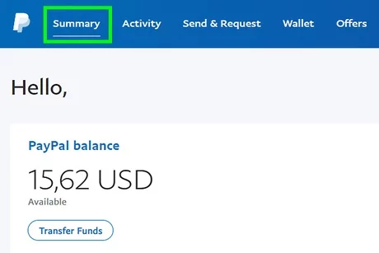
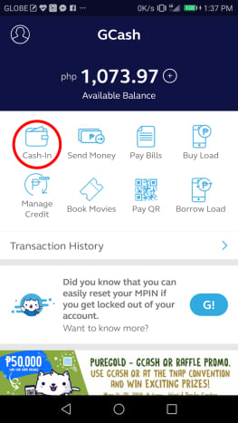
Examples
Virtual Currency
Fiat Currency
E-Money
Notes:
This slide distinguishes “virtual currency” from “e-money”.

Slide 10
TYPES OF VIRTUAL currencies
Virtual Currencies Advanced

Slide 11
Classifications of virtual currencies
There are different ways to classify virtual currencies:
Centralised vs Decentralised
Convertible vs Non-Convertible
Notes:
This slide distinguishes “virtual currency” from “e-money”.

Slide 12


Centralized vs Decentralised
Centralised
Controlled by a single admin
Administrator is responsible for:
  Issuing & redeeming currency
  Establishing rules for use
  Maintaining central payment ledger
  Fix exchange rate (if pegged)
Decentralised/Distributed
Not controlled by single admin
Distributed, open-source, peer-to-peer
includes cryptography-based virtual currencies

Slide 13
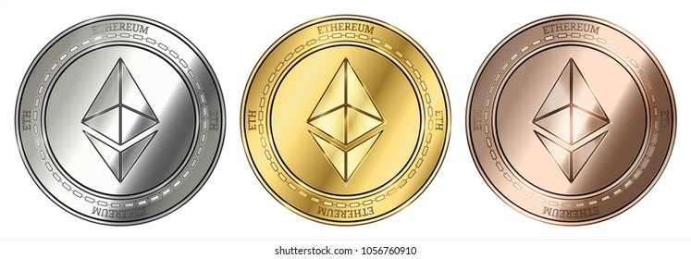


Convertible vs Non-Convertible
Convertible
Can be exchanged for fiat currency
Has exchange rate with fiat currency (pegged or floating)
Non-Convertible
Cannot be exchanged for fiat currency
Created for use in a specific virtual environment (e.g. games)

Slide 14

Crypto-currencies
Currently there are 6,044 crypto-currencies
Dated – August 2021
Notes:
https://www.statista.com/statistics/863917/number-crypto-coins-tokens/

Slide 15
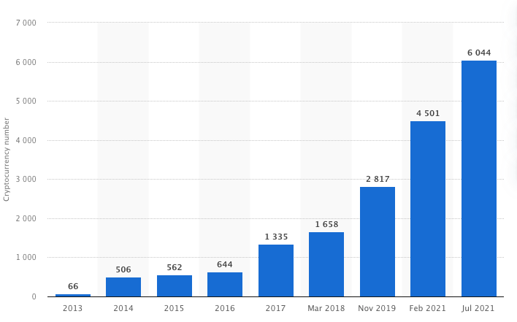
Crypto-currencies
Crypto-currencies 2013 - 2021
Source – Statista 2021
Notes:
https://www.statista.com/statistics/863917/number-crypto-coins-tokens/

Slide 16
Blockchain
Definition
Blockchain is a system of recording information in a way that makes it difficult or impossible to change, hack, or cheat the system.
A blockchain is essentially a digital ledger of transactions that is duplicated and distributed across the entire network of computer systems on the blockchain. Each block in the chain contains a number of transactions, and every time a new transaction occurs on the blockchain, a record of that transaction is added to every participant’s ledger.
The decentralised database managed by multiple participants is known as Distributed Ledger Technology (DLT).
Notes:
https://www.euromoney.com/learning/blockchain-explained/what-is-blockchain

Slide 17
Relevance of virtual currencies to criminal investigations AND CYBERCRIME
Virtual Currencies Advanced

Slide 18
Typologies of offences involving virtual currencies
Virtual currency as subject of crime
Virtual currency as object of a crime
Virtual currency as modus operandi of a crime
Virtual currency used for money laundering

Slide 19

Virtual currency as subject of crime
Some jurisdictions have imposed criminal offences on the possession or operation of virtual currencies
Such offences may include illegal possession of an unlicensed currency or operation of an unlicensed money exchange business

Slide 20
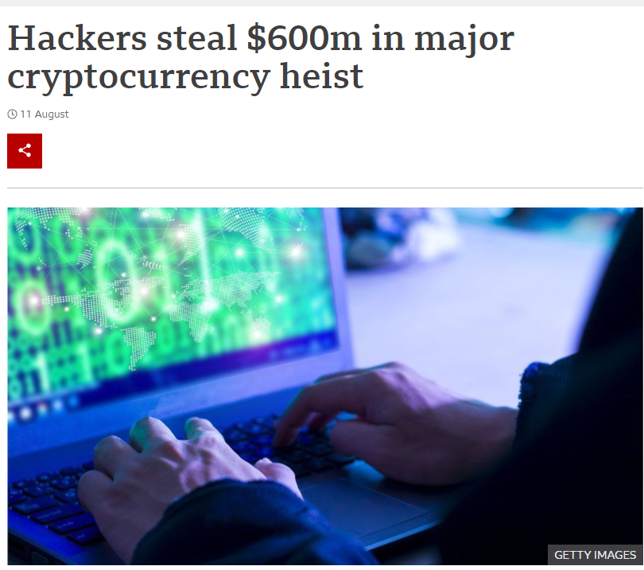
Virtual currency as object of crime
Traditional offences with fiat currency as the object of a crime can also extend to virtual currency
For instance, traditional offences may criminalise:
  Theft of virtual currency
  Fraudulently obtaining virtual currency

Slide 21


Virtual currency as modus operandi
Virtual currencies can also act as the instrumentalities of an offence
For instance, virtual currencies may be used to:
  Purchase illicit goods (weapons, drugs, child abuse materials)
  Pay for regulated services (e.g. online gambling)
  Finance terrorism

Slide 22
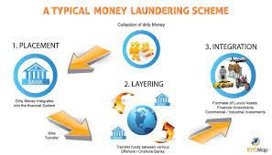
Virtual currency used for money laundering
Virtual currencies can be used to convert or transfer property, knowing that the property constitutes proceeds of crime, for the purpose of concealing or disguising its illicit origin

Slide 23
Relationship between virtual currencies and cybercrime
Hacking virtual currency wallet = Illegal access
(Article 2)
Obtaining virtual currency through fraud = Computer-related fraud
(Article 8)
Procuring online child sexual abuse materials using virtual currency = Child pornography
(Article 9)

Slide 24
Basic concepts of cryptocurrencies
Although there are around 12,000 different cryptocurrencies, Bitcoins are the cryptocurrency used is 40% of the cryptocurrency transactions and has the largest market cap Ethereum is the second largest and represents 20% of crypto-transactions.
A crypto-wallet is an electronic signature in which the public key is the wallet address or identifier.
The blockchain is a publicly available decentralized ledger of all transactions to ensure that a coin owner can only spend his coin once. It is a chain, similar to the “chain of custody” used in investigations to ensure authenticity of evidence.
Mining is done by the nodes in the blockchain. The function is to set the cost of computational calculations so high for modifying the blockchain, that it becomes economically unfeasible. This ensures that a coin cannot be stolen.
www.coe.int/cybercrime
Notes:
https://unsplash.com/photos/jEgQpfkHEWY

Slide 25
IDENTIFYING MONEY TRAILS
Virtual Currencies Advanced

Slide 26
Identifying money trails
Identifying a money trail involves tracing currency from its start point to its end point
Methods to identify cryptocurrency money trails varies from traditional methods used for fiat currency
The ledger for cryptocurrency is public and open to inspection, but “mixing” and “tumbler” services can be used to obfuscate funds

Slide 27
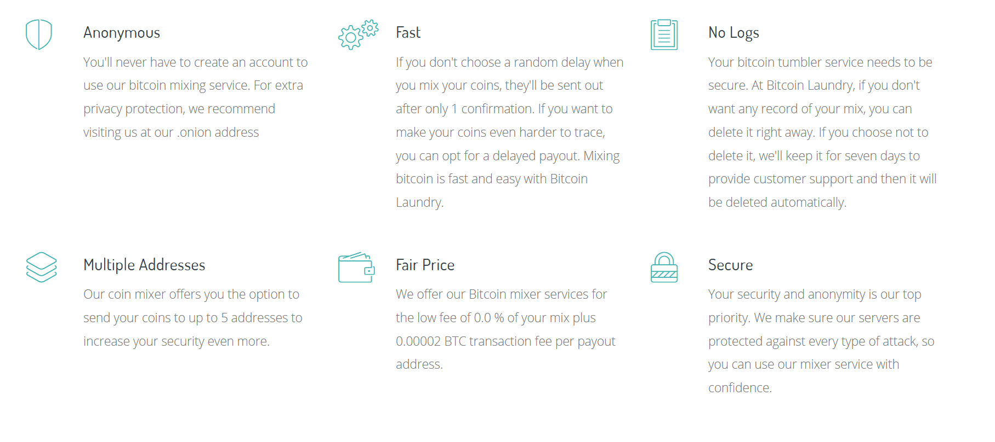
Mixers and Tumblers
To avoid tracking in the blockchain of wallet transfers, mixers and tumblers offer to anonymize the coins.
They do this by putting them in a “washer” which transfers the money back and forth, in various sizes, so it is more difficult, at least for humans, to understand where the coins ended up.
www.coe.int/cybercrime
Notes:
https://blenderbit.com/index.html#whymix

Slide 28
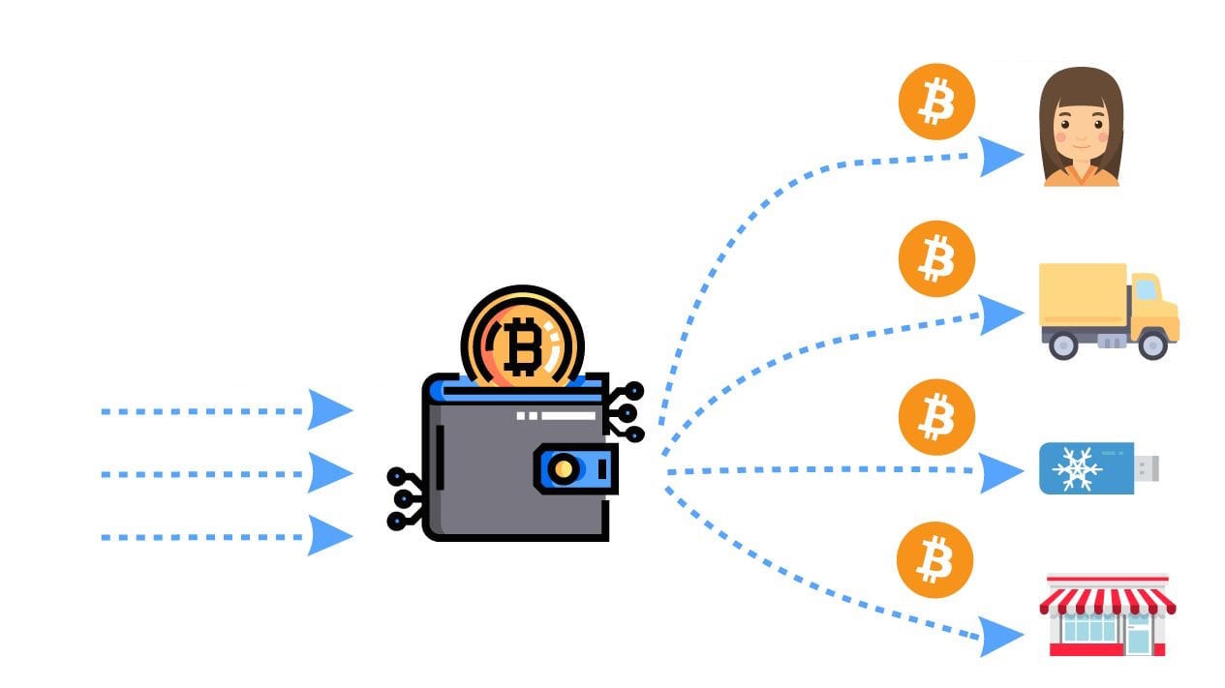
Identifying money trails
Mixer / Tumbler

Slide 29



Identifying money trails
Visualization programs and services can be helpful tools to establish the money trail where mixers and tumblers have been used
Programs and services include:

Slide 30
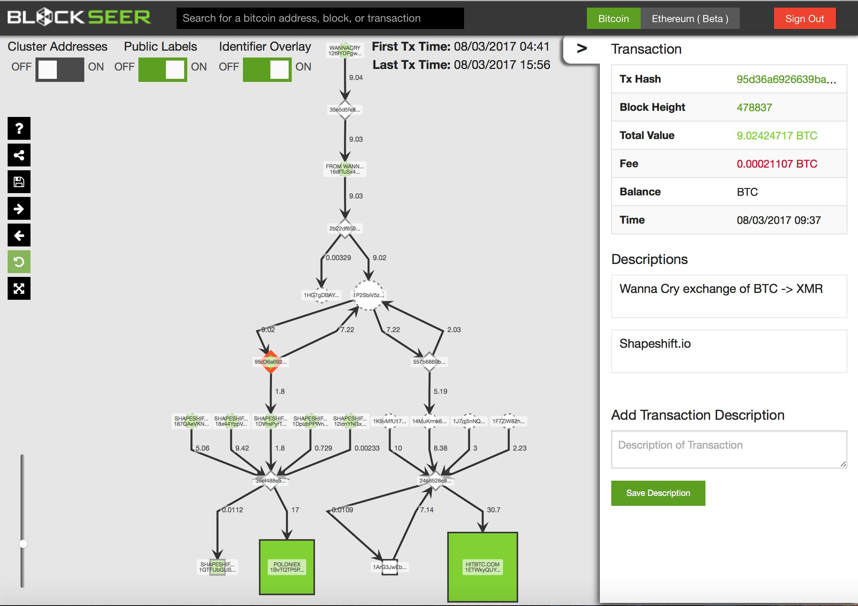
Blockseer shows WannaCry ransomware converting Bitcoin to Monero
  Source: Blockseer.com

Slide 31
Identifying money trails
Identifying the money trail is usually the first stage of investigation involving virtual currencies as it helps identify different individuals and entities involved in a transaction

Slide 32
INVESTIGATIVE MEASURES AND SEIZRE OF VIRTUAL CURRENCIES
Virtual Currencies Advanced

Slide 33
Participants in the Virtual Currency Ecosystem

Slide 34
Investigative measures
Investigations with a virtual currency component usually involve electronic evidence
All the following measures may be exercised in such investigations:
  Expedited preservation of stored computer data
  Expedited preservation and partial disclosure of traffic data
  Production orders
  Search and seizure of stored computer data
  Real-time collection of traffic data
  Interception of content data

Slide 35
Investigative measures
Who can such investigative measures be applied to for virtual currency investigations?
Centralised virtual currencies
Administrator

Slide 36
Centralized virtual currencies
The administrator of a centralised virtual currency has full control over a virtual currency, transaction and user data
All investigative measures may be undertaken against the legal entity which is the administrator of the centralised virtual currency

Slide 37
Investigative measures
Who can such investigative measures be applied to for virtual currency investigations?
Centralised virtual currencies
Decentralised virtual currencies
Administrator
?

Slide 38
Decentralized virtual currencies
Inherent challenges for law enforcement when investigating decentralized virtual currencies include:
No administrator
Fast, irreversible transactions
Pseudonymity
Traceability
Trans-jurisdictional transactions
Absence of funding limits

Slide 39
Decentralized currency ecosystem
In the absence of a central administrator, investigative measures may be applied to other actors in the decentralized currency ecosystem

Slide 40
Virtual currency exchange
Virtual currency exchanges (aka exchangers)
“person or entity engaged as a business in the exchange of virtual currency for real currency, funds, or other forms of virtual currency and also precious metals, and vice versa, for a fee”
  Source: FATF Report on Virtual Currencies

Slide 41
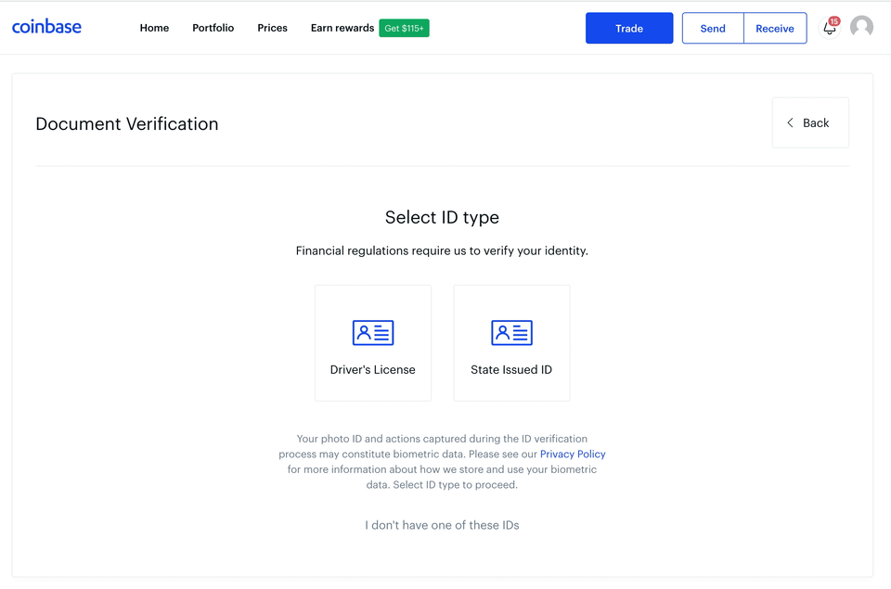
Virtual currency exchange
Many virtual currency exchanges collect KYC information before completing transactions. This may include:
Full name
Residential address
Date of birth
Passport copy
Driver’s license copy
Photograph
They may have , including cash, bank transfer, payment card, PayPal and other virtual currencies

Slide 42
Virtual currency wallet provider
Virtual Currency Wallet Provider
“an entity that provides a virtual currency wallet (i.e., a means (software application or other mechanism/medium) for holding, storing and transferring bitcoins or other virtual currency).”
  Source: FATF Report on Virtual Currencies

Slide 43
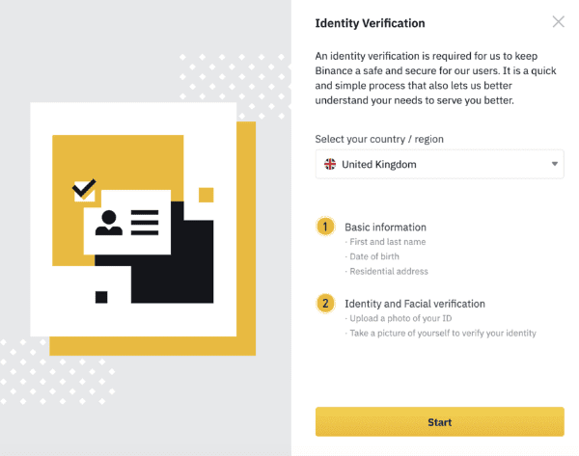
Virtual currency wallet provider
Many virtual currency wallets collect KYC information for wallet holders. This may include:
Full name
Residential address
Date of birth
Passport copy
Driver’s license copy
Photograph

Slide 44





Virtual currency exchanges and wallets
Virtual currency exchanges and wallets may also have:
  bank account information
  payment card information
  e-money wallets such as PayPal
  other virtual currency wallets

Slide 45
Financial Institutions & Payment Cards
Financial Institutions & Payment Cards
Bank accounts & payment cards can be:
  a funding source for virtual currencies
  destination for withdrawing virtual currencies
Bank accounts & payment cards usually have transaction information involving the purchase and sale of virtual currencies

Slide 46
Seizing virtual currencies

Slide 47

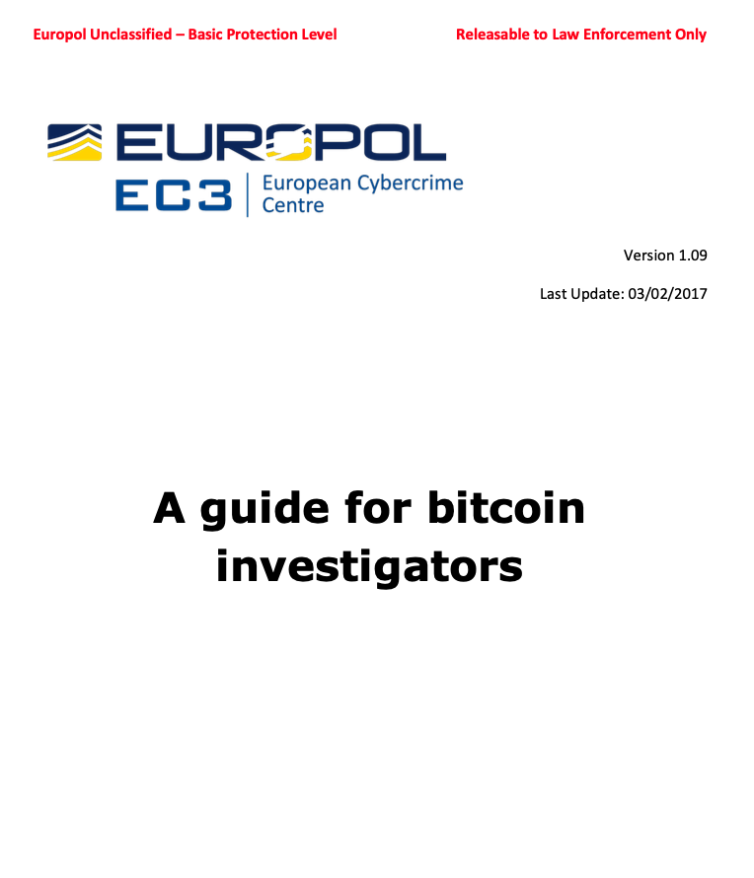

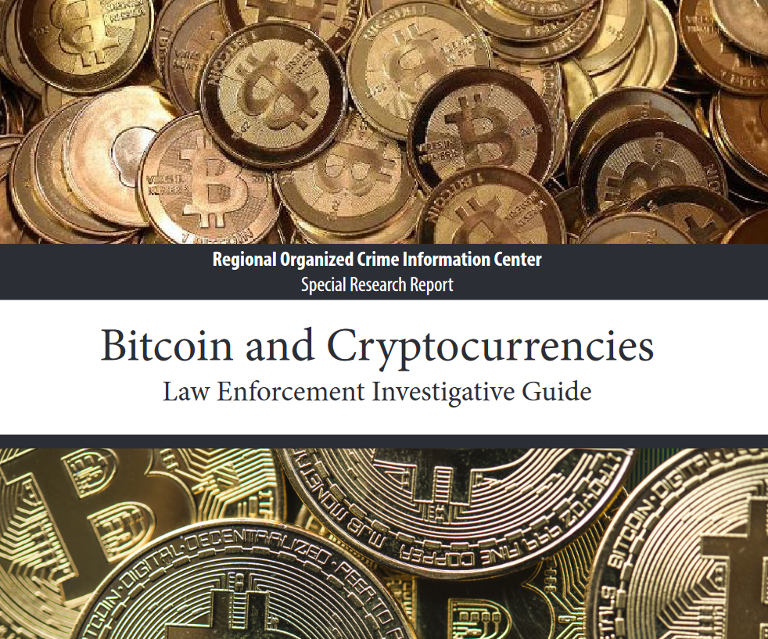
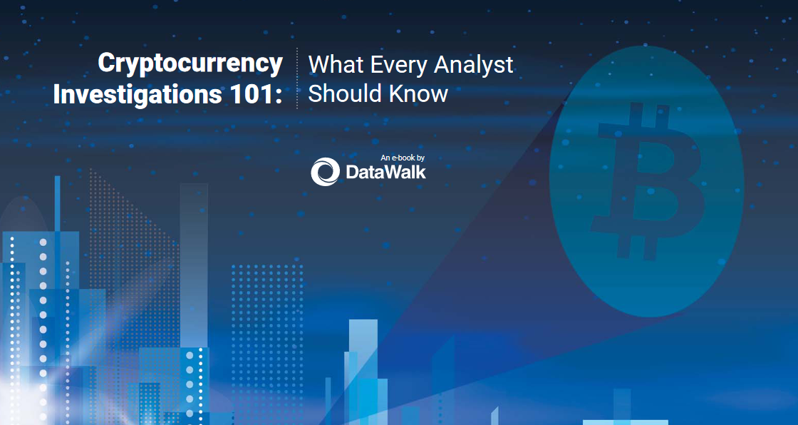
Reference Documents
Notes:
Bitcoin and Cryptocurrencies – Law Enforcement Investigative Guide IACP Cybercenter https://www.iacpcybercenter.org/wp-content/uploads/2018/03/Bitcoin.pdf
Europol EC3 – Available to LEA only
Europol 2021 https://www.europol.europa.eu/cms/sites/default/files/documents/Europol%20Spotlight%20-%20Cryptocurrencies%20-%20Tracing%20the%20evolution%20of%20criminal%20finances.pdf
Private sector – Datawalk - https://datawalk.com/wp-content/uploads/2020/11/Cryptocurrency-Investigations-101-What-Every-Analyst-Should-Know-DataWalk-ebook.pdf

Slide 48
Seizure and confiscation
What is seizing/confiscation – Section 3.1 COE Guidelines
Seizure or confiscation is the act of taking the criminal related assets or evidence by legal process or force, such as the seizure of evidence found at the scene of a crime.
In the European Union, the 2014/42/EU Directive on the freezing and confiscation of instrumentalities and proceeds of crime in the EU widen the scope of the law enforcement authorities to trace, freeze, manage and confiscate the proceeds of crime.
The Directive underlines that the Member States must take the necessary measures to enable the confiscation of instrumentalities and proceeds or property the value of which corresponds to such instrumentalities or proceeds, subject to a final conviction for a criminal offence, which may also result from proceedings in absentia.
48
www.coe.int/cybercrime
Notes:
https://eur-lex.europa.eu/legal-content/EN/TXT/?uri=celex%3A32014L0042
The reference DIRECTIVE 2014/42/EU OF THE EUROPEAN PARLIAMENT AND OF THE COUNCIL
of 3 April 2014
on the freezing and confiscation of instrumentalities and proceeds of crime in the European Union

Slide 49
Decentralized currency ecosystem
The different participants may have certain categories of data that are useful in investigations
However, for seizure of a decentralized virtual currency itself, the target of the seizure must be the individual user

Slide 50
Seizing decentralized virtual currencies
Options to seize decentralized virtual currencies:
Option 1: Compel the user to surrender login credentials associated with their virtual currency wallet
Challenges:
  Some jurisdictions do not have legal power to compel a person to surrender login credentials
  The user or an associate may regain control over the wallet

Slide 51
Seizing decentralized virtual currencies
Options to seize decentralized virtual currencies:
Option 2: Transfer the virtual currency from “hot wallet” controlled by an individual to “cold wallet” controlled by the law enforcement agency

Slide 52
Seizing decentralized virtual currencies
Process to transfer virtual currency to law enforcement wallet:
Step 1: Determine amount of virtual currency/ wallets to be seized
Step 2: Exercise control over the wallet by:
  Seeking suspect’s cooperation
  Exercise other legal measures to gain control of wallet
Step 3: Transfer funds to government-controlled wallet

Slide 53
Seizing decentralized virtual currencies
Good practices for seizing decentralized virtual currencies:
Conduct transfer in presence of witness
Use a screen capturing solution
Complete a “test transfer” of a small amount to cold wallet
After successful test transfer, complete transfer of remaining virtual currency
Create separate wallets for each wallet that is being seized (avoid comingling)
Create physical and digital backup of cold wallet

Slide 54
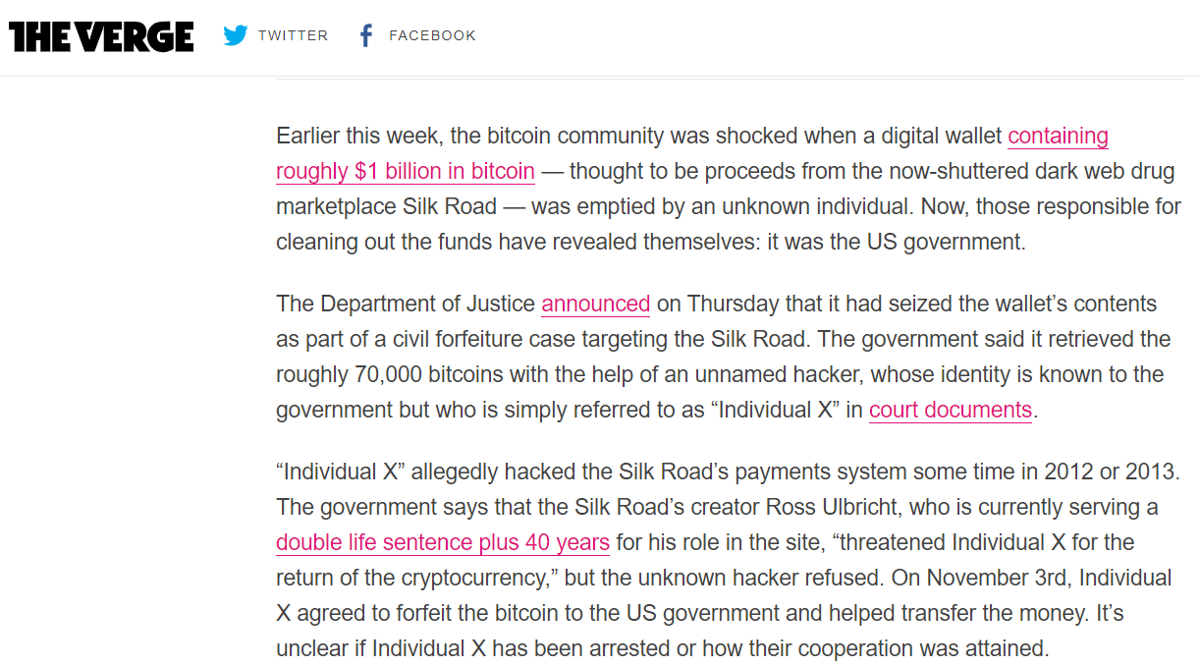
Example of the Department of Justice transferring

Slide 55
Seizing decentralized virtual currencies
Process to transfer virtual currency to law enforcement wallet:
What if it is not possible to exercise control over the user’s wallet?
Initiate value-based recovery by imposing a fine on the individual, which can be realized against other assets of that individual

Slide 56
PUBLIC PRIVATE COOPERATION WITH EXCHANGERS
Virtual Currencies Advanced

Slide 57
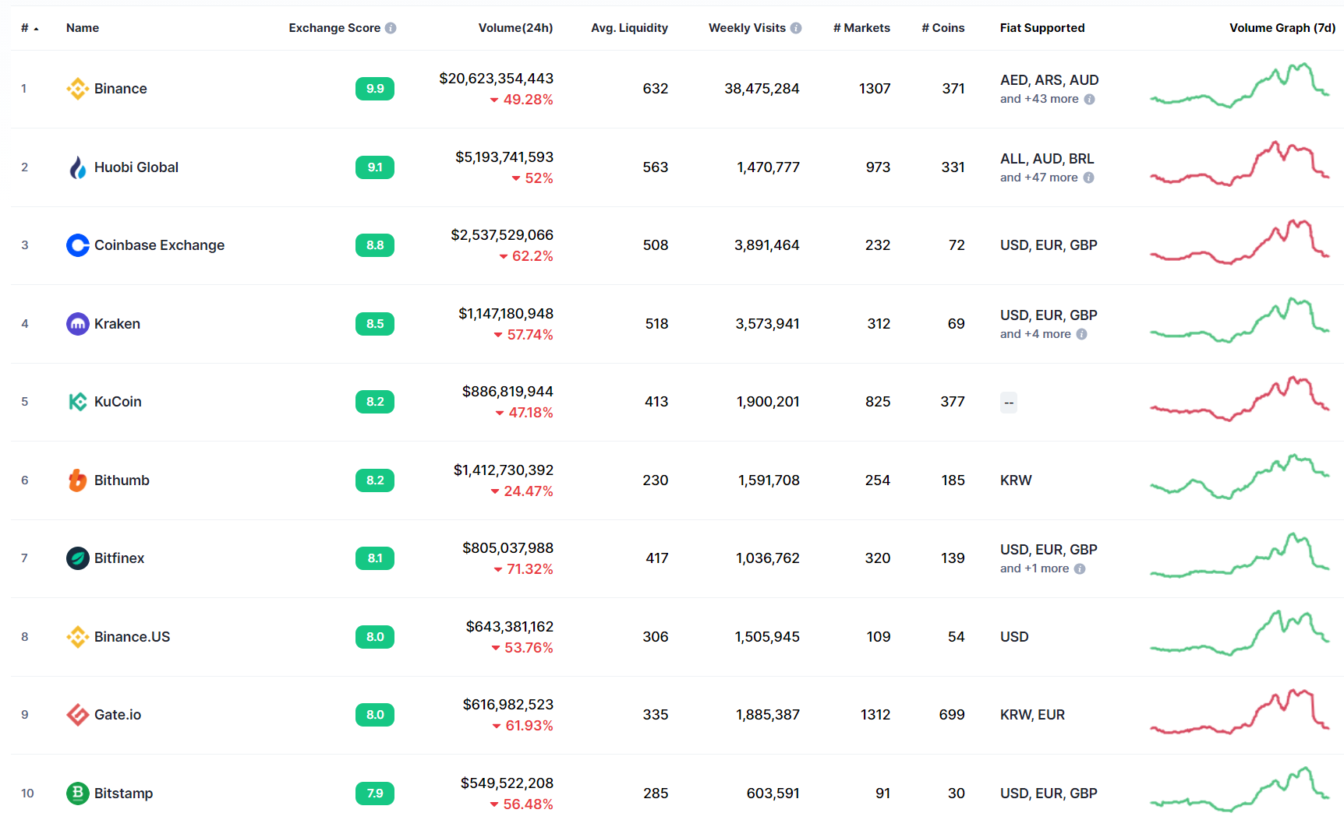
Some virtual currency exchangers
Source: coinmarketcap.com

Slide 58
Public Private Cooperation
Cooperation with service providers is important for investigations involving electronic evidence
Similarly, cooperation with exchangers is important for investigations involving virtual currencies

Slide 59
Regulated exchangers
Exchangers are regulated in some jurisdictions
Exchangers in many jurisdictions are subject to AML/KYC requirements which require:
  Records retention
  Reporting suspicious transactions
  Transaction monitoring
Regulated exchangers may be required to cooperate with regulators and other law enforcement agencies

Slide 60
Unregulated exchangers
Countries may apply production orders or other investigative measures on exchangers operating within their territory
Other countries may make mutual assistance requests seeking the application of investigative measures on exchangers operating outside their territory through the Budapest Convention or other mutual legal assistance treaties

Slide 61
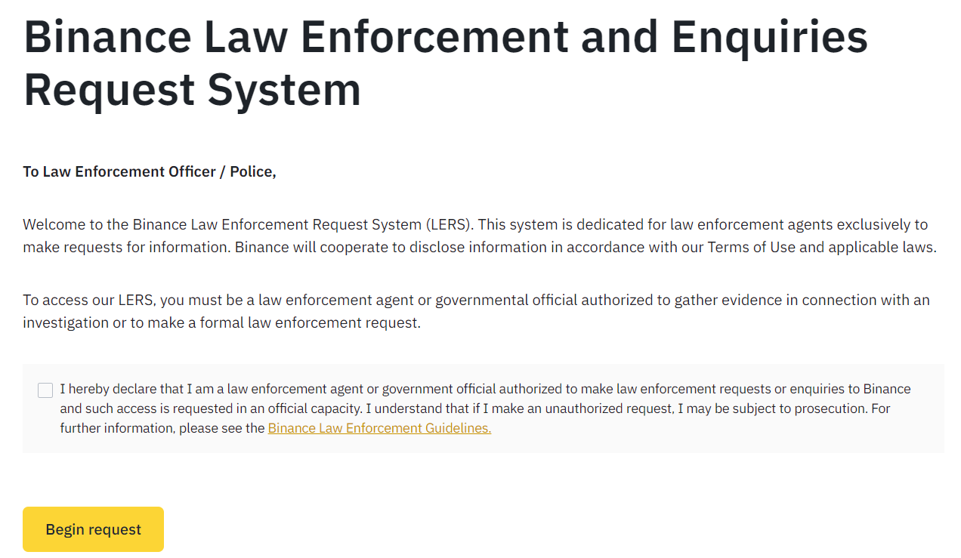
Example of Law Enforcement Request System

Slide 62
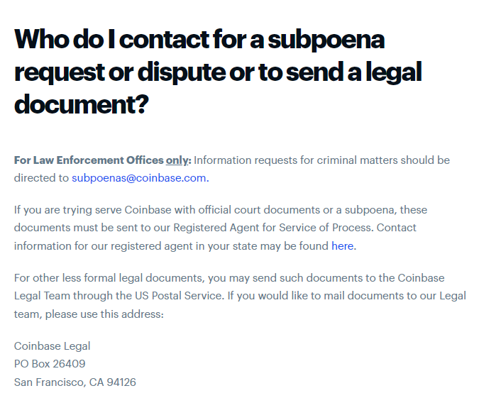
Example of Law Enforcement Request Process

Slide 63
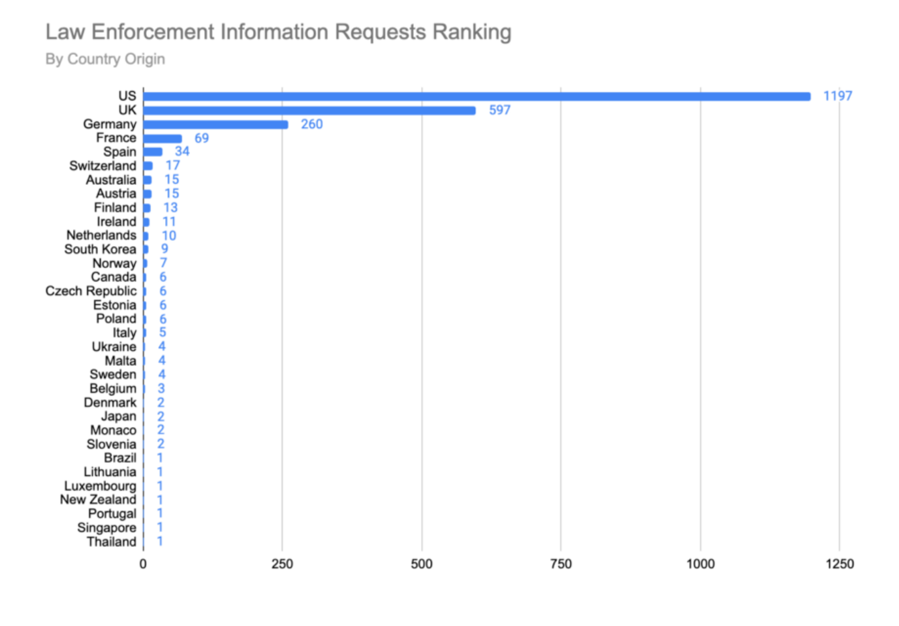
Coinbase Exchanger Transparency Report (H2 2020)

Slide 64

Advanced Cybercrime and Electronic Evidence Training Course for Prosecutors and Judges
Thank you
Xxxxx XXXXXXXX
Council of Europe
email
DD Month YYYY

