Slide 1
Advanced Cybercrime and Electronic Evidence Training Course for Prosecutors and Judges
Session 6
Budapest Convention Refresher Case Study
Notes:
This session is 90 minutes in length

Slide 2

Agenda
Health and safety
Introduction
Aim and objectives
Methodology and timetable
Introductions
Summary
Notes:
Session agenda. Delegates should have a copy of it in their possession.

Slide 3


Slide 4
SESSION OBJECTIVES
Budapest Convention Refresher Case Study

Slide 5
Course Background
At the end of this session, delegates will be able to:
Recall the substantive law, procedural law & international cooperation-related provisions of the Budapest Convention covered in the introductory course
Explain the scope and extent of the substantive law, procedural law & international cooperation-related provisions of the Budapest Convention
Apply the provisions of the Budapest Convention and corresponding domestic legislations apply to case studies related to substantive, procedural & international cooperation law

Slide 6
Introduction TO THE CASE STUDY
Budapest Convention Refresher Case Study

Slide 7


Slide 8
Focus Country: Middle Earth
Party to Budapest Convention
Largest Bank: Middle Earth National Bank (MENB)
Neighboring Countries: Rohan and Mordor
Official Language: Middle Earthean
Notes:
This slide provides a background to the case study that forms the basis of this session. It is important that the trainer give a brief introduction to the case study, which puts the participants in the position of a law enforcement official in a fictitious country called Middle Earth. Other countries that are subsequently discussed in the case study, i.e. Mordor and Rohan, must also be introduced to the participants.
It may be useful to also introduce the participants to the structure of the remaining part of the lesson – the case study is divided into four connected parts, each dealing with a particular category of issues. The first part deals with substantive law issues, the second part with procedural power related issues, the third with issues relating to other forms of cooperation and the fourth with issues relating to mutual legal assistance.

Slide 9
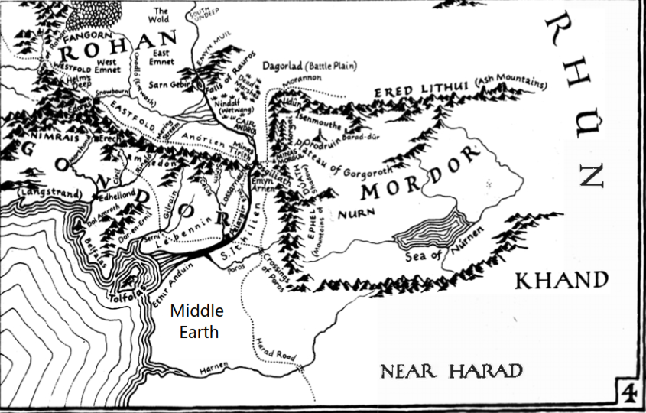
Notes:
The background of the course is provided for the delegates, The title of this course is “Advanced Cybercrime and Electronic Evidence Training for Judges and Prosecutors”. It has been developed as an output of the European Union/Council of Europe Joint Project on Regional Cooperation on Cybercrime in the IPA region.

Slide 10
Background
You receive an anonymous report that cybercriminals have hacked into the main server of MENB.
The cybercriminals have installed malware which affects all the computers in MENB by:
  changing the size of the mouse cursor
  changing the background wallpaper
Notes:
This slide provides a background to the case study that forms the basis of this session. It is important that the trainer give a brief introduction to the case study, which puts the participants in the position of a law enforcement official in a fictitious country called Middle Earth. Other countries that are subsequently discussed in the case study, i.e. Mordor and Rohan, must also be introduced to the participants.
It may be useful to also introduce the participants to the structure of the remaining part of the lesson – the case study is divided into four connected parts, each dealing with a particular category of issues. The first part deals with substantive law issues, the second part with procedural power related issues, the third with issues relating to other forms of cooperation and the fourth with issues relating to mutual legal assistance.

Slide 11



11
Notes:
The background of the course is provided for the delegates, The title of this course is “Advanced Cybercrime and Electronic Evidence Training for Judges and Prosecutors”. It has been developed as an output of the European Union/Council of Europe Joint Project on Regional Cooperation on Cybercrime in the IPA region.

Slide 12
Background
You learn that a group called DarkHacker is responsible.
Its website is www.darkhacker.com
Software ostensibly designed for translating text from Middle Earthean language to English is being sold on this website.
This software is also marketed as a hacking tool.
Notes:
This slide provides a background to the case study that forms the basis of this session. It is important that the trainer give a brief introduction to the case study, which puts the participants in the position of a law enforcement official in a fictitious country called Middle Earth. Other countries that are subsequently discussed in the case study, i.e. Mordor and Rohan, must also be introduced to the participants.
It may be useful to also introduce the participants to the structure of the remaining part of the lesson – the case study is divided into four connected parts, each dealing with a particular category of issues. The first part deals with substantive law issues, the second part with procedural power related issues, the third with issues relating to other forms of cooperation and the fourth with issues relating to mutual legal assistance.

Slide 13
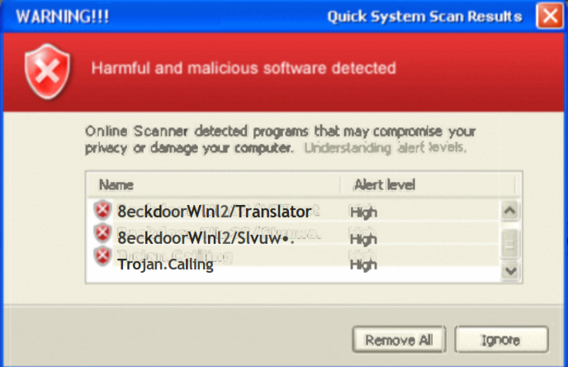
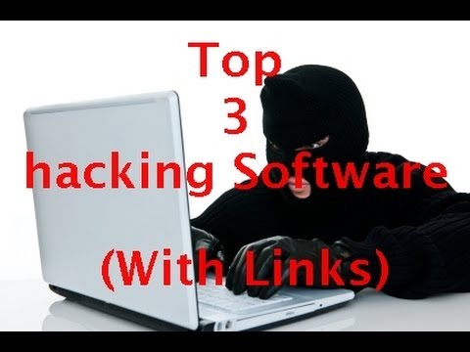

Slide 14
Background
Your investigation also reveals that fingerprint data that enables access to laptops and smartphones is being sold on www.darkhacker.com.
You conduct an undercover operation and purchase fingerprint data from www.darkhacker.com to help identify the individuals operating the website.
Notes:
This slide provides a background to the case study that forms the basis of this session. It is important that the trainer give a brief introduction to the case study, which puts the participants in the position of a law enforcement official in a fictitious country called Middle Earth. Other countries that are subsequently discussed in the case study, i.e. Mordor and Rohan, must also be introduced to the participants.
It may be useful to also introduce the participants to the structure of the remaining part of the lesson – the case study is divided into four connected parts, each dealing with a particular category of issues. The first part deals with substantive law issues, the second part with procedural power related issues, the third with issues relating to other forms of cooperation and the fourth with issues relating to mutual legal assistance.

Slide 15

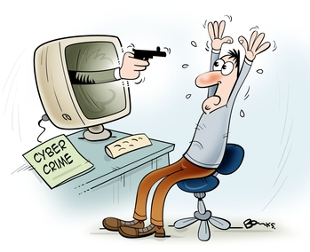

Slide 16
Questions (Substantive Law)
What cybercrimes were committed by hacking into and installing malware on the MENB server?
What cybercrimes can you identify being committed by DarkHacker?
Did you commit a cybercrime by purchasing fingerprint data during the undercover operation?
Notes:
The trainer should explain the questions relating to substantive law to the delegates.
The first question relates to the conduct of hacking into a computer system of a financial institution. It requires identification of the relevant offences and it is expected that a justification for the relevant offences would be provided under domestic law.
The second question relates to criminal conduct that is occurring on DarkHacker and particularly relates to the selling of the translation software on the forum. It requires participants to identify the relevant offences and provide justification for such answer.
The third question relates to the conduct of the law enforcement official who procured access codes for the purposes of accessing a computer system.

Slide 17
During the undercover operation, the DarkHacker website prompts you to enter your email address.
You receive an email from an email account criminal@scammail.com with instructions on how to make the payment using Bitcoin.
Notes:
The trainer is required to explain the facts relating to Part 3 (procedural powers) in this slide to the participants. It is important that the facts be clearly explained so that the participants are able to correctly answer the questions related to the case study.
In particular the trainer should emphasize that the email service provider is headquartered in and has data centers located within the country in which the investigation is being conducted. The trainer should also clarify that the email service provider has a limited retention period of 7 days and deletes all data (content data and traffic data) after this period unless such data is required to be maintained pursuant to a court order.
The aim of law enforcement at this stage should also be clarified. In particular you wish to obtain information to identify the agent who sent you the email. This will assist the delegates to identify the correct procedural powers and necessary action to undertake when solving the case study.

Slide 18



Slide 19
Your investigation reveals that the email service provider for criminal@scammail.com is Scam Mail, Inc.
You identify its website as www.scammailinc.com.
You learn from its website Scam Mail, Inc. has its head office and only data center in Middle Earth.
You also learn that Scam Mail, Inc. only retains data for a period of 7 days after which all data is deleted.
Notes:
The trainer is required to explain the facts relating to Part 2 (substantive law) in this slide to the participants. It is important that the facts be clearly explained so that the participants are able to correctly answer the questions related to the case study.
The trainer should first explain the hack by unknown cybercriminals into the data drives of the unknown cybercriminals. It should also be elaborated that such hack was followed by the installation of malware onto such computer systems. The effect/impact of the malware as being restricted to increasing the size of the mouse cursor and that the hacking has no additional impact on computer systems or computer data.
In regards to the selling of the translation software, the trainer should emphasize that the translation software functions as a dual-use device which is openly advertised as also enabling access to computer systems without right.
In regards to the undercover operation conducted by the participants, the trainer should emphasize that such operation involves the procurement of access codes which enables access to a number of computer systems. It should also be clarified that the undercover operation was done without right, and solely for the purposes of law enforcement and with the intention to identify the individuals operating DarkHacker.

Slide 20

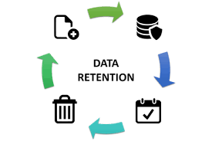
7 days

Slide 21
You consider using the email addresses to identify the individuals behind DarkHacker.
You also consider obtaining details of other people contacted through the email account criminal@scammail.com in the last seven days.
Notes:
The trainer is required to explain the facts relating to Part 2 (substantive law) in this slide to the participants. It is important that the facts be clearly explained so that the participants are able to correctly answer the questions related to the case study.
The trainer should first explain the hack by unknown cybercriminals into the data drives of the unknown cybercriminals. It should also be elaborated that such hack was followed by the installation of malware onto such computer systems. The effect/impact of the malware as being restricted to increasing the size of the mouse cursor and that the hacking has no additional impact on computer systems or computer data.
In regards to the selling of the translation software, the trainer should emphasize that the translation software functions as a dual-use device which is openly advertised as also enabling access to computer systems without right.
In regards to the undercover operation conducted by the participants, the trainer should emphasize that such operation involves the procurement of access codes which enables access to a number of computer systems. It should also be clarified that the undercover operation was done without right, and solely for the purposes of law enforcement and with the intention to identify the individuals operating DarkHacker.

Slide 22
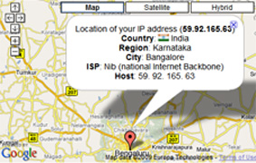


Slide 23
Questions (Procedural Law)
What initial measures should you take to ensure the investigation is not frustrated?
How can you obtain information that would help you identify the person using criminal@scammail.com from Scam Mail, Inc.?
How would you seek data from Scam Mail, Inc. regarding other persons contacted by criminal@scammail.com in the last seven days?
Notes:
The trainer should explain the questions relating to procedural powers to the delegates.
The first question relates to the issue that the email service provider’s retention policy which is limited to 7 days. The delegates are required to identify appropriate measures to prevent the investigation process from being frustrated.
The second question relates to identification of the necessary information that would enable identification of the person who sent the access code through the email account criminal@scammail.com. The second part of this question requires the delegates to explain how such information can be obtained.
The third question is slightly broader and relates to third parties that have been contacted by a particular email account. The delegates are required to identify procedure by which such information is to be obtained.

Slide 24
Once you complete the payment for the fingerprint data, you receive another email from fraud@hackmail.com with the fingerprint data.
Your initial investigation reveals that Hack Mail, Inc. (headquarters in Mordor) does not have any office or data centers in Middle Earth.
You see that Hack Mail, Inc. regularly publishes advertisements in Middle Earthean newspapers.
It also offers its services in Middle Earthean language.
You also learn that Hack Mail, Inc. stores subscriber information in the form of computer data.
Notes:
The trainer is required to explain the facts relating to Part 4 (other forms of cooperation) in this slide to the participants. It is important that the facts be clearly explained so that the participants are able to correctly answer the questions related to the case study.
This part of the case study deals with mechanisms to obtain data from other jurisdictions without having to make a formal request for mutual assistance.
The trainer should explain that as part of the investigation process the LEAs receive an email with bank details. The email service provider is not based in Middle Earth but has its headquarters and data centers in Mordor. The trainer should emphasize that though it does not have any physical presence in Mordor, it has recently published advertisements regarding its free services in Middle Earth in local language.
Another key aspect that should be emphasized is that a number of people who the LEAs identify as having complained about fraudulent activities on DarkHacker have consented to providing access to their email accounts and email messages to help with the investigation.

Slide 25


Slide 26
You learn that several persons in Mordor have complained on a public online forum about incidents of fraud allegedly perpetrated by the user of fraud@hackmail.com.
The public forum is hosted in Mordor.
You wish to use these public forum posts as evidence in subsequent proceedings.
Moreover, you contact these persons for information and they are willing to consent to you accessing their email correspondence with fraud@hackmail.com.
Notes:
The trainer is required to explain the facts relating to Part 4 (other forms of cooperation) in this slide to the participants. It is important that the facts be clearly explained so that the participants are able to correctly answer the questions related to the case study.
This part of the case study deals with mechanisms to obtain data from other jurisdictions without having to make a formal request for mutual assistance.
The trainer should explain that as part of the investigation process the LEAs receive an email with bank details. The email service provider is not based in Middle Earth but has its headquarters and data centers in Mordor. The trainer should emphasize that though it does not have any physical presence in Mordor, it has recently published advertisements regarding its free services in Middle Earth in local language.
Another key aspect that should be emphasized is that a number of people who the LEAs identify as having complained about fraudulent activities on DarkHacker have consented to providing access to their email accounts and email messages to help with the investigation.

Slide 27
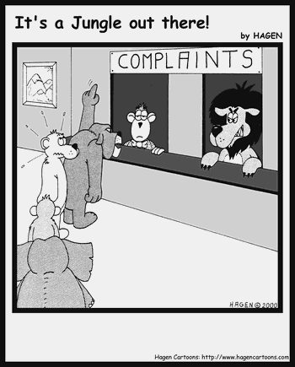


Slide 28
Questions (Other Cooperation)
What kind of information would you need to identify the person using fraud@hackmail.com?
What is the most expeditious way to obtain such information from Hack Mail, Inc.?
Can you use the complaints against Hack Mail, Inc. posted on the public online forum without sending a mutual assistance request to Mordor?
What is the most expeditious way to obtain emails sent from fraud@hackmail.com to victims in Mordor?
Notes:
The trainer should explain the questions relating to other forms of cooperation to the delegates.
The first question relates identification of the kind of information that would be required to determine who is using the mentioned email account.
The second question relates to obtaining the information identified above. The trainer should clarify that though there may be various ways in which such data may be accessed and obtained, the delegates are required to identify the most expeditious measure.
The third question relates to obtaining email data from persons who have voluntary consented to such disclosure. It is again important to stress that the delegates should identify the most expeditious way to obtain such emails.

Slide 29
You identify that Boris Smith, a Middle Earth national, is part of DarkHacker.
You arrest Boris Smith in Middle Earth.
He discloses the location of the computer system being used by DarkHacker to commit criminal activities.
This computer system is located in Rohan.
Since Boris’ arrest is not known to the public, there appears to be no reason to believe that the data in the DarkHacker computer system is vulnerable to loss or modification.
Notes:
The trainer is required to explain the facts relating to Part 4 (international cooperation) in this slide to the participants. It is important that the facts be clearly explained so that the participants are able to correctly answer the questions related to the case study.
Following an interrogation, it is learned that a computer system used by DarkHacker is located in a different country, Rohan.
The trainer should explain that the news of Boris Smith’s arrest has not been made public and there is no reason for LEAs to believe the computer data stored on DarkHacker’s computer system is vulnerable to loss or modification.
Moreover the trainer should explain that Boris Smith has tipped the LEAs of a specified communication that is to be undertaken the following day at 17:00 using the email account fraud@hackmail.com.

Slide 30


Slide 31
Boris Smith informs you that the account fraud@hackmail.com was also used by DarkHacker.
He also informs you of an upcoming transaction for the sale of Debit Card PIN codes the next day at 17:00 using this email account.
Notes:
The trainer is required to explain the facts relating to Part 4 (international cooperation) in this slide to the participants. It is important that the facts be clearly explained so that the participants are able to correctly answer the questions related to the case study.
Following an interrogation, it is learned that a computer system used by DarkHacker is located in a different country, Rohan.
The trainer should explain that the news of Boris Smith’s arrest has not been made public and there is no reason for LEAs to believe the computer data stored on DarkHacker’s computer system is vulnerable to loss or modification.
Moreover the trainer should explain that Boris Smith has tipped the LEAs of a specified communication that is to be undertaken the following day at 17:00 using the email account fraud@hackmail.com.

Slide 32
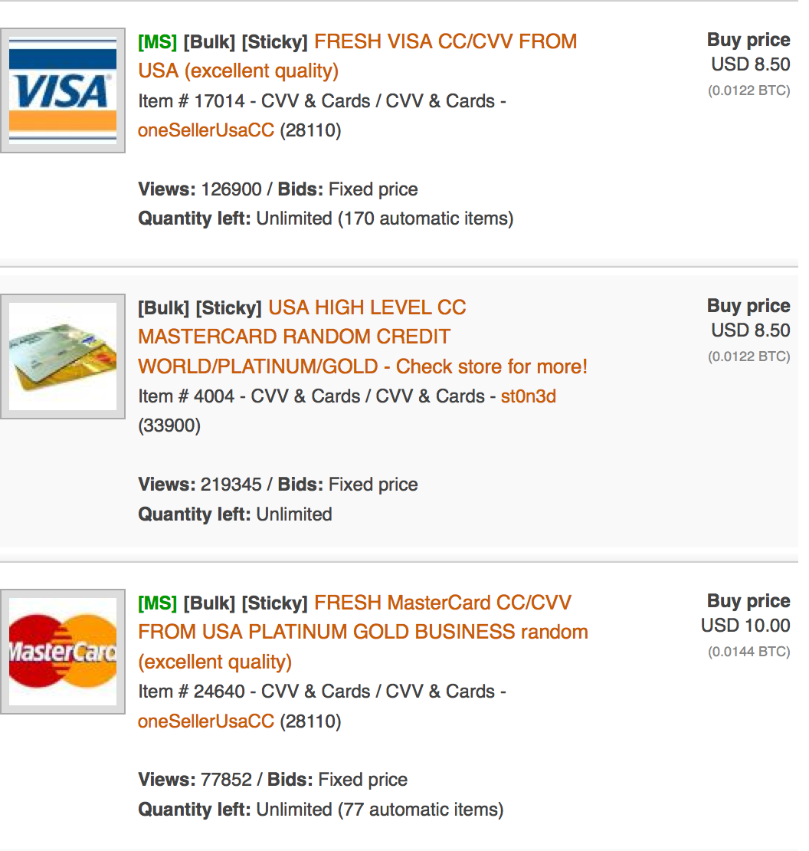

Slide 33
What measures can you take to ensure Hack Mail, Inc. preserves data relating to the email account fraud@hackmail.com?
What measures should you take to identify other service providers involved transmitting communications relating to the email account fraud@hackmail.com?
What measures can you take to obtain computer data from the DarkHacker computer system?
What measures can you take to ascertain the location of the DarkHacker customer who is planning to purchase Debit Card PIN codes?
Notes:
The first question relates to measures that can be undertaken to ensure that the service provider located in another jurisdiction preserves data related to the specified email account?
The second question relates to measures in regards to identifying other service providers involved in the transmission of communications.
The third question relates to measures that may be undertaken to obtain computer data that is stored in another jurisdiction.
The fourth question involves measures to secure and ascertain the location of DarkHacker customer who will be partaking in a future communication.

Slide 34
SUBSTANTIVE LAW
Budapest Convention Refresher Case Study
Notes:
This part of the lesson deals with the substantive law provisions of the Budapest Convention. This part starts with the facts of a case study and relevant questions.

Slide 35
Question
What cybercrimes were committed by hacking into and installing malware on the MENB server?
Notes:
This question relates to the conduct of hacking into computer systems of a renowned financial institution and installation of malware. It requires identification of the relevant offences and it is expected that a justification for the relevant offences would be provided under domestic law.

Slide 36
Article 2 – Illegal Access
when committed intentionally the access to the whole or any part of a computer system without right.
A Party may require that the offence be committed by infringing security measures, with the intent of obtaining computer data or other dishonest intent, or in relation to a computer system that is connected to another computer system.
Notes:
This slide reproduces Article 2 of the Budapest Convention which includes intentionally and without right accessing any part of a computer system with dishonest intent.

Slide 37
Article 5 – System Interference
when committed intentionally, the serious hindering without right of the functioning of a computer system by inputting, transmitting, damaging, deleting, deteriorating, altering or suppressing computer data.
Notes:
This slide reproduces Article 5 of the Budapest Convention which includes intentionally and without right seriously hindering the functioning of a computer system by inputting computer data.

Slide 38
Illegal Access (Article 2):
The conduct involves the access to a a computer system of a financial institution
  Such access is without authorisation
  Such access is with dishonest intent
Some jurisdictions may require that illegal access be committed with the intent to obtain data
Notes:
This slide provides the answer to the question – that the offence of Illegal Access should be identified. This slide shows that aspects of the facts that help determine that the conduct would fall within the scope of Article 2 of the Budapest Convention.

Slide 39
Does not necessarily constitute System Interference (Article 5):
The input of computer data has affected the size of the cursor and background wallpaper
The functioning of the computer has not been seriously hindered
However, in some jurisdictions this may be considered a serious hinderance
Notes:
This slide explains why the offence of System Interference (Article 5 of the Budapest Convention) would not be correct even though it is apparent that system interference services may be provided on DarkHacker.

Slide 40
Question
What cybercrimes can you identify being committed by DarkHacker?
Notes:
The second question relates to criminal conduct that is occurring on DarkHacker and particularly relates to the selling of the translation software on the forum. It requires participants to identify the relevant offences and provide justification for such answer.

Slide 41
Article 6 – Misuse of devices
…when committed intentionally and without right:
the production, sale, procurement for use, import, distribution or otherwise making available of:
i. a device, including a computer program, designed or adapted primarily for the purpose of committing any of the offences established in accordance with Articles 2 through 5;
with intent that it be used for the purpose of committing any of the offences established in Articles 2 through 5
Notes:
This slide shows the relevant parts of Article 6, which is the offence attracted by the conduct.
It may also be noted that Article 6 relates not only to devices but also to computer programs such as translation software.
It should also be emphasized that the following actions would form part of an offence:
Sale
Distribution
Otherwise making available
The trainer should explain the rationale behind the use of the word “primarily” – showing that the Budapest Convention did not intend to exclude misuse of dual-purpose programs such as those being sold on DarkHacker from the ambit of the offence.

Slide 42
Misuse of Devices (Article 6):
Conduct involves the sale, distribution or otherwise making available a translation software; and
Software is primarily designed for the purpose of committing the offence of illegal access
The software is being sold with the intent that it be used to commit illegal access
Notes:
This slide provides the answer to the question – that the offence of Misuse of Devices (Article 6 of the Budapest Convention) should be identified. This slide shows that aspects of the facts that help determine that the conduct would fall within the scope of Article 6 of the Budapest Convention.

Slide 43
Question
Did you commit a cybercrime by purchasing fingerprint data from DarkHacker during the undercover operation?
Notes:
This question in particular is intended to encourage a discussion about whether the conduct of law enforcement officials can constitute an offence corresponding to Article 6 of the Budapest Convention. In particular the participants should realize that this conduct is related to Article 6, Paragraph 1(a)(2) which includes procurement for use of access codes or similar data that enable the access of a computer system. The participants should note that the conduct would only have been an offence if done with the intent to commit an offence corresponding to Articles 2 – 5 and would not constitute criminal conduct if done without such intent (Article 6, Paragraph 2). Moreover the Convention requires that the conduct committed Article 6 is only an offence if committed “without right” – whereas it is possible that the undercover operation conducted has some legal or administrative basis.
Finally it may also be noted that the procurement that forms the basis of this conduct must be “for use” and not general procurement for the purposes of identification of individuals operating a website that involves criminal activity.

Slide 44
Article 6 – Misuse of devices
…when committed intentionally and without right:
the production, sale, procurement for use, import, distribution or otherwise making available of:
ii. a computer password, access code, or similar data by which the whole or any part of a computer system is capable of being accessed,
with intent that it be used for the purpose of committing any of the offences established in Articles 2 through 5
Notes:
This slide reproduces part of Article 6 of the Budapest Convention which includes intentionally and without right procuring for use an access code by which the whole or a part of a computer system is capable of being accessed with the intent that it be used for the purpose of committing an offence established in Articles 2 through 5.

Slide 45
Does not necessarily constitute Misuse of Devices:
  Conduct is not necessarily without right (if undercover operation has legal basis)
  Fingerprint data was not purchased with the intent to commit an offence
Notes:
This slide provides the answer to the question – that the conduct of the LEA does not constitute the offence of Misuse of Devices (Article 6 of the Budapest Convention) or any other offence corresponding to the Budapest Convention. This slide shows that aspects of the facts that help determine that the conduct would not fall within the scope of Article 6 of the Budapest Convention.

Slide 46
PROCEDURAL LAW
Budapest Convention Refresher Case Study
Notes:
This part of the lesson deals with the procedural law provisions of the Budapest Convention. This part starts with the facts of a case study and relevant questions.

Slide 47
Question
What initial measures should you take to ensure the investigation is not frustrated?
Notes:
This question relates to the issue that the email service provider’s retention policy which is limited to 7 days. The delegates are required to identify appropriate measures to prevent the investigation process from being frustrated.

Slide 48
Article 16 – Expedited Preservation of Stored Computer Data
order the expeditious preservation of specified computer data, including traffic data, that has been stored by means of a computer system, in particular where there are grounds to believe that the computer data is particularly vulnerable to loss or modification.
oblige that person to preserve and maintain the integrity of that computer data for a period of time as long as necessary, up to a maximum of ninety days
Notes:
This slide reproduces part of Article 16 of the Budapest Convention which empowers the competent authority to order the expeditious preservation of specified computer data stored by means of a computer system where there are grounds to believe that the computer data is particularly vulnerable to loss or modification, and also to oblige a person to preserve and maintain the integrity of said computer data for a maximum period of ninety days.

Slide 49
Data stored by Scam Mail Inc is vulnerable to loss because of its retention policy
You should seek preservation of all stored computer data (content data and traffic data) related to criminal@scammail.com
You should seek that Scam Mail Inc maintain integrity of the preserved data
Notes:
This slide explains how the appropriate measure that should be taken is expedited preservation of computer data stored in relation to criminal@scammail.com. Given the limited retention period, the data stored with Scam Mail Inc. is particularly vulnerable to loss. Thus it is important that all the relevant data (traffic data and content data) be preserved relating to the last seven days, and that Scam Mail Inc. be ordered to maintain integrity of the preserved data.

Slide 50
Question
How can you obtain information that would help you identify the person using criminal@scammail.com from Scam Mail, Inc.?
Notes:
This question relates to identifying necessary information that would enable identification of the person who sent the access code through the email account criminal@scammail.com. The second part of this question requires the delegates to explain how such information can be obtained.

Slide 51
Article 18 – Production Order
“subscriber information” means any information contained in the form of computer data or any other form that is held by a service provider, relating to subscribers of its services other than traffic or content data and by which can be established:
b the subscriber’s identity, postal or geographic address, telephone and other access number, billing and payment information, available on the basis of the service agreement or arrangement;
Notes:
This slide reproduces part of Article 18 of the Budapest Convention which defines the term subscriber information as information including computer and in other forms which enables the establishment of subscriber’s identity, postal or geographic address, telephone and other access number, billing and payment information, available on the basis of the service agreement or arrangement.

Slide 52
Article 18 – Production Order
competent authorities to order:
b a service provider offering its services in the territory of the Party to submit subscriber information relating to such services in that service provider’s possession or control.
Notes:
This slide reproduces part of Article 18 of the Budapest Convention which describes the procedure by which subscriber information in the possession or control of service providers can be obtained through a production order from such service providers offering services within a particular country.

Slide 53
Subscriber information will help identify the identify of the subscriber using the account criminal@scammail.com.
The competent authority may issue a production order requiring Scam Mail, Inc. to submit subscriber information associated with this account.
Notes:
This slide provides the answer to the question. It first explains why subscriber information is the relevant information that would enable you to identify a person who has subscribed to the services of Scam Mail Inc. In particular it would enable identification of the identity, postal, geographic address, telephone and other information regarding a subscriber. It then goes onto explain how subscriber information may be obtained by seeking a production order under the domestic equivalent of Article 18.1.b. of Budapest Convention.
It may also be explained by the trainer that Article 18 is the only procedural power that relates specifically to subscriber information.

Slide 54
Question
How would you seek data from Scam Mail, Inc. regarding other persons contacted by criminal@scammail.com in the last seven days?
Notes:
This question is slightly broader and relates to third parties that have been contacted by a particular email account. The delegates are required to identify procedure by which such information is to be obtained.

Slide 55
Article 18 – Production Order
competent authorities to order:
a a person in its territory to submit specified computer data in that person’s possession or control, which is stored in a computer system or a computer-data storage medium
Notes:
This slide reproduces part of Article 18 of the Budapest Convention which describes the procedure by which specified stored computer data in the possession or control of a person may be obtained. In particular a production order would enable seeking specified computer data in the possession of any person (which as the delegates will recall includes service providers).

Slide 56
You will need to obtain:
  Content data (to ascertain the content of the emails sent)
  Traffic data (to ascertain the destination of emails sent)
The competent authority may order Scam Mail, Inc. to submit specified computer data relating to criminal@scammail.com account in its possession or control for the last seven days.
Notes:
This slide provides the answer to the question. The first part of the slide identifies the kind of data that would be required at this stage of the investigation. It may be possible that the delegates would have only identified traffic data as data sought to establish other persons contacted by the user of criminal@scammail.com as the question does not relate specifically to the contents of the communication.
It is important to emphasize that in normal circumstances such a broad production order would not be permitted. However given that criminal@scammail.com only retains data for a period of seven days, and given that data sought is in relation to a single account it is possible that such a production order would be allowed.

Slide 57
OTHER COOPERATION
Budapest Convention Refresher Case Study
Notes:
This part of the lesson deals with international cooperation without mutual assistance requests enabled by the Budapest Convention. This part starts with the facts of a case study and relevant questions.

Slide 58
Questions
What kind of information would you need to identify the person using fraud@hackmail.com?
What is the most expeditious way to obtain such information from Hack Mail, Inc.?
Notes:
The first two questions relating to this part of the module are addressed together as both questions are interrelated.
The first question relates identification of the kind of information that would be required to determine who is using the mentioned email account. The second question relates to obtaining the information identified above. The trainer should clarify that though there may be various ways in which such data may be accessed and obtained, the delegates are required to identify the most expeditious measure.

Slide 59
Article 18 – Production Order
“subscriber information” means any information contained in the form of computer data or any other form that is held by a service provider, relating to subscribers of its services other than traffic or content data and by which can be established:
b the subscriber’s identity, postal or geographic address, telephone and other access number, billing and payment information, available on the basis of the service agreement or arrangement;
Notes:
This slide reproduces part of Article 18 of the Budapest Convention which defines the term subscriber information as information including computer and in other forms which enables the establishment of subscriber’s identity, postal or geographic address, telephone and other access number, billing and payment information, available on the basis of the service agreement or arrangement.

Slide 60
Article 18 – Production Order
competent authorities to order:
b a service provider offering its services in the territory of the Party to submit subscriber information relating to such services in that service provider’s possession or control.
Notes:
This slide reproduces part of Article 18 of the Budapest Convention which describes the procedure by which subscriber information in the possession or control of service providers can be obtained through a production order from such service providers offering services within a particular country.
The trainer should emphasize that Article 18.1.b. of the Budapest Convention does not require physical presence of a service provider within the territory but rather requires that such service provider is offering services in the territory. The delegates should be reminded of the Guidance Note on Article 18 which states that one factor to consider when determining whether a service provider offers services in a territory is to see if it advertises its services locally.

Slide 61
Subscriber information will help identify:
Identity, postal or geographic address, telephone, other access number or billing and payment information of the subscriber using the account criminal@scammail.com
Subscriber information may be obtained either by:
Mutual assistance request regarding accessing of stored computer data (because Hack Mail, Inc. stores subscriber information in form of computer data)
Domestic production order
Notes:
This slide answers the first question specifying that subscriber information would be the relevant form of information that would enable identification of the user of a particular email account.
This slide also provides two possible answers to the second question, i.e. that information from a service provider located in another country but offering services within Middle Earth may be obtained either by a formal mutual assistance request to access data, or a production order served directly on the service provider.

Slide 62
Production order is more expeditious:
Hack Mail, Inc. is not located in Middle Earth
Hack Mail, Inc. is offering services in Middle Earth because:
  Local subscribers
  Local advertising
  Local language services
The subscriber information sought is in the possession and control of Hack Mail, Inc.
Notes:
This slide elaborates on the answer to the second question and explains why production orders are more appropriate in the given circumstances. Article 18 as explained in the Article 18 Guidance Note enables seeking subscriber information in the possession or control of service providers located outside a country so long as such service providers are providing services within the territory. Moreover mutual assistance requests are usually quite slow so it is likely that a production order would be a more expeditious way to obtain the information sought.

Slide 63
Question
Can you use the complaints against Hack Mail, Inc. posted on the public online forum without sending a mutual assistance request to Mordor?
Notes:
The third question relates to obtaining data that is publicly available but stored in a foreign country. It is again important to stress that the delegates should identify the most expeditious way to obtain such emails.

Slide 64
Article 32 –Trans-border access to stored computer data with consent or where publicly available
A Party may, without the authorisation of another Party:
a access publicly available (open source) stored computer data, regardless of where the data is located geographically; or
Notes:
This slide reproduces part of Article 32 of the Budapest Convention which enables trans-border to access to stored computer data where such computer data is publicly available or with the consent of a person who has the lawful authority to disclose the data. The trainer should explain that trans-border access under Article 32 does not require a prior request for mutual assistance and may be exercised directly by one party (possibly even without notification to the central authority of the other party depending on domestic MLA laws).

Slide 65
You can directly access the complaints available publicly on the public forum
Under Article 32.a, you are not required to make a mutual assistance request
Notes:
This slide answers the question. Regarding accessing and using as evidence the complaints publicly available, Article 32a would enable you to access such complaints directly and use them as evidence without having to request and obtain such data through a mutual assistance request.

Slide 66
Question
• What is the most expeditious way to obtain emails sent from fraud@hackmail.com to victims in Mordor?
Notes:
The fourth question relates to obtaining email data from persons who have voluntary consented to such disclosure. It is again important to stress that the delegates should identify the most expeditious way to obtain such emails.

Slide 67
Article 32 –Trans-border access to stored computer data with consent or where publicly available
A Party may, without the authorisation of another Party:
b access or receive, through a computer system in its territory, stored computer data located in another Party, if the Party obtains the lawful and voluntary consent of the person who has the lawful authority to disclose the data to the Party through that computer system.
Notes:
This slide reproduces part of Article 32 of the Budapest Convention which enables trans-border to access to stored computer data where such computer data is publicly available or with the consent of a person who has the lawful authority to disclose the data. The trainer should explain that trans-border access under Article 32 does not require a prior request for mutual assistance and may be exercised directly by one party (possibly even without notification to the central authority of the other party depending on domestic MLA laws).

Slide 68
You can access and receive the emails directly with the lawful and voluntary consent of the accountholders
Under Article 32.b, you are not required to make a mutual assistance request
Notes:
This slide answers the question.
Given that the subscribers to email accounts are in many jurisdictions considered to be the party with the lawful authority to disclose emails associated with such email accounts, such emails may be accessed again without a mutual assistance request.

Slide 69

Part Five
Mutual Legal Assistance
Notes:
This part of the lesson deals with mutual assistance requests enabled by the Budapest Convention. This part starts with the facts of a case study and relevant questions.

Slide 70
Questions
What measures can you take to ensure Hack Mail, Inc. preserves data relating to the email account fraud@hackmail.com?
What measures should you take to identify other service providers involved transmitting communications relating to the email account fraud@hackmail.com?
Notes:
These questions relate to the preservation of computer data by the email service provider Hack Mail Inc. as well as obtaining informant that would enable identification of other service providers that are involved in the transmission of communications identified.

Slide 71
Article 29 –Expedited Preservation of Stored Computer Data
1 A Party may request another Party to order or otherwise obtain the expeditious preservation of data stored by means of a computer system, located within the territory of that other Party and in respect of which the requesting Party intends to submit a request for mutual assistance for the search or similar access, seizure or similar securing, or disclosure of the data.
Notes:
This slide reproduces part of Article 29 of the Budapest Convention which relates to seeking cross-border expedited preservation of data. This is a preliminary measure that is to be made in case a party intends to submit a request under Article 31 of the Budapest Convention and it enables temporary preservation of computer data.

Slide 72
Article 30 –Expedited Disclosure of Preserved Traffic Data
1 Where, in the course of the execution of a request made pursuant to Article 29 to preserve traffic data concerning a specific communication, the requested Party discovers that a service provider in another State was involved in the transmission of the communication, the requested Party shall expeditiously disclose to the requesting Party a sufficient amount of traffic data to identify that service provider and the path through which the communication was transmitted.
Notes:
This slide reproduces part of Article 30 of the Budapest Convention which relates to expedited disclosure of preserved traffic data. Article 30 does not provide for parties to make a specific request for expedited disclosure of traffic data. However it binds a party executing a request for expedited preservation under Article 29 if it discovers that another service provider in another state was involved in the transmission of a communication to expeditiously disclose sufficient amounts of traffic data to identify other service providers involved in the transmission of that communication.

Slide 73
Hack Mail, Inc. is based in Rohan.
You cannot directly order Hack Mail, Inc. to preserve data.
Middle Earth may request mutual assistance regarding expedited preservation of specified data in accordance with Article 29.
Rohan will be obligated to automatically disclose sufficient traffic data to enable identification of other service providers if it discovers their involvement. There is no requirement for a separate request from Middle Earth.
Notes:
This slide answers the question. Unlike the domestic procedural power relating to expedited preservation (equivalent to Article 16 of the Budapest Convention), it is necessary that there be reason to believe that the data sought to be preserved is particularly vulnerable to loss or modification. However in this case expedited preservation is a measure prior to making a mutual assistance request and may not necessary require that the data be vulnerable to loss or modification. Given that Middle Earth intends to make a mutual assistance request for seizure and disclose of computer data, it may also make this preliminary request for preservation of said data.
Regarding the second question, during the execution of the request to preserve data, it is possible that Hack Mail Inc will discover that communications from fraud@hackmail.com have been transmitted through service providers in other countries. In such case it is obligated under Article 30 to directly disclose sufficient amounts of data to enable identification of the service provider(s) and the paths through which the communications were transmitted. There is no requirement to make a request for disclosure of traffic data in this case.

Slide 74
Question
What measures can you take to obtain computer data from the DarkHacker computer system?
Notes:
This question relates to measures that may be undertaken to obtain computer data that is stored in another jurisdiction. It is important for the trainer to clarify that the DarkHacker computer is located in Rohan which is neighboring Middle Earth.

Slide 75
Article 31 –Mutual assistance regarding accessing stored computer data
1 A Party may request another Party to search or similarly access, seize or similarly secure, and disclose data stored by means of a computer system located within the territory of the requested Party, including data that has been preserved pursuant to Article 29.
3 The request shall be responded to on an expedited basis where:
a there are grounds to believe that relevant data is particularly vulnerable to loss or modification; or
Notes:
This slide includes relevant parts of Article 31 of the Budapest Convention (Mutual assistance regarding accessing stored computer data). The trainer should explain that Article 31 enables making of a request by one party to a second party to seize or similarly secure and disclose data stored by means of a computer system located within the territory of the second party.
The trainer may also mention that in order for a request for assistance regarding seizure of computer data to be expedited, there must be grounds to believe that the relevant data is particularly vulnerable to loss or modification. However unlike Article 16 of the Budapest Convention which requires that data be vulnerable to loss or modification to allow for a measure to seek computer data

Slide 76
The computer is in Rohan so Middle Earth cannot seize it directly.
Middle Earth may make a mutual assistance request for Rohan to seize & secure the computer
This will also include a request to disclose the computer data obtained as a result of the action to seize and secure the DarkHacker computer
Since the data in the computer system is not vulnerable to loss or modification, Middle Earth may not request expedited action
Notes:
This slide answers the question. The trainer should explain that the relevant computer data may be obtained by making a request for mutual assistance enabled by Article 31 of the Budapest Convention. In particular the request should cover seizure of computer system, securing of computer data and also disclosure of the computer data seized.
Though not required to be answered, the trainer may also explain that given that the DarkHacker computer system and data obtained therefrom are not vulnerable to loss or modification, Middle Earth may not request expedited action.

Slide 77
Questions
What measures can you take to ascertain the location of the DarkHacker customer who is planning to purchase Debit Card PIN codes?
Notes:
This question relates to measures to secure and ascertain the location of DarkHacker customer who will be partaking in a future communication.

Slide 78
Article 33 – Mutual assistance regarding the real-time collection of traffic data
1 The Parties shall provide mutual assistance to each other in the real-time collection of traffic data associated with specified communications in their territory transmitted by means of a computer system.
Notes:
This slide includes relevant parts of Article 33 of the Budapest Convention relating to mutual assistance regarding the real-time collection of traffic data. The trainer should explain that this article enables requesting mutual assistance to seek collection of traffic data associated with specified communications in another territory in real-time.

Slide 79
Middle Earth may request mutual assistance regarding real-time collection of traffic data in regards to the specified communication at 17:00 the following day
Mordor will depending on domestic laws be bound to provide such assistance at the least when such power is available in a similar domestic case
Notes:
This slide contains the answer to the question. Middle Earth may make a request for mutual assistance to Mordor (where Hack Mail Inc is headquartered) in respect to seeking ordering Hack Mail Inc to undertake real-time collection of traffic data associated with the specified communication from fraud@hackmail.com at 17:00 the following day.
The trainer should explain that whether or not this assistance is provided may depend on existing legal requirements in Mordor.

Slide 81

Advanced Cybercrime and Electronic Evidence Training Course for Prosecutors and Judges
Thank you
Xxxxx XXXXXXXX
Council of Europe
email
DD Month YYYY

