Slide 1
Advanced Cybercrime and Electronic Evidence Training Course for Prosecutors and Judges
Session 7
2.1.7 Introduction to the Investigation Exercise Case Study and Mock Trial
Notes:
This session is 90 minutes in length

Slide 2

Agenda
Case scenario
Technical equipment
Division in groups
Notes:
Session agenda. Delegates should have a copy of it in their possession.

Slide 3

Session Objectives
Understanding of the case scenario
Use of the technical equipment
Identification of legal and natural persons involved in scenario.
Explanation of the case layout and state of the introductory facts.
Following and explaining of the flow od proceedings and development of the case investigation.
Explaining of how the criminal act was perpetrated and who were the key players.
How and where criminal investigation should start and what should the vectors be.
Notes:
Session objectives. Delegates should be introduced with what is expected to be achieved by the end of the session.

Slide 4
Case study scenario
Introduction to the Investigation Exercise Case Study and Mock Trial

Slide 5
Case study scenario
The Federal Bank of Atlantis (FBA) is a well-known, successful and trustworthy bank in Europe. It has many branches and businesses in several different countries not only in Europe, but also worldwide. Its banking and business activities are known to be reputable and trustworthy. It seems that due to its policies, the bank is attracting more customers, who are opening bank accounts and using other banking products, than its competitors.
The FBA Board of Directors decided to issue a special anniversary bond to mark its 100 years of existence and successful operations. The Board empowered the Department for Logistics and Operations (DLO) to make the necessary preparation for the printing of bonds, including finding a suitable partner to supply all necessary printing elements.
Notes:
Trainees should identify main facts and key business divisions and decision makers in order to understand the scope and the setup of the business circle in which further case facts are going to be laid-down.

Slide 6
Case study scenario
The DLO identified a partner, well known in the field for providing printing products and services. The selected partner, United Bank Printing (UBP) is headquartered in the Atlantis, with a European branch based in Norland. The DLO also engaged internally with the Finance Department of the FBA)
Due to the summer vacation period, the DLO was short staffed, and the Deputy Head used junior and recently employed staff to work on this activity, making calls and engaging with colleagues from the Finance Department.
An order was placed by FBA for the purchase of 20,000 specialized paper materials from UBP for the price of €300,000. The relevant departments in FBA and UBP began logistical and financial arrangements.

Slide 7
Case study scenario
FBA and UBP exchanged details about invoicing and payment including SWIFT and IBAN accounts and codes. UBP required an advance payment of €100,000 to be paid into their account at Docklands Securities Bank of Norland. This was completed within 24 hours of the order being accepted
The contract required the printing of the 20,000 paper materials to be completed within seven days. UBP fulfilled this obligation one day before the deadline. The Business and Commercial Division informed the UBP Finance Department that the goods are ready to ship upon receipt of the final payment.
The UBP Finance Department e-mailed their FBA counterparts informing them that the order is ready for delivery and that the final payment in the sum of €200,000 will be due within 48 hours. That evening FBA received an email from UBP, informing them that the company bank account in the Norland would not be accessible for the following 3 days, due to a national holiday in the country. The email requested that the balance should be paid to UBP account in Docklands Securities Bank of Norland branch in Ostland.

Slide 8
Case study scenario
On the following working day FBA Finance Department was ready to transfer the money. Chief Financial Officer authorized the transfer of the remaining €200,000, which was transferred to the communicated bank account of the UBP in Ostland.
On the morning of expiration of the 48 hours deadline, UBP Finance Department contacted their FBA counterparts requesting immediate payment of the outstanding balance. FBA informed UBP that the payment had already been made and that they were expecting delivery of the goods. As an aside, FBA offered their congratulations to UBP on the National Holiday.
The UBP Finance Department checked their bank account and responded to FBA that no payment had been received from them. They also asked why UBP is congratulating them on a public holiday, when the next one is not due for another two months.

Slide 9
Technical case aspects
Introduction to the Investigation Exercise Case Study and Mock Trial

Slide 10

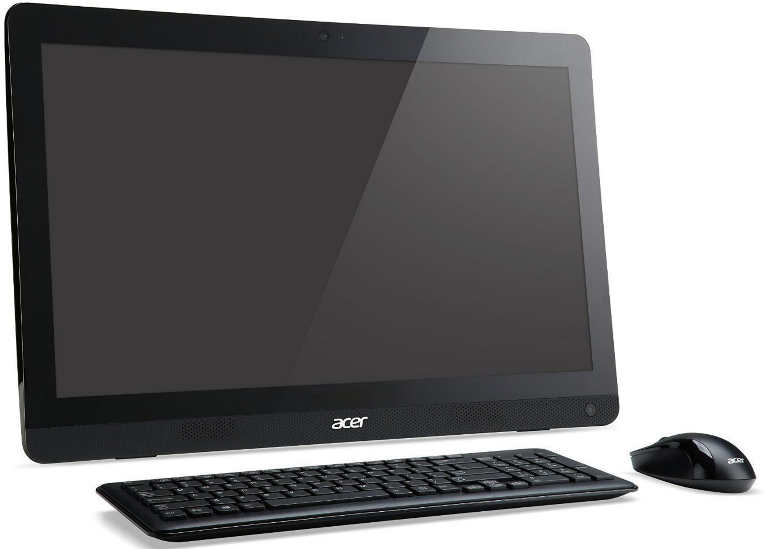

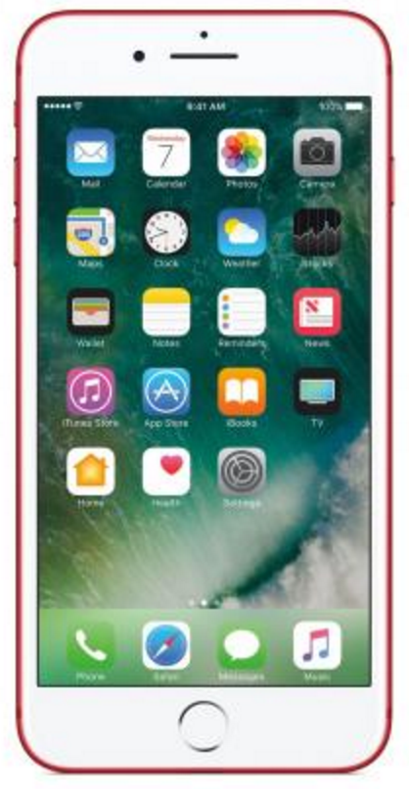
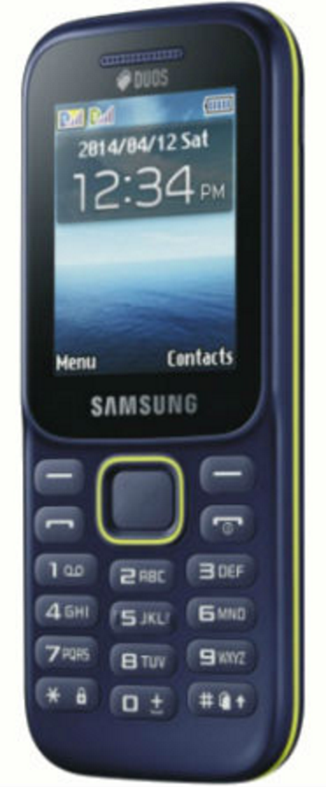
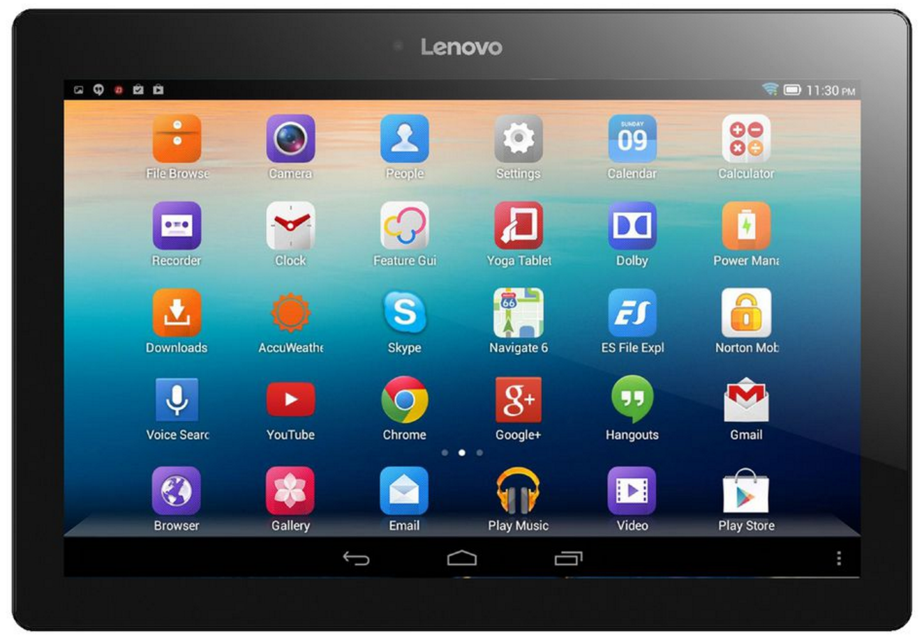
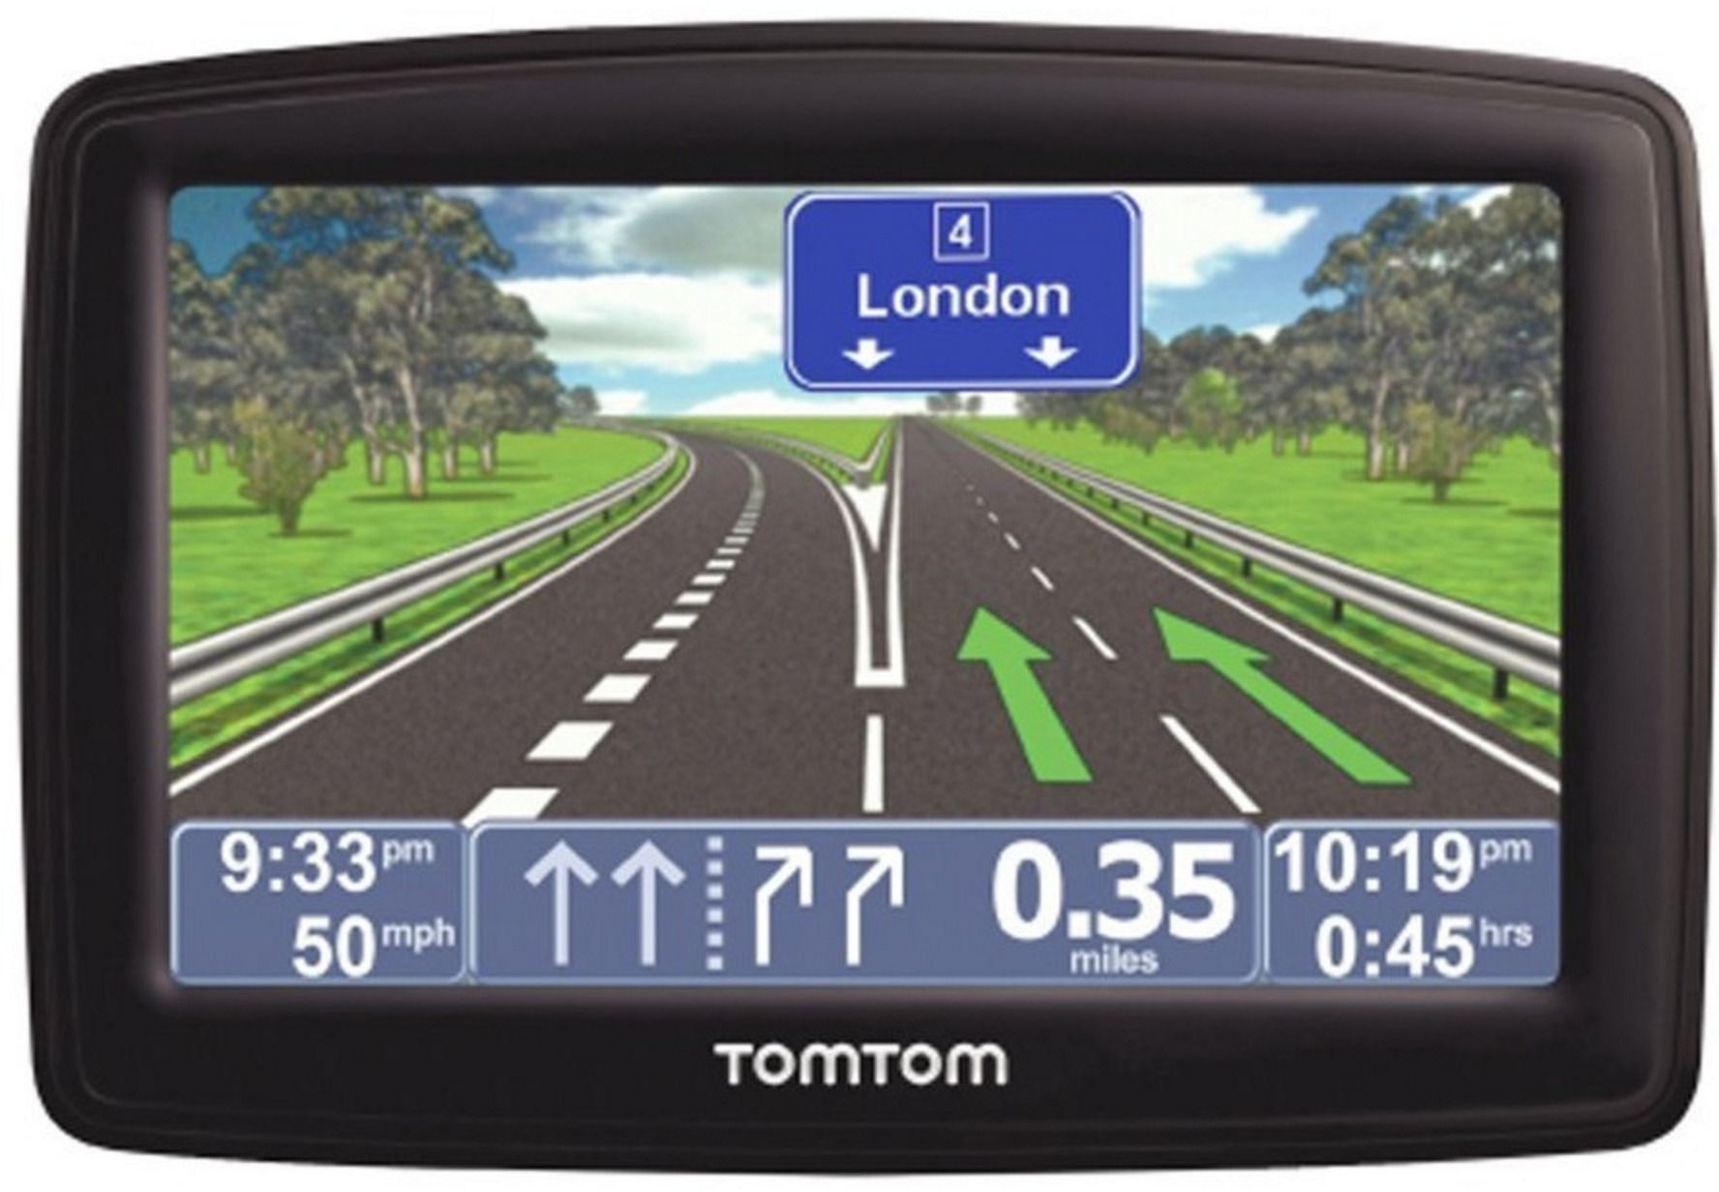
Technical case aspects

Slide 11

Technical case aspects
Hardware
Software

Slide 12
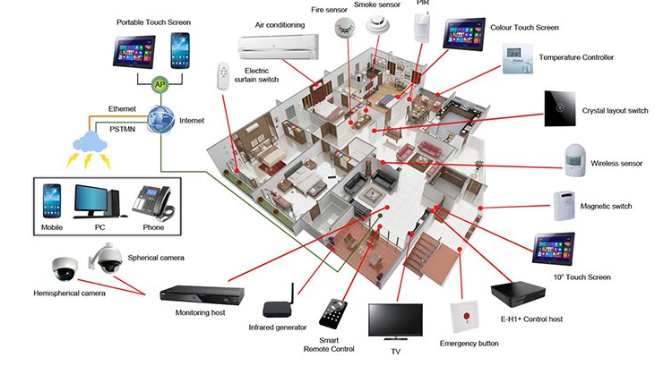
Technical case aspects
www.coe.int/cybercrime

Slide 13
Technical case aspects
Network terminology
IP Address – unique identifier on a network *
Port – an endpoint for network communication
  Are virtual – don’t actually exist (65,536 of them)
  Allow different applications on the same computer to utilise network resources – e.g.
    Web browsing (HTTP) Port 80
    Secure web browsing (HTTPS) Port 443
    Simple mail (SMTP) Port 25
TCP ‘Socket’ – combination of IP address plus port
Notes:
* We will come back to this
Ports – idea here has to be not to confuse people which would be very easy. Concept has to be to show that on the ONE pipe coming in or out, there are virtual channels separating data of different types for different applications
Ports 0-1023 – Well Known Ports (allocated by IANA – Internet Assigned Numbers Authority)
Ports 1024 – 49151 – Registered Ports (can be registered with IANA)
Ports 49153 – 65535 – Free to be used in client programs

Slide 14
Technical case aspects
TCP – Transmission Control Protocol
IP – Internet Protocol
  There are others!
Together they specify how data is exchanged on a network providing the end-to-end communication, making them reliable
TCP – creates channels, manages assembly & disassembly of packets at each end
IP – defines how to address & route each packet
Notes:
We could spend days dissecting this – we will do it in one slide!
There are other protocols in the suite of protocols! Not important for our level of understanding. TCP & IP work together in Internet communication to ready data for transmission, split it up into packets, address it properly & then route it across the internet – ensuring that it reaches the destination in the way it was sent.
Therefore has built in error checking & correcting – analogy would be that a message gets split up into 10 parts – part 1 of 10, part 2 of 10, etc – and is then addressed with an IP address as it’s destination. When it gets tot eh far end, part 6 of 10 has not made it. The protocol will then identify that it has not – and request the resending of the missing part. This is done automatically and in fractions of seconds.
Some other protocols don’t do this! UDP (Universal Datagram Protocol) for example will simple break everything up and send it with no error checking. That seems ludicrous – but it is used for applications like video streaming where overheads like checking are cumbersome and the loss of a few packets in a few million are not going to be noticeable
The enormity of what is done in the background in an internet transmission is sometimes not clearly

Slide 15
Technical case aspects
Every computer in a network has to have a unique ID to send & receive data – an IP address
IPv4 addresses
213.43.112.45
IPv6 addresses
2600:1403:0002:029c:0000:0000:0000:2add
IPv4 are running out – IPv6 are becoming more common as a result
Notes:
IPv5 is version 5 of the IP Protocol ( Internet Protocol ) defined in 1979 and which did not transcend beyond the experimental field. It was never used as a version of the Internet Protocol .
Version number "5" in the IP header was assigned to identify packets that carried an experimental protocol, which was not IP, but ST. ST was never widely used and since version number 5 was already assigned, the new version of the IP protocol had to keep the next identifier, 6 ( IPv6 ). ST is described in RFC 1819.

Slide 16
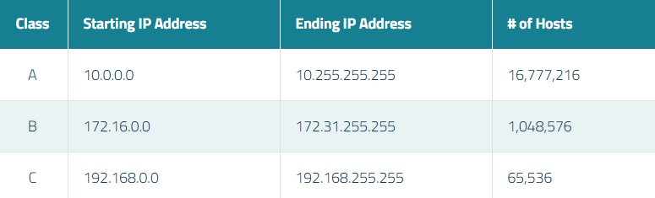
Technical case aspects
Private v Public addresses
  Public IP addresses – used across the internet
  Private IP addresses – used in private networks
  There are certain IP address ranges that are ‘private’
Notes:
Lastly you can have a private network or a public network – and there are addresses reserved for private networks
The intention is not to have the delegates remember the ranges – but to be aware they exist
Internet Assigned Numbers Authority (IANA) is the organisation responsible for registering IP address ranges to organisations and Internet Service Providers (ISPs). To allow organisations to freely assign private IP addresses, the Network Information Centre (InterNIC) has reserved certain address blocks for private use.

Slide 17
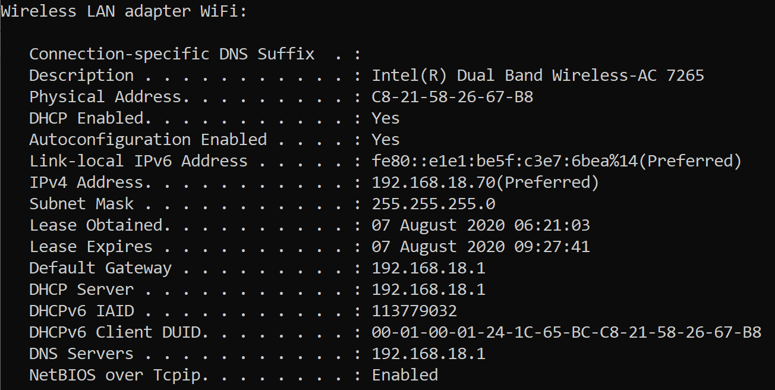
Technical case aspects
Command prompt > ipconfig /all
Notes:
How do you find your internal IP address?
From the command prompt, ipconfig /all will get you this type of box – and the IPv4 & IPv6 addresses are shown
Trainer can also highlight the subnet mask!
And the MAC address – which in this case is on a wifi router (which we mentioned earlier in this section)
Much of the content here is out of the scope of this course
The trainer could do this by demonstration if they are comfortable in doing so

Slide 18
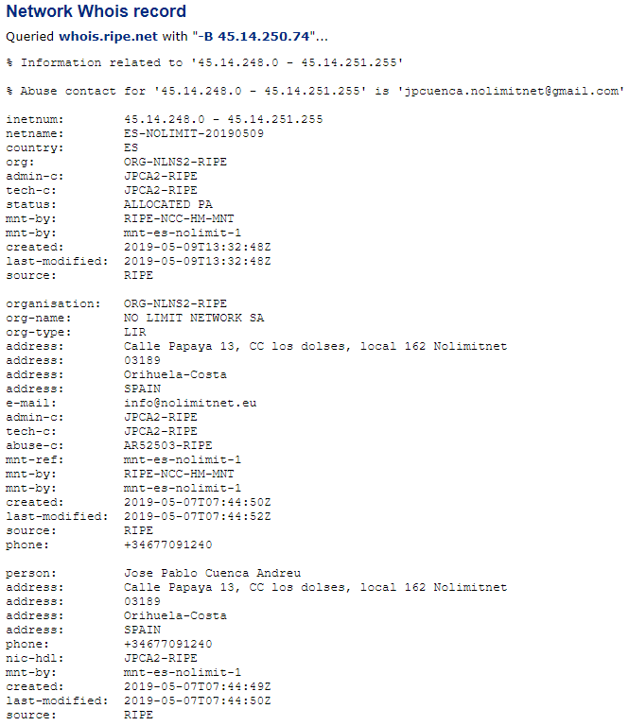

Technical case aspects
IP Address searched
Investigative question?
Who had the use of the IP address 45.14.250.74 at a specific time on a specific date (taking time zones into account)?
IP Address range the address comes from & some company information
Company who holds the IP address, where they are & an email – with a domain name
Some personal information about the registrant
Notes:
The worked example shown is for the IP address which we got as a Whatsmyip search 3 slides ago – the one being used by the author of the slide pack.
Builds - Explain when setting scene – this is a CentralOps response – but many other resources available
Trainer needs to highlight (builds)–
1 The IP address searched for
2 The range the IP address falls in – which is all held by the one company – the netname of the company & who issued it to them – RIPE
3 The company who holds the IP address – and where they are. Also an email – AND A DOMAIN – NOLIMITNET.EU
4 Some personal information about the registrant of that domain
This information collectively will answer the investigative question posed – and the answer will have to be sought from the company NO-LIMIT NETWORK using whatever means necessary to comply with jurisdictional requirements

Slide 19
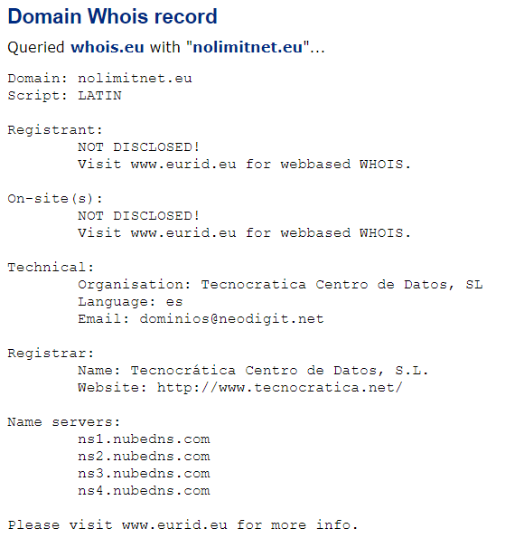
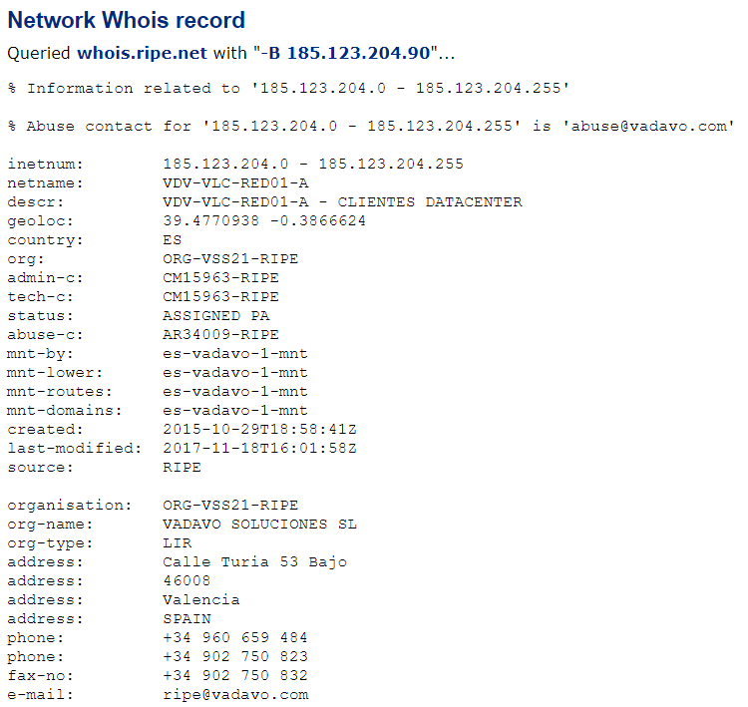
Technical case aspects
Notes:
This is an example of having a domain name rather than an IP address. The same type of search can take place using the same internet resources. So where we had an IP address in the previous slide that took up to NO-LIMIT-NET, this is us asking the question the other way round.
Example continues – we search for the domain NOLIMITNET.EU
1 GDPR will frustrate us by not returning personal detail
2 But we will get some technical detail which can be followed up
3 Along with some information on where the network is based – and contact detail

Slide 20
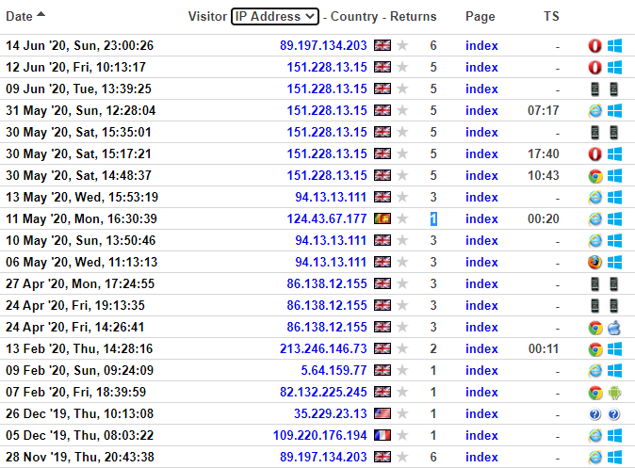
Technical case aspects
Web servers retain logs of requests
  Time, date, IP address, location, pages visited, etc.
This is a graphic representation of a webserver log
The actual logs are highly textual & require work to understand then & provide evidence from them
Notes:
Web logging will keep - Your identity (IP address) Date and time you accessed, What you looked at, How long you looked at it, how often you looked, Your browser, Your operating system, How you got to the page
Investigators need to be aware that this information is kept and can be used for evidence/intelligence or if it is an investigator visiting within an enquiry, can be used against them if they have not fulfilled legal obligations

Slide 21

Technical case aspects
Appearance that this goes direct between machines – it actually goes through a number of computers which can add/remove useful data
Internet
May add or remove data
ISP will add data
SMTP
Server
SMTP
Server
POP3
Server
Alice
Bob
POP3 Mail & IMAP Mail
Principle is similar
Notes:
Electronic Mail or Email is a method of exchanging digital messages.
To the user, It appears that E-mail is passed directly from the sender's machine to the recipient's; however each message typically passes through at least four computers during its lifetime.
A Message is composed on user’s own computer, then sent to ISP's outgoing SMTP mail server* (Simple Mail Transfer Protocol or SMTP)
Outgoing ISP forwards e-mail onto recipient’s ISP SMTP mail server* (SMTP – SMTP)
Recipient’s mail server finds recipient's incoming mail server (Post Office Protocol or POP3) and delivers message to ‘recipient’s post box’
Recipient logs onto account and message is retrieved into recipient’s inbox, normally deleting it from the mail server in the process
* Mail server – dedicated computer used to handle mail
This graphic is massively simplified – to aid basic understanding of the process
E-mail - The traditional Outlook type mail – sent via SMTP – retrieved via POP3 and once downloaded resident on your own machine
Web-based mail - POP3 mail; for instance using Outlook – when you log in you normally download all new mail into you inbox resident on your machine; IMAP mail – ‘true’ web-mail – viewed via your machine but still resident on a remote server – can be organised into folders, etc. but only visible when online.

Slide 22
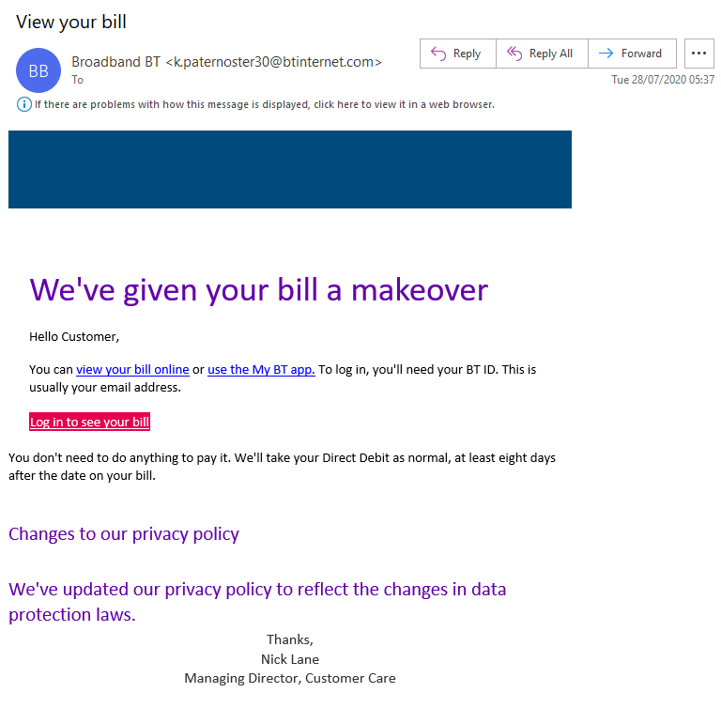
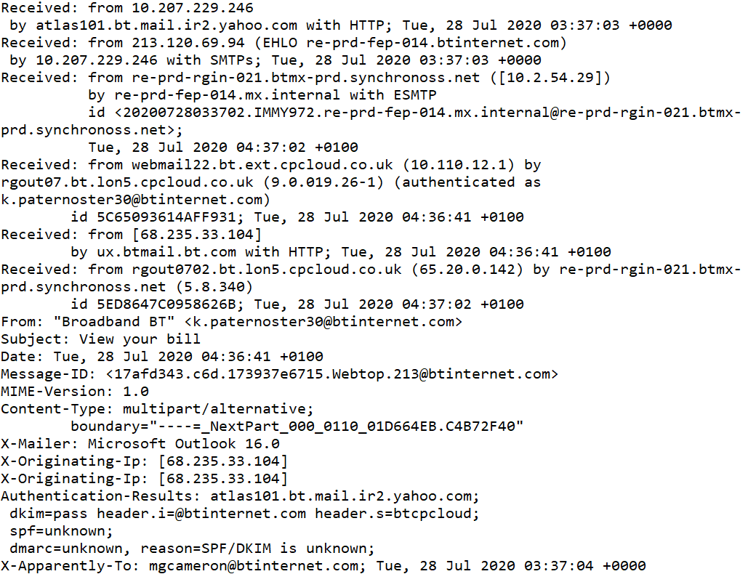
Technical case aspects
What’s in an email?
Short headers
Full headers
Message body
Notes:
The graphics show the content of a mail recovered rom the author’s junk folder – which is a spam/fraudulent email.
A live known example from the trainer’s own mail may assist

Slide 24
Group division and work
Introduction to the Investigation Exercise Case Study and Mock Trial

Slide 25

Group division and work
So far we have been introduced to:
Internet basics
Cybercrime basics
Electronic evidence basics
We learned about cybercrime:
Substantive law
Procedural law
MLA law and practice basics
We understood the:
Cybercrime investigation principles
Domestic law possibilities
Notes:
This slide should be used as for a short reminder about topics covered so far.

Slide 26

Group division and work
Now we are going to implement all that wonderful new knowledge!
We need to divide ourselves into three working groups of 4 to 5 delegates
Working groups are @prosecutors, @defense attorneys, @judges
Delegates should join their groups
Case study as a whole or in parts will be delivered to each group
Notes:
This slide should be used for technical explanation and setup of the exercise.
Case study is envisaged to be a modular one, meaning that different setups of the exercise can be organized. Case study is modular in the way that one, two, four or different number of the groups can work on it, depending on conditions. Every group, when more then one, will get its part of the case story and it will prepare its part of the case report.

Slide 27

Group division and work

Slide 28
Advanced Cybercrime and Electronic Evidence Training Course for Prosecutors and Judges
Thank you
Council of Europe

