Slide 1
Advanced Cybercrime and Electronic Evidence Training Course for Prosecutors and Judges
Session 7
Introduction to the CASM Investigation Exercise Case Study and Mock Trial
Notes:
This session is 90 minutes in length

Slide 2

Session Objectives
Understanding of the technical aspects related to the scenario
Use of the technical equipment
Opportunities from open source research
Identification of legal and natural persons involved in scenario.
Explanation of the introductory facts development of the case investigation.
Outcomes from the investigation
Notes:
Session objectives. Delegates should be introduced with what is expected to be achieved by the end of the session.

Slide 3

Agenda
Exercise
Technical case aspects
Case scenario
Notes:
Session agenda. Delegates should have a copy of it in their possession.

Slide 4
Agenda
Exercise
This exercise will involve an investigations into persons who are initially involved in the exchange of Child Sexual Abuse Material and are making plans to produce their own material.
The exercise has been developed from a case study.
The exercise will involve using open source tools to gather information, intelligence and evidence for :
Identifying the subjects involved;
Pre-Arrest investigations,
Arrest and
Post Arrest investigations.
Notes:
Session agenda. Delegates should have a copy of it in their possession.

Slide 5
Agenda
Exercise Cont..
This exercise will provide technical challenges for you as delegates from :
Open Source methodology
The methodology and reliability of information available on the Internet.
Procedural issues for acquiring information and evidence.
Challenges from jurisdictional boundaries.
Converting information into evidence acceptable in your legal process.
Notes:
Session agenda. Delegates should have a copy of it in their possession.

Slide 6
Agenda
Exercise Cont..
The exercises will be conducted in groups
Each group will have access to a facilitator who will provide Injects as the case study progresses, and will be available to provide information you require.
Your group will be responsible for:
undertaking the investigations,
the decision making process,
managing acquired information, intelligence and evidence,
preparation of the material for a court trial.
Notes:
Session agenda. Delegates should have a copy of it in their possession.

Slide 7
Technical case aspects
Introduction to the Investigation Exercise Case Study and Mock Trial
Notes:
Trainers Note: To avoid duplication of material, Devices, Network –MAC addresses, IP addresses, Ports, Internet Protocols, Ipconfig, Whois, webservers and email protocols are detailed in Session 7 introduction to BEC fraud. If BEC Case study has not been/will not be used in the delivery of your course then the technical slides in presentation Session 8 will need to be provided with this presentation.

Slide 8




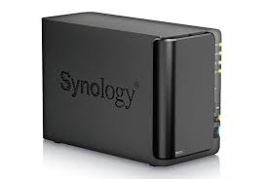
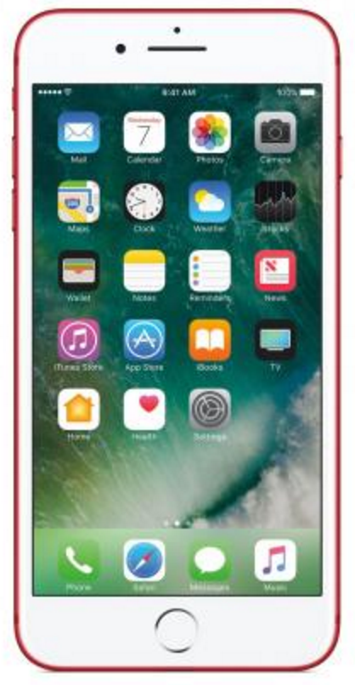
Technical case aspects
Notes:
The exercise will cover various forms of hardware, laptops/phones/Nat storage, as well as virtual components such as cloud storage.
Web services such as email and social media will feature in the exercise.
The delegates will also be expected to consider operational security in relation to the investigation and the legality of actions that are being taken and be able to justify this during the court session.

Slide 9



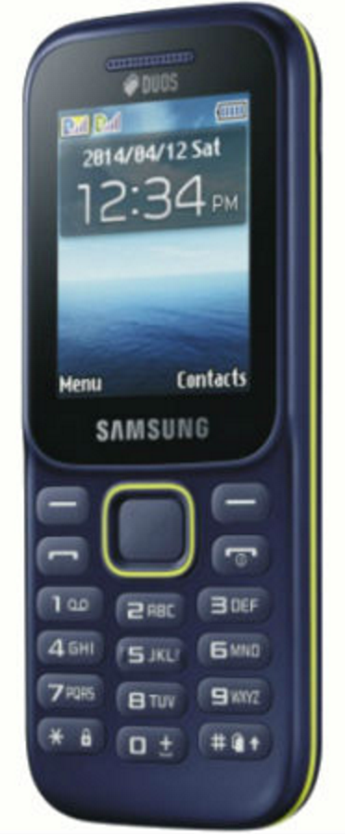
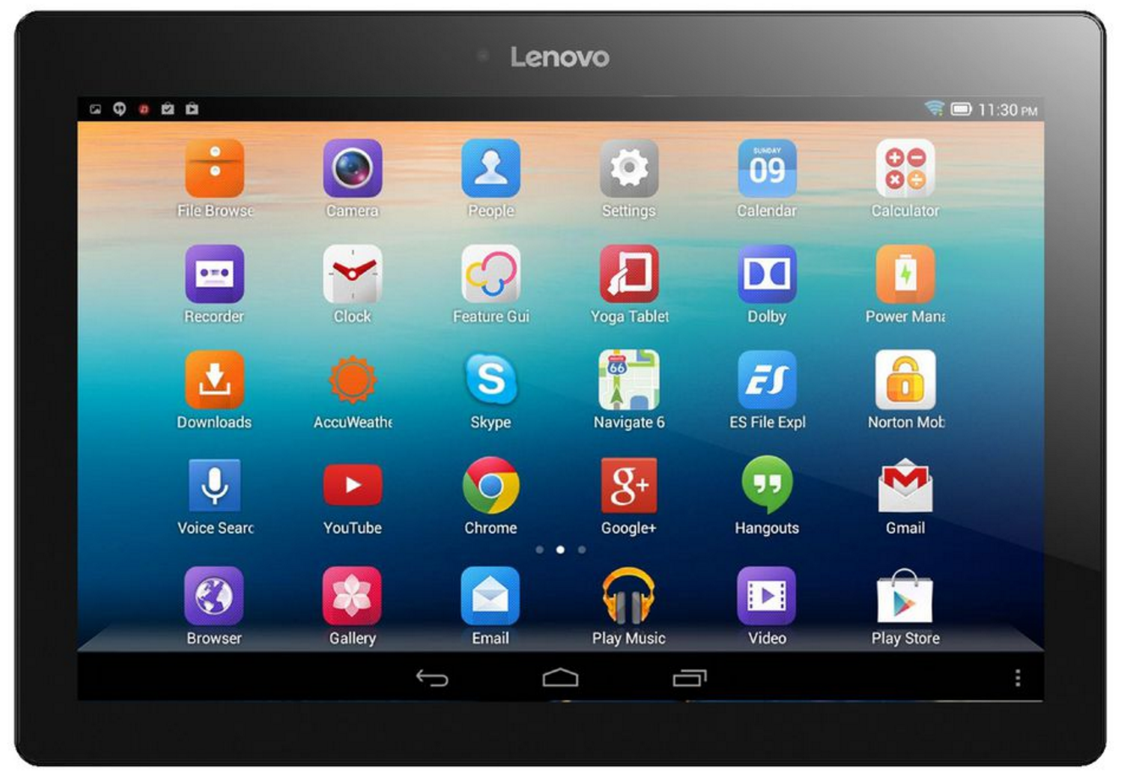
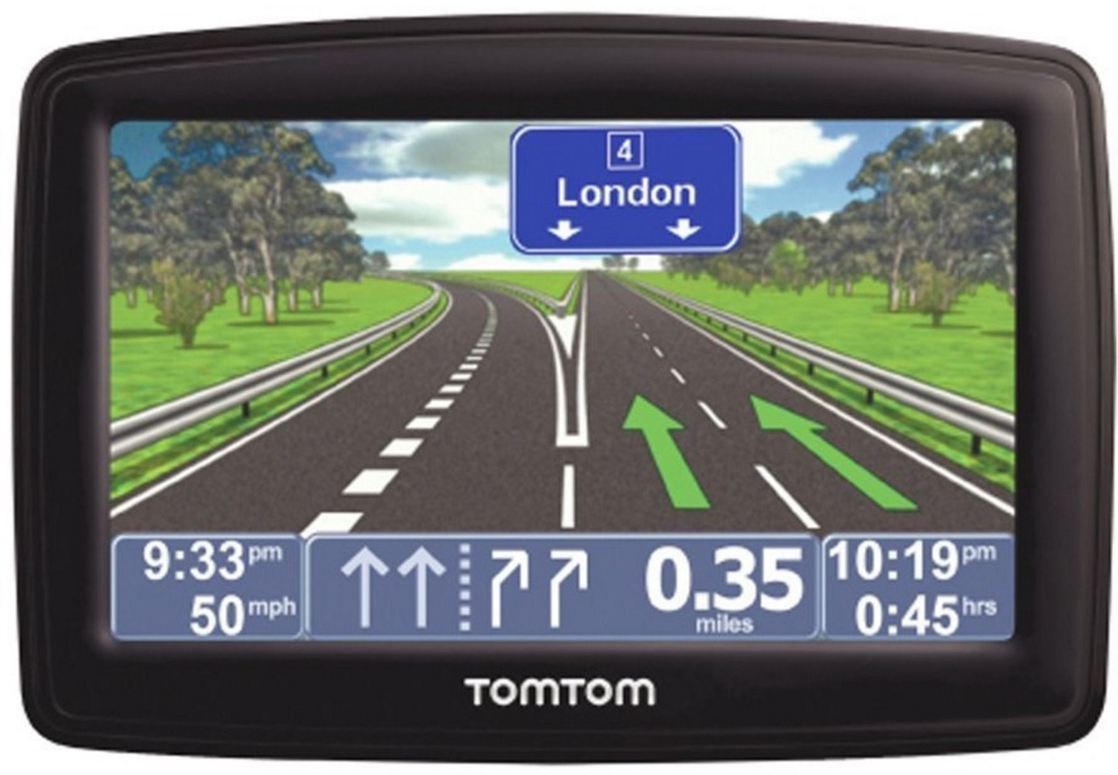
Technical case aspects
Notes:
Trainers Note : Hidden slide – duplicated in Session 7 BEC Fraud Case Study. Unhide slide if Session 7 has not been included in training or this is a standalone CSAM case study.
Explanation of devices and interconnectivity.
Explanation no limits to borders

Slide 10

Technical case aspects
Hardware
Software
Notes:
Trainers Note : Hidden slide – duplicated in Session 7 BEC Fraud Case Study. Unhide slide if Session 7 has not been included in training or this is a standalone CSAM case study.

Slide 11
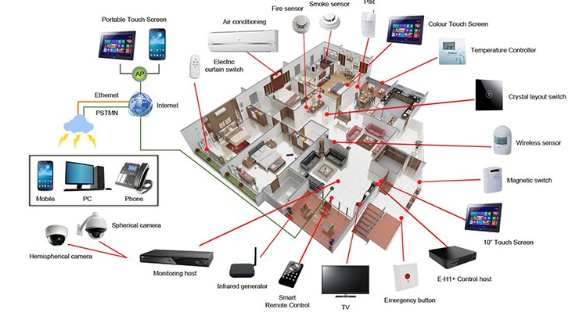
Technical case aspects
Notes:
Trainers Note : Hidden slide – duplicated in Session 7 BEC Fraud Case Study. Unhide slide if Session 7 has not been included in training or this is a standalone CSAM case study.
Explanation regarding devices, common parts and functionality, identifiable factors, where data is stored volatile/non volatile data. Relevance to investigations and evidence gathering.

Slide 12
Technical case aspects
Network terminology
IP Address – unique identifier on a network *
Port – an endpoint for network communication
  Are virtual – don’t actually exist (65,536 of them)
  Allow different applications on the same computer to utilise network resources – e.g.
    Web browsing (HTTP) Port 80
    Secure web browsing (HTTPS) Port 443
    Simple mail (SMTP) Port 25
TCP ‘Socket’ – combination of IP address plus port
Notes:
Trainers Note : Hidden slide – duplicated in Session 7 BEC Fraud Case Study. Unhide slide if Session 7 has not been included in training or this is a standalone CSAM case study.
* We will come back to this
Ports – idea here has to be not to confuse people which would be very easy. Concept has to be to show that on the ONE pipe coming in or out, there are virtual channels separating data of different types for different applications
Ports 0-1023 – Well Known Ports (allocated by IANA – Internet Assigned Numbers Authority)
Ports 1024 – 49151 – Registered Ports (can be registered with IANA)
Ports 49153 – 65535 – Free to be used in client programs

Slide 13
Technical case aspects
TCP – Transmission Control Protocol
IP – Internet Protocol
  There are others!
Together they specify how data is exchanged on a network providing the end-to-end communication, making them reliable
TCP – creates channels, manages assembly & disassembly of packets at each end
IP – defines how to address & route each packet
Notes:
Trainers Note : Hidden slide – duplicated in Session 7 BEC Fraud Case Study. Unhide slide if Session 7 has not been included in training or this is a standalone CSAM case study.
We could spend days dissecting this – we will do it in one slide!
There are other protocols in the suite of protocols! Not important for our level of understanding. TCP & IP work together in Internet communication to ready data for transmission, split it up into packets, address it properly & then route it across the internet – ensuring that it reaches the destination in the way it was sent.
Therefore has built in error checking & correcting – analogy would be that a message gets split up into 10 parts – part 1 of 10, part 2 of 10, etc – and is then addressed with an IP address as it’s destination. When it gets tot eh far end, part 6 of 10 has not made it. The protocol will then identify that it has not – and request the resending of the missing part. This is done automatically and in fractions of seconds.
Some other protocols don’t do this! UDP (Universal Datagram Protocol) for example will simple break everything up and send it with no error checking. That seems ludicrous – but it is used for applications like video streaming where overheads like checking are cumbersome and the loss of a few packets in a few million are not going to be noticeable
The enormity of what is done in the background in an internet transmission is sometimes not clearly

Slide 14
Technical case aspects
Every computer in a network has to have a unique ID to send & receive data – an IP address
IPv4 addresses
213.43.112.45
IPv6 addresses
2600:1403:0002:029c:0000:0000:0000:2add
IPv4 are running out – IPv6 are becoming more common as a result
Notes:
Trainers Note : Hidden slide – duplicated in Session 7 BEC Fraud Case Study. Unhide slide if Session 7 has not been included in training or this is a standalone CSAM case study.
IPv6 is version 6 of the IP Protocol ( Internet Protocol ) defined in 1979 and which did not transcend beyond the experimental field. It was never used as a version of the Internet Protocol .
Version number “6" in the IP header was assigned to identify packets that carried an experimental protocol, which was not IP, but ST. ST was never widely used and since version number 5 was already assigned, the new version of the IP protocol had to keep the next identifier, 6 ( IPv6 ). ST is described in RFC 1819.

Slide 15
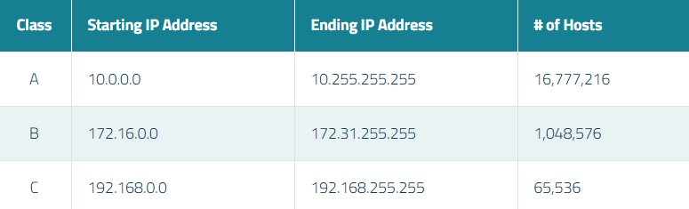
Technical case aspects
Private v Public addresses
  Public IP addresses – used across the internet
  Private IP addresses – used in private networks
  There are certain IP address ranges that are ‘private’
Notes:
Trainers Note : Hidden slide – duplicated in Session 7 BEC Fraud Case Study. Unhide slide if Session 7 has not been included in training or this is a standalone CSAM case study.
Lastly you can have a private network or a public network – and there are addresses reserved for private networks
The intention is not to have the delegates remember the ranges – but to be aware they exist
Internet Assigned Numbers Authority (IANA) is the organisation responsible for registering IP address ranges to organisations and Internet Service Providers (ISPs). To allow organisations to freely assign private IP addresses, the Network Information Centre (InterNIC) has reserved certain address blocks for private use.

Slide 16
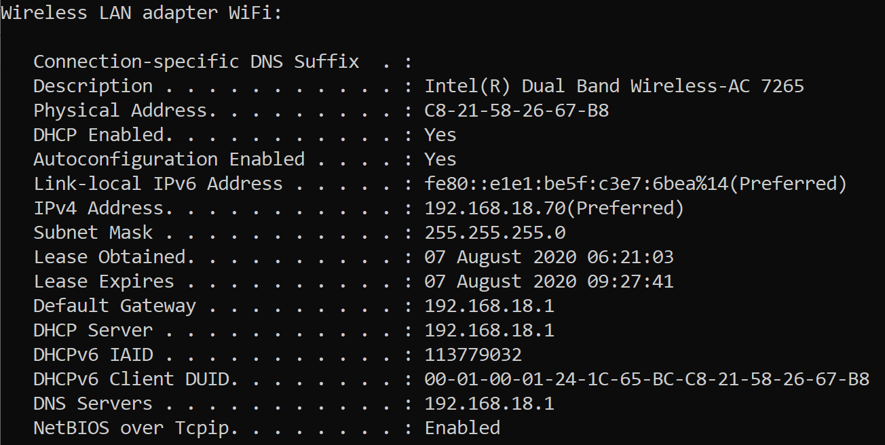
Technical case aspects
Command prompt > ipconfig /all
Notes:
Trainers Note : Hidden slide – duplicated in Session 7 BEC Fraud Case Study. Unhide slide if Session 7 has not been included in training or this is a standalone CSAM case study.
How do you find your internal IP address?
From the command prompt, ipconfig /all will get you this type of box – and the IPv4 & IPv6 addresses are shown
Trainer can also highlight the subnet mask!
And the MAC address – which in this case is on a Wi-Fi router (which we mentioned earlier in this section)
Much of the content here is out of the scope of this course
The trainer could do this by demonstration if they are comfortable in doing so

Slide 17
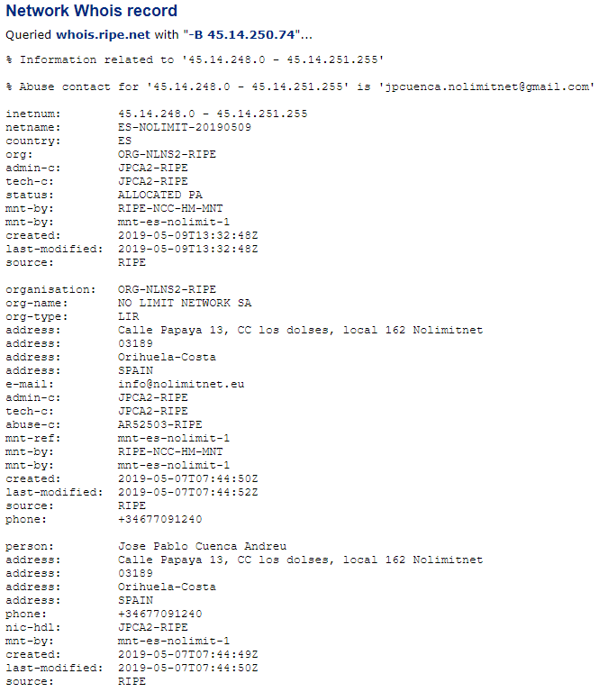

Technical case aspects
IP Address searched
Investigative question?
Who had the use of the IP address 45.14.250.74 at a specific time on a specific date (taking time zones into account)?
IP Address range the address comes from & some company information
Company who holds the IP address, where they are & an email – with a domain name
Some personal information about the registrant
Notes:
Trainers Note : Hidden slide – duplicated in Session 7 BEC Fraud Case Study. Unhide slide if Session 7 has not been included in training or this is a standalone CSAM case study.
The worked example shown is for the IP address which we got as a Whatsmyip search 3 slides ago – the one being used by the author of the slide pack.
Builds - Explain when setting scene – this is a CentralOps response – but many other resources available
Trainer needs to highlight (builds)–
1 The IP address searched for
2 The range the IP address falls in – which is all held by the one company – the netname of the company & who issued it to them – RIPE
3 The company who holds the IP address – and where they are. Also an email – AND A DOMAIN – NOLIMITNET.EU
4 Some personal information about the registrant of that domain
This information collectively will answer the investigative question posed – and the answer will have to be sought from the company NO-LIMIT NETWORK using whatever means necessary to comply with jurisdictional requirements

Slide 18
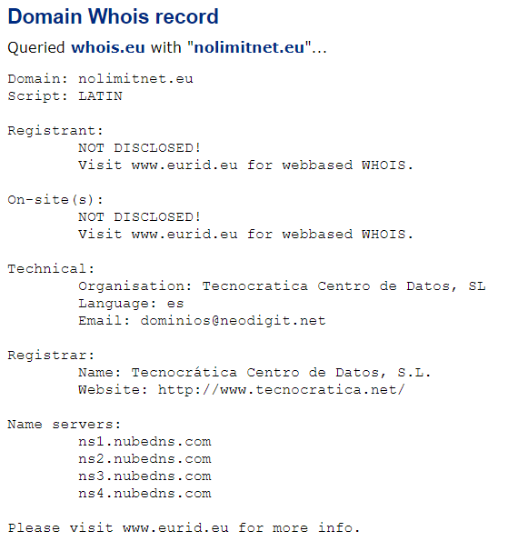
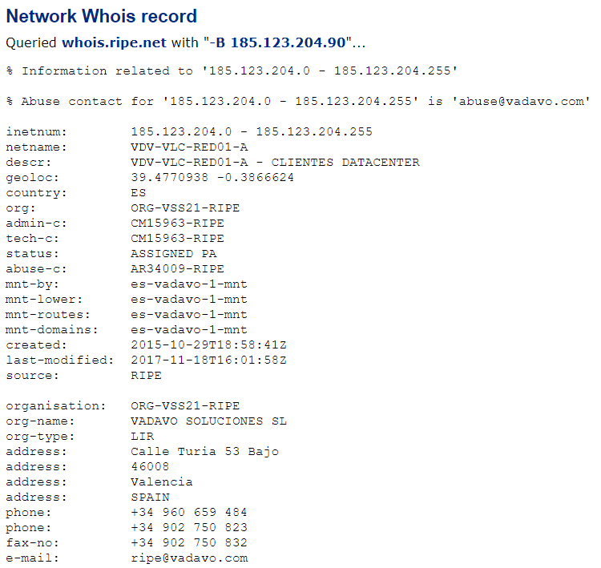
Technical case aspects
Notes:
Trainers Note : Hidden slide – duplicated in Session 7 BEC Fraud Case Study. Unhide slide if Session 7 has not been included in training or this is a standalone CSAM case study.
This is an example of having a domain name rather than an IP address. The same type of search can take place using the same internet resources. So where we had an IP address in the previous slide that took up to NO-LIMIT-NET, this is us asking the question the other way round.
Example continues – we search for the domain NOLIMITNET.EU
1 GDPR will frustrate us by not returning personal detail
2 But we will get some technical detail which can be followed up
3 Along with some information on where the network is based – and contact detail

Slide 19
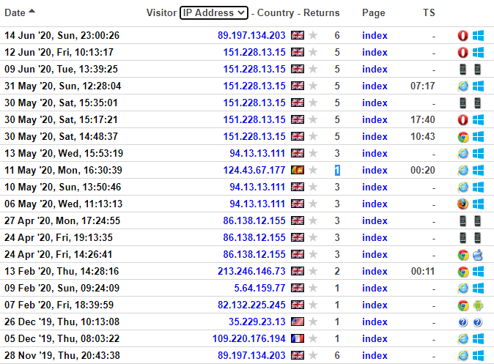
Technical case aspects
Web servers retain logs of requests
  Time, date, IP address, location, pages visited, etc.
This is a graphic representation of a webserver log
The actual logs are highly textual & require work to understand then & provide evidence from them
Notes:
Trainers Note : Hidden slide – duplicated in Session 7 BEC Fraud Case Study. Unhide slide if Session 7 has not been included in training or this is a standalone CSAM case study.
Web logging will keep - Your identity (IP address) Date and time you accessed, What you looked at, How long you looked at it, how often you looked, Your browser, Your operating system, How you got to the page
Investigators need to be aware that this information is kept and can be used for evidence/intelligence or if it is an investigator visiting within an enquiry, can be used against them if they have not fulfilled legal obligations

Slide 20


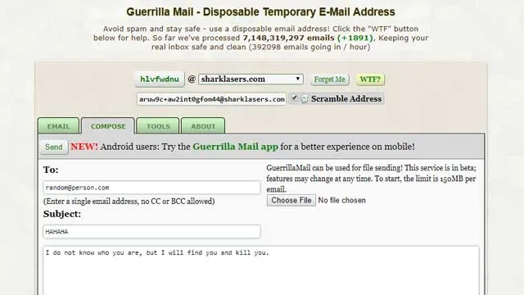

Emails Services
Registered
Limited registration
Temporary
Encrypted
Notes:
Webmail – numerous providers
User Full registration, mobile number, alternative email address, SMS codes for security and activation, e.g.: Gmail, Hotmail.
Limited registration i.e.: no phone– Proton Mail, Tutanota, Yandex
Temporary – Guerrilla, Email on deck, Mailproof.
Encryption, Auto deletion,

Slide 21

Technical case aspects
Appearance that this goes direct between machines – it actually goes through a number of computers which can add/remove useful data
Internet
May add or remove data
ISP will add data
SMTP
Server
SMTP
Server
POP3
Server
Alice
Bob
POP3 Mail & IMAP Mail
Principle is similar
Notes:
Trainers Note : Hidden slide – duplicated in Session 7 BEC Fraud Case Study. Unhide slide if Session 7 has not been included in training or this is a standalone CSAM case study.
Electronic Mail or Email is a method of exchanging digital messages.
To the user, It appears that E-mail is passed directly from the sender's machine to the recipient's; however each message typically passes through at least four computers during its lifetime.
A Message is composed on user’s own computer, then sent to ISP's outgoing SMTP mail server* (Simple Mail Transfer Protocol or SMTP)
Outgoing ISP forwards e-mail onto recipient’s ISP SMTP mail server* (SMTP – SMTP)
Recipient’s mail server finds recipient's incoming mail server (Post Office Protocol or POP3) and delivers message to ‘recipient’s post box’
Recipient logs onto account and message is retrieved into recipient’s inbox, normally deleting it from the mail server in the process
* Mail server – dedicated computer used to handle mail
This graphic is massively simplified – to aid basic understanding of the process
E-mail - The traditional Outlook type mail – sent via SMTP – retrieved via POP3 and once downloaded resident on your own machine
Web-based mail - POP3 mail; for instance using Outlook – when you log in you normally download all new mail into you inbox resident on your machine; IMAP mail – ‘true’ web-mail – viewed via your machine but still resident on a remote server – can be organised into folders, etc. but only visible when online.

Slide 22
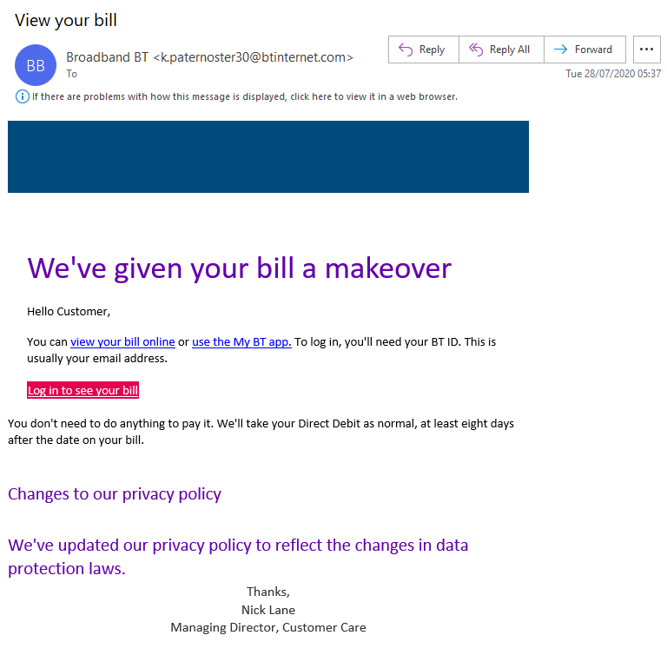
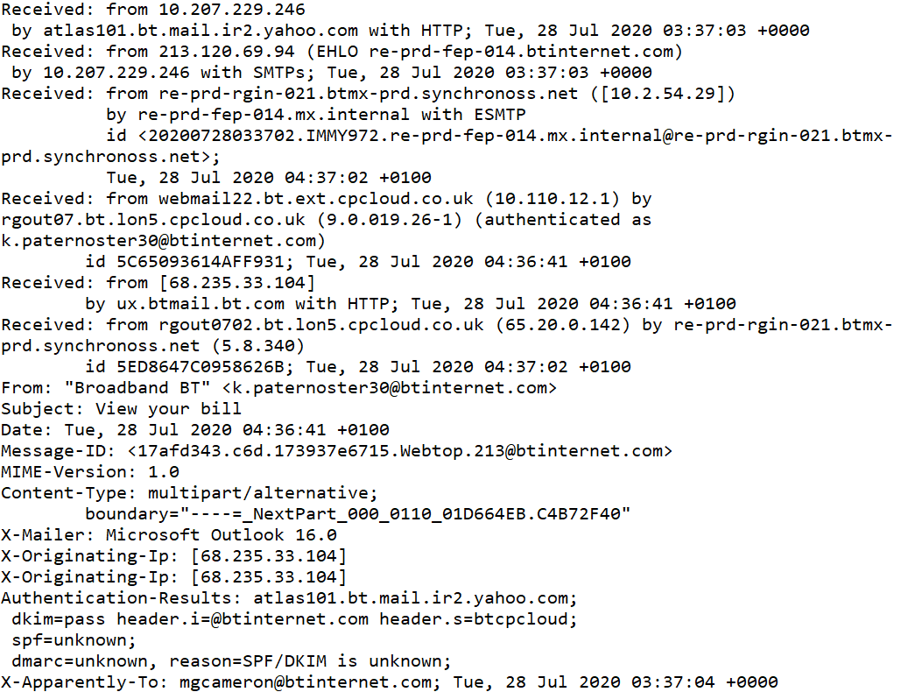
Technical case aspects
What’s in an email?
Short headers
Full headers
Message body
Notes:
Trainers Note : Hidden slide – duplicated in Session 7 BEC Fraud Case Study. Unhide slide if Session 7 has not been included in training or this is a standalone CSAM case study.
The graphics show the content of a mail recovered rom the author’s junk folder – which is a spam/fraudulent email.
A live known example from the trainer’s own mail may assist

Slide 23
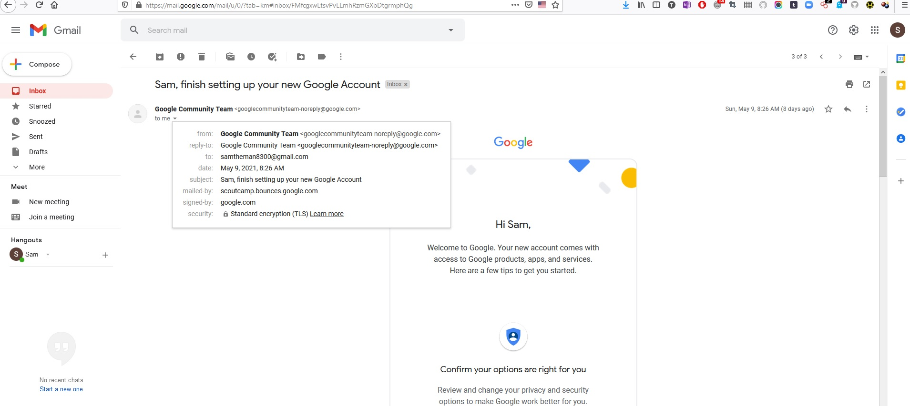
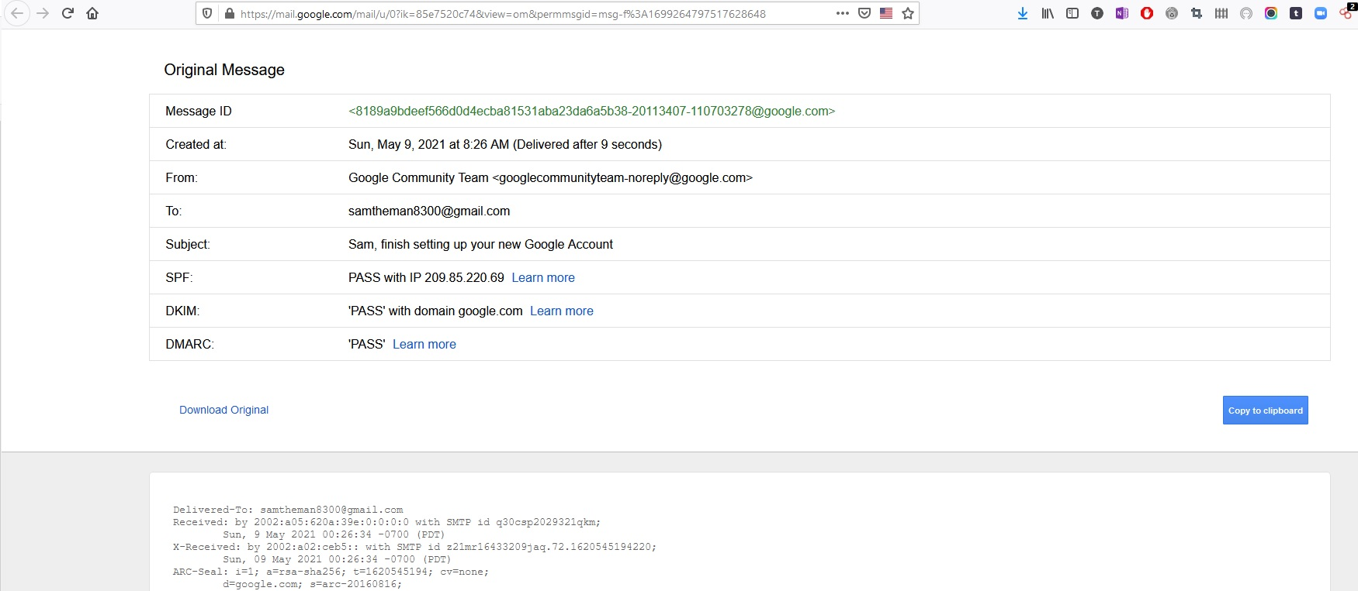
Technical case aspects
Emails
Methodology for capturing the emails for information and/or evidence from Tom’s account.
Consider operational security - legality - chain of evidence.
Identify data from headers
Notes:
Explain methods for capturing emails and source data. Data varies from mail providers.
Example is Gmail, basic information available from message, sender email, cc etc.
Next slide details source data

Slide 24
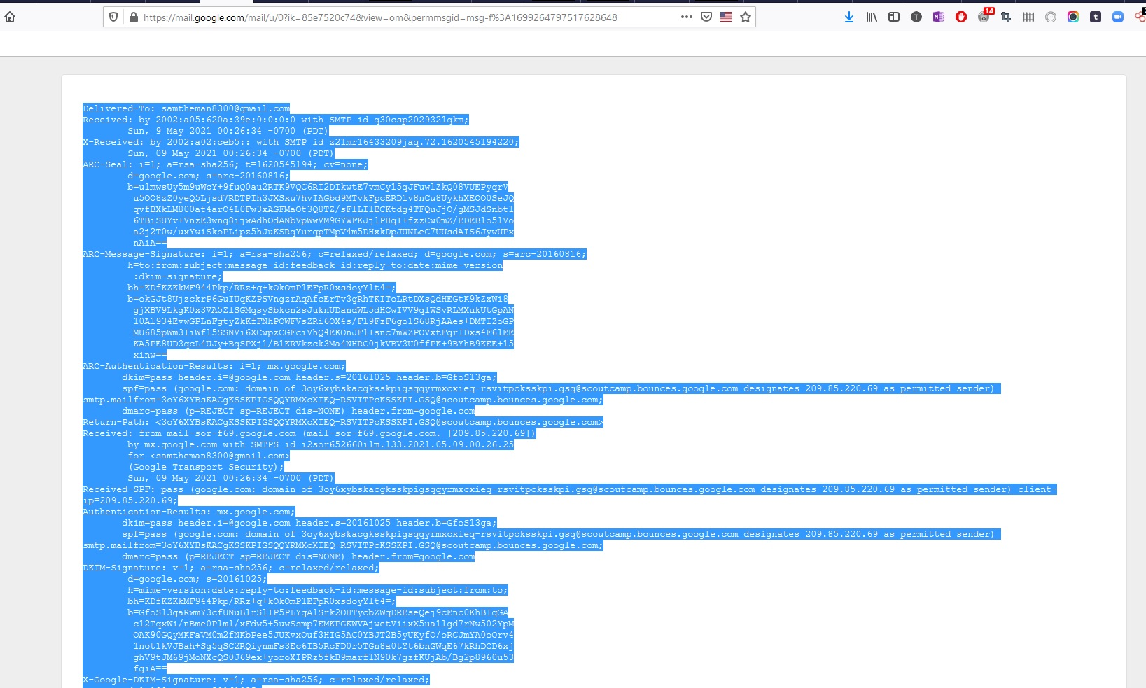
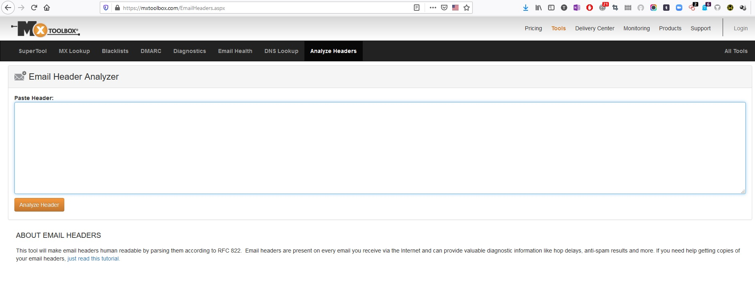
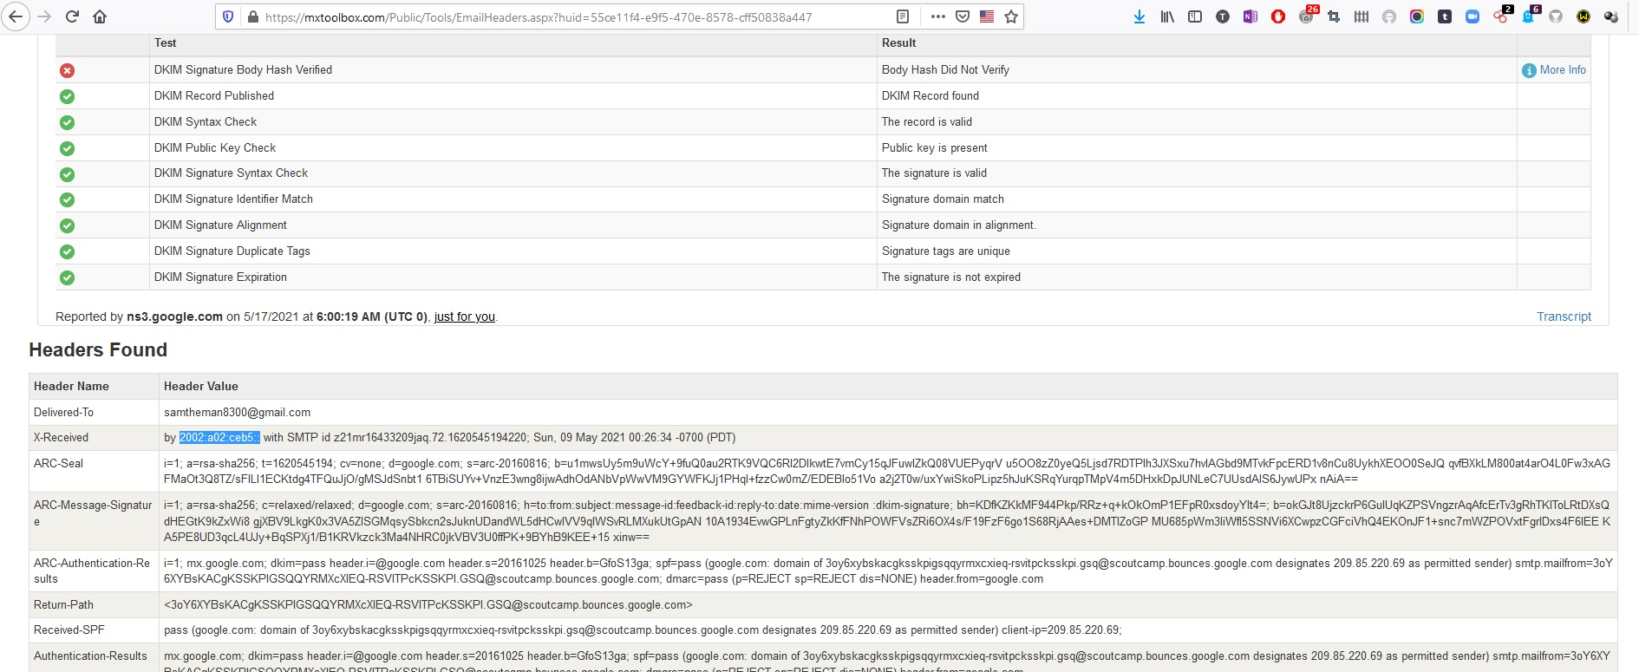
Technical case aspects
Email Analysers
MxToolbox
Notes:
Source data provides more information. Tools available such as MX Toolbox Analyse Headers. Paste source data into field and return for results.
In this example with Gmail the IP addresses are stripped out or obviated for privacy. This is not the case with all emails. Also consider the use of proxies when investigating email headers. Compare with a second analyser as often additional information may be available.

Slide 25

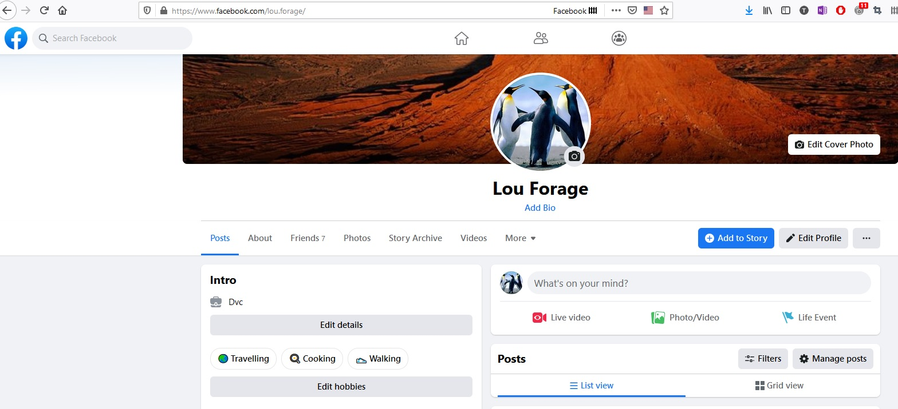
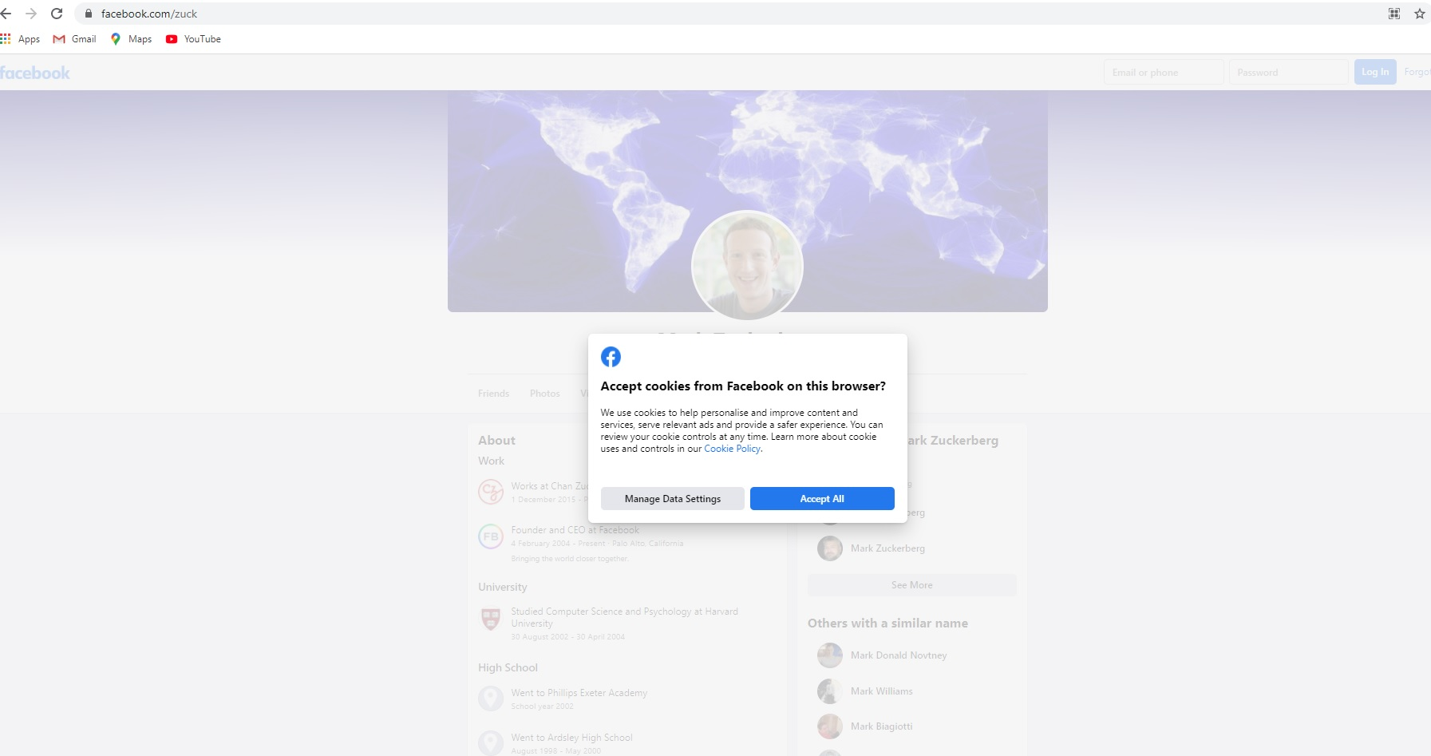
Technical case aspects
Facebook
Risks
Unique identifier
"profile_owner"
Notes:
Operational risk – Facebook algorithms links users/interests/search patterns, therefore its cookies will try to constantly connect profiles and will place cookies on your browser.
Creating a false identity is in breach of Facebook terms and conditions, therefore a profile is at risk of being deleted or suspended if suspicious activity is identified.
Each profile has a unique id, it is essential when making any data preservation/production request that this ID be provided.

Slide 26
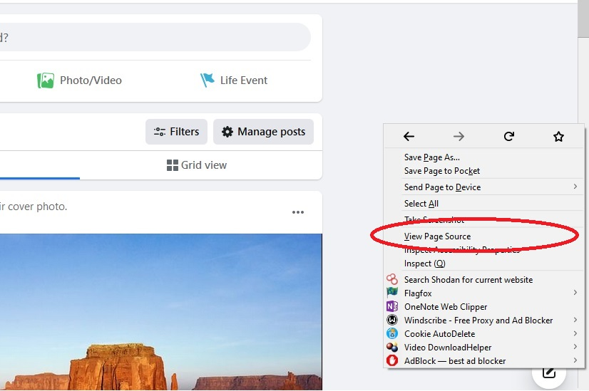
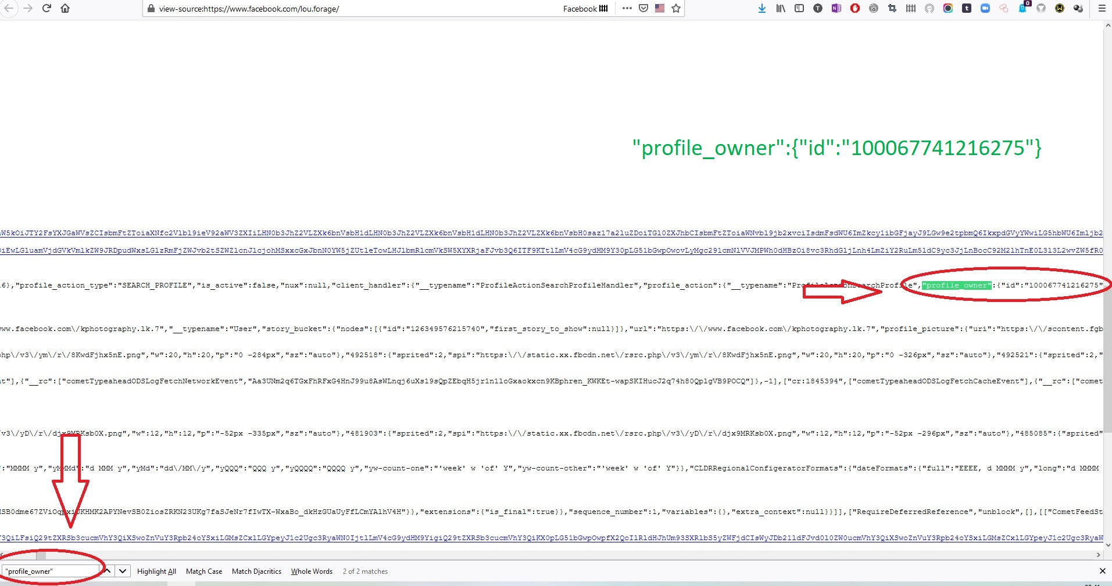
Technical case aspects
Facebook ID
Right Click on profile page
Select - View Page Source
Ctrl + f provides search facility
Enter
"profile_owner"
or “id” or "id":"1000
Notes:
Method for establishing profile unique identifier on face book account.
To check that it is correct you can paste the number into a browser https://www.facebook.com/100067741216275 it will bring up the account of Lou Forage or https://www.facebook.com/4 will bring up a Facebook founder.

Slide 27
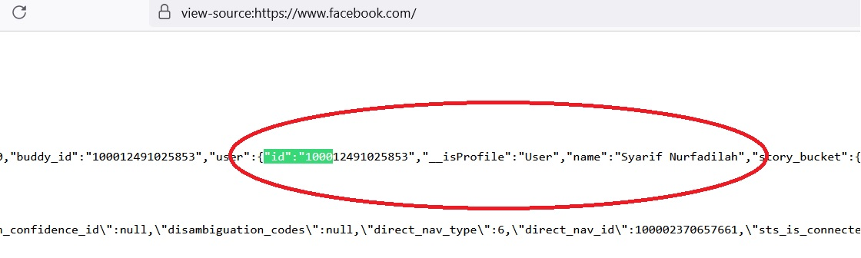
Technical case aspects
Facebook Friends ID
Right Click on profile page
Select - View Page Source
Ctrl + f provides search facility
Enter
"id":"1000
or “id”
Notes:
Method for establishing friends profile unique identifier (PUID) on face book account. PUID start with 1000 so "id":"1000 reduces hits on storylines/photos etc which you will get in the results from purely doing “id”.

Slide 28

Technical case aspects
Skype
Search Skype contacts using Facebook vanity name
Search Skype contacts for email address
Only works if subject has previously linked skype and Facebook account
Notes:
Until changes in privacy legislation and amendments to Skype by Microsoft it was possible to search the last Ip address a user logged into Skype with, through a number of on-line platforms, this is no longer possible, they will return results but they are not accurate and are mainly a platform for advertising monetisation.
It is still possible to track Facebook users by their vanity name or email address. The vanity is the short name that appears in the URL.
In order to undertake this research you will need a Skype account – WARNING do not use a personal account as it is very easy to add the person you are searching as a contact or accidently send an emoji.

Slide 29
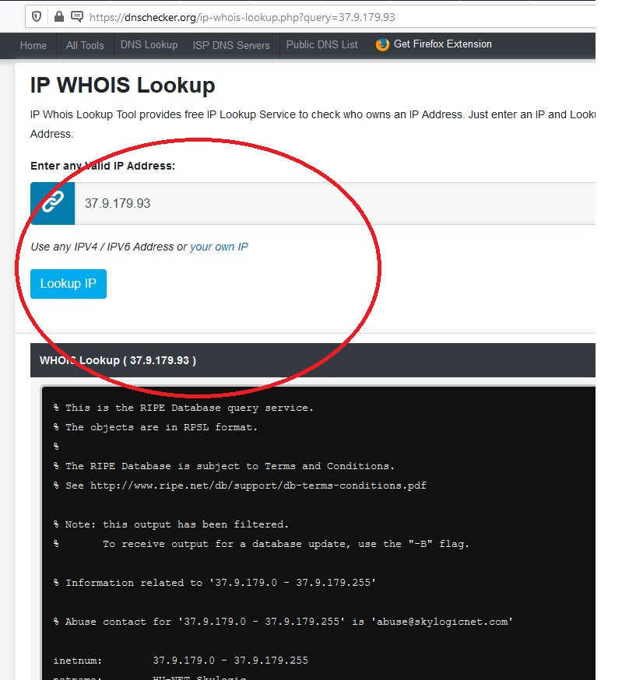
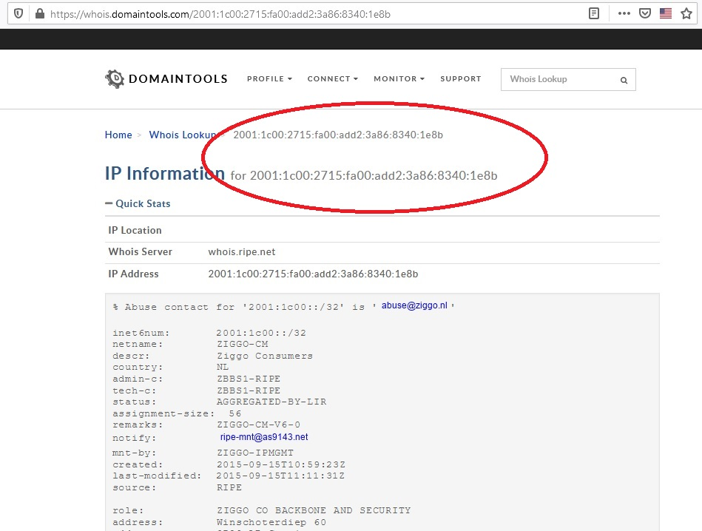
Technical case aspects
Resolving IP addresses
Domaintools.com
dnschecker.org
Notes:
Multiple tools available for IP V4 & V6 look up, attached are examples a dnschecker.org with and IP V4 address.
It is advisable to undertake two checks as the refresh rate of the data from the registrars is dependant on individual website contracts, e.g. live feed, weekly update, monthly update.

Slide 30

Technical case aspects
Domestic Legislation
Budapest Convention on Cybercrime
International Co-operation
Public Private Partnerships
Notes:
The exercises should be conducted using domestic legislation and Articles of the Budapest Convention.
In particular delegates will be expected throughout the exercise to be looking at transborder evidence gathering, location of servers.
Delegates should be using domestic templates for data requests or convention templates.
Delegates should consider various routes for International Co-operation/PPP, but primarily consider articles of the Budapest Convention.

Slide 32
Group division and work
Introduction to the Investigation Exercise Case Study and Mock Trial

Slide 33
Introduction to exercise
The report you are about to receive and significant elements of the scenario are from a real case that has been adapted for these training purposes. Please deal with it as if it is a case in action.
For the purpose of reality and the ability to undertake open-source investigations, locations in the region of Roubaix, France have been used, consider these to be a location in your jurisdiction for the purpose of this exercise.
You are not only required to consider your own domestic legislation and procedures but provisions of the Budapest Convention on Cybercrime, and the First and Second Protocols.

Slide 34
Introduction to exercise
As a group, review the report and commence an investigation plan and take appropriate action.
Once you have developed a plan, present to the facilitator, the options and proceed with the actions you are going to undertake.
The facilitator role is not to investigate or manage the investigation, the facilitator will provide support, provide clarification and facilitate any actions or requests you make.
The training will involve you in an investigation, evidence collection, preparation of case and materials for court and a court hearing in the presence of a judge and defence counsel.

Slide 35
Introduction to exercise
The exercise will have 6 Phases;
Each phase will start with an Inject which will provide a report requiring action by you as a group.
Those injects should result in you defining investigative activity, on submission by the group of the appropriate requests with supporting material and evidence where required, then additional injects will be provided.
As far as possible all anticipated activities have been considered, where a proposed request is received from you that is not possible to provide in this workshop the facilitator will provide suitable direction.

Slide 36
Introduction to exercise
There will be a short debrief after each phase, where the group will be required to present their actions and the facilitator will ensure key elements have been considered to enable progression to the next phase.

Slide 37

GROUP DIVISION AND WORK
Now we are going to implement all that wonderful new knowledge!
We need to divide ourselves into three working groups of 4 to 5 delegates
Working groups are @prosecutors, @defense attorneys, @judges
Delegates should join their groups
Case study as a whole or in parts will be delivered to each group
Notes:
This slide should be used for explanation and setup of the exercise.
Case study is envisaged to be a modular one, enabling one, two, four or different number of the groups can work on elements, depending on conditions. Every group, when more then one, will get the same initial reports and case story but it will be dependent on their own decision-making that determines what other elements are provided by the trainer/facilitator.
Trainers/facilitators will not provide direction; but may encourage delegates to consider options for the path of investigation and evidence gathering; preparing its part of the case report for the mock trial.
Trainers/facilitators will need to adjust how and when the injects are provided to delegates in accordance to the time allocated for the training.

Slide 38

Group division and work

Slide 39
Case study scenario
Introduction to the Investigation Exercise Case Study and Mock Trial

Slide 40
Inject 1
Inject 1 - Report of Crime:
In your jurisdiction, a man called Tom wants to report a crime going on.
He admits that he loves very young girls and that he is involved in pedo-pornographic chats and data exchange.
One month ago, he got into contact with three like-minded men.
They started chatting on a forum called www.pedofilie-info.cz/chat (general information: http://www.pedofilie-info.cz/introduction).
The other men called themselves Rick, John and Sam.

Slide 41
Inject 1
The topic of the discussion went very quickly from ‘how to restrain their own pedosexual feelings’ to ‘how to satisfy pedosexual needs’. In this interaction they send each other some pedo-pornographic images and some footage of a pedo-pornographic film in which a young girl performs sexual acts.
John, Rick and Sam launch the idea of kidnapping a young girl just across the border.
Rick says that he knows an old building at an industrial estate where they can lock up the girl for a weekend, and where they can rape and torture her.
Sam says he can borrow a white van from his brother-in-law.
Rick is a trained nurse and can supply drugs to etherize her.

Slide 42
Inject 1
At this time, Tom decided that it went too far, and that he had to alert the police.
Tom invites you to look into his mail account tjones_822@hotmail.com.
He saved some mails from John, Rick and Sam in case the authorities wanted to see some proof.
Allocated time: 20 minutes

Slide 43
Inject 1 outcomes.
Elements
Outcomes
www.pedofilie-info.cz/chat
Tom’s email address
tjones_822@hotmail.com
Whois
Access account?
Consent or Judicial Order
Location of Servers – Impact on evidence
Preservation requests

Slide 44
Inject 1 outcomes.
Elements
Outcomes
Sam email address
samtheman8300@gmail.com
John email address
johndoe830@hotmail.com
Preservation requests
Urgent Request – Google
IP addresses
Preservation requests
Urgent Request – Microsoft
Notes:
Sam - Google provide under urgent request registration information and recent log-in data, content will take longer. Pattern of Ip addresses indicate Proxy connection.
John - Request made to Microsoft regarding Hotmail account johndoe830@hotmail.com will be a dead end: Microsoft states that the account does not exist anymore.

Slide 45
Inject 1 outcomes.
Elements
Outcomes
Rick email address
rick69@sweetxxx.de
Role of Tom in investigation
No records of their users
Not cooperative with LEA
Preservation requests?
Legal Implications
Notes:
This is a temporary mail service operated from Germany, has strict privacy regime, according to website they keep no records of their users. Request to appfield.net regarding Tempr.email account rick69@sweetxxx.de will be a dead end:
Tempr.email states they keep no records of users, emails are stored on the server for 30 days unless deleted by user. Contact : appfield.net Frank Burian, B.Sc. Lutherstraße 26, 09126 Chemnitz, Germany.
Tom being used as witness/informant/participating informant in investigation – to be discussed with delegates.

Slide 46
Inject 2.
Police Report of Sam Hendrix:
The police thinks that Sam could be Sam Hendrix, a Belgian citizen, who happens to be no stranger to court.
In the past, he has been suspected of assaulting a minor but due to a lack of evidence the case was eventually dismissed. He is known to be a hardline paedophile.
In order to conduct the open source investigation the police use a false Facebook account they made themselves to undertake investigations on Facebook.
Open source enquiries undertaken by the Police establishes Sam Hendrix apparently has a Facebook account under his own name.
Allocated time: 20 minutes

Slide 47
Inject 2 outcomes
Elements
Outcomes
Sam Hendrix Facebook account
Associates
Facebook Report Sam Hendrix
"profile_owner":{"id":"100005145937054"
John Doe
Tom Jones
Tom Emmanuel Jones
Cloud Lord
Multiple IP addresses and locations
Notes:
Profile Id Required for Facebook data application.
Associates Tom Jones and Tom Emmanuel Jones (the same person)?
Cloud Lord – LEA profile – operational compromise? Dual investigation or previous investigation? Disclosure issue?
What do the IP addresses reveal, historic registration IP Belgium, Netherlands ISP, Skylogic SPA, Italian company satellite services, recent log-in IP addresses relate to different ISP’s/countries, is Sam using a proxy?

Slide 48
Inject 2 outcomes
Elements
Outcomes
John Doe Facebook account
Associates
Facebook Report John Doe
"profile_owner"
“100005145937054"
Tom Jones
Tom Emmanuel Jones
Saved a recognised device iPad, to his Facebook account on 13th February 2014.
Notes:
Profile ID Required for Facebook data application.
Associates Tom Jones and Tom Emmanuel Jones (the same person)?
Saved device while old may be relevant during any house or premises search.

Slide 49
Inject 3
Internal Police Report - Telephone Call from Tom Jones (TJ) - 09:30hrs to Officer Allard (OA).
TJ: You asked me to call if I thought of anything else. I have been thinking about John and I have remembered we once had a call on skype a few months ago, it was just a general call me and him, but the fact he uses skype may help you find him before it is too late.
OA: Can you give me his skype account details?
TJ: Unfortunately, I no longer use Skype, I deleted the app, so I do not have his details.
OA: Did he say where he was when he called?
Action: Report forwarded to Investigation Team

Slide 50
Inject 3
TJ: No, he did complain about his sister getting on his nerves, but I cannot remember anything else, we just discussed our interests.
OA: Is there anything else you remember?
TJ. Not currently.
OA: OK call me if you have anything else, it is important we find John, Sam and Rick.
Call completed. Action: Report forwarded to Investigation Team
Allocated time: 20 minutes

Slide 51
Inject 3 outcomes
Elements
Outcomes
Skype account
Email
johndoe830@hotmail.com
Opportunity to monitor when on-line?
Use information from Facebook to find his skype account
johndoe830@hotmail.com identified Skype account:
Jonathan Doe
johndoe830
Notes:
Skype investigation – required n account, run the vanity names and emails against Skype Search, with Facebook account and Skype being linked provided account name and number.
Consider the accumulating information, make decisions regarding, evidence, disclosure, special material.

Slide 52
Inject 3 outcomes
Elements
Outcomes
Proximus N.V.
IP Address 81.241.223.216.
Mastercard
5309 9780 9432 6725
Proximus provide data records
Juliette Lepage, of Rue Les Petites Filles 72, 59100 Roubaix, France
Microsoft provide data records

Slide 53
Inject 4
STATEMENT
Name: Leparge
First name: Juliette
Place of birth: 25 March 1984, Paris, France
Address: Rue Les Petites Filles 72, 59100 Roubaix, France
You tell me that your investigation showed that my Mastercard 5309 9780 9432 6725 has been used to buy Skype Out credits for the Skype account of ‘Jonathan Doe’. You tell me that this account has also been used from an IP address which refers to my internet access registration. I am stunned and shocked. I do not know anyone named Jonathan Doe. I do not have a Skype account. My children only use the Internet supervised and do not have Skype accounts.

Slide 54
Inject 4
I do have a brother, Jean Lepage, who frequently asks me for money to help him out, occasionally I give him my credit card so he can buy some stuff he needs in order to get back on track. He has had a hard time since he came out of prison.
I do not give my credit card to anyone else to use. I only have the one credit card from Mastercard.
Occasionally Jean comes to visit me and spends the day here in my house and garden with my three children and the dog. He so great with children, they all love him, except for the youngest one, which I find strange.

Slide 55
Inject 4
To answer your question, yes, he does have a smartphone and he does have access to my Wi-Fi.
I think he is currently staying in a little studio in the centre of Roubaix, in Rue de l'Alma area. He recently found a good job. I believe the company is located somewhere on the industrial premises in the north of Roubaix.
I have checked my credit card statements and I have one purchase shown for 16th March 2019 for 10 Euros to Microsoft. I did not make any purchase from Microsoft, but Jean may have done as he is the only person who uses my card.
Allocated time: 20 minutes

Slide 56
Inject 4 outcomes
Elements
Outcomes
Statement from Juliette LeParge – Skype Top-up
Juliette has a brother Jean Leparge.
Jean occasionally uses her Internet and Credit Card online.
Jean has been to Prison.
Jean’s relationship with his sister’s youngest daughter.
Lives and works in Roubaix

Slide 57
Inject 4 outcomes
Elements
Outcomes
Statement from Juliette LePage – Skype Top-up
Operational Risk - Juliette Leparge informing brother Jean about the enquiries.
Protection and welfare for Juliette Leparge and children.
Request for Police or Court report on Jean Leparge.
Undertake open-source enquiries for Jean Leparge.
Discuss actions to locate and monitor Jean Leparge.
Home address identification.
Work identification.

Slide 58
Inject 4 outcomes
Elements
Outcomes
Police Intelligence Report
Vehicle registration report
Statement Ricardo Gauthier
Renault Van AB223LL
Company ZVX Group
Identifies employee Jean Leparge, Studio 3a, 39 Rue de l'Alma, Roubaix.

Slide 59
Inject 5
Inject 5 – Police report - Sam Hendrix
The vetting office of the Belgian Police have informed officers that Sam Hendrix has applied for a job as a school caretaker, he has not revealed his convictions. The vetting unit will inform the school human resources.
In his application he has provided his address as 45 Rue du Travail, Mons, Wallonia, Belgium.
Investigations by local detectives reveal the property is vacant land housing a prefabricated building which is being rented to Sam Hendrix. According to the local postal service he has been at the address for about 3 months, no one else is registered there he appears to be alone.

Slide 60
Inject 5
There is occasionally a white van that visits the address.
It is not known whether he is presently employed.
Local officers have seen a male at the address today who they believe to be Sam Hendrix, described as White Male 1.75m tall, stocky build, long shoulder length light coloured hair, aged about 35-40.
Allocated time: 20 minutes

Slide 61
Inject 5 outcomes
Elements
Outcomes
Sam Hendrix located to
45 Rue du Travail, Mons, Wallonia, Belgium
Discussions concerning further investigation warrants for search and arrest.
Hendrix is in a neighbouring country, Joint Investigation Team – who takes lead in investigation, where is the crime?

Slide 62
Inject 5.1 outcomes
Elements
Outcomes
Search of 45 Rue du Travail, Mons, Wallonia, Belgium
Arrest of Sam Hendrix
Exhibits seized
Confirmation of email address samtheman8300@gmail.com and email from John Doe re kidnap.
Jurisdiction and location of Google servers - Articles 29 and 30

Slide 63
Inject 5.1 outcomes
Elements
Outcomes
Search of 45 Rue du Travail, Mons, Wallonia, Belgium
Arrest of Sam Hendrix
folder on the C drive Path: This Pc> OS(C:) >babes , with 15 thumbnails of child sexual abuse images
Defence put forward by Hendrix re images being on computer, malware insecure network
Forensic Strategy

Slide 64
Inject 5.2 outcomes
Elements
Outcomes
Search of Studio 3a 39 Rue de l'Alma, Roubaix
Arrest of Jean Leparge
Apple iPhone 8 was seized as an exhibit
Cloud services
Refused to co-operate
‘self-incrimination’ and the jurisprudence of the ECHR
Apple policy regarding their (un)willingness to assist to law enforcement in unlocking devices

Slide 65
Inject 5.2 outcomes
Elements
Outcomes
Search of Studio 3a 39 Rue de l'Alma, Roubaix
Arrest of Jean Leparge
Forensic Strategy
Keywords
Two gel packets addressed to Leparge mailed from the USA, sent from Rowell, 1442 Grove Street, Brentwood, NY 11717

Slide 66
Inject 5.3 outcomes
Elements
Outcomes
Analysis of Motorola phone seized from Sam Hendrix.
Confirmation of johndoe830@hotmail.com, and new email JohnDoe830@protonmail
Rick data
home: 00-1-123-4567890
work: 00- 1 631-761-3500
email: rick69@sweetxxx.de

Slide 67
Inject 5.3 outcomes
Elements
Outcomes
Analysis of Motorola phone seized from Sam Hendrix.
mega.nz cloud storage
In notes there is a note titled: mega,
  Recovery key
  tSHnBbHJjk17RuwRpvd34w
  Br0nz3$R00st3r
Articles 29 and 30 of the Cybercrime Convention can be evaluated (transborder evidence gathering, expedited disclosure).

Slide 68
Inject 5.3 outcomes
Elements
Outcomes
Report from FBI Agent Lorraine W. Aviles, NY
Eric L Rowell, 1442 Grove Street, Brentwood, NY 11717, born December 14, 1972
employed as a porter at Pilgrim Psychiatric Center, 998 Crooked Hill Rd, Brentwood, NY 11717, United States
+1 631-761-3500 is for the central switchboard at Pilgrim Psychiatric Center.

Slide 69
Inject 5.3 outcomes
Elements
Outcomes
Report from FBI Agent Lorraine W. Aviles, NY
Trusted employee with access to secure areas,
Forename is Eric he prefers to be known as Rick and wears his name badge as Rick.
He often spends time outside of work volunteering to assist with the younger patients.

Slide 70
Inject 6
INJECT 6 and 6.1
Federal Computer Crime Unit - Forensic analysis of devices
Forensic Analysis - Suspect claims that child sexual abuse material in the form of images have been put –through the open Wi-Fi-router- on his computer
Allocated time: 20 minutes

Slide 71
Inject 6 outcomes
Elements
Outcomes
Report from Koen SMETS Forensic Examiner
Examination of router and laptop
Router of suspect is “open”, not protected by a password and encryption. But there are no indications that a 3rd person used the connection on the moment(s) that the illegal files were downloaded.
No access to the DMZ of the router, nor are ports open to the “outside” world

Slide 72
Inject 6 outcomes
Elements
Outcomes
Report from Koen SMETS Forensic Examiner
Examination of router and laptop
The PC of the suspect is kept up-to-date and has all necessary protection tools and rules: password protected, no open shares, up-to-date operating system and anti-virus/malware.
No unknown process or malware.
Browser search history indicative of CSAM.

Slide 73
Preparation of case file
This is the end of the exercise.
You have all the material that is available to formulate decisions on proceedings.
Prepare you case files for a judicial hearing.

Slide 74
Questions
Notes:
Go to second presentation

Slide 75
Advanced Cybercrime and Electronic Evidence Training Course for Prosecutors and Judges
Thank you
Xxxxx XXXXXXXX
Council of Europe
email
DD Month YYYY

