Slide 1
Advanced Cybercrime and Electronic Evidence Training Course for Prosecutors and Judges
Session 10
Advance Electronic Evidence Challenges – Preparing for Court techniques
Notes:
This session is 90 minutes in length

Slide 2

Agenda
Refresher on the Electronic Evidence
Trial preparation considerations
Trial presentation considerations
Investigation case specific considerations
Notes:
Session agenda. Delegates should have a copy of it in their possession.

Slide 3

Session Aims
Identify methods of validating electronic evidence;
Review admissibility issues for electronic evidence in the trial process;
Examine and explain values of the electronic evidence files;
Observe trial preparation techniques and presentation of electronic evidence in court.
Notes:
Session objectives. Delegates should be introduced with what is expected to be achieved by the end of the session.

Slide 4


Slide 5
Refresher on the electronic evidence
Advance Electronic Evidence Challenges – Preparing for Court techniques

Slide 6
Definitions
Evidence
  'any species of proof or probative matter, legally presented at the trial of an issue, by the act of parties and through the medium of witnesses, records, documents, exhibits, concrete objects, etc. for the purpose of inducing belief in the minds of the court or jury as their contention’
Electronic Evidence?
  Evidence emanating from an electronic device
  Generally admissible into legal proceedings
Source: Black’s Law Dictionary
Notes:
Evidence is 'any species of proof, or probative matter, legally presented at the trial of an issue, by the act of parties and through the medium of witnesses, records, documents, exhibits, concrete objects, etc. for the purpose of inducing belief in the minds of the court or jury as their contention.' Electronic information generally is admissible into evidence in a legal proceeding.
All legal proceedings rely on the production of evidence in order to take place.
Traditionally and historically, that evidence has been in a physical form such as documents, photographs etc.
Evidence that is used in judicial proceedings that emanates from electronic devices such as computers and its peripheral devices, computer networks, mobile telephones, digital cameras, other mobile devices including data storage devices as well as from the Internet are all forms of electronic evidence.

Slide 7
Definitions
Electronic Evidence Definitions:
1. Council of Europe Electronic Evidence Guide:
”Any information generated, stored or transmitted in digital form that may later be needed to prove or disprove a fact disputed in legal proceedings”
2. Proposal for a Regulation of the European Parliament and of the Council on European Production and Preservation Orders for electronic evidence in criminal matters (2018):
”Electronic evidence means evidence stored in electronic form by or on behalf of a service provider at the time of receipt of a production or preservation order certificate, consisting in stored subscriber data, access data, transactional data and content data”
3. Guidelines of the Committee of Ministers of the Council of Europe on electronic evidence in civil and administrative proceedings (2019):
“Electronic evidence” means any evidence derived from data contained in or produced by any device, the functioning of which depends on a software program or data stored on or transmitted over a computer system or network”
Source: OECD
Notes:
There is no internationally accepted definition of electronic evidence. However, in all countries there are regulations containing precepts which, in some way, refer to electronic evidence.
The “definition” in the COE guide is:
“Any information generated, stored or transmitted in digital form that may later be needed to prove or disprove a fact disputed in legal proceedings”.
Once again it is the responsibility of the trainer to ensure that any national definition that may exist is included in the course for in country training.

Slide 8
Differences
Electronic Evidence
  Not different from traditional evidence
  Necessary for the party introducing it into legal proceedings, to be able to demonstrate that it is no more and no less than it was, when it came into their possession
  In other words, it shows that no changes, deletions, additions or other alterations have taken place
That is the difficulty with
electronic evidence!
www.coe.int/cybercrime
Notes:
The following two slides set out in general terms, the requirements for the production of evidence and explain the differences and challenges of electronic evidence.

Slide 9
Differences
Electronic Evidence
  Nature of data and information held in electronic form makes it easier to manipulate than traditional forms of evidence
  Creates specific issues for the justice system and requires that the handling of such data is carried out in a manner that ensures the continued integrity of the information may be maintained and proved.
That is the difficulty with
electronic evidence!
Notes:
The following two slides set out in general terms, the requirements for the production of evidence and explain the differences and challenges of electronic evidence.

Slide 10
Budapest Convention definitions
Computer System
  any device or group of interconnected or related devices, one or more of which, pursuant to a program, performs automatic data processing
Computer Data
  any representation of facts, information or concepts in a form suitable for processing in a computer system, including a program suitable to cause a computer system to perform a function
Notes:
It is not necessary to revisit the entire lists of types and sources of evidence that were identified in the technology section of this course. The trainer should recap using the list that was created at the beginning of this session.
Sources cover any electronic device. The trainer may wish to identify at this stage the importance of electronic evidence from different devices and the role they have played in cases.
The types of evidence to be covered are those involving:
Static Data
Live Data
Internet Data

Slide 11
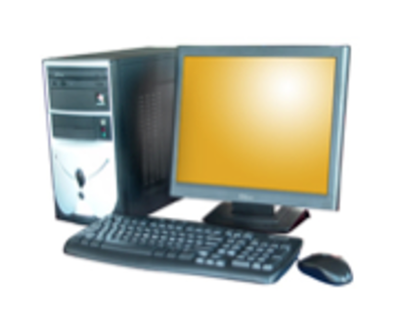
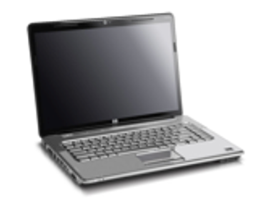
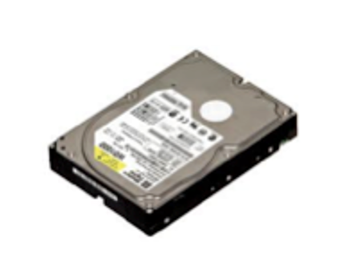
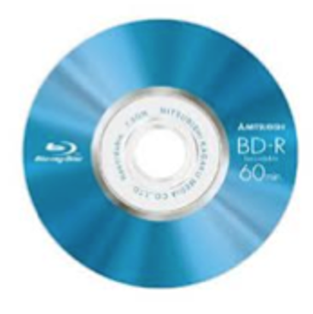
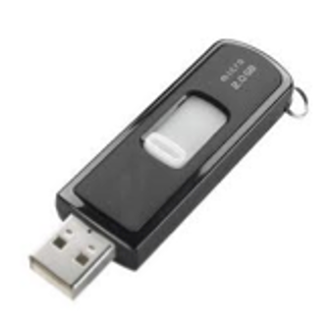
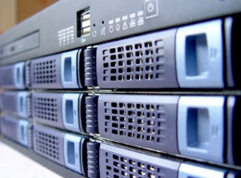
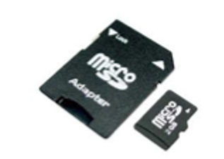
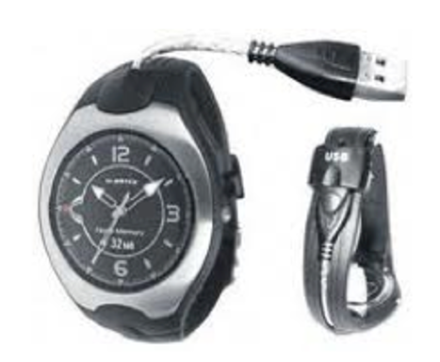
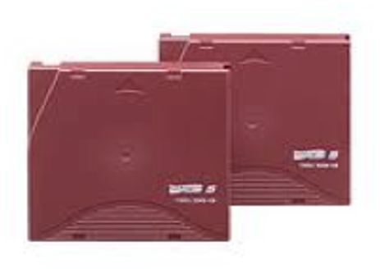
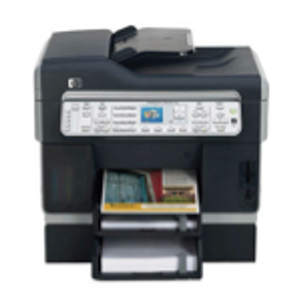
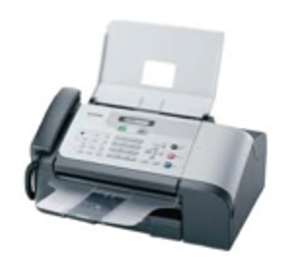



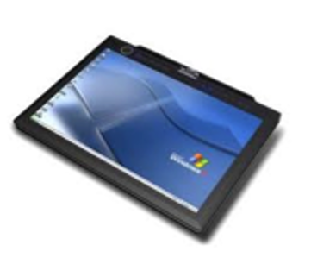
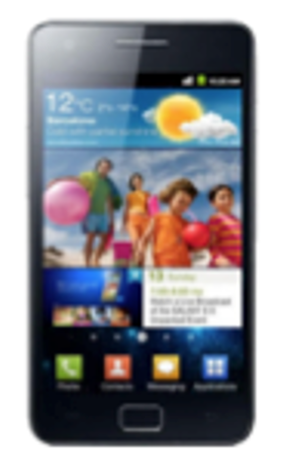


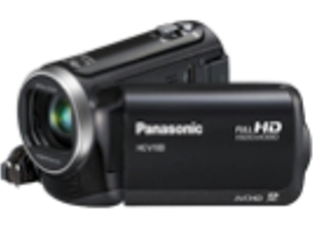




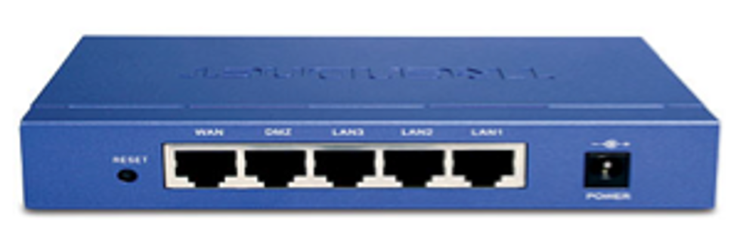
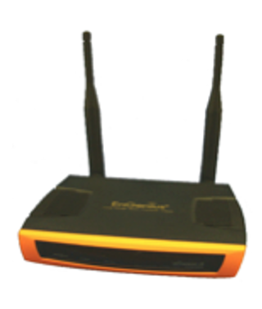


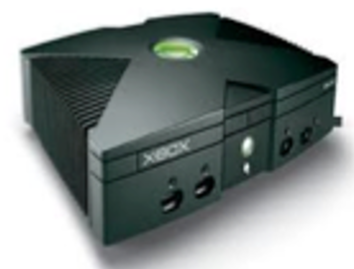
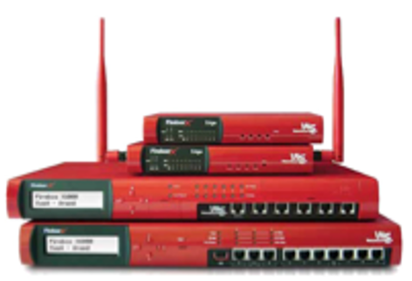
Sources
Notes:
This slide reduces the number of slides in the slide pack – and also crystallises the sources of evidence
From T-B, L-R – PC, laptop, server, HDD, blu-ray disk, micro-sd card, usb drive,
usb wearable, tape backups, printer, scanner, card reader, fax machine, label machine
Tablet, phone or smartphone, camera, wearable recording device, spy pen, video camera, VHS video
Voice recorder, CCTV, ipod/music player, games console, external network storage, router, firewall, wireless access point
Below are descriptives if needed –
Server – A server is a computer or device that provides information and/or services to other computers on a network. Given the right software, any network-connected computer can be
configured as a server. In most cases, a server will be a dedicated powerful computer designed to be “always available”. One computer server can run several services (e.g. web server, email server, file server, print server etc.). In business it often makes sense to run different services on different machines for reasons of security and to minimise the impact of any failure.
Hard disk drives (HDD) are the main storage devices within computer systems. They consist of a circuit board, data and power connections. Inside the hard disk drive there are magnetically charged ceramic, metal or glass platters (i.e. plates or disks) that rotate at high speed. An arm travels across the surface of the platter like in old fashioned record players and ‘writes’ the data to the disk. It is not unusual to discover separate hard disk drives during a search that are not connected to or installed in a computer system. Usually a hard disk drive in desk top computers will measure 3.5 inches (8.9 cm) across and 2.5 inches (6.35 cm) across laptops.
Solid state disks (SSD) have a different structure to hard disks and are becoming more popular. Instead of storing data on platters, solid state disks store data using microchips and have no moving parts. As such they are less likely to be damaged when dropped or knocked and offer faster access to the data.
Compact Disk (CD), Digital Video Disk4 (DVD) and Blu-ray Disks (BD) are typically used for storage of large video or audio files. They may, however, also hold large quantities of other kinds of data that can be of evidential value. Although they look very similar, the storage capacities vary greatly.
Memory cards, also known as flash cards, are also devices for storing digital information. They are used in devices such as digital cameras, mobile phones, laptop computers, music players and games consoles. They retain data without power and can store huge amounts of data while being easy to conceal.
Universal Serial Bus (USB) is the name given to a set of rules or ‘protocol’ used for communication, connection and power supply for devices that connected to computers. The range of devices using this protocol has grown enormously since it was introduced in the 1990s. Some examples of the more usual USB devices are shown below.
Data stored on tape is more likely to be encountered in a business rather than a domestic setting. The most common type used now is the ‘Linear Tape-Open’ (LTO) technology developed in the 1990s as an open-format9 standard. Tapes are normally used for backup and therefore may be useful in cases where an historical analysis is required or where the original computer is not available.
Peripherals are devices that are not an integral part of the computer, but connect to it to increase its range of functions. Examples of peripheral devices are: scanners; printers; tape drives; webcams; loudspeakers; microphones; calculators; fax machines; answering machines; and card readers. Many of these devices have their own data storage capacity and may be relevant to particular types of investigation (for example, the presence of a card reader may be relevant in a credit card cloning investigation). Here are some images of just a few of the types of peripherals that might be encountered:
A tablet computer is a device that is operated by touching the screen rather than using a keyboard or mouse. It is normally larger than a mobile phone or Personal Digital Assistant (PDA). Tablets may store data in the form of a hard disk or flash memory, but , increasingly, user-generated data are stored in the cloud. Tablets have become very popular in recent years. They run their own operating systems and are often connected to the Internet via a Wireless Local Area Network (WLAN), Third Generation Mobile Telecommunications (3G) (now slowly becoming Fourth Generation or 4G) or Long Term Evolution (LTE)12 networks.
The time when a telephone was used simply for making and receiving calls is long past. Nowadays, mobile or ‘cell’ phones are used for many other tasks: sending and receiving text or multimedia messages; accessing the Internet and email; playing games; listening to music; and, taking photographs. Many modern mobile phones are really computers, although their connectivity requires them to be handled in a somewhat different manner. It is important to note that different phones have different capabilities and the way they connect (their ‘connection interfaces’) can require specialist equipment in order to capture evidence.
Digital cameras take still or video photographs in the form of thousands of small dots of light called pixels. Most modern digital cameras can also record sound as well as pictures. Digital cameras can store thousands of images on small “memory cards” (see 2.1.1.3 above) or on the camera itself. For investigations involving photographs it may be possible to prove which camera took a specific photograph because certain metadata are often stored with the image15. Examples of common types of digital camera are shown below, along with some cameras disguised as other devices.
A digital video camera also often stores its images on removable media, but can also record to a hard disk contained within the camera itself. In some cases these cameras look very similar to digital still cameras (bearing in mind that digital still cameras can usually also take video and a digital video camera can take still photographs). Some examples of video cameras are shown below.
Video recorders are usually found in the domestic setting and used to record TV programmes or other locally based activity. They are also used to playback prerecorded films, music and other data. The Video Home System (VHS) recorders were prominent from the 1970s until overtaken by digital versions. VHS was recorded and played back using large cassette tapes that may still be found under some circumstances. Certain kinds of optical discs were also produced, but did not become mainstream. Instead, the Digital Versatile Disk (DVD) became the standard. DVDs and their later evolution, Blu-ray discs, are still used today, but some modern video recorders store their recording on built-in hard drives.
Digital audio recorders are small handheld devices used to record sound on a memory chip to play the recording back. They come in various capacities in terms of maximum recording time and quality. Some recorders have a USB capability that allows the recordings to be uploaded to a computer and may have associated speech recognition software allowing for the creation of automatic draft transcripts.
Closed Circuit Television (CCTV) cameras are used by companies, governments and private individuals. CCTV cameras may be deployed continually or to monitor a particular activity. In some countries they have become a tool for surveillance in public places monitoring traffic or crowd flows, detecting public disorder or criminal activity. Some CCTV cameras record images onto storage media while others are only used for live monitoring. They can also be motion activated and operate in low light or under infrared conditions. They should always be considered as a potential source of electronic evidence wherever they are at or near a crime scene. Some examples of how CCTV cameras may look like are shown below
Portable media players such as iPods or MP3 players store and play digital media. These can include music and other audio, photographs or video as well as documents and other types of file. Once again, these devices have many similarities with computers. Some of these devices use removable flash storage while others have large hard disks capable of storing many thousands of files. Some examples of portable media players are provided below.
Video games consoles have existed since the early 1970s, but have developed greatly over the years. These devices use onboard or removable storage that allows the users not only to play games, but also to visit websites and to store and play videos, photos and music. For this reason, they should never be overlooked as sources of electronic evidence even if they seem innocuous at first sight. Major console producers include Sony, Nintendo and Microsoft and these companies currently hold the majority of the market for consoles and games.
When two or more computers are linked by data cables or by wireless connectivity a ‘network’ is established. Computers in a network are able to share data and other resources between them and will often be connected to additional hardware components that extend their scope and the functions available. Computer networks can be limited such as those found in the home (e.g. where members of a family establish a network sharing an Internet modem) or as extensive as those used by major corporations or governments linking hundreds or even thousands of computers together.
Local Area Network (LAN) – A Local Area Network is a computer network covering a limited ‘local’ area like a home, an office, or a group of buildings (such as a school). Defining characteristic of LANs include the much higher speed they can achieve for transferring data between computers on the network, the limited geographic range and the fact that they do not
need to rent lines from telecommunications companies.
Wide Area Network (WAN) – A Wide Area Network is a computer network that covers a broader area and will include any network that crosses metropolitan, regional, or national boundaries. The term implies a network that uses routers24 and public communications links. Contrast these with personal area networks (PANs), campus area networks (CANs), or
metropolitan area networks (MANs) which are usually limited to a room, building, campus or specific metropolitan area respectively. The largest and most well-known example of a WAN is the Internet.
Some of the terminology and devices that may be encountered when dealing with networks are:
Port – There are two types of ports: computer or hardware ports and network or internet ports. A computer port is a connection point between a computer and another device where information comes in and out (examples include USB, Ethernet and parallel ports by which devices can be attached). A network port is located in the software at the point where the software connects to internet or network services. A common analogy would be the doors and windows to a building. Each port is allocated a different number in computer programming. The number identifies the port’s role and function and is set according to common standards.
Bandwidth – Like the diameter of a pipe, the size of the bandwidth indicates the maximum volume of information that can be carried along a phone line, cable line, satellite feed etc. The
greater the bandwidth, the faster the potential speed for downloading and uploading data. Media Access Control (MAC) address – The MAC address is a unique reference code assigned
by the manufacturer to most network adaptors or network interface cards (NICs). MAC addresses function as an address on a network so that devices can be identified and the appropriate data can be forwarded to it.
Network Attached Storage (NAS) – A NAS is similar to an external hard-drive with the difference that it provides storage space for a whole network rather than just a single PC. NAS can
often offer a lot more than just data storage. A NAS can be used as an automatic downloading server (e.g. uTorrent) and even as a small webserver. Many NAS devices house more than one hard drive and offer ‘RAID’ functionality.
A so-called ‘Redundant Array of Independent Disks’ (RAID) is a way of arranging the storage of data (a data ‘configuration’) using multiple disk drives. Data is stored across the individual disks to ensure the best level of performance and/or data reliability. The operating system will access the RAID as though it were a single hard disk. The access is controlled and coordinated either by software or by a hardware RAID controller. Standalone RAIDs are commonly found in network configurations and may contain huge amounts of electronic evidence.
Network Switch – A network switch is very similar to a hub. Switches are mainly used to connect groups of network devices to each other. In contrast to hubs they use internally stored databases to remember which MAC address has used which port of the switch. This allows a switch to route data packets to a specific device rather than to all devices.
Router – A router is like a sorter in a post room. It is a device that identifies the destination to which a parcel or packet of data is addressed and then sends that packet on to the next point in the network nearest to where it needs to go. Although a router must be located at the gateway between networks it does not necessarily have to be linked to the Internet. Routers are commonly used in the home to connect a house to a broadband connection. In such a situation it will often serve multiple purposes acting as a switch, access point, firewall, router and gateway all together.
Firewall – A firewall is a hardware device or software service that is used to increase the security of a network by preventing unauthorised access. For instance a firewall may be configured (set up) to detect and block any attempt to enter a network using multiple ports except for those ports that have been configured to allow incoming traffic. In homes, it is more common to find a software firewall, but in business settings the investigator is more likely to come across hardware firewalls.
Wireless Access Point – Wireless Access Points connect Wireless LAN devices to the rest to the network. In every WLAN infrastructure an access point is necessary whenever there are more than two devices. Modern routers can often function as an Access Point. A computer’s NIC or even a mobile phone can also be configured to act as an Access Point.
While the network devices listed above can be standalone devices as shown in the photographs, it is very likely that a single device will serve multiple purposes. Routers in the home often function as a modem, firewall, switch and access point and a Networked Attached Storage (NAS) system may also serve as a Virtual Private Network , E-Mail and Webserver with switching as well as access point capabilities.

Slide 12
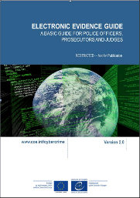
Most important investigation Electronic Evidence Principles
Data Integrity
‘No action taken should change electronic devices or media, which may subsequently be relied upon in court’
  Aim is to make no change
  OIC is responsible for integrity & the forensic chain
  Data on a ‘live’ machine may change
    Change should cause the least impact
    Undertaken in particular manner
    By person qualified to do so
Notes:
When handling electronic devices and data, they must not be changed, either in relation to hardware or software. The person in charge is responsible for the integrity of the material recovered from the scene and thus for commencing a forensic chain of custody.
There are circumstances where a decision will be made to access the data on a “live” computer system to avoid the loss of potential evidence. This must be undertaken in a manner, which causes the least impact on the data and by a person qualified to do so. Principles 2 to 5 should be taken into account if this course of action is found necessary.

Slide 13
Most important investigation Electronic Evidence Principles
2. Legality
‘The person and agency in charge of the case are responsible for ensuring that the law, the general forensic and procedural principles are adhered to. This applies to the possession of and access to electronic evidence’
  Member states should have their own documentation
  Need to ensure processes & training in place
Notes:
Each Member State should take its own legal documents and regulations into consideration when interpreting the measures proposed in this document.

Slide 14

Considerations
Handled - by specialists
Evolution - sources change quickly
Procedures - proper tools & techniques
Admissibility - follow guidance & principles
Authenticity - must be tied to the incident
Completeness - the whole story & not selective
Reliability - no doubt about it
Believability – be understandable
Proportionality - meet the tests
Notes:
Handling by specialists: Each electronic device has specific characteristics, so specific procedures must be strictly followed to access its memory where electronic evidence could be stored. In the case of electronic evidence, one of the most prominent risks is the unintentional modification of part of the evidence. This could raise doubts about the specific changes, and whether the incriminating or exonerating evidence has been tampered with, which could in turn raise admissibility problems in Court.
Rapid evolution of electronic evidence sources: New technologies develop very quickly and there is a need for constant update not only of the new technologies themselves but also of the procedures and techniques that have to be applied in order to seise their content and analyse it.
Use of proper procedures, techniques and tools: As in more traditional forensic disciplines, digital forensic specialists require, besides the specialist knowledge, specific tools to undertake their job properly, such as to capture all original information from advice. It is imperative that adequate techniques and tools are used, and that procedures are traceable and repeatable by other specialists, so that the captured information is of evidentiary value.
Admissibility: Since the ultimate goal is the use of acquired and analysed evidence to support a case in court, electronic evidence must be obtained in compliance with existing legislation and best practice procedure to be admissible in a trial. Although the details differ depending on national legislation, the following basic criteria must generally be taken into account.
Authenticity: It must be possible to positively tie evidentiary material to the investigated incident.
Completeness: It must tell the whole story and not just a particular perspective.
Reliability: There must be nothing about how the evidence was collected and subsequently handled which causes doubt about its authenticity and veracity.
Believability: It must be readily believable and understandable to a judge and/or the members of a jury.
Proportionality: its application to Digital Forensics establishes that the whole investigative process must be adequate and appropriate: the benefits that are to be gained by using a specific measure must outweigh the harms for the party or parties affected by the measure.

Slide 15
Refresher on the electronic evidence

Slide 16
electronic evidence and trial – preparation considerations
Advance Electronic Evidence Challenges – Preparing for Court techniques

Slide 17
Preparation considerations
Fundamental definitions (Guidelines of the Committee of Ministers of the Council of Europe on electronic evidence in civil and administrative proceedings from 2019):
Electronic evidence
“Electronic evidence” means any evidence derived from data contained in or produced by any device, the functioning of which depends on a software program or data stored on or transmitted over a computer system or network.
Metadata
“Metadata” refers to electronic information about other electronic data, which may reveal the identification, origin or history of the evidence, as well as relevant dates and times.
Trust service
“Trust service” means an electronic service which consists of:
a. the creation, verification and validation of electronic signatures, electronic seals or electronic time stamps, electronic registered delivery services and certificates related to those services; or
b. the creation, verification and validation of certificates for website authentication; or
c. the preservation of electronic signatures, seals or certificates related to those services.
Notes:
Guidelines of the Committee of Ministers of the Council of Europe on electronic evidence in civil and administrative proceedings
(Adopted by the Committee of Ministers on 30 January 2019,
at the 1335th meeting of the Ministers’ Deputies

Slide 18
Preparation considerations
2. Fundamental principles:
It is for courts to decide on the potential probative value of electronic evidence in accordance with national law.
Electronic evidence should be evaluated in the same way as other types of evidence, in particular regarding its admissibility, authenticity, accuracy and integrity.
The treatment of electronic evidence should not be disadvantageous to the parties or give unfair advantage to one of them.
Notes:
Guidelines of the Committee of Ministers of the Council of Europe on electronic evidence in civil and administrative proceedings
(Adopted by the Committee of Ministers on 30 January 2019,
at the 1335th meeting of the Ministers’ Deputies

Slide 19
Preparation considerations
3. Use of electronic evidence:
Courts should not refuse electronic evidence and should not deny its legal effect only because it is collected and/or submitted in an electronic form.
Courts should not deny the legal effect of electronic evidence only because it lacks an advanced, qualified or similarly secured electronic signature.
Courts should be aware of the probative value of metadata and of the potential consequences of not using it.
Parties should be permitted to submit electronic evidence in its original electronic format, without the need to supply printouts.
Notes:
Guidelines of the Committee of Ministers of the Council of Europe on electronic evidence in civil and administrative proceedings
(Adopted by the Committee of Ministers on 30 January 2019,
at the 1335th meeting of the Ministers’ Deputies

Slide 20
Preparation considerations
4. Collection, seizure and transmission:
Electronic evidence should be collected in an appropriate and secure manner and submitted to the courts using reliable services.
Having regard to the higher risk of the potential destruction or loss of electronic evidence compared to non-electronic evidence, procedures should be established for the secure seizure and collection of electronic evidence.
Courts should be aware of the specific issues that arise when dealing with the seizure and collection of electronic evidence abroad, including in cross-border cases.
Courts should co-operate in the cross-border taking of evidence. The court receiving the request should inform the requesting court of all the conditions, including restrictions, under which evidence can be taken by the requested court.
Notes:
Guidelines of the Committee of Ministers of the Council of Europe on electronic evidence in civil and administrative proceedings
(Adopted by the Committee of Ministers on 30 January 2019,
at the 1335th meeting of the Ministers’ Deputies

Slide 21
Preparation considerations
5. Relevance:
Courts should engage in the active management of electronic evidence in order to avoid excessive or speculative provision of, or demand for, electronic evidence.
Courts may require the analysis of electronic evidence by experts, especially when complex evidentiary issues are raised or where manipulation of electronic evidence is alleged.
Courts should decide whether such persons have sufficient expertise in the matter.
Notes:
Guidelines of the Committee of Ministers of the Council of Europe on electronic evidence in civil and administrative proceedings
(Adopted by the Committee of Ministers on 30 January 2019,
at the 1335th meeting of the Ministers’ Deputies

Slide 22
Preparation considerations
6. Reliability:
Courts should consider all relevant factors concerning the source and authenticity of the electronic evidence.
As far as a national legal system permits, and subject to the court’s discretion, electronic data should be accepted as evidence unless the authenticity of such data is challenged by one of the parties.
As far as a national legal system permits, and subject to the court’s discretion, the reliability of the electronic data should be presumed, provided that the identity of the signatory can be validated and the integrity of the data secured, unless and until there are reasonable doubts to the contrary.
As far as a national legal system so provides, where a public authority transmits electronic evidence independently of the parties, such evidence is conclusive as to its content, unless and until proved to the contrary.
Notes:
Guidelines of the Committee of Ministers of the Council of Europe on electronic evidence in civil and administrative proceedings
(Adopted by the Committee of Ministers on 30 January 2019,
at the 1335th meeting of the Ministers’ Deputies

Slide 23
Preparation considerations
7. Storage and preservation:
Electronic evidence should be stored in a manner that preserves readability, accessibility, integrity, authenticity, reliability and, where applicable, confidentiality and privacy.
Electronic evidence should be stored with standardized metadata so that the context of its creation is clear.
The readability and accessibility of stored electronic evidence should be guaranteed over time, taking into account the evolution of information technology.
Notes:
Guidelines of the Committee of Ministers of the Council of Europe on electronic evidence in civil and administrative proceedings
(Adopted by the Committee of Ministers on 30 January 2019,
at the 1335th meeting of the Ministers’ Deputies

Slide 24
Preparation considerations
8. Archiving:
Courts should archive electronic evidence in accordance with national law.
Electronic archives should meet all safety requirements and guarantee the integrity, authenticity, confidentiality and quality of the data as well as respect for privacy.
The archiving of electronic evidence should be carried out by qualified specialists.
Data should be migrated to new storage media, when necessary, in order to preserve accessibility to electronic evidence.
Notes:
Guidelines of the Committee of Ministers of the Council of Europe on electronic evidence in civil and administrative proceedings
(Adopted by the Committee of Ministers on 30 January 2019,
at the 1335th meeting of the Ministers’ Deputies

Slide 25
Preparation considerations

Slide 26
electronic evidence and trial –presentation considerations
Advance Electronic Evidence Challenges – Preparing for Court techniques

Slide 27
Presentation considerations
1. Presentation of evidence principles:
Admissibility: computer evidence is admissible if it conforms to a series of laws and rules that ensure it is acceptable to the court.
Authenticity: electronic evidence is no different to physical evidence, such as a document recorded on a piece of paper. It is necessary to ensure that the evidence is authentic.
Convincing: electronic evidence is dealt with in court in the same way as any other form of evidence. The prosecution will have to prove that the document is authentic, and its contents are admissible.

Slide 28
Presentation considerations
2. Explanation of the principles:
electronic evidence is subject to the same rules and laws that apply to documentary evidence
the onus is on the prosecution to show to the court that the evidence produced is no more and no less now than when it was first taken into the possession of law enforcement
at trial it is essential to display objectivity, as well as the continuity and integrity of evidence
it is also necessary to demonstrate how evidence has been recovered, showing each process through which, the evidence was obtained

Slide 29
Presentation considerations
3. Disclosure:
each jurisdiction has different rules and procedures for disclosing evidence to the defense
breach of procedure if electronic evidence is not available for disclosure to the defense
evidence should always be accompanied by a full audit trail

Slide 30
Presentation considerations
3. Court presentation:
more effective if it is visual using computer demonstrations, video demonstration, computer graphics, schedules and charts
prosecutors should be aware of the bias that using such technology can cause, and be prepared to discuss these issues with authority if the defense challenges the use of such technology
many people give more attention to what they see rather than hear

Slide 31
Presentation considerations
4. Unused material and jurisdiction:
there will be material that will not be used as an evidence
to ensure that a defendant has a fair trial, the judge should ensure that the prosecution has properly discharged its disclosure responsibilities
decision about application of mutual legal assistance involving electronic evidence – e.g., need to issue court orders for investigators to access records and data held by service providers
possible questions of extradition of criminals to face trial in countries with different approach.
possible need to rule on disputes over the most appropriate country in which to hold a trial.

Slide 32
Presentation considerations

Slide 33
Investigation case study specific considerations (BEC Exercise only)
Advance Electronic Evidence Challenges – Preparing for Court techniques

Slide 34
BEC case study specific considerations
1st mail - Emails between FBA Board and Head of FBA Logistics – 21st Sept 2017
2nd mail - Emails between Head and Deputy Head of FBA Logistics – 21st Sept 2017
3rd mail - Emails between Deputy Head of FBA Logistics and CEO UBP – 21st Sept 2017
4th mail - Various emails between FBA and UBP – 21st September 2017
5th mail - Emails between Deputy Head of FBA Logistics and Hermes Novas FBA – 21st September 2017
6th mail - Emails between Head of FBA Logistics and CFO of FBA – 21st September 2017
7th mail - Emails between Deputy Head of FBA Logistics and CFO of FBA – 21st September 2017
8th mail - Emails between CFO of FBA and Otos Polaroidos UBP – 21st September 2017
9th mail - Emails between Deputy Head of FBA Logistics and CFO FBA – 21st September 2017
10th mail - Emails between Otos Polaroidos UBP and CFO of FBA – 28th September 2017
11th mail - Emails between Otos Polaroidos UBP and CFO of FBA – 28th September 2017
Notes:
The following two slides give details of the evidence that has been produced in the case investigation. The trainer should remind the delegates and discuss the issues of admissibility in respect of different file types.

Slide 35
Case Investigation Evidence
BEC case study specific considerations
Miscellaneous Evidence
Anti-spyware software scan results report
DSBNO UBPO Account Registration
FBA - UBP contract
FBA Announcement of the Anniversary bond
FBA Bond
SMTP Server Company Bitcoin payment report
SMTP server network tracing report
UBPO dummy company registration
Financial Information
FBA Bank Statement
UBP Bank Statement
UBP false invoice
UBP proforma invoice
Witness Statements
FBA DLO Statement
FBA FD Statement
FBA IT Statement

Slide 36
BEC case study specific considerations
Please look at the two documents:
  Mail 11
  Mail 11 (hash)
Can you see any differences between the documents?
Notes:
The trainer should provide the delegates with printed copies of the documents mail 11.doc and mail 11 (hash).doc and ask them to identify any differences. If anyone sees that there is an extra space between the words use and following in the first line of the first paragraph they have good eyesight. The purpose of asking the question is to highlight that even the most minor change will change the MD5 hash, or fingerprint of the file as demonstrated in the following slides

Slide 37

BEC case study specific considerations
Mail11.doc
Notes:
This is file mail 11.doc and a screen capture of the first page has been taken and inserted in the slide

Slide 38
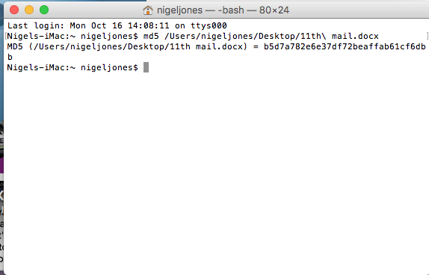
BEC case study specific considerations
b5d7a782e6e37df72beaffab61cf6db
Notes:
This is the hash of the mail11.doc file and should be pointed out to the delegates. The hash value has been highlighted for ease of viewing.

Slide 39
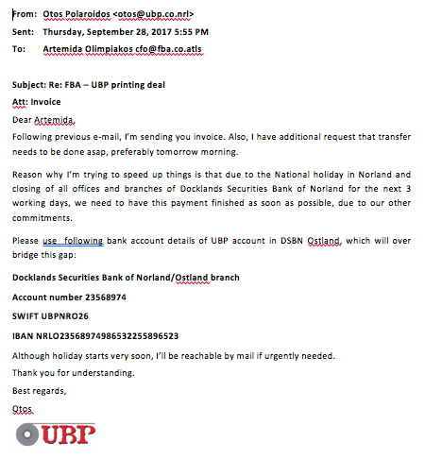
BEC case study specific considerations
Mail11 (hash).doc
Notes:
This is file mail 11.(hash). doc and a screen capture of the first page has been taken and inserted in the slide. An observer will see the difference between this and the original file, is the extra space in between the words use and following, which is helpfully highlighted in the screen capture.

Slide 40
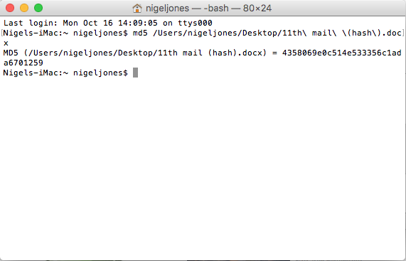
BEC case study specific considerations
4358069e0c514e533356c1ada6701259
Notes:
This is the hash of the mail11(hash).doc file and should be pointed out to the delegates. The hash value has been highlighted for ease of viewing.

Slide 41
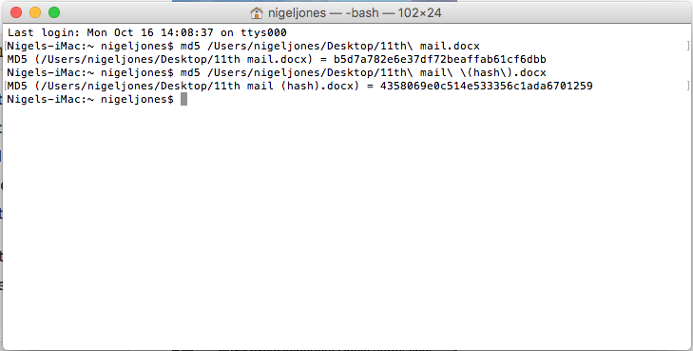
BEC case study specific considerations
b5d7a782e6e37df72beaffab61cf6dbb
4358069e0c514e533356c1ada6701259
Notes:
This shows the hashes of each file and can be seen to be different. The only change made to the file was to insert an extra space between words. It should be pointed out to the delegates that hashing is very reliable and allows easy comparison between documents. The trainer should demonstrate this where possible by making a simple change to a file and then hashing the original and the new files, to see the difference.

Slide 42
BEC case study specific considerations
If handled correctly, electronic evidence is one of the best evidence types:
  There should be evidence at both ends of an email chain.
  It can be checked against the original or the evidence image.
  Judges can ask for any file to be checked.
  Judges can ask how the evidence was collected and handled.
  Emails have additional header information that can be checked.
  IP addresses in emails can sometimes be checked.
  Third party validation of evidence is preferable.
Notes:
There are many ways in which validity of emails may be checked. In this scenario, all the email messages are in the form of word documents and therefore there are no email artefacts to review. The trainer, may if they wish, introduce actual emails to explain how email evidence may be adduced.

Slide 43
Presentation considerations

Slide 44
Advanced Cybercrime and Electronic Evidence Training Course for Prosecutors and Judges
Thank you
Xxxxx XXXXXXXX
Council of Europe
email
DD Month YYYY

