Slide 1
Advanced Cybercrime and Electronic Evidence Training Course for Prosecutors and Judges
Session 11
2.1.11 Phase 2: Trial Preparation Phase
(BEC exercise only)
Notes:
This session is 90 minutes in length

Slide 2

Session Aims
Trial preparation
Prosecution team to develop the indictment
Defense team to build up the defense and the defense arguments
The judge's team to start preparing and anticipating on the probable indictments and defense arguments.
Notes:
Session objectives. Delegates should be introduced with what is expected to be achieved by the end of the session.

Slide 3


Slide 4
Trial preparation phase
Introduction to the Investigation Exercise Case Study and Mock Trial

Slide 5
Trial Preparation Phase
Folder “Introduction”:
Case Synopsis
Case study scenario belongs to recently well-known, so called “Business E-mail Compromise” schemes, or “BEC” cases, which are derived from previously detected “CEO fraud” or “Man-in-the-middle” frauds.
The scope and size of these frauds is astonishing.
Notes:
The scenario begins with establishment of Federal Bank of Atlantis (FBA) as a well-known, long established and reputable international bank. A description like this should lead trainees to conclude that this kind of bank shouldn’t be involved in any kind of problems, let alone ones similar to that, which are going to be described later in this document.

Slide 6
Trial Preparation Phase
Folder “Company profiles”:
Company profile of Federal Bank of Atlantis
Overview, organization and officers
Company profile of United Bank Printing
Overview, organization and officers
Company profile of Doklands Securities Bank of Norland
Overview, organization and officers
Notes:
Company profile of companies involved in the Case Scenario. 3 different MS Word files in 97-2003 format are produced in the material. They should be at the disposal for delegates in hard copy, or, if circumstances allow and all delegates have single access to the computers, in electronic way.

Slide 7
Trial Preparation Phase
Folder “Documents and reports”:
FBA announcement of the Anniversary Bond
Board of Directors decision about bond issuing and financial elements of it;
FBA bond
draft design of bond including print elements;
FBA – UBP contract
contract concluded for the service of printing 20.000 elements of the FBA Anniversary bond.
Notes:
Miscellaneous supporting documents for the Case Scenario. 3 different MS Word files in 97-2003 and in Adobe Reader format are produced in the material. They should be at the disposal for delegates in hard copy, or, if circumstances allow and all delegates have single access to the computers, in electronic way.

Slide 8
Trial Preparation Phase
Folder “E-mails”:
E-mail exchange between FBA and UBP
e-mails are provided following development of the exchange between contracting and in-charge persons in FBA and UBP for the issuing of the Anniversary bond;
Folder “Documents and reports”:
FBA and UBP contract is provided for closer insight and analysis, but also as supporting evidence for the case file.
Notes:
10 e-mails are regular ones following exchange between FBA and UBP persons in charge of different business and contract deals for printing Anniversary bond.
FBA – UBP contract is following e-mail exchange and puts into the perspective outline of the commercial framework of the deal. It also sets crucial steps for further case development.

Slide 9
Trial Preparation Phase
Folder “Bank Statements”:
FBA Bank Statement
numerous transactions are listed, including advance payment of 100.000 EUR listed in this Statement;
UBP Bank Statement
Docklands Securities Bank of Norland serves United Bank Printing banking transactions;
UBP Pro-Forma Invoice
Prof-Forma Invoice has been issued by UBP to FBA for the amount of 100.000 EUR.
Notes:
Bank statements are closely following development of the case. Delegates will be able to implement “follow the money” principle by analyzing FBA and UBP bank statements.
Pro forma invoice is genuine one issued by UBP to FBA for 100K advance.

Slide 10
Trial Preparation Phase
Folder “E-mails”:
11th e-mail and following exchange as key perpetration moment;
Folder “Bank Statements”:
UBP false invoice includes fraudulent account information and request for payment of actual 200.000 EUR due to the finalization of printing of 20.000 bonds;
Notes:
11th e-mail and following ones are tools of perpetration. Content of the e-mails is written by the perpetrator and includes or necessary elements for analysis.
False invoice is made by the perpetrator and directs transfer of the money to the existing real bank account, but opened with fraudulent purpose.

Slide 11
Trial Preparation Phase
Folder “Witness Statements”:
FBA Department for Logistics and Operations Statement;
FBA Financial Department Statement;
FBA Information Technologies Department Statement.
Notes:
Statements of Federal Bank of Atlantis officials who were involved in case at different stages. Most important statements are the ones from Financial and IT Department, since they are giving the clues or explanations how actual perpetration accured.

Slide 12
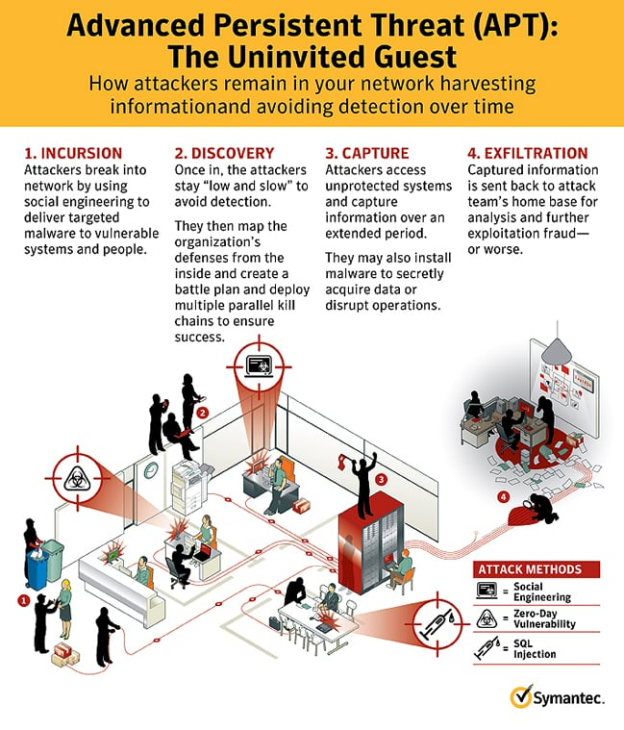
Trial Preparation Phase
Advanced Persistent Threat:
- “set of stealthy and continuous computer hacking processes, often orchestrated by a person or persons targeting a specific entity”;

Slide 13
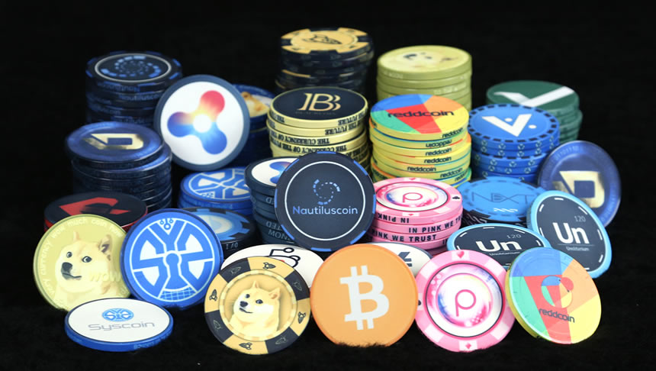
Trial Preparation Phase
Crypto-currencies:
- “digital asset designed to work as a medium of exchange using cryptography to secure the transactions and to control the creation of additional units of the currency”;

Slide 14

Trial Preparation Phase
Cyber Social Engineering:
- “type of confidence trick for the purpose of information gathering, fraud, or system access, it differs from a traditional "con" in that it is often one of many steps in a more complex fraud scheme;

Slide 15

Group division and work
Group 1 :
Prosecutors Team
based on previously undertaken proceedings Prosecution team builds an Indictment with sufficient evidence and arguments and the way how they will be presented (outlines, Power Point presentation, etc.);
Prosecution Team will notify the Defense Team about the content of the Indictment, so the defense can base/adjust its arguments on the exact indictments that will be brought in court;
Defense Team will be allowed to respond before the trial starts)

Slide 16
Group division and work
Group 2 :
Defense Team
based on previously undertaken proceedings Defense team builds a defense strategy with sufficient evidence and arguments and the way how they will be presented (outlines, Power Point presentation, etc.);
Defense Team will be allowed to respond to the Indictment before the trial starts;
Defense can adjust its arguments on the exact indictments that will be brought in court.

Slide 17
Group division and work
Group 3 :
Judges Team
The Judges team will asses the Indictment and Prosecution arguments;
Judges will start to anticipate on potential defense arguments;
Judges will do the existing electronic evidence assessment, the trial preparation and preparation for the possible hearing of witnesses.

Slide 19
Advanced Cybercrime and Electronic Evidence Training Course for Prosecutors and Judges
Thank you
Xxxxx XXXXXXXX
Council of Europe
email
DD Month YYYY

