Slide 1
Specialized Judicial Course on International Cooperation
Session 2.1
Mechanisms under the Budapest Convention

Slide 2
Agenda
Part One
General provisions
Part Two
Specific provisions
Part Three
Provisions of the draft Second Additional Protocol
Part Four
Mutual legal assistance form templates
Part Five
Summary
Notes:
This session will be divided into 5 parts.
The first part of the session will review the general provisions of the Budapest Convention in relation to international cooperation and mutual assistance.
The second part of the session will look at specific provisions in relation to international cooperation and mutual assistance.
The third part of the session will look at some of the provisions of the draft Second Additional Protocol to the Budapest Convention.
The fourth part of the session will look at some mutual legal assistance form templates.
The fifth part of the session will summarise the session objectives.

Slide 3
Session Objectives
Reviewing the general provisions of international cooperation and mutual assistance under the Budapest Convention
Reviewing the specific provisions of international cooperation and mutual assistance under the Budapest Convention
Discussing provisions of Second Additional Protocol to the Budapest Convention
Understanding how to use different mechanisms under the Budapest Convention to seek cooperation
Introduction to different templates for MLA requests
Notes:
This slide outlines the objectives of this session. It underscores what participants should expect to learn from the slides. The participants can be informed that this slide will be revisited at the end of the session to assess whether the objectives were met.

Slide 4
Specialized Judicial Course on
International Cooperation
Part One
General Provisions
Notes:
The first part will review the general provisions of the Budapest Convention which relate to international cooperation and mutual assistance.

Slide 5
Article 23 – General Principles Related to International Cooperation
The Parties shall co-operate with each other, in accordance with the provisions of this chapter, and through the application of relevant international instruments on international co-operation in criminal matters, arrangements agreed on the basis of uniform or reciprocal legislation, and domestic laws, to the widest extent possible for the purposes of investigations or proceedings concerning criminal offences related to computer systems and data, or for the collection of evidence in electronic form of a criminal offence.
Mandates international cooperation through;
  Application of relevant international instruments on cooperation in criminal matters (e.g. UNCAC, UNTOC, etc.)
  Arrangements on basis of uniform or reciprocal legislation (e.g. bilateral agreements)
  Domestic laws
Notes:
On the left side, this slide shows the text of Article 23 of the Budapest Convention with one element “relevant international instruments…. Arrangements agreed on the basis of uniform or reciprocal legislation…. domestic laws” highlighted in red.
On the right side, this slide provides an explanation of the highlighted element.
The Budapest Convention recognizes other international and bilateral instruments as well as domestic laws that relate to and enable international cooperation. It requires the use of these instruments and domestic laws for international cooperation in criminal matters.

Slide 6
Article 23 – General Principles Related to International Cooperation
The Parties shall co-operate with each other, in accordance with the provisions of this chapter, and through the application of relevant international instruments on international co-operation in criminal matters, arrangements agreed on the basis of uniform or reciprocal legislation, and domestic laws, to the widest extent possible for the purposes of investigations or proceedings concerning criminal offences related to computer systems and data, or for the collection of evidence in electronic form of a criminal offence.
Budapest Convention enables international cooperation for:
  Offences related to computer systems and data
  Collection of evidence for any criminal offence
The international cooperation shall be to the widest extent possible
Notes:
On the left side, this slide shows the text of Article 23 of the Budapest Convention with one element “widest extent possible….offences related to computer systems and data…. Collection of evidence in electronic form of a criminal offence” highlighted in red.
On the right side, this slide provides an explanation of the highlighted element.
Though the Budapest Convention is largely thought of as a cybercrime convention that enables international cooperation with respect to cybercrime, its scope is actually much broader. The highlighted elements show that the Budapest Convention enables and mandates international cooperation for both:
Offences related to computer systems and data (cybercrime)
Collection of evidence for any criminal offence (cybercrime and non-cybercrime).
This means that the Budapest Convention enables cooperation with respect to the exchange of electronic evidence, irrespective of whether the offence being investigated is a cybercrime offence.

Slide 7

Poll question
Which of the following offences would the Budapest Convention enable international cooperation in?
a) Hacking
b) Political offence
c) Computer-related forgery
d) DDoS attack
e) Possession of child pornography in USB
Notes:
The correct answers are: a) Hacking (c) Computer-related forgery (d) DDoS (e) Possession of child pornography in USB

Slide 8
Poll question
Which of the following offences would the Budapest Convention enable international cooperation in?
a) Hacking
b) Political offence
c) Computer-related forgery
d) DDoS attack
e) Possession of child pornography in USB
Notes:
The correct answers are: a) Hacking (c) Computer-related forgery (d) DDoS (e) Possession of child pornography in USB

Slide 9
Article 24 – Extradition
1a This article applies to extradition between Parties for the criminal offences established in accordance with … this Convention, provided that they are punishable under the laws of both Parties concerned by deprivation of liberty for a maximum period of at least one year, or by a more severe penalty.
b Where a different minimum penalty is to be applied under an arrangement agreed on the basis of uniform or reciprocal legislation or an extradition treaty… applicable between two or more parties, the minimum penalty provided for under such arrangement or treaty shall apply.
Article 24 relates to offences established in accordance with Budapest Convention
Prerequisite for extradition: Offence must be punishable in both countries for at least 1 year imprisonment
Parties may agree to different minimum penalty based on arrangement or extradition treaty applicable
Notes:
On the left side, this slide shows the text of one part of Article 24 of the Budapest Convention with one element “punishable…maximum period of at least one year…. more severe penalty…..different minimum penalty” highlighted in red.
On the right side, this slide provides an explanation of the highlighted element.
The Budapest Convention is not ordinarily an extradition treaty – but it requires parties to extradite suspected offenders under certain circumstances in relation to offences established in accordance with the Budapest Convention. The offence must be punishable in both countries for at least one year though parties may agree to a different penalty on the basis of legislation or an extradition treaty.

Slide 10
Article 24 – Extradition
2 The criminal offences described in paragraph 1 of this article shall be deemed to be included as extraditable offences in any extradition treaty existing between or among the Parties. The Parties undertake to include such offences as extraditable offences in any extradition treaty to be concluded between or among them.
3 If a Party that makes extradition conditional on the existence of a treaty receives a request for extradition from another Party with which it does not have an extradition treaty, it may consider this Convention as the legal basis for extradition with respect to any criminal offence referred to in paragraph 1 of this article.
Budapest Convention is not ordinarily an extradition treaty
Offences established under Budapest Convention are deemed extraditable offences under existing treaties between parties
Notes:
On the left side, this slide shows the text of one part of Article 24 of the Budapest Convention with one element “criminal offences…. deemed to be included as extraditable offences in any extradition treaty” highlighted in red.
On the right side, this slide provides an explanation of the highlighted element.
The Budapest Convention is not ordinarily an extradition treaty – and rather than prescribe a specific procedure for extradition, it provides that the offences established in accordance with the Budapest Convention will be deemed to be included as extraditable offences in any extradition treaty. This means that the existing procedures accepted by each party would apply in relation to offences established in accordance with the Budapest Convention.

Slide 11
Article 24 – Extradition
2 The criminal offences described in paragraph 1 of this article shall be deemed to be included as extraditable offences in any extradition treaty existing between or among the Parties. The Parties undertake to include such offences as extraditable offences in any extradition treaty to be concluded between or among them.
3 If a Party that makes extradition conditional on the existence of a treaty receives a request for extradition from another Party with which it does not have an extradition treaty, it may consider this Convention as the legal basis for extradition with respect to any criminal offence referred to in paragraph 1 of this article.
If extradition conditional on treaty, and if a party does not have an extradition treaty with a party, it may use the Budapest Convention as basis for extradition for offences established in accordance with the Budapest Convention
Notes:
On the left side, this slide shows the text of one part of Article 24 of the Budapest Convention with one element “does not have an extradition treaty… may consider this convention as the legal basis for extradition…. any criminal offence referred to in paragraph 1” highlighted in red.
On the right side, this slide provides an explanation of the highlighted element.
This provision enables extradition with respect to offences established in accordance with the Budapest Convention even in the absence of an extradition treaty – providing that if a party requires a legal basis to extradite, the Budapest Convention would be considered a legal basis for extradition with respect to such offences. In this limited scenario, the Budapest Convention itself would act as an extradition treaty.

Slide 12
Article 24 – Extradition
4 Parties that do not make extradition conditional on the existence of a treaty shall recognise the criminal offences referred to in paragraph 1 of this article as extraditable offences between themselves.
5 Extradition shall be subject to the conditions provided for by the law of the requested Party or by applicable extradition treaties, including the grounds on which the requested Party may refuse extradition.
If extradition not conditional upon treaty, parties must recognize the offences established in accordance with the Budapest Convention as extraditable offence
Notes:
On the left side, this slide shows the text of one part of Article 24 of the Budapest Convention with one element “do not make extradition conditional on the existence of a treaty… recognize…. extraditable offences between themselves” highlighted in red.
On the right side, this slide provides an explanation of the highlighted element.
This provision enables extradition with respect to offences established in accordance with the Budapest Convention even in the absence of an extradition treaty – providing that if a party requires a legal basis to extradite, the Budapest Convention would be considered a legal basis for extradition with respect to such offences. In this limited scenario, the Budapest Convention itself would act as an extradition treaty.

Slide 13
Article 24 – Extradition
4 Parties that do not make extradition conditional on the existence of a treaty shall recognise the criminal offences referred to in paragraph 1 of this article as extraditable offences between themselves.
5 Extradition shall be subject to the conditions provided for by the law of the requested Party or by applicable extradition treaties, including the grounds on which the requested Party may refuse extradition.
All extradition requests are subject to conditions provided in extradition treaties or law of requested party
Such treaties or law of requested party may also determine grounds for refusal
Notes:
On the left side, this slide shows the text of one part of Article 24 of the Budapest Convention with one element “subject to the conditions provided for by the law of the requested Party…. extradition treaties … refuse extradition” highlighted in red.
On the right side, this slide provides an explanation of the highlighted element.
The extradition provisions of the Budapest Convention do not override conditions that exist in extradition treaties – including the grounds on which a requested party may refuse extradition. This means that parties continue to have flexibility, on the basis of existing extradition treaties, to accept or refuse extraditions on such conditions that have been mutually accepted.

Slide 14
Article 24 – Extradition
6 If extradition for a criminal offence referred to in paragraph 1 of this article is refused solely on the basis of the nationality of the person sought, or because the requested Party deems that it has jurisdiction over the offence, the requested Party shall submit the case at the request of the requesting Party to its competent authorities for the purpose of prosecution and shall report the final outcome to the requesting Party in due course. Those authorities shall take their decision and conduct their investigations and proceedings in the same manner as for any other offence of a comparable nature under the law of that Party.
If requested party refuses extradition based on nationality of person or if it deems jurisdiction over offence, it shall prosecute the individual and notify the requesting party of outcome of prosecution
Investigation and prosecution must be in same manner as comparable offence under local law
Notes:
On the left side, this slide shows the text of one part of Article 24 of the Budapest Convention with one element “refused solley on the basis of the nationality…. requested party deems that it has jurisdiction…. requested party” highlighted in red.
On the right side, this slide provides an explanation of the highlighted element.
If requested party refuses extradition based on nationality of person or if it deems jurisdiction over offence, it shall prosecute the individual and notify the requesting party of outcome of prosecution. However, the requested party must conduct the investigation and prosecution in same manner as comparable offence under local law.

Slide 15
Article 25 – General Principles Related
to Mutual Assistance
1 The Parties shall afford one another mutual assistance to the widest extent possible for the purpose of investigations or proceedings concerning criminal offences related to computer systems and data, or for the collection of evidence in electronic form of a criminal offence.
3 Each Party may, in urgent circumstances, make requests for mutual assistance or communications related thereto by expedited means of communication, including fax or e-mail, to the extent that such means provide appropriate levels of security and authentication (including the use of encryption, where necessary), with formal confirmation to follow, where required by the requested Party. The requested Party shall accept and respond to the request by any such expedited means of communication.
Budapest Convention enables mutual assistance in relation to:
  Offences related to computer systems and data
  Collection of evidence for any criminal offence
The mutual assistance shall be to the widest extent possible
Notes:
On the left side, this slide shows the text of one part of Article 25 of the Budapest Convention with one element “widest extent possible… offences related to computer systems and data… collection of evidence in electronic form of a criminal offence.” highlighted in red.
On the right side, this slide provides an explanation of the highlighted element.
Though the Budapest Convention is largely thought of as a cybercrime convention that enables mutual assistance with respect to cybercrime, its scope is actually much broader. The highlighted elements show that the Budapest Convention enables and mandates mutual assistance in relation to both:
Offences related to computer systems and data (cybercrime)
Collection of evidence for any criminal offence (cybercrime and non-cybercrime).
This means that the Budapest Convention enables mutual assistance with respect to the exchange of electronic evidence, irrespective of whether the offence being investigated is a cybercrime offence.

Slide 16
Article 25 – General Principles Related
to Mutual Assistance
1 The Parties shall afford one another mutual assistance to the widest extent possible for the purpose of investigations or proceedings concerning criminal offences related to computer systems and data, or for the collection of evidence in electronic form of a criminal offence.
3 Each Party may, in urgent circumstances, make requests for mutual assistance or communications related thereto by expedited means of communication, including fax or e-mail, to the extent that such means provide appropriate levels of security and authentication (including the use of encryption, where necessary), with formal confirmation to follow, where required by the requested Party. The requested Party shall accept and respond to the request by any such expedited means of communication.
Traditional mutual assistance requests often sent through written, sealed documents through diplomatic pouches or mail delivery systems
Budapest Convention recognizes computer data is volatile and some requests may have to be sent urgently
Parties can use any expedited means of communication including (but not limited to) fax and email
Notes:
On the left side, this slide shows the text of one part of Article 25 of the Budapest Convention with one element “urgent circumstances… expedited means of communication… fax… e-mail... security…. authentication” highlighted in red.
On the right side, this slide provides an explanation of the highlighted element.
Computer data is highly volatile. By a few keystrokes or by operation of automatic programs, it may be deleted, rendering it impossible to trace a crime to its perpetrator or destroying critical proof of guilt. Some forms of computer data are stored for only short periods of time before being deleted. In other cases, significant harm to persons or property may take place if evidence is not gathered rapidly. In such urgent cases, not only the request, but the response as well should be made in an expedited manner. This is why the highlighted provisions of the Budapest Convention enable the use of expedited means of communication (which include but are not limited to fax or email) to make requests for mutual assistance in urgent circumstances. Such expedited means of communication would be followed by the traditional written, sealed documents through diplomatic pouches or mail delivery systems if required by the requested party.
In addition to enabling expedited means of communication, the Budapest Convention also allows parties to decide among themselves how to ensure the authenticity of the communications and whether there is a need for special security protections (including encryption) that may be necessary in a particularly sensitive case.

Slide 17
Article 25 – General Principles Related
to Mutual Assistance
4 Except as otherwise specifically provided in articles in this chapter, mutual assistance shall be subject to the conditions provided for by the law of the requested Party or by applicable mutual assistance treaties, including the grounds on which the requested Party may refuse co-operation. The requested Party shall not exercise the right to refuse mutual assistance in relation to the offences referred to in Articles 2 through 11 solely on the ground that the request concerns an offence which it considers a fiscal offence.
5 Where, in accordance with the provisions of this chapter, the requested Party is permitted to make mutual assistance conditional upon the existence of dual criminality, that condition shall be deemed fulfilled, irrespective of whether its laws place the offence within the same category of offence or denominate the offence by the same terminology as the requesting Party, if the conduct underlying the offence for which assistance is sought is a criminal offence under its laws.
Mutual assistance (including grounds for refusal) is subject to MLATs and domestic laws
However, this discretion may not be exercised where Budapest Convention obliges parties to provide cooperation (e.g. preservation, real time collection of data, search and seizure, and maintenance of a 24/7 network) solely on the ground that the requested party considers the offence a fiscal offence
Notes:
On the left side, this slide shows the text of one part of Article 25 of the Budapest Convention with one element “mutual assistance… subject to conditions… law of the requested party… requested party may refuse co-operation…. fiscal offences” highlighted in red.
On the right side, this slide provides an explanation of the highlighted element.
A common myth about the Budapest Convention is that it allows unfettered access to data of a particular country. In fact, the Budapest Convention clearly recognizes that any mutual assistance will be subject to conditions that are provided under in mutual legal assistance treaties or under the domestic laws of the requested party. This includes grounds for refusal of assistance. The Budapest Convention prohibits parties from refusing mutual assistance solely on the ground that the request concerns an offence which it considers a fiscal offence.

Slide 18
Article 25 – General Principles Related
to Mutual Assistance
4 Except as otherwise specifically provided in articles in this chapter, mutual assistance shall be subject to the conditions provided for by the law of the requested Party or by applicable mutual assistance treaties, including the grounds on which the requested Party may refuse co-operation. The requested Party shall not exercise the right to refuse mutual assistance in relation to the offences referred to in Articles 2 through 11 solely on the ground that the request concerns an offence which it considers a fiscal offence.
5 Where, in accordance with the provisions of this chapter, the requested Party is permitted to make mutual assistance conditional upon the existence of dual criminality, that condition shall be deemed fulfilled, irrespective of whether its laws place the offence within the same category of offence or denominate the offence by the same terminology as the requesting Party, if the conduct underlying the offence for which assistance is sought is a criminal offence under its laws.
Definition of dual criminality under the Budapest Convention:
  Underlying conduct must be an offence in both countries
  Whether or not offence is in same category or uses same terminology is irrelevant
Notes:
On the left side, this slide shows the text of one part of Article 25 of the Budapest Convention with one element “conditional upon the existence of dual criminality…. Irrespective of whether …. same category… same terminology…. conduct underlying the offence” highlighted in red.
On the right side, this slide provides an explanation of the highlighted element.
This slide effectively provides the definition of dual criminality. As noted in the Explanatory Report to the Budapest Convention: “Dual criminality shall be deemed present if the conduct underlying the offence for which assistance is sought is also a criminal offence under the requested Party’s laws, even if its laws place the offence within a different category of offence or use different terminology in denominating the offence. This provision was believed necessary in order to ensure that requested Parties do not adopt too rigid a test when applying dual criminality. Given differences in national legal systems, variations in terminology and categorisation of criminal conduct are bound to arise. If the conduct constitutes a criminal violation under both systems, such technical differences should not impede assistance. Rather, in matters in which the dual criminality standard is applicable, it should be applied in a flexible manner that will facilitate the granting of assistance.” (Paragraph 259).
Parties can make dual criminality as a condition for all forms of mutual assistance, except in certain cases with respect to the preservation of data under Article 29.4 of the Budapest Convention.

Slide 19
Poll question
The Budapest Convention allows a party to refuse provision of assistance if the other party uses different terminology to define an offence, even if the underlying conduct is an offence in both countries. True or false?
True
False
Notes:
The correct answer is: False.
Though the Budapest Convention allows parties to refuse cooperation in the absence of dual criminality, it measures the presence of dual criminality based on whether the conduct underlying the offence is criminalized in both countries, irrespective of the terminology used. In other words, even if parties use different terminology to define an offence, if the underlying conduct is criminalized in both countries, the absence of dual criminality cannot be claimed.

Slide 20
Poll question
The Budapest Convention allows a party to refuse provision of assistance if the other party uses different terminology to define an offence, even if the underlying conduct is an offence in both countries. True or false?
True
False
Notes:
The correct answer is: False.
Though the Budapest Convention allows parties to refuse cooperation in the absence of dual criminality, it measures the presence of dual criminality based on whether the conduct underlying the offence is criminalized in both countries, irrespective of the terminology used. In other words, even if parties use different terminology to define an offence, if the underlying conduct is criminalized in both countries, the absence of dual criminality cannot be claimed.

Slide 21
Article 26 – Spontaneous Information
1 A Party may, within the limits of its domestic law and without prior request, forward to another Party information obtained within the framework of its own investigations when it considers that the disclosure of such information might assist the receiving Party in initiating or carrying out investigations or proceedings concerning criminal offences established in accordance with this Convention or might lead to a request for co-operation by that Party under this chapter.
2 Prior to providing such information, the providing Party may request that it be kept confidential or only used subject to conditions. If the receiving Party cannot comply with such request, it shall notify the providing Party, which shall then determine whether the information should nevertheless be provided. If the receiving Party accepts the information subject to the conditions, it shall be bound by them.
Some countries require positive grant of legal authority to share information with other countries
This provision does not impose an obligation to spontaneously forward information to other parties – it is discretionary
Disclosure does not preclude disclosing party from investigating or prosecuting based on facts disclosed
Notes:
On the left side, this slide shows the text of Article 26 of the Budapest Convention with one element “without prior request, forward to another Party information…. when it considers that the disclosure of such information might assist the receiving party” highlighted in red.
On the right side, this slide provides an explanation of the highlighted element.
It is not uncommon for a country to possess valuable information that it believes may assist another country in a criminal investigation or proceeding, and which the other country conducting the investigation or proceeding is not aware exists. In such cases, no request for mutual assistance would be forthcoming. The Budapest Convention, like many other international conventions, empowers a country which is in possession of the information to forward it to the other country without a prior request. This is particularly useful where states require a positive legal basis or authority to send information to another country. This provision does not create a legal mandate for cooperation.

Slide 22
Article 26 – Spontaneous Information
1 A Party may, within the limits of its domestic law and without prior request, forward to another Party information obtained within the framework of its own investigations when it considers that the disclosure of such information might assist the receiving Party in initiating or carrying out investigations or proceedings concerning criminal offences established in accordance with this Convention or might lead to a request for co-operation by that Party under this chapter.
2 Prior to providing such information, the providing Party may request that it be kept confidential or only used subject to conditions. If the receiving Party cannot comply with such request, it shall notify the providing Party, which shall then determine whether the information should nevertheless be provided. If the receiving Party accepts the information subject to the conditions, it shall be bound by them.
The disclosing party has the right to request that the information forwarded be kept confidential or used subject to conditions. These conditions will be binding if accepted by receiving party
If the receiving party cannot comply with a condition (for instance, it cannot keep information confidential as has to be used in public trial), it must inform disclosing party – which can decide whether to provide information
Notes:
On the left side, this slide shows the text of Article 26 of the Budapest Convention with one element “confidential… used subject to conditions… receiving party accepts… bound by them” highlighted in red.
On the right side, this slide provides an explanation of the highlighted element.
Where sensitive information is involved, countries that send information may require that it is either kept confidential or used in accordance with certain specified conditions. The Budapest Convention allows parties to request that information to be shared spontaneously be kept confidential or used in accordance with such conditions. If the receiving country accepts these conditions, it will be bound by them. However, it will have an opportunity to notify the other country that it cannot comply with the conditions, in which case the providing country will have an opportunity to reassess whether it wishes to provide the information without the conditions objected to.

Slide 23
Article 27 – Procedures pertaining to mutual assistance
requests in the absence of applicable international agreements
1 Where there is no mutual assistance treaty or arrangement on the basis of uniform or reciprocal legislation in force between the requesting and requested Parties, the provisions of paragraphs 2 through 9 of this article shall apply. The provisions of this article shall not apply where such treaty, arrangement or legislation exists, unless the Parties concerned agree to apply any or all of the remainder of this article in lieu thereof.
Budapest Convention prioritises existing processes under MLAT or other arrangements
This provision only applies if there is no MLAT or other arrangement for mutual assistance between parties
This provision outlines the procedure to be adopted for mutual legal requests
Notes:
On the left side, this slide shows part of the text of Article 27 of the Budapest Convention with one element “no mutual assistance treaty or arrangement….this article shall apply” highlighted in red.
On the right side, this slide provides an explanation of the highlighted element.
Though the Budapest Convention primarily seeks to rely on existing channels for mutual assistance (such as mutual legal assistance treaties or other applicable international arrangements). Article 27 provides for a procedure pertaining to mutual assistance in cases where parties do not have MLATs or international arrangements that would allow for implementation of the Budapest Convention.

Slide 24
Article 27 – Procedures pertaining to mutual assistance
requests in the absence of applicable international agreements
2 a Each Party shall designate a central authority or authorities responsible for sending and answering requests for mutual assistance, the execution of such requests or their transmission to the authorities competent for their execution.
b The central authorities shall communicate directly with each other.
3 Mutual assistance requests under this article shall be executed in accordance with the procedures specified by the requesting Party, except where incompatible with the law of the requested Party.
Central authority to:
  Send requests
  Answer requests
  Execute requests
  Transmit requests to competent authorities within country for execution
  Communicate directly with other central authorities
Central authorities are expected to be speedier than diplomatic channels
Notes:
On the left side, this slide shows part of the text of Article 27 of the Budapest Convention with one element “central authority…. sending and answering requests… execution… transmission… communicate directly…” highlighted in red.
On the right side, this slide provides an explanation of the highlighted element.
The Budapest Convention requires the establishment of a central authority or authorities responsible for sending and answering requests for assistance. The institution of central authorities is a common feature across treaties for mutual assistance in criminal matters. More so given the nature of cooperation with respect to electronic evidence, it is helpful to have an authority that can undertake speedy and efficient communication and to ensure that both incoming and outgoing requests are diligently pursued, that advice is provided to foreign law enforcement partners on how best to satisfy legal requirements in the requested country, and that particularly urgent or sensitive requests are dealt with properly.
A country may have more than one central authority if appropriate within its legal system, though it is usually more efficient to have a single central authority.
It is important for that central authorities have the authority and the capacity to directly communicate with each other to ensure that they can work efficiently.

Slide 25
Article 27 – Procedures pertaining to mutual assistance
requests in the absence of applicable international agreements
2 a Each Party shall designate a central authority or authorities responsible for sending and answering requests for mutual assistance, the execution of such requests or their transmission to the authorities competent for their execution.
b The central authorities shall communicate directly with each other.
3 Mutual assistance requests under this article shall be executed in accordance with the procedures specified by the requesting Party, except where incompatible with the law of the requested Party.
Imperative that the requesting state receives evidence in a manner that meets its local evidentiary requirements
Requesting party can specify procedural requirements in their requests – these requests must be honoured unless incompatible with legal principles of requested party
The fundamental procedural protections of requested party will continue to apply
Notes:
On the left side, this slide shows part of the text of Article 27 of the Budapest Convention with one element “procedures specified by the requesting Party, except where incompatible with … requested Party.” highlighted in red.
On the right side, this slide provides an explanation of the highlighted element.
Since the primary purpose of seeking mutual assistance under the Budapest Convention is to obtain electronic evidence for the use in criminal trial, it is important that the evidence is collected in accordance with procedures specified by the requesting country – so that it can be used by the requesting country in a criminal trial. However, the procedure specified by the requesting country may not be implemented by the requested country if it is incompatible with its domestic laws.

Slide 26
Article 27 – Procedures pertaining to mutual assistance
requests in the absence of applicable international agreements
4 The requested Party may, in addition to the grounds for refusal established in Article 25, paragraph 4, refuse assistance if:
  a the request concerns an offence which the requested Party considers a political offence or an offence connected with a political offence, or
  b it considers that execution of the request is likely to prejudice its sovereignty, security, ordre public or other essential interests.
This provides grounds for refusal other than grounds provided for in the law of the requested party
Grounds for refusal established should be narrow and exercised with restraint
For instance, a broad, categorical, or systematic application of data protection principles to refuse cooperation is precluded
Parties should seek to impose conditions rather than refuse cooperation
Notes:
On the left side, this slide shows part of the text of Article 27 of the Budapest Convention with one element “refuse assistance… political offence…. sovereignty, security, ordre public… essential interests.” highlighted in red.
On the right side, this slide provides an explanation of the highlighted element.
The Budapest convention allows for the refusal of request other than those established in accordance with its domestic laws or in MLATs on the following grounds:
The offence is a political offence
The execution of the request is likely to prejudice its:
Sovereignty
Security
Ordre public
Other essential interests
It is expected that countries will interpret these grounds narrowly and exercise them with restraint.

Slide 27
Article 27 – Procedures pertaining to mutual assistance
requests in the absence of applicable international agreements
5 The requested Party may postpone action on a request if such action would prejudice criminal investigations or proceedings conducted by its authorities.
6 Before refusing or postponing assistance, the requested Party shall, where appropriate after having consulted with the requesting Party, consider whether the request may be granted partially or subject to such conditions as it deems necessary.
There may be cases where immediate provision of assistance may prejudice local investigations or proceedings
E.g. Country A requests Country B for witness testimony for a trial in country A. The same testimony is needed for use at trial about to commence in Country B. Country B may postpone provision of assistance
Notes:
On the left side, this slide shows part of the text of Article 27 of the Budapest Convention with one element “refuse assistance… political offence…. sovereignty, security, ordre public… essential interests.” highlighted in red.
On the right side, this slide provides an explanation of the highlighted element.
The Budapest Convention allows a requested Party to postpone, rather than refuse, assistance where immediate action on the request would be prejudicial to investigations or proceedings in the requested Party. For example, where the requesting Party has sought to obtain evidence or witness testimony for purposes of investigation or trial, and the same evidence or witness are needed for use at a trial that is about to commence in the requested Party, the requested Party would be justified in postponing the providing of assistance.

Slide 28
Article 27 – Procedures pertaining to mutual assistance
requests in the absence of applicable international agreements
5 The requested Party may postpone action on a request if such action would prejudice criminal investigations or proceedings conducted by its authorities.
6 Before refusing or postponing assistance, the requested Party shall, where appropriate after having consulted with the requesting Party, consider whether the request may be granted partially or subject to such conditions as it deems necessary.
Where assistance would otherwise be refused or postponed, requested party can offer assistance subject to conditions
Requested party can impose any conditions but must exercise restraint
Notes:
On the left side, this slide shows part of the text of Article 27 of the Budapest Convention with one element “granted partially or subject to such conditions” highlighted in red.
On the right side, this slide provides an explanation of the highlighted element.
The Budapest Convention allows the requested party to explore whether a particular request can be granted partially or subject to any conditions, prior to refusing or postponing assistance. This can be done through consultations with the requesting party.

Slide 29
Article 27 – Procedures pertaining to mutual assistance
requests in the absence of applicable international agreements
7 The requested Party shall promptly inform the requesting Party of the outcome of the execution of a request for assistance. Reasons shall be given for any refusal or postponement of the request. The requested Party shall also inform the requesting Party of any reasons that render impossible the execution of the request or are likely to delay it significantly.
8 The requesting Party may request that the requested Party keep confidential the fact of any request made … as well as its subject, except to the extent necessary for its execution. If the requested Party cannot comply with the request for confidentiality, it shall promptly inform the requesting Party, which shall then determine whether the request should nevertheless be executed.
The requested party must keep the requesting party informed of the outcome of a request & give reasons for refusal
The requested party should share any previously unknown factual information about the availability or condition of witnesses or evidence
The requested party can also provide consultation in order to improve the future efficiency of mutual assistance
Notes:
On the left side, this slide shows part of the text of Article 27 of the Budapest Convention with one element “promptly inform… outcome of the execution …. Reasons … reasons that render impossible the execution ” highlighted in red.
On the right side, this slide provides an explanation of the highlighted element.
The requesting Party must be kept informed of the outcome of the request, and requires reasons to be given in the case of refusal or postponement of assistance. The providing of reasons can, inter alia, assist the requesting Party to understand how the requested Party interprets the requirements of this article, provide a basis for consultation in order to improve the future efficiency of mutual assistance, and provide to the requesting Party previously unknown factual information about the availability or condition of witnesses or evidence.

Slide 30
Article 27 – Procedures pertaining to mutual assistance
requests in the absence of applicable international agreements
7 The requested Party shall promptly inform the requesting Party of the outcome of the execution of a request for assistance. Reasons shall be given for any refusal or postponement of the request. The requested Party shall also inform the requesting Party of any reasons that render impossible the execution of the request or are likely to delay it significantly.
8 The requesting Party may request that the requested Party keep confidential the fact of any request made … as well as its subject, except to the extent necessary for its execution. If the requested Party cannot comply with the request for confidentiality, it shall promptly inform the requesting Party, which shall then determine whether the request should nevertheless be executed.
Some sensitive cases may be prejudiced if fact and subject of request is made public prematurely
Requesting party can ask that fact and subject of request is kept confidential
Confidentiality cannot restrict necessary disclosures to execute request such as:
  to private persons who possess evidence
  to court to obtain court order
Notes:
On the left side, this slide shows part of the text of Article 27 of the Budapest Convention with one element “keep confidential… fact of any request…. except to the extent necessary for its execution” highlighted in red.
On the right side, this slide provides an explanation of the highlighted element.
The requesting Party has the right under the Budapest Convention to request that the fact of the request being made be kept confidential. This is particularly important for sensitive cases where the public disclosure of the request may prejudice an investigation. This would not restrict disclosure necessary to execute the request such as in conditions as indicated on the slide.

Slide 31
Article 27 – Procedures pertaining to mutual assistance
requests in the absence of applicable international agreements
9 a In the event of urgency, requests for mutual assistance or communications related thereto may be sent directly by judicial authorities of the requesting Party to such authorities of the requested Party. In any such cases, a copy shall be sent at the same time to the central authority of the requested Party through the central authority of the requesting Party.
b Any request or communication … may be made through … (Interpol).
c Where a request is made pursuant to sub-paragraph a. of this article and the authority is not competent to deal with the request, it shall refer the request to the competent national authority and inform directly the requesting Party that it has done so.
d Requests or communications made under this paragraph that do not involve coercive action may be directly transmitted by the competent authorities of the requesting Party to the competent authorities of the requested Party.
e Each Party may, at the time of signature or when depositing its instrument of ratification, acceptance, approval or accession, inform the Secretary General of the Council of Europe that, for reasons of efficiency, requests made under this paragraph are to be addressed to its central authority.
Article 27 enables:
  judicial authorities of one country to send requests to another (with copy to central authority) where there is urgency
  sending requests through Interpol
  competent authority of one country to send request directly to competent authority of another country where there is no coercive action involved
Notes:
On the left side, this slide shows part of the text of Article 27 of the Budapest Convention with one element “urgency… directly by judicial authorities… copy… to the central authority… request or communication… through … (Interpol)… do not involve coercive action… directly transmitted… to the competent authorities…” highlighted in red.
On the right side, this slide provides an explanation of the highlighted element.
While the Budapest Convention mandates the formation of central authorities to communicate directly with one another with respect to mutual assistance requests, in case of urgency, requests for mutual legal assistance may be sent directly by judges and prosecutors of the requesting Party to the judges and prosecutors of the requested Party. The judge or prosecutor following this procedure must also address a copy of the request made to his own central authority with a view to its transmission to the central authority of the requested Party. The Budapest Convention also enables making requests or other communications through Interpol Requests may also be transmitted directly without the intervention of central authorities even if there is no urgency, as long as the authority of the requested Party is able to comply with the request without making use of coercive action.

Slide 32
Article 28 – Confidentiality and Limitation on Use
1 When there is no mutual assistance treaty or arrangement on the basis of uniform or reciprocal legislation in force between the requesting and the requested Parties, the provisions of this article shall apply. The provisions of this article shall not apply where such treaty, arrangement or legislation exists, unless the Parties concerned agree to apply any or all of the remainder of this article in lieu thereof.
2 The requested Party may make the supply of information or material in response to a request dependent on the condition that it is:
  a kept confidential where the request for mutual legal assistance could not be complied with in the absence of such condition, or
  b not used for investigations or proceedings other than those stated in the request.
Budapest Convention prioritises existing processes under MLAT or other arrangements
This provision only applies if there is no MLAT or other arrangement for mutual assistance between parties
This provision outlines the ability of parties to impose conditions of confidentiality and limitation on use of data obtained through MLA
Notes:
On the left side, this slide shows part of the text of Article 28 of the Budapest Convention with one element “no mutual assistance treaty or arrangement” highlighted in red.
On the right side, this slide provides an explanation of the highlighted element.
Like Article 27, Article 28 only applies when there is no other mutual assistance treaty or arrangement that would allow for the mutual assistance envisaged by the Budapest Convention. If there is such another treaty or arrangement, the confidentiality and limitation of use provisions of such treaty or arrangement would apply unless otherwise agreed to by the parties. This is to allow parties to use already-established and well-understood regime rather than resulting in two competing and possibly contradictory instruments.

Slide 33
Article 28 – Confidentiality and Limitation on Use
1 When there is no mutual assistance treaty or arrangement on the basis of uniform or reciprocal legislation in force between the requesting and the requested Parties, the provisions of this article shall apply. The provisions of this article shall not apply where such treaty, arrangement or legislation exists, unless the Parties concerned agree to apply any or all of the remainder of this article in lieu thereof.
2 The requested Party may make the supply of information or material in response to a request dependent on the condition that it is:
  a kept confidential where the request for mutual legal assistance could not be complied with in the absence of such condition, or
  b not used for investigations or proceedings other than those stated in the request.
The first condition is confidentiality
This confidentiality can only be imposed where the request could not be complied with in the absence of confidentiality (e.g. where name of confidential informant involved)
Not appropriate to require absolute confidentiality since requesting party cannot use evidence in trial (requires public disclsoure)
Notes:
On the left side, this slide shows part of the text of Article 28 of the Budapest Convention with one element “condition…. confidential…. could not be complied with in the absence of such condition” highlighted in red.
On the right side, this slide provides an explanation of the highlighted element.
The requested Party, when responding to a request for mutual assistance, may impose two types of conditions. The first condition, highlighted in this slide, allows the requested party to request that the information or material furnished be kept confidential where the request could not be complied with in the absence of such condition, such as where the identity of a confidential informant is involved. It is not appropriate to require absolute confidentiality in cases in which the requested Party is obligated to provide the requested assistance, as this would, in many cases, thwart the ability of the requesting Party to successfully investigate or prosecute crime, e.g. by using the evidence in a public trial (including compulsory disclosure).

Slide 34
Article 28 – Confidentiality and Limitation on Use
1 When there is no mutual assistance treaty or arrangement on the basis of uniform or reciprocal legislation in force between the requesting and the requested Parties, the provisions of this article shall apply. The provisions of this article shall not apply where such treaty, arrangement or legislation exists, unless the Parties concerned agree to apply any or all of the remainder of this article in lieu thereof.
2 The requested Party may make the supply of information or material in response to a request dependent on the condition that it is:
  a kept confidential where the request for mutual legal assistance could not be complied with in the absence of such condition, or
  b not used for investigations or proceedings other than those stated in the request.
The second condition is limitation on use
This condition must be expressly invoked by requested party
Notes:
On the left side, this slide shows part of the text of Article 28 of the Budapest Convention with one element “condition…. not used for…. other than those stated in the request” highlighted in red.
On the right side, this slide provides an explanation of the highlighted element.
The requested Party, when responding to a request for mutual assistance, may impose two types of conditions. The second condition, highlighted in this slide, allows the requested party to request that the information or material furnished not be used for investigations or proceedings other than those stated in the request. In order for this condition to apply, it must be expressly invoked by the requested Party, otherwise, there is no such limitation on use by the requesting Party. In cases in which it is invoked, this condition will ensure that the information and material may only be used for the purposes foreseen in the request, thereby ruling out use of the material for other purposes without the consent of the requested Party.

Slide 35
Article 28 – Confidentiality and Limitation on Use
3 If the requesting Party cannot comply with a condition referred to in paragraph 2, it shall promptly inform the other Party, which shall then determine whether the information should nevertheless be provided. When the requesting Party accepts the condition, it shall be bound by it.
4 Any Party that supplies information or material subject to a condition referred to in paragraph 2 may require the other Party to explain, in relation to that condition, the use made of such information or material.
If requesting party cannot comply with condition imposed, it must inform the requested party
The requested party can determine whether to provide or refuse cooperation
if requesting party accepts a condition, it must honour it
Notes:
On the left side, this slide shows part of the text of Article 28 of the Budapest Convention with one element “cannot comply with a condition … promptly inform… accepts the condition …. bound by it” highlighted in red.
On the right side, this slide provides an explanation of the highlighted element.
If the Party to which the information is forwarded cannot comply with the condition imposed, it is required to notify the providing Party, which then has the option of not providing the information. If the receiving Party agrees to the condition, however, it must honour it.

Slide 36
Article 28 – Confidentiality and Limitation on Use
3 If the requesting Party cannot comply with a condition referred to in paragraph 2, it shall promptly inform the other Party, which shall then determine whether the information should nevertheless be provided. When the requesting Party accepts the condition, it shall be bound by it.
4 Any Party that supplies information or material subject to a condition referred to in paragraph 2 may require the other Party to explain, in relation to that condition, the use made of such information or material.
The requesting party may be asked to explain the use made of information obtained conditionally so that the requested party can ascertain the conditions were complied with
The explanation sought should not call for overly burdensome accounting
Notes:
On the left side, this slide shows part of the text of Article 28 of the Budapest Convention with one element “may require… explain… the use made” highlighted in red.
On the right side, this slide provides an explanation of the highlighted element.
The requesting Party may be required to explain the use made of the information or material it has received under conditions in order that the requested Party may ascertain whether such condition has been complied with. It was agreed that the requested Party may not call for an overly burdensome accounting e.g., of each time the material or information furnished was accessed.

Slide 37
Poll question
The Budapest Convention overrides the procedural and confidentiality provisions of existing arrangements related to mutual assistance in criminal matters between countries?
True
False
Notes:
The correct answer is: False.
The Budapest Convention respects procedural and confidentiality provisions in existing arrangements. Article 27 of the Budapest Convention provides procedure that will only be applicable in the absence of existing arrangements, while Article 28 of the Budapest Convention provides confidentiality requirements that will only be applicable in the absence of existing arrangements.

Slide 38
Poll question
The Budapest Convention overrides the procedural and confidentiality provisions of existing arrangements related to mutual assistance in criminal matters between countries?
True
False
Notes:
The correct answer is: False.
The Budapest Convention respects procedural and confidentiality provisions in existing arrangements. Article 27 of the Budapest Convention provides procedure that will only be applicable in the absence of existing arrangements, while Article 28 of the Budapest Convention provides confidentiality requirements that will only be applicable in the absence of existing arrangements.

Slide 39

Specialized Judicial Course on
International Cooperation
Questions

Slide 40
Specialized Judicial Course on
International Cooperation
Part Two
Special Provisions
Notes:
The second part will review the special provisions of the Budapest Convention which relate to international cooperation and mutual assistance.

Slide 41

Article 29 – Expedited Preservation
Expedited preservation of data stored in a computer system
Parallel framework to the internal provision allows one Party to require from other Party the expedited preservation of data if at the same time expresses its intention of sending a formal request of assistance for a search, or a seizure, or any similar measure
The requested party must act with due diligence, to preserve requested data, according to its own national law
Dual criminality cannot be required by the requested party, as condition for preservation of data (except offenses other than Art 2-11 or political, sovereignty, security, public order, or other essential interests)
Notes:
This slide summarizes some key features of Article 29 of the Budapest Convention – which relates to the Expedited Preservation of Stored Computer Data in another jurisdiction. It is the international equivalent of the domestic power under Article 16 of the Budapest Convention.

Slide 42
Article 29 – Expedited Preservation
1 A Party may request another Party to order or otherwise obtain the expeditious preservation of data stored by means of a computer system, located within the territory of that other Party and in respect of which the requesting Party intends to submit a request for mutual assistance for the search or similar access, seizure or similar securing, or disclosure of the data.
2 A request for preservation made under paragraph 1 shall specify:
a the authority seeking the preservation;
b the offence that is the subject of a criminal investigation or proceedings and a brief summary of the related facts;
c the stored computer data to be preserved and its relationship to the offence;
d any available information identifying the custodian of the stored computer data or the location of the computer system;
e the necessity of the preservation; and
f that the Party intends to submit a request for mutual assistance for the search or similar access, seizure or similar securing, or disclosure of the stored computer data.
Preservation is limited, provisional measure to secure data from modification / deletion while party submits request for search/ similar access, seizure/ similar securing or disclosure of data
Preservation intended to take place faster than the execution of other requests for mutual assistance
Notes:
On the left side, this slide shows part of the text of Article 29 of the Budapest Convention with one element “in respect of hwihc the requesting party intends to submit a request for mutual assistance” highlighted in red.
On the right side, this slide provides an explanation of the highlighted element.
The power to seek preservation is a provisional measure that is intended to enable the expeditious preservation of volatile electronic evidence while the requesting party makes a request for disclosure of the data through slower mutual assistance channels. Thus the Budapest Convention requires the intention of the requesting party to submit a request for mutual assistance for the disclosure of data (pursuant to Article 31) in order to request preservation in relation to that data.

Slide 43
Article 29 – Expedited Preservation
1 A Party may request another Party to order or otherwise obtain the expeditious preservation of data stored by means of a computer system, located within the territory of that other Party and in respect of which the requesting Party intends to submit a request for mutual assistance for the search or similar access, seizure or similar securing, or disclosure of the data.
2 A request for preservation made under paragraph 1 shall specify:
a the authority seeking the preservation;
b the offence that is the subject of a criminal investigation or proceedings and a brief summary of the related facts;
c the stored computer data to be preserved and its relationship to the offence;
d any available information identifying the custodian of the stored computer data or the location of the computer system;
e the necessity of the preservation; and
f that the Party intends to submit a request for mutual assistance for the search or similar access, seizure or similar securing, or disclosure of the stored computer data.
Contents of request for preservation
Information to be a summary and minimum information required to enable preservation of data
Request must specify:
  Authority seeking preservation
  Offence
  Summary of facts
  Information sufficient to identify data and its location
  Relevance of data
  Necessity for preservation
  Undertaking to submit MLA request
Notes:
On the left side, this slide shows part of the text of Article 29 of the Budapest Convention with one element “specify… authority… offence… facts… stored computer data… available information identifying the custodian… location… necessity… intends to submit a request for mutual assistance” highlighted in red.
On the right side, this slide provides an explanation of the highlighted element.
This slide outlines the contents of a request for preservation. This covers minimum information required to be submitted. This has been listed on the slide.

Slide 44
Article 29 – Expedited Preservation
3 Upon receiving the request from another Party, the requested Party shall take all appropriate measures to preserve expeditiously the specified data in accordance with its domestic law. For the purposes of responding to a request, dual criminality shall not be required as a condition to providing such preservation.
4 A Party that requires dual criminality as a condition for responding to a request for mutual assistance for the search or similar access, seizure or similar securing, or disclosure of stored data may, in respect of offences other than those established in accordance with Articles 2 through 11 of this Convention, reserve the right to refuse the request for preservation under this article in cases where it has reasons to believe that at the time of disclosure the condition of dual criminality cannot be fulfilled.
5 In addition, a request for preservation may only be refused if:
a the request concerns an offence which the requested Party considers a political offence or an offence connected with a political offence, or
b the requested Party considers that execution of the request is likely to prejudice its sovereignty, security, ordre public or other essential interests.
Dual criminality not required as condition to provide preservation
Increasing global trend to require dual criminality only for intrusive powers - preservation not intrusive as it does not involve disclosure of data
It takes too long to conclusively establish existence of dual criminality by which time volatile data may be modified or deleted
Notes:
On the left side, this slide shows part of the text of Article 29 of the Budapest Convention with one element “all appropriate measures to preserve expeditiously the specified data in accordance with its domestic law. For the purposes of responding to a request, dual criminality shall not be required ” highlighted in red.
On the right side, this slide provides an explanation of the highlighted element.
This slide lays out the general rule of the Budapest Convention that unlike other provisions of mutual assistance in the Budapest Convention, dual criminality should not be required as a precondition to providing preservation. This is because the power of preservation does not involve the disclosure of data and thus is not an intrusive power. It often takes time to determine conclusively whether dual criminality exists – which poses a risk that the evidence being sought to be preserved will be deleted prior to preservation.

Slide 45
Article 29 – Expedited Preservation
3 Upon receiving the request from another Party, the requested Party shall take all appropriate measures to preserve expeditiously the specified data in accordance with its domestic law. For the purposes of responding to a request, dual criminality shall not be required as a condition to providing such preservation.
4 A Party that requires dual criminality as a condition for responding to a request for mutual assistance for the search or similar access, seizure or similar securing, or disclosure of stored data may, in respect of offences other than those established in accordance with Articles 2 through 11 of this Convention, reserve the right to refuse the request for preservation under this article in cases where it has reasons to believe that at the time of disclosure the condition of dual criminality cannot be fulfilled.
5 In addition, a request for preservation may only be refused if:
a the request concerns an offence which the requested Party considers a political offence or an offence connected with a political offence, or
b the requested Party considers that execution of the request is likely to prejudice its sovereignty, security, ordre public or other essential interests.
Limited exception that allows refusing request for preservation due to absence of dual criminality
This can only be done:
  in relation to offences other than Budapest Convention offences
  if requested party requires dual criminality as condition for MLA request for disclosure
  if requested party has reason to believe that dual criminality will not be satisfied at time of disclosure
Notes:
On the left side, this slide shows part of the text of Article 29 of the Budapest Convention with one element “all appropriate measures to preserve expeditiously the specified data in accordance with its domestic law. For the purposes of responding to a request, dual criminality shall not be required ” highlighted in red.
On the right side, this slide provides an explanation of the highlighted element.
Though dual criminality should not be required as a precondition to providing preservation, a party may refuse request for preservation in cases where (i) it requires dual criminality as a condition for mutual assistance with respect to search or similar access, seizure or similar securing, or disclosure of data, and (ii) if it has reasons to believe that the condition of dual criminality cannot be fulfilled at the time of disclosure. This is a limited exception to the general rule that expedited preservation should not be denied for the absence of dual criminality.

Slide 46
Article 29 – Expedited Preservation
3 Upon receiving the request from another Party, the requested Party shall take all appropriate measures to preserve expeditiously the specified data in accordance with its domestic law. For the purposes of responding to a request, dual criminality shall not be required as a condition to providing such preservation.
4 A Party that requires dual criminality as a condition for responding to a request for mutual assistance for the search or similar access, seizure or similar securing, or disclosure of stored data may, in respect of offences other than those established in accordance with Articles 2 through 11 of this Convention, reserve the right to refuse the request for preservation under this article in cases where it has reasons to believe that at the time of disclosure the condition of dual criminality cannot be fulfilled.
5 In addition, a request for preservation may only be refused if:
a the request concerns an offence which the requested Party considers a political offence or an offence connected with a political offence, or
b the requested Party considers that execution of the request is likely to prejudice its sovereignty, security, ordre public or other essential interests.
Limited grounds of refusal of preservation request
Party may only refuse if:
  it believes the execution will prejudice its sovereignty, security, ordre public or other essential interests
  offence considered political offence or offence connected with political offence
Since preservation is central to investigation and prosecution of crimes involving electronic evidence, no other grounds for refusal available
Notes:
On the left side, this slide shows part of the text of Article 29 of the Budapest Convention with one element “refused… political offence… prejudice its sovereignty, security, ordre public or other essential interests” highlighted in red.
On the right side, this slide provides an explanation of the highlighted element.
This slide lists the limited grounds on the basis of which expedited preservation can be refused.

Slide 47
Article 29 – Expedited Preservation
6 Where the requested Party believes that preservation will not ensure the future availability of the data or will threaten the confidentiality of or otherwise prejudice the requesting Party’s investigation, it shall promptly so inform the requesting Party, which shall then determine whether the request should nevertheless be executed.
7 Any preservation effected in response to the request referred to in paragraph 1 shall be for a period not less than sixty days, in order to enable the requesting Party to submit a request for the search or similar access, seizure or similar securing, or disclosure of the data. Following the receipt of such a request, the data shall continue to be preserved pending a decision on that request.
If requested party feels custodian of data may take action that would affect confidentiality of or otherwise prejudice requesting party’s investigation, it must inform requesting party who can then decide whether the request should be executed
For instance – data sought to be preserved held by service provider controlled by criminal group
Notes:
On the left side, this slide shows part of the text of Article 29 of the Budapest Convention with one element “not ensure the future availability of the data or will threaten the confidentiality of or otherwise prejudice the requesting Party’s investigation, it shall promptly so inform” highlighted in red.
On the right side, this slide provides an explanation of the highlighted element.
If the requested Party realises that the custodian of the data is likely to take action that will threaten the confidentiality of, or otherwise prejudice, the requesting Party’s investigation (for example, where the data to be preserved is held by a service provider controlled by a criminal group, or by the target of the investigation himself). In such situations, the requesting Party must be notified promptly, so that it may assess whether to take the risk posed by carrying through with the request for preservation, or to seek a more intrusive but safer form of mutual assistance, such as production or search and seizure.

Slide 48
Article 29 – Expedited Preservation
6 Where the requested Party believes that preservation will not ensure the future availability of the data or will threaten the confidentiality of or otherwise prejudice the requesting Party’s investigation, it shall promptly so inform the requesting Party, which shall then determine whether the request should nevertheless be executed.
7 Any preservation effected in response to the request referred to in paragraph 1 shall be for a period not less than sixty days, in order to enable the requesting Party to submit a request for the search or similar access, seizure or similar securing, or disclosure of the data. Following the receipt of such a request, the data shall continue to be preserved pending a decision on that request.
Purpose of expedited preservation is to give time to requesting party to make request for seizure / disclosure
Minimum period for preservation: 60 days
Once request for seizure / disclosure is made, data shall continue to be preserved until decision on that request is made
Notes:
On the left side, this slide shows part of the text of Article 29 of the Budapest Convention with one element “a period not less than sixty days… data shall continue to be preserved pending a decision on that request.” highlighted in red.
On the right side, this slide provides an explanation of the highlighted element.
The purpose of the power of expedited preservation is to give the requesting party sufficient time to make a request for disclosure of data. The minimum period of preservation has therefore been set as 60 days, which would provide sufficient time for a request for search or similar access, seizure or similarly securing or disclosure of the data to be made. Once such a request is made, the data must be preserved until a decision on the request is finally reached. This will ensure that the data has been adequately preserved and will be available for disclosure if the requested party accepts the request.

Slide 49
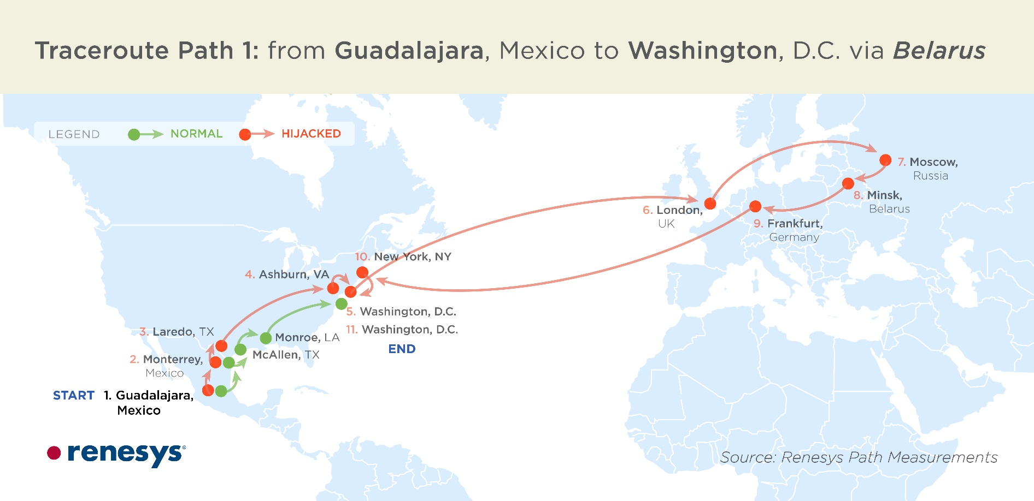
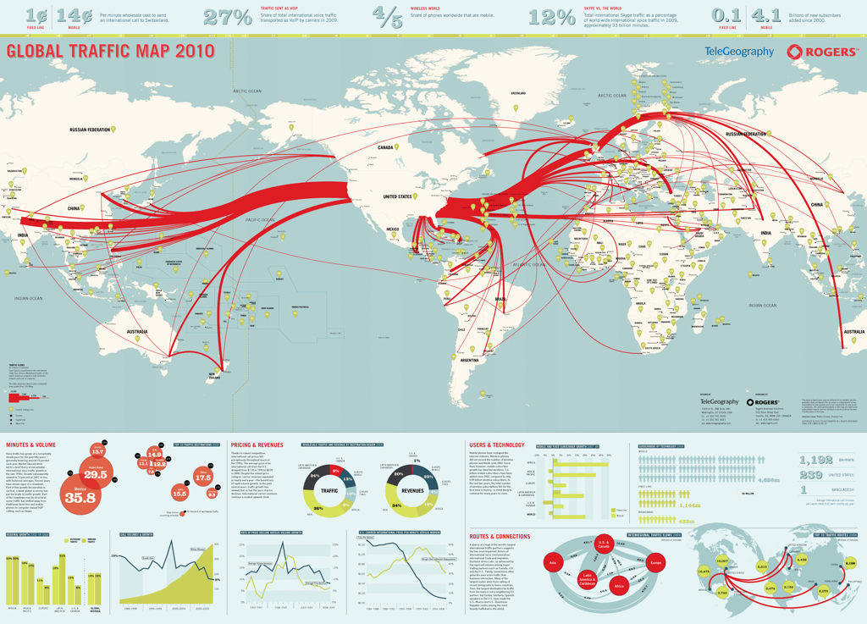
Article 30 – Disclosure of Traffic Data
Disclosure of sufficient amount of traffic data be provided to identify service provider and path of a communication
Disclosure may be withheld if:
  Request in relation to political offence
  Execution of request will prejudice sovereignty, security, ordre public or other essential interests
Notes:
This slide summarizes some key features of Article 30 of the Budapest Convention – which relates to the disclosure of traffic data in another jurisdiction. It is the international equivalent of the domestic power under Article 17 of the Budapest Convention.

Slide 50
Article 30 – Disclosure of Traffic Data
1 Where, in the course of the execution of a request made pursuant to Article 29 to preserve traffic data concerning a specific communication, the requested Party discovers that a service provider in another State was involved in the transmission of the communication, the requested Party shall expeditiously disclose to the requesting Party a sufficient amount of traffic data to identify that service provider and the path through which the communication was transmitted.
2 Disclosure of traffic data under paragraph 1 may only be withheld if:
a the request concerns an offence which the requested Party considers a political offence or an offence connected with a political offence; or
b the requested Party considers that execution of the request is likely to prejudice its sovereignty, security, ordre public or other essential interests.
Disclosure of traffic data does not require mutual assistance request
Party executing request under A.29 must expeditiously disclose (without a request) traffic data if it discovers that service provider in another country was involved in transmission of communication
This enables the party that requested preservation under A.29 to expeditiously seek preservation of data held by service providers in other jurisdictions
Notes:
On the left side, this slide shows the text of Article 30 of the Budapest Convention with one element “…course of the execution of a request made pursuant to Article 29… requested Party discovers… service provider in another State was involved… requested Party shall expeditiously disclose” highlighted in red.
On the right side, this slide provides an explanation of the highlighted element.
Unlike most other mutual assistance provisions of the Budapest Convention, Article 30 does not require a party to make a request to another party. Rather, it imposes an obligation on a party executing a request for preservation pursuant to Article 29 to automatically and without a request expeditiously disclose traffic data to another party if it discovers that a service provider in another jurisdiction was involved in the transmission of the communication. This enables the party that requested preservation to expeditiously seek preservation of data held by such service providers in other jurisdictions. This is an important power that helps ensure that the complete trail of evidence related to a communication of interest can be identified and preserved.

Slide 51
Article 30 – Disclosure of Traffic Data
1 Where, in the course of the execution of a request made pursuant to Article 29 to preserve traffic data concerning a specific communication, the requested Party discovers that a service provider in another State was involved in the transmission of the communication, the requested Party shall expeditiously disclose to the requesting Party a sufficient amount of traffic data to identify that service provider and the path through which the communication was transmitted.
2 Disclosure of traffic data under paragraph 1 may only be withheld if:
a the request concerns an offence which the requested Party considers a political offence or an offence connected with a political offence; or
b the requested Party considers that execution of the request is likely to prejudice its sovereignty, security, ordre public or other essential interests.
Disclosure of traffic data must be sufficient to enable identification of:
  Service provider in other jurisdiction involved in transmission of communication
  Path through which communication was transmitted
Notes:
On the left side, this slide shows the text of Article 30 of the Budapest Convention with one element “sufficient… traffic data… identify… service provider… path” highlighted in red.
On the right side, this slide provides an explanation of the highlighted element.
The party which discovers the involvement of a service provider in another jurisdiction in the transmission of a communication is required to disclose sufficient traffic data that would enable identification of:
Service provider in other jurisdiction involved in transmission of communication
Path through which communication was transmitted

Slide 52
Article 30 – Disclosure of Traffic Data
1 Where, in the course of the execution of a request made pursuant to Article 29 to preserve traffic data concerning a specific communication, the requested Party discovers that a service provider in another State was involved in the transmission of the communication, the requested Party shall expeditiously disclose to the requesting Party a sufficient amount of traffic data to identify that service provider and the path through which the communication was transmitted.
2 Disclosure of traffic data under paragraph 1 may only be withheld if:
a the request concerns an offence which the requested Party considers a political offence or an offence connected with a political offence; or
b the requested Party considers that execution of the request is likely to prejudice its sovereignty, security, ordre public or other essential interests.
Party may only withhold traffic data if:
  it believes the execution will prejudice its sovereignty, security, ordre public or other essential interests
  offence considered political offence or offence connected with political offence
Notes:
On the left side, this slide shows the text of Article 30 of the Budapest Convention with one element “withheld if: … political offence … sovereignty, security, ordre public … essential interests.” highlighted in red.
On the right side, this slide provides an explanation of the highlighted element.
This slide lists the limited circumstances in which a party can withhold data that it is bound to disclose under Article 30.

Slide 53
Poll question
Parties are not required to make a mutual assistance request for disclosure of traffic data collected by another party pursuant to a data preservation request. The other party must disclose relevant traffic data without a request.
True
False
Notes:
The correct answer is: True.
Article 30 requires parties to disclose traffic data collected by another party pursuant to a data preservation request that identifies service providers outside its jurisdiction automatically without a request from the other party.

Slide 54
Poll question
Parties are not required to make a mutual assistance request for disclosure of traffic data collected by another party pursuant to a data preservation request. The other party must disclose relevant traffic data without a request.
True
False
Notes:
The correct answer is: True.
Article 30 requires parties to disclose traffic data collected by another party pursuant to a data preservation request that identifies service providers outside its jurisdiction automatically without a request from the other party.

Slide 55
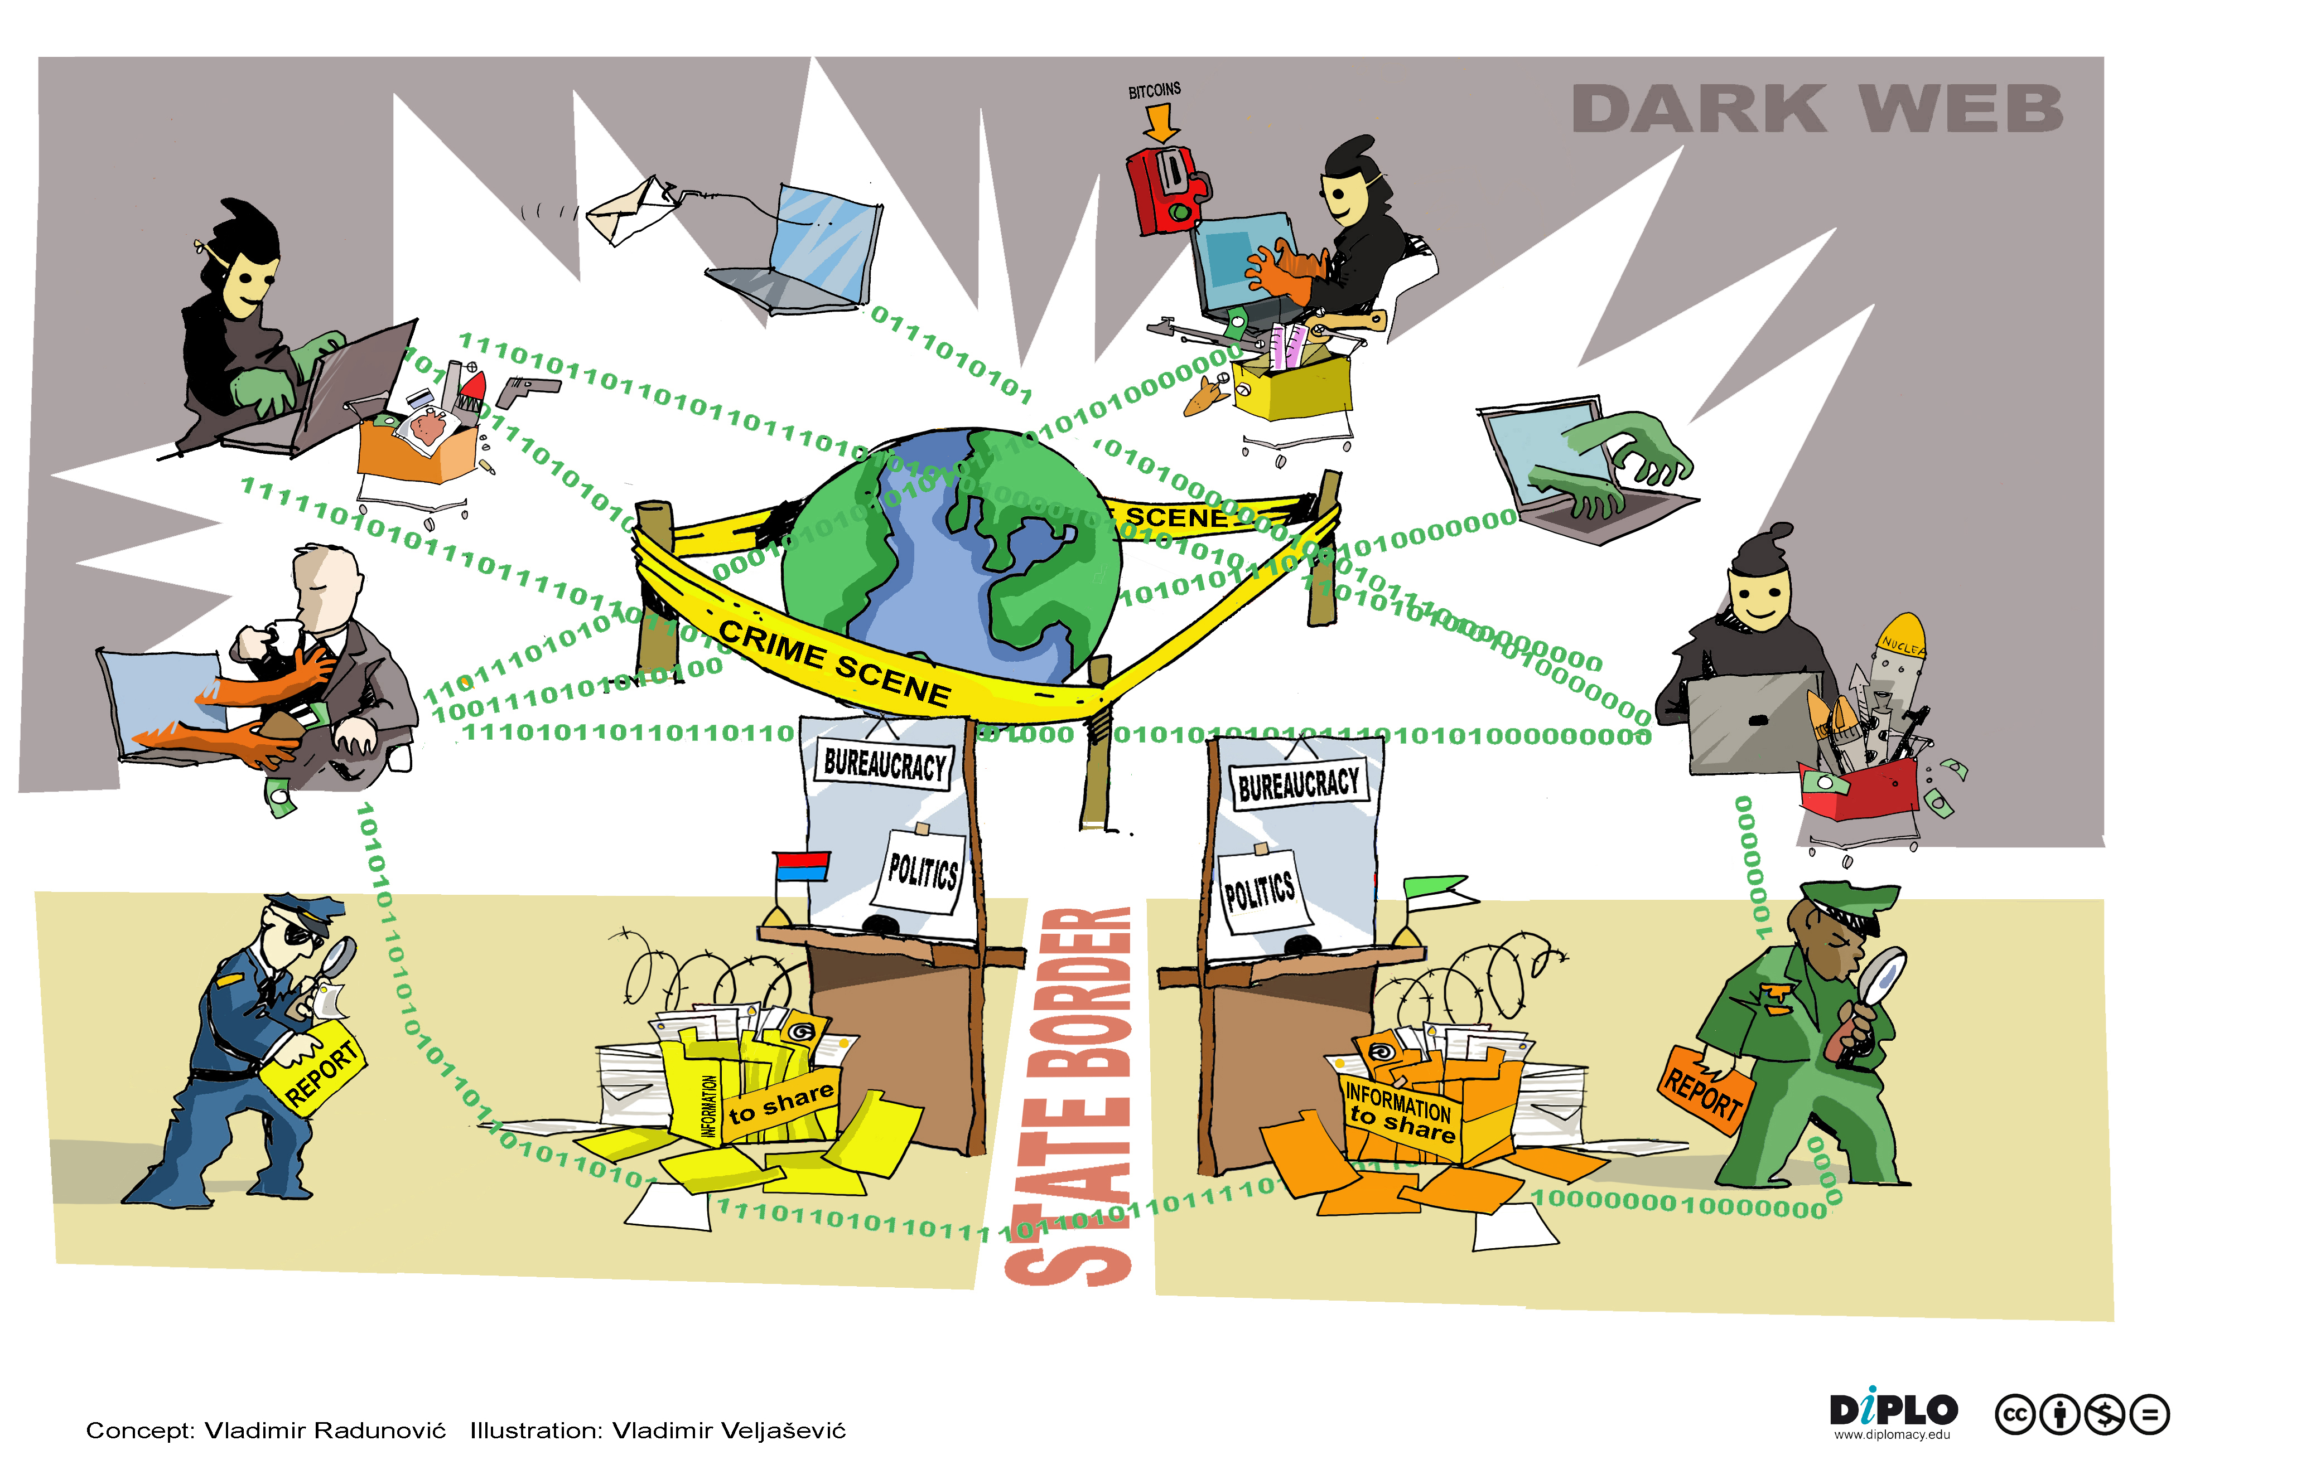
Article 31 – Mutual Assistance Regarding
Accessing of Stored Computer Data
Request to another state to search or seize (and disclose) data stored by means of a computer system
  Located within the territory of the requested State
  Including data that has been preserved pursuant to Article 29
Notes:
This slide summarizes some key features of Article 31 of the Budapest Convention – which relates to mutual assistance regarding searching or similary accessing, seizing or similarly securing and disclosing data by means of a computer system stored in another jurisdiction. It is the international equivalent of the domestic power under Article 19 of the Budapest Convention.

Slide 56
Article 31 – Mutual Assistance Regarding
Accessing of Stored Computer Data
1 A Party may request another Party to search or similarly access, seize or similarly secure, and disclose data stored by means of a computer system located within the territory of the requested Party, including data that has been preserved pursuant to Article 29.
2 The requested Party shall respond to the request through the application of international instruments, arrangements and laws referred to in Article 23, and in accordance with other relevant provisions of this chapter.
3 The request shall be responded to on an expedited basis where:
a there are grounds to believe that relevant data is particularly vulnerable to loss or modification; or
b the instruments, arrangements and laws referred to in paragraph 2 otherwise provide for expedited co-operation.
Parties can send requests for search or similarly access, seize or similarly secure and disclose computer data
This request can relate to data stored in a computer system in another country, including data that has been preserved pursuant to A.29
Notes:
On the left side, this slide shows the text of Article 31of the Budapest Convention with one element “search or similarly access, seize or similarly secure… disclose data… including data that has been preserved pursuant to Article 29” highlighted in red.
On the right side, this slide provides an explanation of the highlighted element.
Article 30 enables Parties to send requests for searching or similarly accessing, seizing or similarly securing and disclosing computer data that is stored in a computer system located in a territory of another party, including data preserved pursuant to Article 29 of the Budapest Convention. It is the international equivalent of the domestic power under Article 19 of the Budapest Convention.

Slide 57
Article 31 – Mutual Assistance Regarding
Accessing of Stored Computer Data
1 A Party may request another Party to search or similarly access, seize or similarly secure, and disclose data stored by means of a computer system located within the territory of the requested Party, including data that has been preserved pursuant to Article 29.
2 The requested Party shall respond to the request through the application of international instruments, arrangements and laws referred to in Article 23, and in accordance with other relevant provisions of this chapter.
3 The request shall be responded to on an expedited basis where:
a there are grounds to believe that relevant data is particularly vulnerable to loss or modification; or
b the instruments, arrangements and laws referred to in paragraph 2 otherwise provide for expedited co-operation.
Parties are required to respond to requests for search or similarly access, seize or similarly secure and disclose computer data
The terms and conditions for providing such mutual assistance will be such set forth in applicable treaties, arrangements and domestic laws governing mutual legal assistance
Notes:
On the left side, this slide shows the text of Article 31of the Budapest Convention with one element “respond through… international instruments, arrangements and laws… other relevant provisions of this chapter.” highlighted in red.
On the right side, this slide provides an explanation of the highlighted element.
The terms and conditions for providing mutual assistance under Article 30 will be such set forth in applicable treaties, arrangements and domestic laws governing mutual legal assistance – and in their absence – Article 27 and 28 of the Budapest Convention.

Slide 58
Article 31 – Mutual Assistance Regarding
Accessing of Stored Computer Data
1 A Party may request another Party to search or similarly access, seize or similarly secure, and disclose data stored by means of a computer system located within the territory of the requested Party, including data that has been preserved pursuant to Article 29.
2 The requested Party shall respond to the request through the application of international instruments, arrangements and laws referred to in Article 23, and in accordance with other relevant provisions of this chapter.
3 The request shall be responded to on an expedited basis where:
a there are grounds to believe that relevant data is particularly vulnerable to loss or modification; or
b the instruments, arrangements and laws referred to in paragraph 2 otherwise provide for expedited co-operation.
Requests must be responded to on an expedited basis where
  there are grounds to believe that relevant data is particularly vulnerable to loss or modification, or
  otherwise where such treaties, arrangements or laws so provide.
Notes:
On the left side, this slide shows the text of Article 31of the Budapest Convention with one element “expedited basis … data… particularly vulnerable… loss… modification… instruments,… provide for expedited co-operation” highlighted in red.
On the right side, this slide provides an explanation of the highlighted element.
A request under Article 30 must be responded to on an expedited basis where (1) there are grounds to believe that relevant data is particularly vulnerable to loss or modification, or (2) otherwise where such treaties, arrangements or laws so provide.

Slide 59
Article 32 – Trans-border Access
Possibility given to law enforcement from a Party to obtain evidence stored in a computer physically located in other Party’s territory
Without any request of international cooperation if, during a concrete investigation, the officers in charge
  need to obtain open source information from a computer located in a foreign country; or
  access data with the lawful and voluntary consent of the lawfully authorised person
Notes:
This slide summarizes some key features of Article 32 of the Budapest Convention – which relates to the trans-border access of computer data where publicly available or with consent.

Slide 60
Article 32 - Trans-border Access
Article 32 – Trans-border access to stored computer data with consent or where publicly available
A Party may, without the authorisation of another Party:
a access publicly available (open source) stored computer data, regardless of where the data is located geographically; or
b access or receive, through a computer system in its territory, stored computer data located in another Party, if the Party obtains the lawful and voluntary consent of the person who has the lawful authority to disclose the data to the Party through that computer system.
Does not require mutual assistance request to country where service provider is located
Does not mandate notification to country where service provider is located
Notes:
On the left side, this slide shows the text of Article 32 of the Budapest Convention with one element (“without the authorisation of another party”) highlighted.
On the right side, this slide provides an explanation of the highlighted element.
The trainer should emphasize that while most of the international cooperation provisions of the Budapest Convention require authorisation of another state, Article 32 is different in that it may be used to obtain electronic evidence from another jurisdiction even if the state where such evidence resides does not give its authorisation.

Slide 61
Article 32 - Trans-border Access
Article 32 – Trans-border access to stored computer data with consent or where publicly available
A Party may, without the authorisation of another Party:
a access publicly available (open source) stored computer data, regardless of where the data is located geographically; or
b access or receive, through a computer system in its territory, stored computer data located in another Party, if the Party obtains the lawful and voluntary consent of the person who has the lawful authority to disclose the data to the Party through that computer system.
Allows accessing publicly available data
If portion of a website is closed to public, it is not publicly available
Location of data is not relevant (whether or not in a Budapest Convention party)
Notes:
On the left side, this slide shows the text of Article 32 of the Budapest Convention with one element (“publicly available (open source)….. regardless of where the data is stored”) highlighted.
On the right side, this slide provides an explanation of the highlighted element.
This is one of the conditions that allows for transborder access to data without the authorisation of the party where the data is stored – i.e. that the data is publicly available data (open source). The slides explain that if a portion of a website is closed to the general public, then it is not considered publicly available for the purposes of Article 32.a. The geographical location data of the data is irrelevant when accessing publicly available data – so it is irrelevant whether it is stored within or outside a Budapest Convention party.

Slide 62
Article 32 - Trans-border Access
Article 32 – Trans-border access to stored computer data with consent or where publicly available
A Party may, without the authorisation of another Party:
a access publicly available (open source) stored computer data, regardless of where the data is located geographically; or
b access or receive, through a computer system in its territory, stored computer data located in another Party, if the Party obtains the lawful and voluntary consent of the person who has the lawful authority to disclose the data to the Party through that computer system.
Location of data must be in another Budapest Convention party
Notes:
On the left side, this slide shows the text of Article 32 of the Budapest Convention with one element (“stored computer data located in another Party”) highlighted.
On the right side, this slide provides an explanation of the highlighted element.
Unlike the power to access publicly available data which may be exercised in relation to data stored anywhere, the power to access data with consent is only available when the data sought is located in another Budapest Convention party.

Slide 63
Article 32 - Trans-border Access
Article 32 – Trans-border access to stored computer data with consent or where publicly available
A Party may, without the authorisation of another Party:
a access publicly available (open source) stored computer data, regardless of where the data is located geographically; or
b access or receive, through a computer system in its territory, stored computer data located in another Party, if the Party obtains the lawful and voluntary consent of the person who has the lawful authority to disclose the data to the Party through that computer system.
Data can be accessed based on lawful and voluntary consent
Lawfulness of consent is based on local law (e.g. minors and persons with mental incapacitation may not be able to consent)
Agreement to general terms of service may not qualify as specific, explicit consent
Notes:
On the left side, this slide shows the text of Article 32 of the Budapest Convention with one element (“lawful and voluntary consent”) highlighted.
On the right side, this slide provides an explanation of the highlighted element.
The power to access data trans-border may be exercised on the basis of lawful and voluntary consent obtained from the person who has authority to disclose the data. The slide explains the scope of the term lawful and voluntary consent, and how it can be used to obtain data from foreign service providers without going through mutual assistance channels. It is important to note that in many jurisdictions, the agreement to “general terms of service” of service providers may not qualify as specific, explicit consent that would be required to enable disclosure of information to foreign governments.

Slide 64
Article 32 - Trans-border Access
Article 32 – Trans-border access to stored computer data with consent or where publicly available
A Party may, without the authorisation of another Party:
a access publicly available (open source) stored computer data, regardless of where the data is located geographically; or
b access or receive, through a computer system in its territory, stored computer data located in another Party, if the Party obtains the lawful and voluntary consent of the person who has the lawful authority to disclose the data to the Party through that computer system.
The consent must be of the person who has lawful authority to disclose the data
This would depend on circumstances, nature of the person and applicable law
E.g. An individual may provide access to his/her personal email that is stored abroad to a law enforcement official
Service providers usually do not have lawful authority to disclose data of subscribers
Notes:
On the left side, this slide shows the text of Article 32 of the Budapest Convention with one element (“person who has the lawful authority to disclose the data”) highlighted.
On the right side, this slide provides an explanation of the highlighted element.
Who is a person that is "lawfully authorised" to disclose data may vary depending on the circumstances, the nature of the person and the applicable law concerned. For example, a person’s e-mail may be stored in another country by a service provider, or a person may intentionally store data in another country. These persons may retrieve the data and, provided that they have the lawful authority, they may voluntarily disclose the data to law enforcement officials or permit such officials to access the data, as provided in Article 32.

Slide 65
Poll question
In which situations would the Budapest Convention allow a party to access data in another jurisdiction without authorisation of another party?
a) Private data
b) Publicly accessible data
c) Any stored data with lawful or voluntary consent of person authorised to disclose
d) Traffic data
e) Content data
Notes:
The correct answers are: b) Publicly accessible data (c) Any stored data with lawful or voluntary consent of person authorised to disclose.
These powers are available under Article 32 of the Budapest Convention.

Slide 66
Poll question
In which situations would the Budapest Convention allow a party to access data in another jurisdiction without authorisation of another party?
a) Private data
b) Publicly accessible data
c) Any stored data with lawful or voluntary consent of person authorised to disclose
d) Traffic data
e) Content data
Notes:
The correct answers are: b) Publicly accessible data (c) Any stored data with lawful or voluntary consent of person authorised to disclose.
These powers are available under Article 32 of the Budapest Convention.

Slide 67
Article 33 – Mutual assistance regarding the
real-time collection of traffic data
1 The Parties shall provide mutual assistance to each other in the real-time collection of traffic data associated with specified communications in their territory transmitted by means of a computer system. Subject to the provisions of paragraph 2, this assistance shall be governed by the conditions and procedures provided for under domestic law.
2 Each Party shall provide such assistance at least with respect to criminal offences for which real-time collection of traffic data would be available in a similar domestic case.
This provision empowers investigators to have the ability to obtain traffic data in real time regarding communications passing through a computer system in other parties
This is important given that communications typically flow across territorial boundaries
Notes:
On the left side, this slide shows the text of Article 33 of the Budapest Convention with one element (“real-time collection of traffic data”) highlighted.
On the right side, this slide provides an explanation of the highlighted element.
This provision empowers investigators to have the ability to obtain traffic data in real time regarding communications passing through a computer system in other parties. It is the international equivalent of the domestic law power established in accordance with Article 20 of the Budapest Convention. This power is important given that communications typically flow across territorial boundaries

Slide 68
Article 33 – Mutual assistance regarding the
real-time collection of traffic data
1 The Parties shall provide mutual assistance to each other in the real-time collection of traffic data associated with specified communications in their territory transmitted by means of a computer system. Subject to the provisions of paragraph 2, this assistance shall be governed by the conditions and procedures provided for under domestic law.
2 Each Party shall provide such assistance at least with respect to criminal offences for which real-time collection of traffic data would be available in a similar domestic case.
Requests for collection of traffic data must be associated with specified communications identified by requesting states
Making requests for general or indiscriminate surveillance or collection of large amounts of traffic data is not permitted
Notes:
On the left side, this slide shows the text of Article 33 of the Budapest Convention with one element (“specified communications”) highlighted.
On the right side, this slide provides an explanation of the highlighted element.
As indicated by the slide, requests for collection of traffic data made in accordance with Article 33 must be associated with specified communications identified by requesting states. Given the privacy concerns associated with real-time collection of traffic data, it is required that any exercise of powers under this article be with respect to specified communications and not giving general or indiscriminate surveillance powers to competent authorities.

Slide 69
Article 33 – Mutual assistance regarding the
real-time collection of traffic data
1 The Parties shall provide mutual assistance to each other in the real-time collection of traffic data associated with specified communications in their territory transmitted by means of a computer system. Subject to the provisions of paragraph 2, this assistance shall be governed by the conditions and procedures provided for under domestic law.
2 Each Party shall provide such assistance at least with respect to criminal offences for which real-time collection of traffic data would be available in a similar domestic case.
Applicable conditions and procedures provided under the requested party’s domestic laws will govern the provision of assistance
The terms and conditions by which such co-operation is to be provided are generally those set forth in applicable treaties, arrangements and laws governing mutual legal assistance in criminal matters
Notes:
On the left side, this slide shows the text of Article 33 of the Budapest Convention with one element (“assistance… governed… conditions and procedures…. domestic law”) highlighted.
On the right side, this slide provides an explanation of the highlighted element.
The mutual assistance provision under Article 33 is to be implemented by the requested party in accordance with applicable conditions and procedures provided under the requested party’s domestic laws (i.e. those powers established in accordance with Article 20 of the Budapest Convention).

Slide 70
Article 33 – Mutual assistance regarding the
real-time collection of traffic data
1 The Parties shall provide mutual assistance to each other in the real-time collection of traffic data associated with specified communications in their territory transmitted by means of a computer system. Subject to the provisions of paragraph 2, this assistance shall be governed by the conditions and procedures provided for under domestic law.
2 Each Party shall provide such assistance at least with respect to criminal offences for which real-time collection of traffic data would be available in a similar domestic case.
Real-time collection of traffic data is intrusive measure so parties have some discretion to limit scope of cooperation
However, in no event may the range of offences be narrower than the range of offences for which such measure is available domestically
Notes:
On the left side, this slide shows the text of Article 33 of the Budapest Convention with one element (“at least… similar domestic case”) highlighted.
On the right side, this slide provides an explanation of the highlighted element.
Parties are required to provide mutual assistance under Article 33 at least for those offences for which the same power (equivalent to Article 20 of the Budapest Convention) would be available in a domestic case.

Slide 71
Article 34 – Mutual assistance regarding the interception of content data
The Parties shall provide mutual assistance to each other in the real-time collection or recording of content data of specified communications transmitted by means of a computer system to the extent permitted under their applicable treaties and domestic laws.
This provision empowers investigators to have the ability to obtain content data of specified communications transmitted by a computer system in another party
Notes:
On the left side, this slide shows the text of Article 34 of the Budapest Convention with one element (“real-time collection or recording of content data”) highlighted.
On the right side, this slide provides an explanation of the highlighted element.
This provision empowers investigators to have the ability to obtain content data in real time regarding communications passing through a computer system in other parties. It is the international equivalent of the domestic law power established in accordance with Article 21 of the Budapest Convention. This power is important given that communications typically flow across territorial boundaries.

Slide 72
Article 34 – Mutual assistance regarding the interception of content data
The Parties shall provide mutual assistance to each other in the real-time collection or recording of content data of specified communications transmitted by means of a computer system to the extent permitted under their applicable treaties and domestic laws.
Requests for interception of content data must be associated with specified communications identified by requesting states
Making requests for general or indiscriminate surveillance or collection of large amounts of content data is not permitted
Notes:
On the left side, this slide shows the text of Article 34 of the Budapest Convention with one element (“specified communications”) highlighted.
On the right side, this slide provides an explanation of the highlighted element.
As indicated by the slide, requests for recording or collection of content data made in accordance with Article 34 must be associated with specified communications identified by requesting states. Given the high privacy concerns associated with this power, it is required that any exercise of powers under this article be with respect to specified communications and not giving general or indiscriminate surveillance powers to competent authorities.

Slide 73
Article 34 – Mutual assistance regarding the interception of content data
The Parties shall provide mutual assistance to each other in the real-time collection or recording of content data of specified communications transmitted by means of a computer system to the extent permitted under their applicable treaties and domestic laws.
Interception of content data is a highly intrusive measure so parties have full discretion to limit scope of cooperation
Domestic law and applicable treaties can limit the extent of cooperation
Notes:
On the left side, this slide shows the text of Article 34 of the Budapest Convention with one element (“to the extent permitted under their applicable treaties and domestic laws”) highlighted.
On the right side, this slide provides an explanation of the highlighted element.
Parties are required to provide mutual assistance under Article 34 to such extent permitted under their domestic law. Since this is a highly intrusive measure, parties have full discretion to limit the scope of mutual assistance they are willing to provide regarding the interception of content data.

Slide 74
Poll question
A party refuses to provide mutual assistance regarding the interception of content data to another party because this is not allowed under its domestic law. The Party has violated Article 34 of the Budapest Convention.
True
False
Notes:
The correct answer is: False.
Article 34 of the Budapest Convention allows parties to refuse mutual assistance regarding interception of content data to another party on the basis that it is not permitted under its domestic law.

Slide 75
Poll question
A party refuses to provide mutual assistance regarding the interception of content data to another party because this is not allowed under its domestic law. The Party has violated Article 34 of the Budapest Convention.
True
False
Notes:
The correct answer is: False.
Article 34 of the Budapest Convention allows parties to refuse mutual assistance regarding interception of content data to another party on the basis that it is not permitted under its domestic law.

Slide 76
Article 35 – 24/7 Network
1 Each Party shall designate a point of contact available on a twenty-four hour, seven-day-a-week basis, in order to ensure the provision of immediate assistance for the purpose of investigations or proceedings concerning criminal offences related to computer systems and data, or for the collection of evidence in electronic form of a criminal offence. Such assistance shall include facilitating, or, if permitted by its domestic law and practice, directly carrying out the following measures:
  a the provision of technical advice;
  b the preservation of data pursuant to Articles 29 and 30;
  c the collection of evidence, the provision of legal information, and locating of suspects.
Effective collection of electronic evidence requires rapid response
Existing mutual assistance modalities require supplemental channels for immediate assistance
Budapest Convention requires each Party to create this supplemental point of contact that is available 24/7 for provision of immediate assistance
Notes:
On the left side, this slide shows part of the text of Article 35 of the Budapest Convention with one element (“point of contact… twenty-four hour, seven-day-a-week basis… immediate assistance”) highlighted.
On the right side, this slide provides an explanation of the highlighted element.
As noted in the Explanatory Report to the Budapest Convention, “effective combating of crimes committed by use of computer systems and effective collection of evidence in electronic form requires very rapid response. Moreover, with a few keystrokes, action may be taken in one part of the world that instantly has consequences many thousands of kilometres and many time zones away. For this reason, existing police co-operation and mutual assistance modalities require supplemental channels to address the challenges of the computer age effectively. The channel established in this Article is based upon the experience gained from an already functioning network created under the auspices of the G8 group of nations.”
In this vein, Article 35 requires parties to designate a point of contact available 24 hours per day, 7 days per week in order to ensure immediate assistance in investigations and proceedings within the scope of Chapter III of the Budapest Convention.

Slide 77
Article 35 – 24/7 Network
1 Each Party shall designate a point of contact available on a twenty-four hour, seven-day-a-week basis, in order to ensure the provision of immediate assistance for the purpose of investigations or proceedings concerning criminal offences related to computer systems and data, or for the collection of evidence in electronic form of a criminal offence. Such assistance shall include facilitating, or, if permitted by its domestic law and practice, directly carrying out the following measures:
  a the provision of technical advice;
  b the preservation of data pursuant to Articles 29 and 30;
  c the collection of evidence, the provision of legal information, and locating of suspects.
24/7 Networks are to provide immediate assistance for the purpose of:
  Offences related to computer systems and data
  Collection of evidence for any criminal offence
Parties can determine the location of a 24/7 Network within their jurisdictions (within central authority, police or elsewhere)
Notes:
On the left side, this slide shows part of the text of Article 35 of the Budapest Convention with one element (“investigations… proceedings… related to computer systems and data… collection of evidence in electronic form of a criminal offence”) highlighted.
On the right side, this slide provides an explanation of the highlighted element.
The purpose of the 24/7 network is to provide immediate assistance for the purpose of investigations or proceedings:
a) Concerning offences related to computer systems and data
b) Collection of evidence in electronic form of any criminal offence
This means that like the other international cooperation and mutual assistance of the Budapest Convention, Article 35 relates not only to cybercrime but also more broadly to electronic evidence.

Slide 78
Article 35 – 24/7 Network
1 Each Party shall designate a point of contact available on a twenty-four hour, seven-day-a-week basis, in order to ensure the provision of immediate assistance for the purpose of investigations or proceedings concerning criminal offences related to computer systems and data, or for the collection of evidence in electronic form of a criminal offence. Such assistance shall include facilitating, or, if permitted by its domestic law and practice, directly carrying out the following measures:
  a the provision of technical advice;
  b the preservation of data pursuant to Articles 29 and 30;
  c the collection of evidence, the provision of legal information, and locating of suspects.
24/7 Networks can facilitate, or if permitted by local law, directly render assistance
Assistance can relate to:
  Provision of technical advice for stopping or tracing an attack
  Preservation of data pursuant to request (to enable more expeditious preservation than through central authority)
  Collection of evidence
  Provision of legal information (such as legal pre-requisites for provision of assistance)
  Locating of suspects
Notes:
On the left side, this slide shows part of the text of Article 35 of the Budapest Convention with one element (“facilitating… if permitted by its domestic law… directly carrying out… technical advice… preservation… collection of evidence… legal information… locating of suspects”) highlighted.
On the right side, this slide provides an explanation of the highlighted element.
This slide gives examples of the type of assistance that may be provided by a 24/7 Network. The list on the slide is meant to be non-exhaustive.

Slide 79
Article 35 – 24/7 Network
2 a A Party’s point of contact shall have the capacity to carry out communications with the point of contact of another Party on an expedited basis.
b If the point of contact designated by a Party is not part of that Party’s authority or authorities responsible for international mutual assistance or extradition, the point of contact shall ensure that it is able to co-ordinate with such authority or authorities on an expedited basis.
3 Each Party shall ensure that trained and equipped personnel are available, in order to facilitate the operation of the network.
24/7 Network must have capacity to communicate with other 24/7 Networks on expedited basis
24/7 Network must also have ability to communicate with relevant competent authorities (e.g. police, prosecutor, Ministry of Foreign Affairs, etc.) within its jurisdiction to enforce requests on expedited basis (24/7)
Notes:
On the left side, this slide shows part of the text of Article 35 of the Budapest Convention with one element (“capacity to carry out communications… expedited basis…able to co-ordinate with such authority… expedited basis”) highlighted.
On the right side, this slide provides an explanation of the highlighted element.
This slide outlines the capacity requirements for the 24/7 Network.

Slide 80
Article 35 – 24/7 Network
2 a A Party’s point of contact shall have the capacity to carry out communications with the point of contact of another Party on an expedited basis.
b If the point of contact designated by a Party is not part of that Party’s authority or authorities responsible for international mutual assistance or extradition, the point of contact shall ensure that it is able to co-ordinate with such authority or authorities on an expedited basis.
3 Each Party shall ensure that trained and equipped personnel are available, in order to facilitate the operation of the network.
24/7 Network must have proper equipment such as:
  Up-to-date telephone
  Fax
  Computer equipment
  Other forms of communication
  Analytical equipment
24/7 Network must personnel properly trained regarding cybercrime and electronic evidence and how to respond effectively to requests
Notes:
On the left side, this slide shows part of the text of Article 35 of the Budapest Convention with one element (“trained… equipped personnel”) highlighted.
On the right side, this slide provides an explanation of the highlighted element.
This slide outlines the capacity requirements for the 24/7 Network.

Slide 81
Specialized Judicial Course on
International Cooperation
Part Three
Provisions of the Draft Second Additional Protocol
Notes:
The first part will provide a background of and review the provisions of the draft Second Additional Protocol to the Budapest Convention.

Slide 82
Protocol Drafting Group
Adopted Draft Articles (May 2020)
Language of requests
Video conferencing (for taking testimony or statements from witnesses)
Joint investigation teams and joint investigations
Emergency mutual assistance
Direct disclosure of subscriber information
Giving effect to orders of another party for expedited production of data
Notes:
Language of request: This Article provides a framework for languages that may be used when addressing Parties and service providers. Even where in practice Parties are able to work in languages other than their official languages, such possibility may not be foreseen by domestic law or treaties. The objective of this Article is to provide additional flexibility under this Protocol.
Video conferencing: Article primarily addresses the use of video conferencing technology to take testimony or statements. This form of cooperation may be provided for in existing bilateral and multilateral mutual assistance treaties, e.g., ETS 182 (Second Additional Protocol to the Convention on Mutual Assistance in Criminal Matters). In order to not supersede provisions specifically designed to meet the requirements of the parties to those treaties or conventions, Article [ ], like several other articles in this Protocol, applies in the absence of a mutual legal assistance treaty, or arrangement on the basis of uniform or reciprocal legislation, in force between the requesting and requested Parties. Such articles follow the same approach as in Article 27 of the Budapest Convention.
JIT and joint investigations: Given the transnational nature of cybercrime and electronic evidence, investigations and prosecutions related to cybercrime and electronic evidence often have links to other States. Joint investigation teams (JITs) can be an effective means for operational cooperation or coordination between two or more States. Article [ ] provides a basis for such forms of cooperation.
Emergency mutual assistance: Article is intended to provide maximally expedited procedure for mutual assistance requests made in emergency situations. An emergency is defined in paragraph 1 as being those in which there is a significant and imminent risk to the life or safety of a natural person. The definition is intended to cover situations in which the risk is imminent, meaning that it does not include situations in which the risk to the life or safety of the person has already passed, or in which there may be a future risk that is not imminent. The reason for this very precise definition is that the article places labor intensive obligations on both the requested and requesting Parties to react in a greatly accelerated manner in emergencies, which consequently requires that emergency requests be given a higher priority than other important but somewhat less urgent cases, even if they had been submitted earlier.
Direct disclosure of subscriber information: his article establishes a procedure that provides for the direct cooperation between the authorities of one Party and a service provider in the territory of another Party to obtain subscriber information. The procedure builds on the conclusions of the Convention Committee’s Cloud Evidence Group and Guidance Note on Article 18 of the Convention, acknowledging the importance of timely cross-border access to electronic evidence in criminal investigations and proceedings, in view of the challenges posed by existing procedures for obtaining electronic evidence from service providers in other countries.
Giving the effects to orders: The purpose of this Article is for a requesting Party to have the ability to issue an order
to be submitted to a requested Party and for the requested Party to have the ability to give effect to that order by compelling a service provider in its territory to produce subscriber information or traffic data in the service provider’s possession or control.

Slide 83
Protocol Drafting Group
Adopted Draft Articles (May 2020)
Language of requests:
Requests, and orders and accompanying information, submitted to a Party shall be in a language acceptable to the requested Party or the Party notified under Article [direct disclosure], or be accompanied by a translation into such a language.
For purposes of Articles [direct disclosure], [preservation], and [emergency disclosure], an order [or request]3 and accompanying information4 submitted directly to a service provider in the territory of another Party shall be:
  submitted in a language of the other Party in which the service provider accepts comparable domestic process;
  submitted in another language acceptable to the service provider; or
  accompanied by a translation into one of the languages under subparagraphs
  (a) or (b).
Notes:
Language of request: This Article provides a framework for languages that may be used when addressing Parties and service providers. Even where in practice Parties are able to work in languages other than their official languages, such possibility may not be foreseen by domestic law or treaties. The objective of this Article is to provide additional flexibility under this Protocol.
Inaccurate or costly translations of mutual assistance requests relating to electronic crime are a chronic complaint requiring urgent attention. This impediment erodes legitimate processes to obtain data and protect public safety. The same considerations apply outside of traditional mutual assistance, such as when a Party transmits an order directly to a service provider in another Party’s territory under Article [ ], or requests to give effect to an order under Article [ ]. While machine translation capabilities are expected to improve, they are currently inadequate. For these reasons, the translation problem was mentioned repeatedly in proposals about the articles to include in a protocol.

Slide 84
Protocol Drafting Group
Adopted Draft Articles (May 2020)
Video conferencing:
A requesting Party may request, and the requested Party may permit, testimony and statements to be taken from a witness or expert by video conference. The requesting Party and the requested Party shall consult in order to facilitate resolution of any issues that may arise with regard to the execution of the request, including, as applicable: which Party shall preside; the authorities and persons that shall be present; whether one or both Parties shall administer particular oaths, warnings or instructions to the witness or expert; the manner of questioning of the witness or expert; the manner to ensure due respect for the rights of the witness or expert; the treatment of claims of privilege or immunity; the treatment of objections to questions or responses; and whether one or both Parties shall provide interpretation and transcription services.
Notes:
This article primarily addresses the use of video conferencing technology to take testimony or statements. This form of cooperation may be provided for in existing bilateral and multilateral mutual assistance treaties, e.g., ETS 182 (Second Additional Protocol to the Convention on Mutual Assistance in Criminal Matters). In order to not supersede provisions specifically designed to meet the requirements of the parties to those treaties or conventions, Article [ ], like several other articles in this Protocol, applies in the absence of a mutual legal assistance treaty, or arrangement on the basis of uniform or reciprocal legislation, in force between the requesting and requested Parties. Such articles follow the same approach as in Article 27 of the Budapest Convention.
In addition, Article [ ] has the same material scope as in Article 25 of the Budapest Convention, that is, it is available “for the purpose of investigations or proceedings concerning criminal offences related to computer systems and data, or for the collection of evidence in electronic form of a criminal offence.” As stated in paragraph 253 of the Explanatory Report to the Budapest Convention, “criminal offences related to computer systems and data” means “the offences covered by Article 14, paragraph 2, litterae a-b” of the Budapest Convention, i.e., “the criminal offences established in accordance with Articles 2-11 of this Convention” and “other criminal offences committed by means of a computer system ....”

Slide 85
Protocol Drafting Group
Adopted Draft Articles (May 2020)
Video conferencing:
A requested Party providing assistance under this article shall endeavor to obtain the presence of the person whose testimony or statement is sought. Where appropriate the requested Party may, to the extent possible under its law, take the necessary measures to compel a witness or expert to appear in the requested Party at a set time and location.
The procedures relating to the conduct of the video conference specified by the requesting Party shall be followed, except where incompatible with the law of the requested Party. In case of incompatibility, or to the extent the procedure has not been specified, the requested Party shall apply the procedure under its law unless otherwise agreed upon by the requesting and requested Parties.
Without prejudice to any jurisdiction under the law of the requesting Party, where in the course of the video conference, the witness or expert:
  makes an intentionally false statement when the requested Party has, in accordance with the law of the requested Party, obliged such person to testify truthfully; or
  refuses to testify when the requested Party has, in accordance with the law of the requested Party, obliged such person to testify; or
  commits other misconduct that is prohibited by the law of the requested Party in the course of such proceedings;
  the person shall be sanctionable in the requested Party in the same manner as if such conduct had been committed in the course of its domestic proceedings.

Slide 86
Protocol Drafting Group
Adopted Draft Articles (May 2020)
Video conferencing:
Unless otherwise agreed between the requesting Party and the requested Party, the requested Party shall bear all costs related to the execution of a request under this article, except:
the fees of an expert witness;
the costs of translation, interpretation and transcription; and
costs of an extraordinary nature.
If the execution of a request would impose costs of an extraordinary nature, the requesting Party and the requested Party shall consult in order to determine the conditions under which the request will be executed.
Where mutually agreed upon by the requesting Party and the requested Party:
  the provisions of this article may be applied for the purposes of carrying out audio conferences;
  video conferencing technology may be used for purposes, or hearings, other than those described in paragraph 1, including for purposes of identification of persons or objects.
Where a requested Party chooses to permit the hearing of a suspect or accused person, it may require particular conditions and safeguards with respect to the taking of testimony or a statement from, or providing notifications or applying procedural measures to, such person.

Slide 87
Protocol Drafting Group
Adopted Draft Articles (May 2020)
Joint investigation teams and joint investigations:
By mutual agreement, the competent authorities of two or more Parties may establish and operate a joint investigation team in their territories to facilitate investigations or prosecutions, where enhanced coordination is deemed to be of particular utility. The competent authorities shall be determined by the respective Parties concerned.
The procedures and conditions governing the operation of joint investigation teams, such as their specific purposes; composition; functions; duration and any extension periods; location; organization; gathering, transmission and use of information or evidence; and terms of involvement of participating authorities of a Party in investigative activities taking place in another Party's territory, shall be as agreed between those competent authorities.
Those competent and participating authorities shall communicate directly, except that Parties may agree on other appropriate channels of communication where exceptional circumstances require more central coordination.
Where investigative measures need to be taken in the territory of one of the Parties concerned, participating authorities from that Party may request their own authorities to take those measures without the other Parties having to submit a request for mutual assistance. Those measures shall be carried out by that Party’s authorities in its territory under the conditions that apply under domestic law in a national investigation.
Notes:
Experience has shown that where a State is investigating an offence with a cross- border dimension in relation to cybercrime or for which electronic evidence needs to be obtained, the investigation can benefit from the participation of the authorities of other States that are also investigating the same or related conduct or where coordination is otherwise useful.
As indicated in Article [general principles re this chapter] of this Protocol and explanatory report paragraphs [x to y], [the provisions of this Article shall not apply where there is a mutual assistance treaty or arrangement on the basis of uniform or reciprocal legislation in force between the requesting and requested Parties unless the Parties concerned agree to apply any or all of the remainder of this Article in lieu thereof

Slide 88
Protocol Drafting Group
Adopted Draft Articles (May 2020)
Joint investigation teams and joint investigations:
Use of information or evidence provided by the participating authorities of one Party to participating authorities of other Parties concerned may be refused or restricted in the manner set forth in the agreement described in paragraphs 1 and 2. If that agreement does not set forth terms for refusing or restricting use, the Parties may use the information or evidence provided:
for the purposes for which the agreement has been entered into;
for detecting, investigating and prosecuting criminal offenses other than those for which the agreement was entered into, subject to the prior consent of the authorities providing the information or evidence.
  However, consent shall not be required where fundamental legal principles of the Party using the information or evidence require that it disclose the information or evidence to protect the rights of an accused person in criminal proceedings. In that case, those authorities shall notify the authorities that provided the information or evidence without undue delay; or for them to prevent a situation in which there is a significant and imminent threat involving the life or safety of a natural person.8 In that case, the participating authorities that received the information or evidence shall notify the participating authorities that provided the information or evidence without undue delay, unless mutually determined otherwise.
  In the absence of an agreement described in paragraphs 1 and 2, joint investigations may be undertaken under mutually agreed terms on a case-by-case basis [and in accordance with applicable domestic conditions and safeguards.

Slide 89
Protocol Drafting Group
Adopted Draft Articles (May 2020)
Emergency mutual assistance:
For the purposes of this Article, an emergency means a situation in which there is a significant and imminent risk to the life or safety of any natural person.
Each Party may seek mutual assistance on a rapidly expedited basis where it is of the view that an emergency exists. A request under this Article shall include, in addition to the other contents required, a description of the facts that demonstrate that there is an emergency and how the assistance sought relates to it.
A requested Party shall accept such request in electronic form. However, it may require appropriate levels of security and authentication before accepting the request.
The requested Party may seek, on a rapidly expedited basis, supplemental information in order to evaluate the request. The requesting Party shall provide such supplemental information on the most rapidly expedited basis possible.
Once satisfied that an emergency exists and the other requirements for mutual assistance are satisfied, the requested Party shall respond to the request on the most rapidly expedited basis possible.
Each Party shall ensure that a person from its authority responsible for responding to mutual assistance requests under Article 25 or 27 of the Convention is available on a twenty-four hour, seven-day-a-week basis for purposes of responding to a request under this Article.
Notes:
Article is designed to provide maximally expedited procedure for mutual assistance requests made in emergency situations. An emergency is defined in paragraph 1 as being those in which there is a significant and imminent risk to the life or safety of a natural person. The definition is intended to cover situations in which the risk is imminent, meaning that it does not include situations in which the risk to the life or safety of the person has already passed, or in which there may be a future risk that is not imminent. The reason for this very precise definition is that the article places labor intensive obligations on both the requested and requesting Parties to react in a greatly accelerated manner in emergencies, which consequently requires that emergency requests be given a higher priority than other important but somewhat less urgent cases, even if they had been submitted earlier.
Because protocol Article [ ] is limited to the circumstances justifying such rapidly accelerated action, it is distinct from Article 25(3) of the main Convention, in which requests for mutual assistance may be made by expedited means of communications in urgent circumstances that do not rise to the level of emergency as defined. In other words, Article 25(3) is broader in scope than protocol Article [ ], in that 25(3) covers situations not covered in Article [ ], such as ongoing but non-imminent risks to life or safety of persons, potential destruction of evidence that may result from delay, a rapidly approaching trial date, or other types of urgencies. While the mechanism in Article 25(3) provides for a more rapid method of conveying and responding to a request, the obligations in the case of an emergency under protocol Article [ ] are significantly greater; i.e. where MLA is required to prevent significant andimminentrisktolifeorsafety,theprocessshouldbeevenmoreaccelerated. Emergencies involving a significant and imminent risk to the life or safety of a person often involve hostage situations in which there is a credible risk of imminent loss of life, serious injury or other harm to the victim and the suspect is negotiating for ransom via email or social media so that the location of the victim may be determined through data stored by the provider, sexual abuse of a child as evidenced by the discovery of recently produced child sexual exploitation or child sexual abuse materials, or other indicia of abuse, immediate post terrorist attack scenarios in which authorities seek to determine with whom the attackers communicated in order to determine if further attacks are imminent, and threats to the security of critical infrastructure in which there is a significant and imminent risk of danger to life or safety of a natural person.

Slide 90
Protocol Drafting Group
Adopted Draft Articles (May 2020)
Emergency mutual assistance:
The authorities responsible for mutual assistance of the requesting and requested Parties responsible for mutual assistance may agree to provide that the results of the execution of a request under this Article, or an advance copy thereof, may be provided to the requesting Party through an alternate channel other than that used for the request.
8. a.
In the event of an emergency, requests may be sent directly by judicial authorities of the requesting Party to such authorities of the requested Party, or through Interpol or the 24/7 point of contact established under Article 35 of the Convention. In any such cases, a copy shall be sent at the same time to the central authority of the requested Party through the central authority of the requesting Party.
Where a request is sent directly to a judicial authority of the requested Party and the authority is not competent to deal with the request, it shall refer the request to the competent national authority and inform directly the requesting Party that it has done so.
Each Party may, at the time of signature or when depositing its instrument of ratification, acceptance, approval or accession, inform the Secretary General of the Council of Europe that, for reasons of efficiency, requests made under this paragraph are to be addressed only to its central authority.

Slide 91
Protocol Drafting Group
Adopted Draft Articles (May 2020)
Each Party shall adopt such legislative and other measures as may be necessary for a service provider in its territory to disclose subscriber information in response to an order under paragraph 1.
At the time of signature or when depositing its instrument of ratification, acceptance, approval or accession, a Party may – with respect to orders issued to service providers in its territory - make the following declaration: “the order under Article [ ] paragraph 1 must be issued by, or under the supervision of, a prosecutor or other judicial authority, or otherwise be issued under independent supervision.”
Direct disclosure of subscriber information:
Each Party shall adopt such legislative and other measures as may be necessary to empower its competent authorities to issue an order to be submitted directly to a service provider in the territory of another Party, to obtain the disclosure of specified, stored subscriber information in that service provider’s possession or control, where the information is needed for the issuing Party’s specific criminal investigations or proceedings.
Notes:
This article establishes a procedure that provides for the direct cooperation between the authorities of one Party and a service provider in the territory of another Party to obtain subscriber information. The procedure builds on the conclusions of the Convention Committee’s Cloud Evidence Group and Guidance Note on Article 18 of the Convention, acknowledging the importance of timely cross-border access to electronic evidence in criminal investigations and proceedings, in view of the challenges posed by existing procedures for obtaining electronic evidence from service providers in other countries.
An increasing number of criminal investigations and proceedings nowadays require access to electronic evidence from service providers in other countries. Even for crimes that are entirely domestic in nature – i.e., where the crime, the victim and the perpetrator are all in the same country as the investigating authority – the electronic evidence may be held by a service provider in the territory of another country. In many situations, authorities that are investigating a crime may be required to use international cooperation procedures, such as mutual assistance, which are not always able to provide assistance rapidly or effectively enough for the needs of the investigation or proceeding due to the continually increasing volume of requests seeking electronic evidence.

Slide 92
Protocol Drafting Group
Adopted Draft Articles (May 2020)
Direct disclosure of subscriber information:
The order under paragraph 1 shall specify:
the issuing authority and date issued;
a statement that the order is issued pursuant to this Protocol.
the name and address of the service provider(s) to be served;
the offence(s) that is the subject of the criminal investigation or proceeding;
the authority seeking the specific subscriber information, if not the issuing authority; and
a detailed description of the specific subscriber information sought.
The order under paragraph 1 shall be accompanied
by the following additional information:
the domestic legal grounds that empower the authority to issue the order;
reference to legal provisions and applicable penalties for the offence being
investigated or prosecuted;
contact information of the authority to which the service provider shall return
the subscriber information, request further information, or otherwise respond;
the time and the manner in which to return the subscriber information;
whether preservation of the data has already been sought, including date of
preservation and any applicable reference number;
any special procedural instructions; and
any other information that may aid in obtaining disclosure of the subscriber information.

Slide 93
Protocol Drafting Group
Adopted Draft Articles (May 2020)
  disclosure may prejudice criminal investigations or proceedings in the receiving Party; or
  conditions or grounds for refusal would apply under Articles 25.4 and 27.4 of the Convention if the subscriber information had been sought through mutual assistance.
The authorities notified under paragraph 5.a or consulted with under paragraph 5.b:
may request additional information from the issuing Party for the purposes of applying paragraph 5.c;
shall promptly inform the issuing Party if the service provider has been instructed not to disclose the information and give the reasons for doing so.
Direct disclosure of subscriber information:
A Party may, at the time of signature or when depositing its instrument of ratification, acceptance, approval or accession, and at any other time, notify the Secretary General of the Council of Europe that, when an order is issued under paragraph 1 to a service provider in its territory, the Party requires simultaneous notification, in every case or in identified circumstances, of the order, the supporting information and a summary of the facts related to the investigation or proceeding.
Whether or not a Party requires notification under paragraph 5.a, it may require the service provider to consult the Party’s authorities in identified circumstances prior to disclosure.
The authorities notified under paragraph 5.a or consulted with under paragraph 5.b may, without undue delay, instruct the service provider not to disclose the information if:

Slide 94
Protocol Drafting Group
Adopted Draft Articles (May 2020)
Direct disclosure of subscriber information:
For the purposes of paragraph 5, a Party shall designate a single authority to receive notification under paragraph 5.a and perform the duties related to consultations described in paragraphs 5.c. and 5.d. The Party shall, at the time of signature, or when depositing its instrument of ratification, acceptance, approval or accession, communicate to the Secretary General of the Council of Europe the contact information of that authority.
The Secretary General of the Council of Europe shall set up and keep updated a register of the authorities designated by the Parties pursuant to paragraph 5.e and whether and under what circumstances they require notification pursuant to paragraph 5.a. Each Party shall ensure that the details held on the register are correct at all times.

Slide 95
Protocol Drafting Group
Adopted Draft Articles (May 2020)
Direct disclosure of subscriber information:
A Party may submit an order under paragraph 1, additional information under paragraph 4 and notification under paragraph 5 in electronic form. However, appropriate levels of security and authentication may be required.
If a service provider informs the authority in paragraph 4.c that it will not disclose the subscriber information sought, or if it does not disclose subscriber information in response to the order under paragraph 1 within 30 days of receipt of the order or the timeframe stipulated in subparagraph 4.d, whichever time period is longer, the competent authorities of the issuing Party may then seek to enforce the order only
via Article [Giving effect to orders from another Party for expedited production of data] or other forms of mutual assistance.
Parties may request that a service provider give a reason why the provider is not disclosing subscriber information sought by the order.
A Party may declare that another Party shall seek disclosure of subscriber information from the service provider before seeking it under Article [Giving effect to orders from another Party for expedited production of data], unless the issuing Party provides reasonable explanation for not having done so.
A Party may:
reserve the right not to apply this Article; or
if disclosure of certain types of access numbers under this Article would be inconsistent with the fundamental principles of its domestic legal system, reserve the right not to apply this Article to such numbers.

Slide 96
Protocol Drafting Group
Adopted Draft Articles (May 2020)
Giving effect to orders from another Party for expedited production of data:
Each Party shall adopt such legislative and other measures as may be necessary to empower its competent authorities to issue an order to be submitted to another Party (requested Party) for the purpose of compelling a service provider in the requested Party’s territory to produce specified and stored
subscriber information,
traffic data
in that service provider’s possession or control which is needed for the Party’s specific criminal investigations or proceedings.
Each Party shall adopt such legislative and other measures as may be necessary to give effect to an order under paragraph 1 submitted by another Party (requesting Party).
The requesting Party shall submit the order under paragraph 1, the supporting information and any special procedural instructions to the requested Party.
The order shall specify:
the issuing authority and date issued;
a statement that the order is submitted pursuant to this Protocol;
the name and address of the service provider(s) to be served;
the offence(s) that is the subject of the criminal investigation o r proceeding;
the authority seeking the information or data, if not the issuing authority; and a detailed description of the specific information or data sought.
Notes:
The purpose of this Article is for a requesting Party to have the ability to issue an order
to be submitted to a requested Party and for the requested Party to have the ability to give effect to that order by compelling a service provider in its territory to produce subscriber information or traffic data in the service provider’s possession or control.
The Article establishes a mechanism that complements the mutual assistance provisions of the Convention. It is designed to be more streamlined than mutual assistance currently is, in that the information the requesting Party must provide is more limited, and the process for obtaining the data more rapid. This Article complements, and therefore is without prejudice to, other mutual assistance processes under the Convention, or other multilateral or bilateral agreements, which a Party remains free to invoke. Indeed, in situations in which a requesting Party wishes to seek traffic data from a Party that has reserved to that aspect of this Article, the requesting Party can use another mutual assistance procedure. Where, as is often the case, subscriber information, traffic data and stored content data are sought at the same time, it may be more efficient to seek all three forms of data for the same account via a single traditional mutual assistance request, rather than to seek some types of data via the method provided by this Article and others via a separate mutual assistance request.

Slide 97
Protocol Drafting Group
Adopted Draft Articles (May 2020)
Giving effect to orders from another Party for expedited production of data:
The supporting information, provided for the purpose of assisting the requested Party give effect to the order and which shall not be disclosed to the service provider without the consent of the requesting Party, shall specify:
the domestic legal grounds that empower the authority to issue the order; the legal provisions and applicable penalties for the offence(s) being investigated or prosecuted;
why the requesting Party believes that the service provider is in possession or control of the data;
a summary of the facts related to the investigation or proceeding;
the relevance of the information or data to the investigation or proceeding;
contact information of an authority or authorities to provide further information;
whether preservation of the information or data has already been sought, including date of preservation and any applicable reference number; and
whether the data has already been sought by other means, and in what manner.
The requesting Party may request that the requested Party carry out special procedural instructions.
A Party may declare at the time of signature or when depositing its instrument of ratification, acceptance, approval or accession, and at any other time, that additional supporting information is required to give effect to orders under paragraph 1.

Slide 98
Protocol Drafting Group
Adopted Draft Articles (May 2020)
Giving effect to orders from another Party for expedited production of data:
The supporting information, provided for the purpose of assisting the requested Party give effect to the order and which shall not be disclosed to the service provider without the consent of the requesting Party, shall specify:
the domestic legal grounds that empower the authority to issue the order; the legal provisions and applicable penalties for the offence(s) being investigated or prosecuted;
why the requesting Party believes that the service provider is in possession or control of the data;
a summary of the facts related to the investigation or proceeding;
the relevance of the information or data to the investigation or proceeding;
contact information of an authority or authorities to provide further information;
whether preservation of the information or data has already been sought, including date of preservation and any applicable reference number; and
whether the data has already been sought by other means, and in what manner.
The requesting Party may request that the requested Party carry out special procedural instructions.
A Party may declare at the time of signature or when depositing its instrument of ratification, acceptance, approval or accession, and at any other time, that additional supporting information is required to give effect to orders under paragraph 1.

Slide 99
Protocol Drafting Group
Adopted Draft Articles (May 2020)
Giving effect to orders from another Party for expedited production of data:
The requested Party shall accept requests in electronic form. However, it may require appropriate levels of security and authentication before accepting the request.
The requested Party, from the date of receipt of all the information specified in paragraphs 3 and 4, shall make reasonable efforts to serve the service provider within 45 days, if not sooner, and shall order a return of production no later than:
20 days for subscriber information; and
45 days for traffic data.
The requested Party shall provide for the transmission of the produced information or data to the requesting Party without undue delay.
If the requested Party cannot comply with instructions under paragraph 3.c in the manner requested, it shall promptly inform the requesting Party, and, if applicable, specify any conditions under which it could comply, following which the requesting Party shall determine whether the request should nevertheless be executed.
The requested Party may refuse or impose terms and conditions on the execution of a request on the grounds established in Article 25.4 or Article 27.4 of the Convention. The requested Party may postpone execution of requests for reasons established under Article 27.5. In either case, the requested Party shall notify the requesting Party as soon as practicable of the refusal, terms or conditions, or postponement. The requested Party shall also notify the requesting Party of other circumstances that are likely to delay execution of the request significantly.

Slide 100
Protocol Drafting Group
Adopted Draft Articles (May 2020)
Giving effect to orders from another Party for expedited production of data:
Every Party shall, at the time of signature or when depositing its instrument of ratification, acceptance, approval or accession, communicate to the Secretary General of the Council of Europe and keep up to date the contact information of the authorities designated:
to submit an order under this Article, and
to receive an order under this Article.
A Party may, at the time of signature or when depositing its instrument of ratification, acceptance, approval or accession, declare that it requires that requests under this Article be transmitted by the central authority or authorities of the requesting Party, or by such other authority as agreed between the Parties concerned.
The Secretary General of the Council of Europe shall set up and keep updated a register of authorities designated by the Parties under paragraph 9. Each Party shall ensure that the details held on the register are correct at all times.
A Party may reserve the right not to apply this Article to traffic data.

Slide 101
Protocol Drafting Group
Draft Articles Under Development (2020)
Common provisions
Conditions and safeguards
Extension of a search to a connected computer
Undercover investigations by means of computer system (domestic level)
Undercover investigations (international level)
General principles
Direct preservation of data by service providers
Disclosure of data in emergency situations
Access to information related to registered Internet domains – Request for domain name registration information [WHOIS]
Final provisions
Notes:
Protocol drafting group meetings continued during COVID 19 pandemic with on-line meetings. Various discussions on added value under way together with discussions on feasibility of international cooperation element of UC investigations.
As work on adoption of the draft provisions develops this and previous slide should be updated accordingly.

Slide 102
Specialized Judicial Course on
International Cooperation
Questions

Slide 103
Specialized Judicial Course on
International Cooperation
Part Four
Mutual legal assistance form templates
Notes:
The fourth part will look at some templates of mutual legal assistance forms.

Slide 104
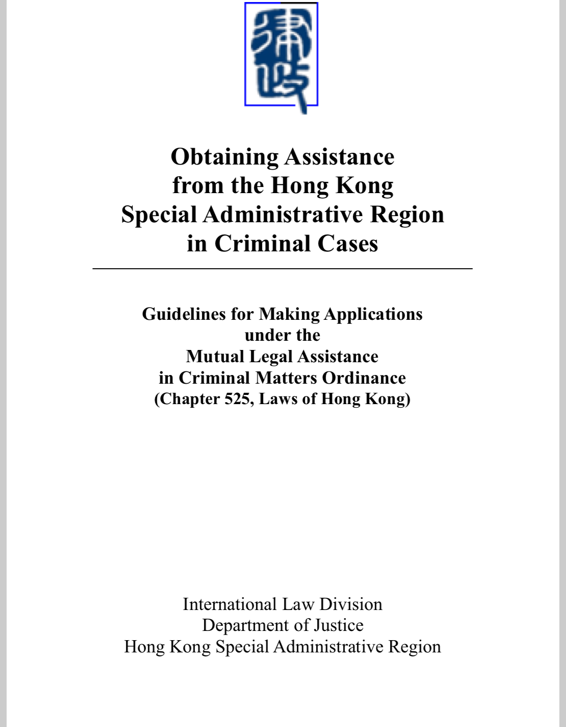
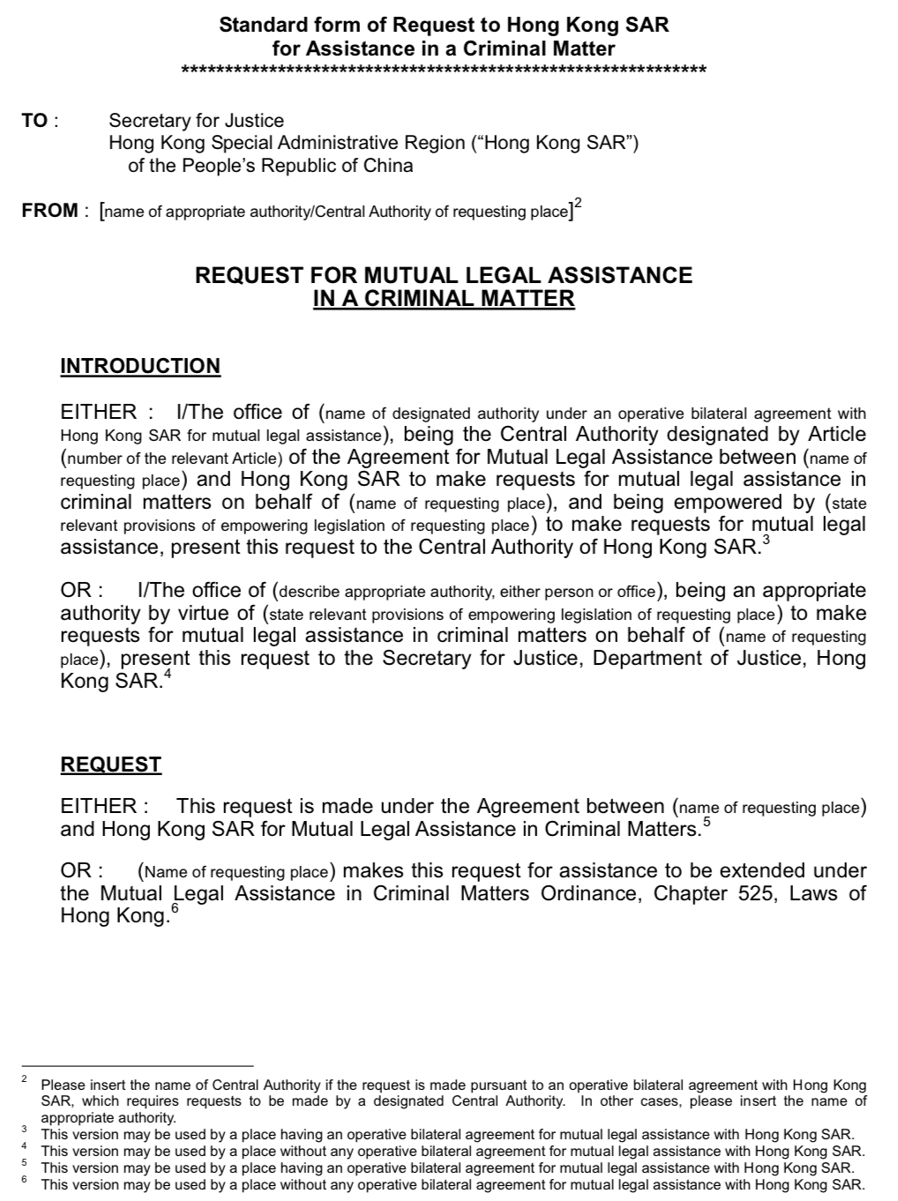
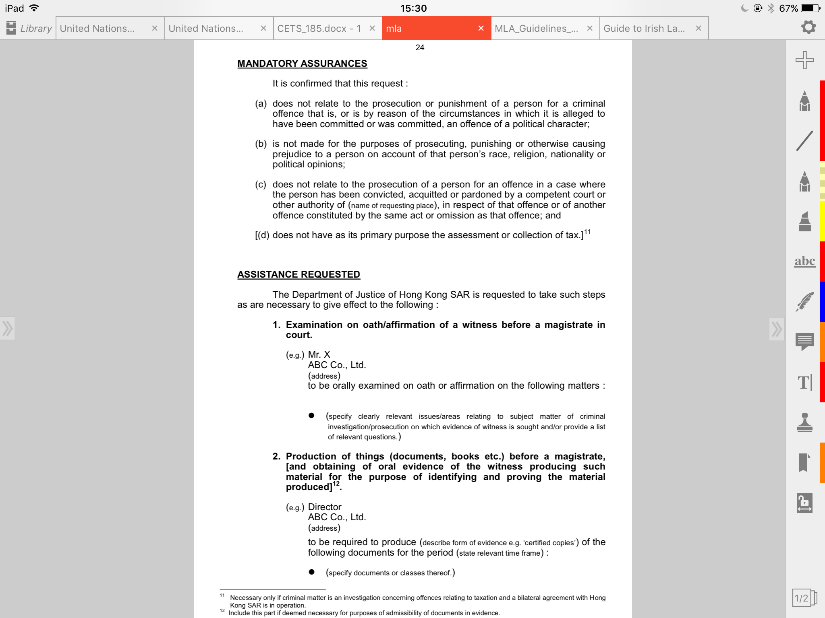
Hong Kong
http://www.doj.gov.hk/lawdoc/mla.pdf
Notes:
This slide shows a screenshot of the Standard Form of Request to Hong Kong SAR for Assistance in a Criminal Matter. This is part of the Guidelines for Making Application under the Mutual Legal Assistance in Criminal Matters Ordinance published by the Department of Justice of Hong Kong SAR.
It includes:
Introduction of the individual and office making the request
Mandatory assurances about the nature of the request (i.e. that it is not being made in relation to a political offence, for the purposes of causing prejudice to a person on account of protected characteristics of that person, and does not involve double jeopardy, and is not primarily a fiscal offence.
Summary of facts
Description of assistance requested

Slide 105
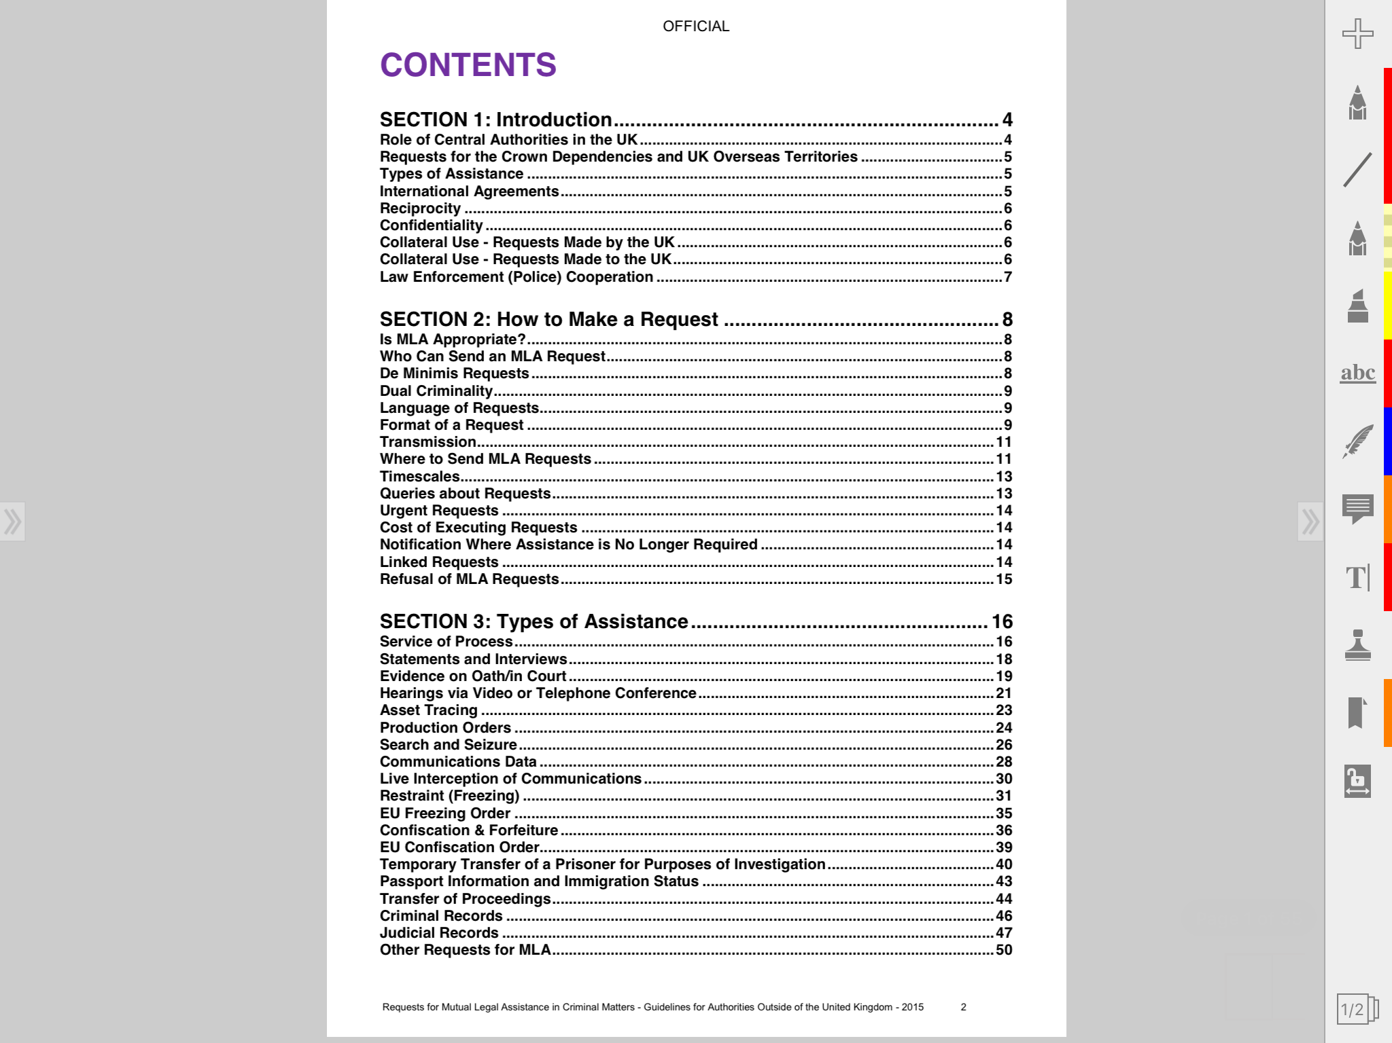
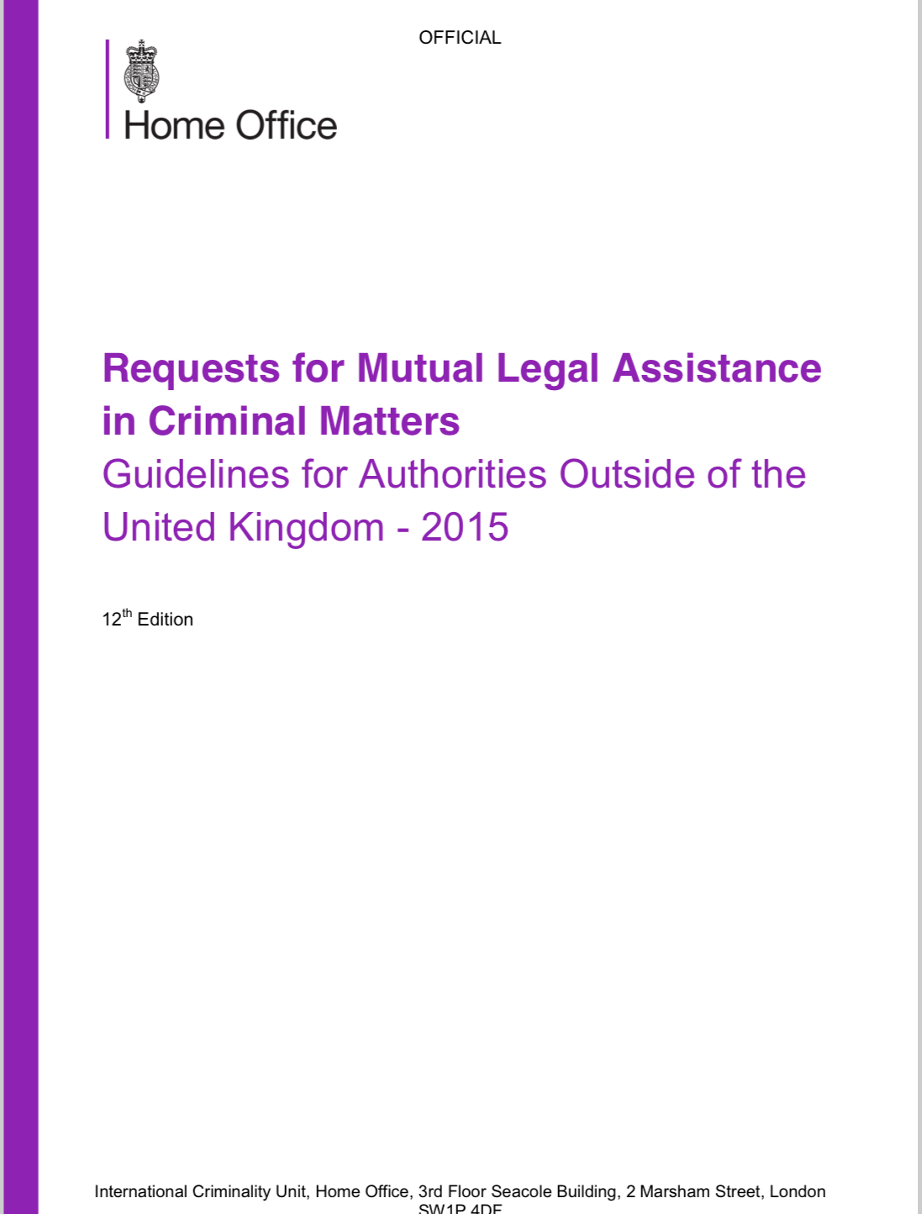
United Kingdom
https://www.gov.uk/government/uploads/system/uploads/attachment_data/file/415038/MLA_Guidelines_2015.pdf
Notes:
This slide shows a screenshot of the “Requests for Mutual Legal Assistance in Criminal Matters – Guidelines for Authorities Outside of the United Kingdom – 2015” published by the UK Home Office. The trainer can share the URL on the slide with participants interested in seeing the guide.

Slide 106
Council of Europe templates: Background
Background
Reasons for going forward with Article 29/30 data preservation template:
  Text of Article 35 of the Convention taken as blueprint for mandatory fields;
  Minimization of input and thus less time for processing;
  Guidance for newly established or upcoming points of contact;
  More uniform practice of preservation requests across jurisdictions.
Capacity building efforts (regional meetings, training) 2016 and 2017;
Initial templates (Art. 29 and 31 BCC) tested by several states;
Further submissions and discussions through mailing list and T-CY Bureau (2017 and 2018);
Final version reviewed and adopted by the 19th Plenary of the T-CY (9-10 July 2018).
Notes:
The trainer can introduce the participants to the templates of the Council of Europe for seeking the preservation of data under Article 29 and the 31 of the Budapest Convention.
The trainer can explain why the Council of Europe prepared the Article 29/30 - mainly to minimize the time to prepare requests, provide guidance to established and new points of contact, and in the longer run, to create a more uniform practice for preservation requests going forward. As part of capacity building efforts of the Cybercrime&EAP project, initial templates for article 29 and 31 of the Budapest Convention were tested and developed by several states.
The templates were presented and reviewed at the first meeting of the 24/7 points of contact at the Hague in September 2017. The template was adopted as a non-binding document
After further submissions and discussions through mailing list and T-CY Bureau in 2017 and 2018, the version reviewed and adopted by the 19th Plenary of the T-CY on 9-10 July 2018.

Slide 107
Article 29/30 template – Mutual Legal
Assistance Request for Preservation
Article 29/30 template – main features:
Marking obligatory items with asterisk (Art. 35 requirements);
Reference/case status;
Less details requested / more details on requesting authority;
Details of authorities in charge of investigation and prosecution (separately);
Contact person details for additional confirmation;
Choice as to the means of response;
Possibility to attach the mutual legal assistance request;
Streamlined “offences” section;
Description of data requested / annex (specification form);
Information identifying the person or organisation;
Article 30 reference;
Case status / urgency (pre-defined items) / confidentiality;
Confirmation/notification options.
Notes:
This slide lists the main features of the article 29/30 template.

Slide 108
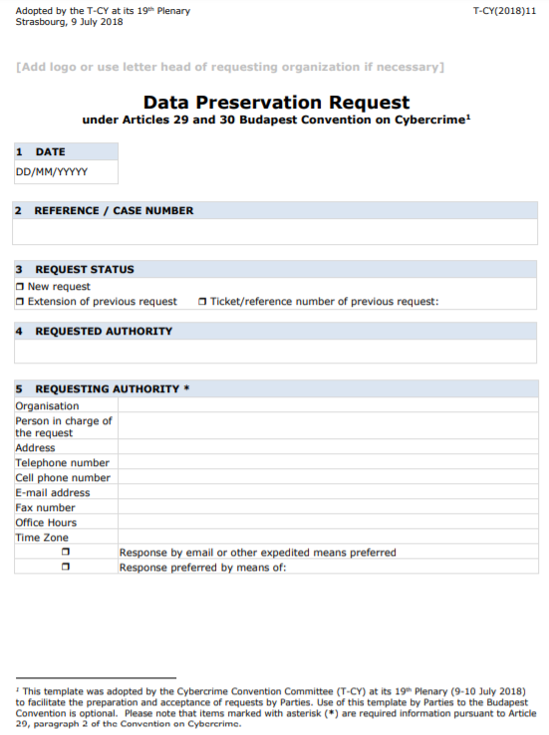
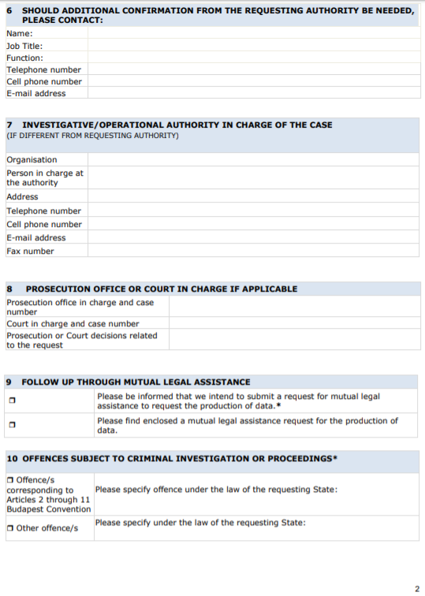
Article 29/30 template
Notes:
These slides show screenshots of the entire Article 29/30 template.

Slide 109
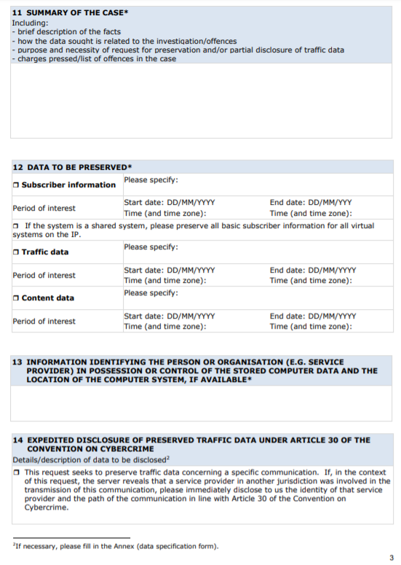
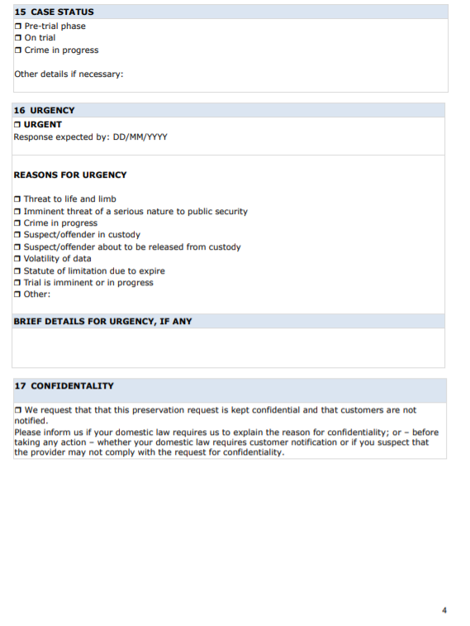
Article 29/30 template
Notes:
These slides show screenshots of the entire Article 29/30 template.

Slide 110
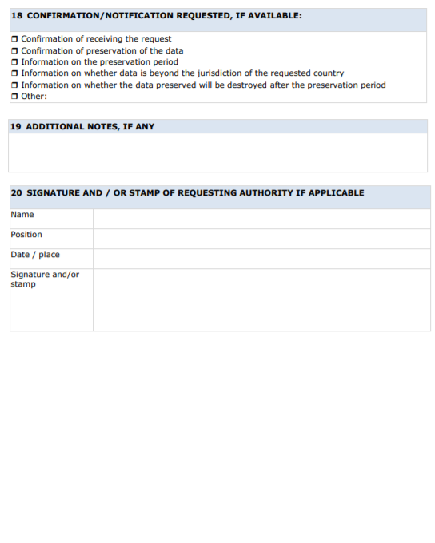
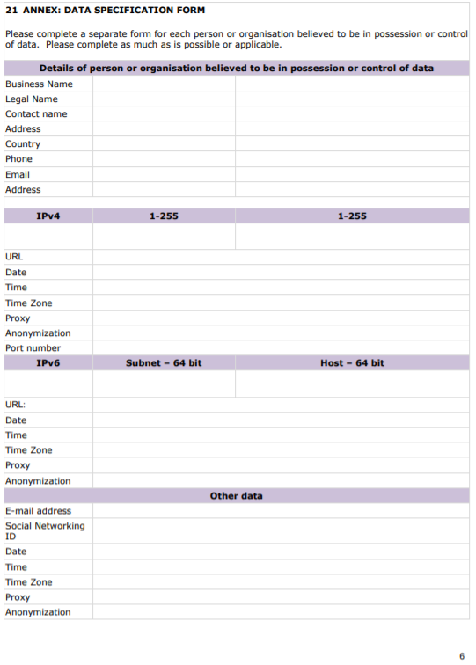
Article 29/30 template
Notes:
These slides show screenshots of the entire Article 29/30 template.

Slide 111
Article 31 template – Mutual Legal Assistance Request for Subscriber Information
Article 31 template - Mutual Legal Assistance Request for subscriber information
Synchronised for applicable content from Article 29/30 template;
Focuses exclusively on subscriber information;
No specifically obligatory items, thus allowing more flexibility;
Details about previous MLA or preservation request;
Streamlined list of offences;
Separate section on domestic legal basis;
Focus on information identifying the service provider;
Separate annexes for subscriber information needed for IP addresses, and for subscriber information needed for accounts;
Future outlook:
  MLA templates should be multilingual in order to save the time for translation and processing;
  The idea of the template is to be electronic / currently editable PDF format;
  Identification / signature (comparable to 24/7 Network).
Notes:
This slide lists the main features of the article 31 template.

Slide 112
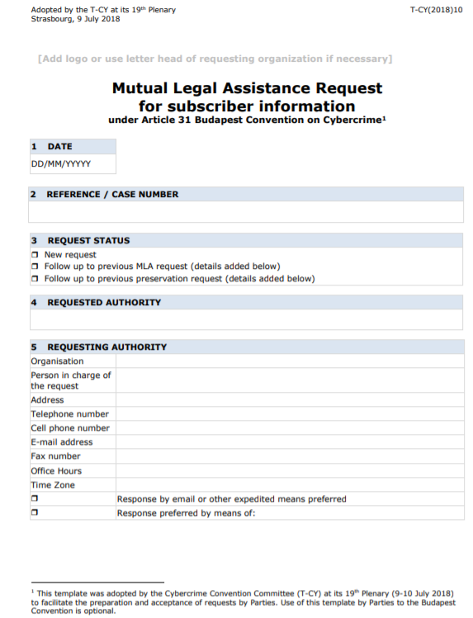
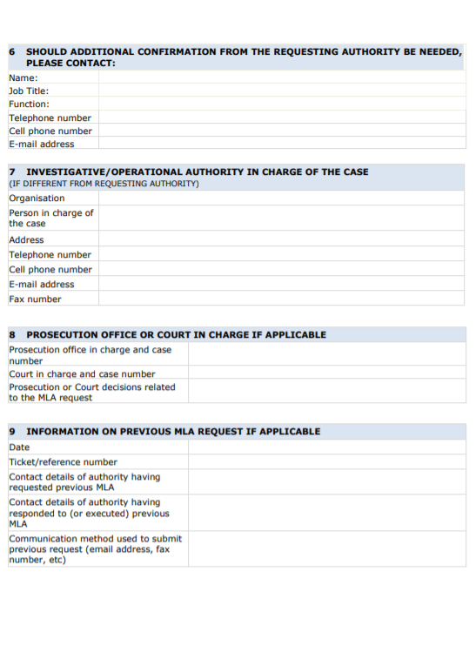
Article 31 template
Notes:
These slides show screenshots of the entire Article 31 template.

Slide 113
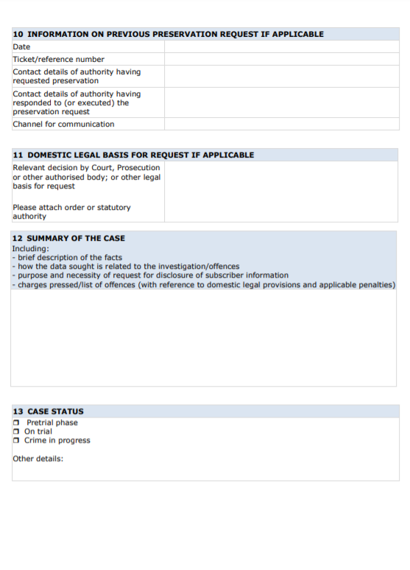
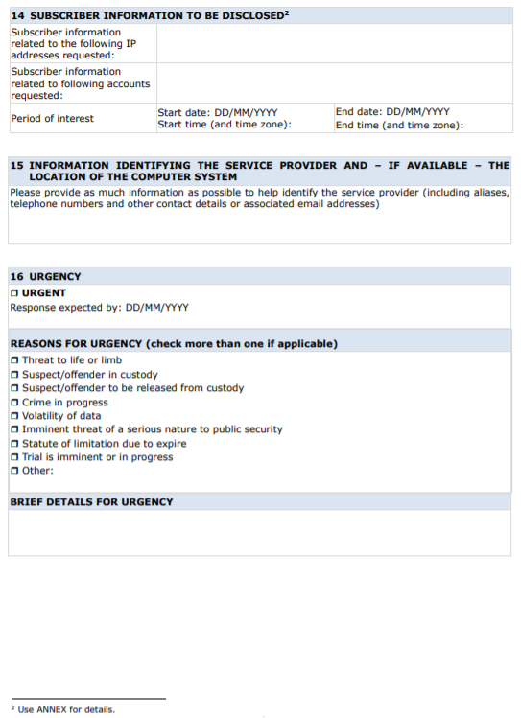
Article 31 template
Notes:
These slides show screenshots of the entire Article 31 template.

Slide 114
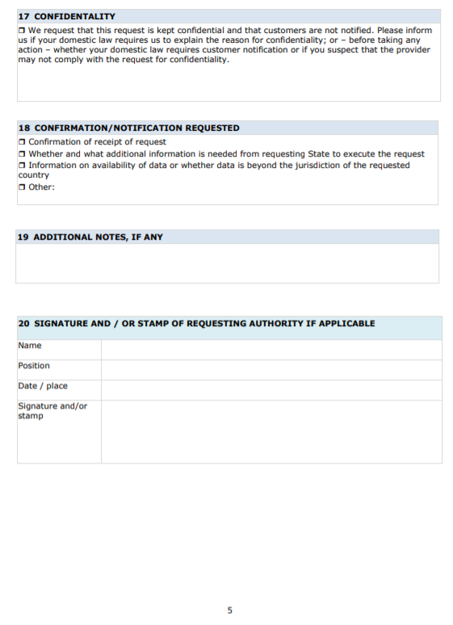
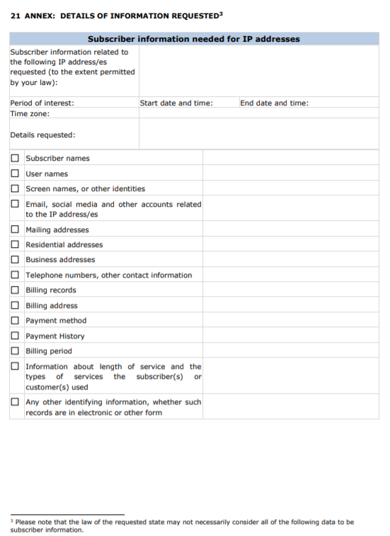
Article 31 template
Notes:
These slides show screenshots of the entire Article 31 template.

Slide 115
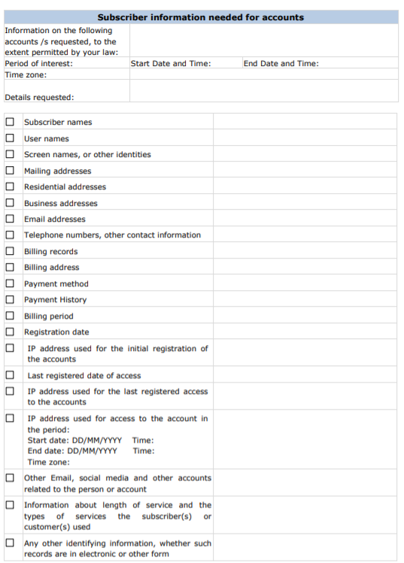
Article 31 template
Notes:
These slides show screenshots of the entire Article 31 template.

Slide 116
Specialized Judicial Course on
International Cooperation
Questions

Slide 117
Specialized Judicial Course on
International Cooperation
Part Five
Summary

Slide 118
Summary
Reviewing the general provisions of international cooperation and mutual assistance under the Budapest Convention
Reviewing the specific provisions of international cooperation and mutual assistance under the Budapest Convention
Discussing provisions of Second Additional Protocol to the Budapest Convention
Understanding how to use different mechanisms under the Budapest Convention to seek cooperation
Introduction to different templates for MLA requests
Notes:
This slide repeats the objectives of this session. The trainer can run through these objectives to ensure that these aspects have been covered in this module.

Slide 119
Specialized Judicial Course on
International Cooperation
Questions

