Slide 1
Specialized Judicial Course on International Cooperation
Session 3.1
Public-Private Partnership / Cooperation

Slide 2
Agenda
Part One
Reviewing key definitions
Part Two
Cooperation with domestic service providers
Part Three
Cooperation with foreign service providers for data acquisition
Part Four
Cooperation with foreign service providers for illegal content removal
Part Five
Case study
Part Six
Summary
Notes:
This session will be divided into 6 parts.
The first part of the session will review key definitions.
The second part of the session will look at cooperation with domestic service providers.
The third part of the session will look at cooperation with foreign service providers for data acquisition.
The fourth part of the session will provide an overview of cooperation with foreign service providers for illegal content removal.
The fifth part of the session has a case study.
The sixth part of the session will summarise the session objectives.

Slide 3
Session Objectives
Review primary classifications of data and information held by private sector
Understand key considerations when cooperating with domestic service providers
Discuss mechanisms for cooperation with foreign service providers for acquisition of data including MLATs, emergency requests, production orders and voluntary cooperation
Discuss mechanisms for cooperation with foreign service providers for removal of illegal content
Understand best practices for cooperating with foreign service providers
Notes:
This slide outlines the objectives of this session. It underscores what participants should expect to learn from the slides. The participants can be informed that this slide will be revisited at the end of the session to assess whether the objectives were met.

Slide 4
Specialized Judicial Course on
International Cooperation
Part One
Reviewing Key Definitions
Notes:
The first part will review the meaning of key terms, namely “service provider”, “traffic data”, “subscriber information” and “content data”, which will be used throughout the session.

Slide 5
Service Provider
"service provider" means:
i any public or private entity that provides to users of its service the ability to communicate by means of a computer system, and
ii any other entity that processes or stores computer data on behalf of such communication service or users of such service.
Yes:
  communication or related data processing services (e.g. hosting and caching providers)
  private & public entities
  free or paid services
  provision to closed group or public
No:
  content providers
Notes:
On the left side, this slide shows the text of Article 1.c of the Budapest Convention which is the definition of “service provider”.
On the right side, this slide provides an explanation of the definition.
The term service provider as defined in the Budapest Convention encompasses a broad category of persons that play a particular role with regard to communication or processing of data on computer systems. It includes both private and public entities, covers provision of services to a closed group or to the public, free or paid services.

Slide 6
Traffic Data
Yes:
  category of computer data
  generated by computer that formed part in chain of communication
  Indicates communication’s:
    origin
    destination
    route
    time
    date
    size
    duration
    type of underlying service
No:
  content of communication
"traffic data" means any computer data relating to a communication by means of a computer system, generated by a computer system that formed a part in the chain of communication, indicating the communication’s origin, destination, route, time, date, size, duration, or type of underlying service.
Notes:
On the left side, this slide shows the text of Article 1.d of the Budapest Convention which is the definition of “traffic data”.
On the right side, this slide provides an explanation of the definition.
Traffic data as defined under the Budapest Convention is a category of computer data that is subject to a specific legal regime. This data is generated by computers in the chain of communication in order to route a communication from its origin to its destination. It is therefore auxiliary to the communication itself. The slide describes some key characteristics of traffic data.

Slide 7
Subscriber Information
“subscriber information” means any information contained in the form of computer data or any other form that is held by a service provider, relating to subscribers of its services other than traffic or content data and by which can be established:
a the type of communication service used, the technical provisions taken thereto and the period of service;
b the subscriber’s identity, postal or geographic address, telephone and other access number, billing and payment information, available on the basis of the service agreement or arrangement;
c any other information on the site of the installation of communication equipment, available on the basis of the service agreement or arrangement.
Yes:
  Form of computer data or other form
  Held by service provider
  Relates to subscriber of services, including:
    Free clients
    Pay-per-use clients
    Paid subscription clients
    Individuals entitled to use subscribers account
No:
  content of communications of subscriber
  traffic data associated with subscriber account
Notes:
On the left side, this slide shows the text of Article 18.3 of the Budapest Convention which is the definition of “subscriber information”.
On the right side, this slide provides an explanation of the definition.
It is important to note that subscriber information may not necessarily be in the form of computer data; and thus includes physical records held by service providers in relation to their subscribers. Subscriber information is basically information that relates to a subscriber and could help ascertain the identity of a subscriber, but it does not include the content of communications or traffic data.

Slide 8

Poll question
Which of the following would not fall under the definition of “subscriber information”?
a) User’s postal address
b) User’s emails
c) User’s phone number
d) User’s contact list
e) User’s credit card number
Notes:
The correct answer is b) User’s emails, and (d) User’s contact list. These would be considered content data, which is excluded from the definition of “subscriber information”.

Slide 9
Poll question
Which of the following would not fall under the definition of “subscriber information”?
a) User’s postal address
b) User’s emails
c) User’s phone number
d) User’s contact list
e) User’s credit card number
Notes:
The correct answer is b) User’s emails, and (d) User’s contact list. These would be considered content data, which is excluded from the definition of “subscriber information”.

Slide 10
Content Data
Not defined in the Budapest Convention
Explanatory Report: Content data refers to:
  communication content of the communication; i.e., the meaning or purport of the communication, or the message or information being conveyed by the communication (other than traffic data).
Yes:
  Stored content
  Future content
  Examples:
    Emails
    Images
    Movies
    Music
No:
  Traffic data
  Subscriber information
Notes:
On the left side, the definition of “content data” in the explanatory report has been provided (since the term “content data” has not been defined in the Budapest Convention).
On the right side, an explanation of this definition has been provided.

Slide 11
Specialized Judicial Course on
International Cooperation
Part Two
Cooperation with Domestic Service Providers
Notes:
The second part will review how to cooperate with domestic service providers – i.e. how to cooperate with service providers that have a legal presence within the jurisdiction that is seeking cooperation.

Slide 12
Cooperation with Domestic Service Providers
Countries may use existing procedural powers including:
  Expedited preservation of stored traffic data
  Expedited preservation and partial disclosure of traffic data
  Production order
  Search and seizure
  Real-time collection of traffic data
  Interception of content data
Some procedural powers are highly onerous for service providers
Production orders are preferred method for cooperation with domestic service providers
Private sector has contractual and non-contractual privacy obligations
Production orders provide legal basis to provide assistance to cooperation without liability
Notes:
This slide outlines how local authorities can cooperate with domestic service providers. This can be done through the exercise of the procedural law provisions established in accordance with Chapter II Section 2 of the Budapest Convention, namely:
Expedited preservation of stored traffic data
Expedited preservation and partial disclosure of traffic data
Production order
Search and seizure
Real-time collection of traffic data
Interception of content data
The trainer should explain that the scope of each power is different – and while some are highly onerous for service providers, production orders are the preferred method for cooperation for service providers. While service providers would often like to cooperate voluntarily, they require legal cover since they have legal and contractual obligations to maintain the privacy of subscriber information in their possession. Production orders provide such legal cover and enable the private sector to cooperate with adequate legal basis.

Slide 13
Production Orders
Article 18 - Production Order
1 Each Party shall adopt such legislative and other measures as may be necessary to empower its competent authorities to order:
a a person in its territory to submit specified computer data in that person’s possession or control, which is stored in a computer system or a computer-data storage medium; and
b a service provider offering its services in the territory of the Party to submit subscriber information relating to such services in that service provider’s possession or control.
Any person in territory (including service provider)
Location of data is not relevant
Notes:
On the left side, this slide shows the text of Article 18 of the Budapest Convention with one element (“person in its territory”) highlighted.
On the right side, this slide provides an explanation of the highlighted element.
Article 18,1,a applies to persons in the territory of the Party. Thus while it does not require that the computer data that is the subject of a production order be located in the territory, the person to whom the order is made is required to be physically present in the territory. The term person is broad and it includes both natural persons and legal persons, including service providers.

Slide 14
Production Orders
Article 18 - Production Order
1 Each Party shall adopt such legislative and other measures as may be necessary to empower its competent authorities to order:
a a person in its territory to submit specified computer data in that person’s possession or control, which is stored in a computer system or a computer-data storage medium; and
b a service provider offering its services in the territory of the Party to submit subscriber information relating to such services in that service provider’s possession or control.
Relates to all computer data (traffic content or other computer data)
Order must specify computer data (cannot be indiscriminate)
  Allowed: Ordering production of email address associated with a particular name
  Not allowed: Ordering production of all email communications during last three years associated with a particular name
Notes:
On the left side, this slide shows the text of Article 18 of the Budapest Convention with one element (“specified computer data”) highlighted.
On the right side, this slide provides an explanation of the highlighted element.
It is necessary that the competent authority that orders production of computer data be allowed to do the same with respect to only specified data, and not generally request large volumes of data indiscriminately. Thus a production order to a person to produce all data stored in their computer system would not be allowed under Article 18.

Slide 15
Production Orders
Article 18 - Production Order
1 Each Party shall adopt such legislative and other measures as may be necessary to empower its competent authorities to order:
a a person in its territory to submit specified computer data in that person’s possession or control, which is stored in a computer system or a computer-data storage medium; and
b a service provider offering its services in the territory of the Party to submit subscriber information relating to such services in that service provider’s possession or control.
Service provider can either have:
  physical possession
  constructive possession (free control over its production)
Local of data irrelevant as long as controlled by service provider in territory
Control does not include technical ability to access remotely stored data not within legitimate control
Notes:
On the left side, this slide shows the text of Article 18 of the Budapest Convention with one element (“possession or control”) highlighted.
On the right side, this slide provides an explanation of the highlighted element.
The competent authority may only order a person to produce computer data where such specified computer data is in either the possession or the control of such person. This slide distinguishes between possession (i.e. physical possession) and control (i.e. free control over the data, even if it may not be in their physical possession).

Slide 16
Production Orders
Article 18 - Production Order
1 Each Party shall adopt such legislative and other measures as may be necessary to empower its competent authorities to order:
a a person in its territory to submit specified computer data in that person’s possession or control, which is stored in a computer system or a computer-data storage medium; and
b a service provider offering its services in the territory of the Party to submit subscriber information relating to such services in that service provider’s possession or control.
Power only relates to stored (existing) data
Does not impose data retention obligation
Notes:
On the left side, this slide shows the text of Article 18 of the Budapest Convention with one element (“stored in a computer system or a computer data storage medium”) highlighted.
On the right side, this slide provides an explanation of the highlighted element.
Production orders can only be made with respect to existing data that is either in a computer system or a computer-data storage medium. It cannot be used to order a person to retain data; or to produce data that will come into existence at a future date.

Slide 17
Production Orders
Article 18 - Production Order
1 Each Party shall adopt such legislative and other measures as may be necessary to empower its competent authorities to order:
a a person in its territory to submit specified computer data in that person’s possession or control, which is stored in a computer system or a computer-data storage medium; and
b a service provider offering its services in the territory of the Party to submit subscriber information relating to such services in that service provider’s possession or control.
It can be in any form (computer data or not)
It may include:
  the type of communication service used, the technical provisions & period of service;
  subscriber’s identity, postal/geographic address, telephone and other access number, billing and payment information, available
  other information on the site of the installation of communication equipment, available on the basis of the service arrangement
Notes:
On the left side, this slide shows the text of Article 18 of the Budapest Convention with one element (“submit subscriber information”) highlighted.
On the right side, this slide provides an explanation of the highlighted element.
This slide provides an explanation of the definition of subscriber information under Article 18 of the Budapest Convention. It is important to note that subscriber information may not necessarily be in the form of computer data; and thus includes physical records held by service providers in relation to their subscribers.

Slide 18
Production Orders
Article 18 - Production Order
1 Each Party shall adopt such legislative and other measures as may be necessary to empower its competent authorities to order:
a a person in its territory to submit specified computer data in that person’s possession or control, which is stored in a computer system or a computer-data storage medium; and
b a service provider offering its services in the territory of the Party to submit subscriber information relating to such services in that service provider’s possession or control.
The information being ordered must relate to services being offered within the territory
Subscriber information cannot be sought for services offered solely outside the territory
Notes:
On the left side, this slide shows the text of Article 18 of the Budapest Convention with one element (“relating to such services”) highlighted.
On the right side, this slide provides an explanation of the highlighted element.
This limits the scope of subscriber information that may the subject of a production order to such subscriber information that is related to the services being offered by a service provider in the territory.

Slide 19
Production Orders
Article 18 - Production Order
1 Each Party shall adopt such legislative and other measures as may be necessary to empower its competent authorities to order:
a a person in its territory to submit specified computer data in that person’s possession or control, which is stored in a computer system or a computer-data storage medium; and
b a service provider offering its services in the territory of the Party to submit subscriber information relating to such services in that service provider’s possession or control.
Service provider can either have:
  physical possession
  constructive possession (free control over its production)
Local of data irrelevant as long as controlled by service provider in territory
Control does not include technical ability to access remotely stored data not within legitimate control
Notes:
On the left side, this slide shows the text of Article 18 of the Budapest Convention with one element (“service provider’s possession or control”) highlighted.
On the right side, this slide provides an explanation of the highlighted element.
The competent authority may only order a service provider to produce subscriber information where such subscriber information is in either the possession or the control of such service provider. This slide distinguishes between possession (i.e. physical possession) and control (i.e. free control over the information, even if it may not be in their physical possession).

Slide 20
Poll question
Under Article 18, which data cannot be ordered from local service providers?
a) Subscriber information
b) Stored traffic data
c) Real-time collection of traffic data
d) Stored content data
Notes:
The correct answer is c) Real-time collection of traffic data.
This is because the scope of Article 18 is limited to stored computer data and subscriber information and would not enable real-time collection or interception, for which Article 20 and 21 would have to be exercised.

Slide 21
Poll question
Under Article 18, which data cannot be ordered from local service providers?
a) Subscriber information
b) Stored traffic data
c) Real-time collection of traffic data
d) Stored content data
Notes:
The correct answer is c) Real-time collection of traffic data.
This is because the scope of Article 18 is limited to stored computer data and subscriber information and would not enable real-time collection or interception, for which Article 20 and 21 would have to be exercised.

Slide 22

Specialized Judicial Course on
International Cooperation
Questions

Slide 23
Specialized Judicial Course on
International Cooperation
Part Three
Cooperation with Foreign Service Providers on Data Acquisition
Notes:
The third part will provide an overview of cooperation with foreign service providers with respect to data acquisition (i.e. obtaining electronic evidence from service providers which do not have a legal presence in the country seeking the evidence).

Slide 24
Cooperation with Foreign Service Providers
Many global service providers offer services in a territory without a legal presence in that territory
Challenges constructing long-arm jurisdiction in view of existing norms of international law
Options for cooperation include:
  MLA frameworks
  Emergency disclosure requests
  Production orders
  Trans-border access with consent
  Voluntary cooperation
Countries can use existing MLA frameworks to seek foreign governments to obtain data from foreign service providers
MLA frameworks are legally binding mechanism to compel foreign service providers
MLA frameworks can be relatively slow and cumbersome
Notes:
Given the global nature of the internet, it is not uncommon for any service provider to make its services available in jurisdictions where it does not have a legal presence. For example:
Google has offices across 40 countries
Facebook has offices across 35 countries
Twitter has offices across 19 countries
This is much less than the number of countries these platforms operate in.
Given traditional legal principles and international law norms, there tends to be a challenge for many countries to effectively construct long-arm jurisdiction. This slide highlights some options available for cooperation with foreign service providers, namely:
MLA frameworks
Emergency disclosure requests
Production orders
Trans-border access with consent
Voluntary cooperation
The right side of the slide introduces cooperation through MLA frameworks. MLA frameworks (usually known as mutual legal assistance treaties) can be used to seek cooperation from foreign service providers. This would usually entail a central authority of the requesting state making a formal mutual assistance request to the central authority of the requested state. The central authority of the requested state will then exercise domestic procedural powers in accordance with domestic law and obtain the evidence from the service provider. Once this information has been obtained, it will be transmitted to the central authority of the requesting state.
While MLA frameworks are a legally binding mechanism to compel foreign service providers, they tend to be relatively slow and cumbersome.

Slide 25

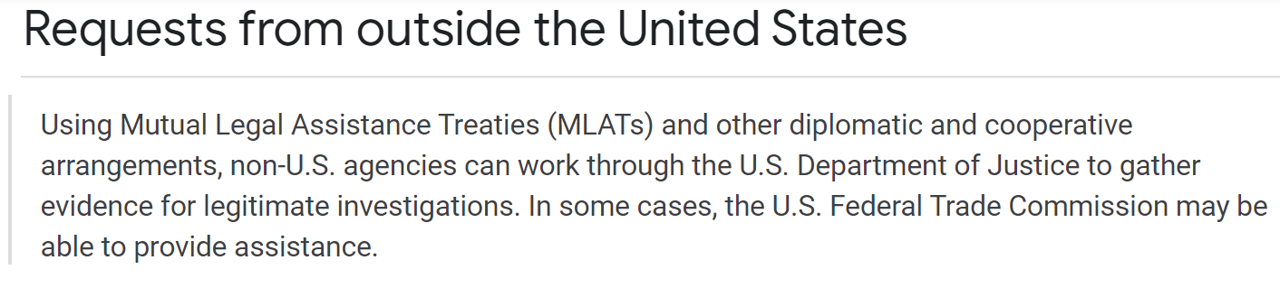

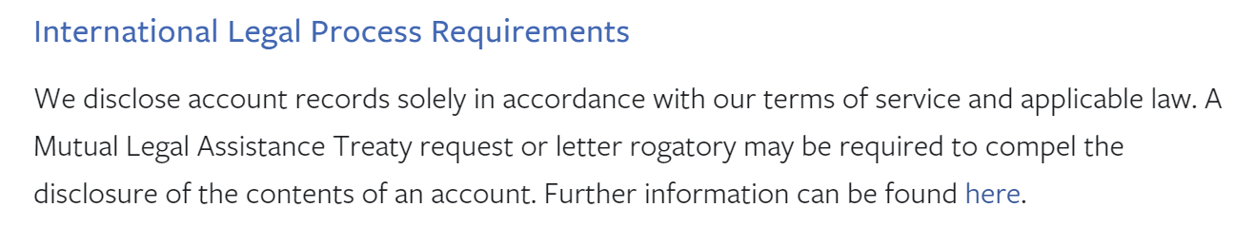
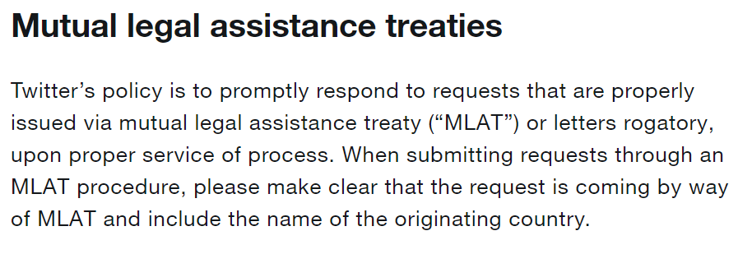

MLA Frameworks
Most global service providers require MLATs for disclosure of subscriber information
Notes:
This slide shows how many global service providers such as Google, Facebook and Twitter require a request made in accordance with a mutual legal assistance treaty to disclose subscriber information.

Slide 26
Emergency Disclosure
Service providers may disclose data in emergencies even in the absence of MLAT requests
This is where the disclosure is necessary to prevent death or serious bodily harm
Different service providers have different criteria and procedures for emergency disclosure
The state requesting emergency disclosure need not have an MLAT with the country where service provider is based
Notes:
These slides explain how emergency disclosure requests can be used to get cooperation from foreign service providers.
As mentioned on a previous slide, the process for obtaining information from mutual legal assistance treaties tends to be quite slow and may not be appropriate for emergency cases. Many global service providers disclose data in emergency cases even the absence of a request made pursuant to a mutual legal assistance treaty. Such requests must demonstrate that disclosure is necessary to prevent death or serious bodily harm – though different service providers have varying criteria for emergency disclosure. It is important to note that emergency disclosure, unlike a disclosure request made pursuant to an MLAT, is not legally binding on foreign service providers.

Slide 27
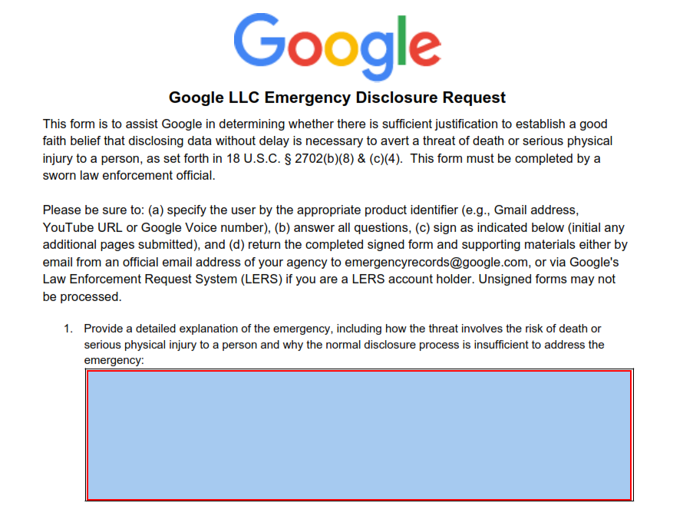
Notes:
This slide shows the template of the Emergency Disclosure Request Form for Google. The trainer can take the participants through each of the required fields to demonstrate, as one example, what kind of information must be shared with a service provider when making an emergency disclosure request.

Slide 28
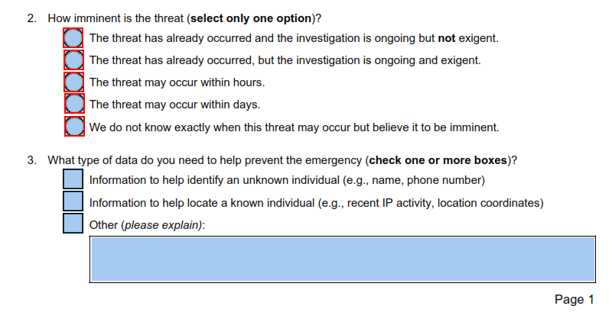
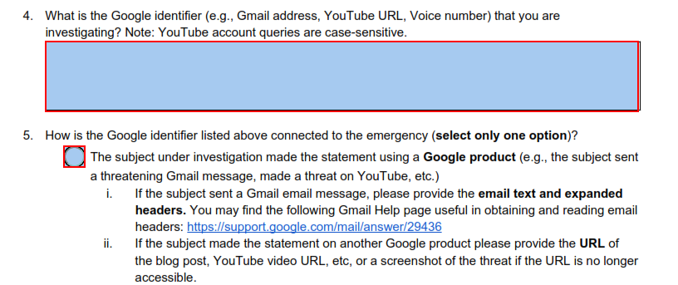
Notes:
This slide shows the template of the Emergency Disclosure Request Form for Google. The trainer can take the participants through each of the required fields to demonstrate, as one example, what kind of information must be shared with a service provider when making an emergency disclosure request.

Slide 29
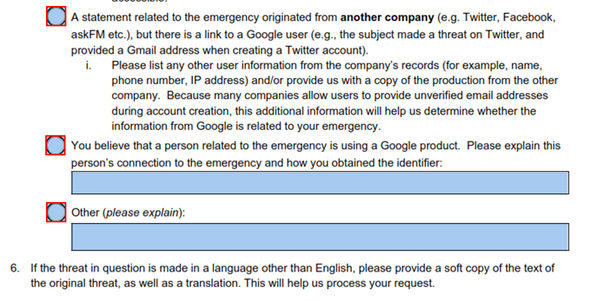
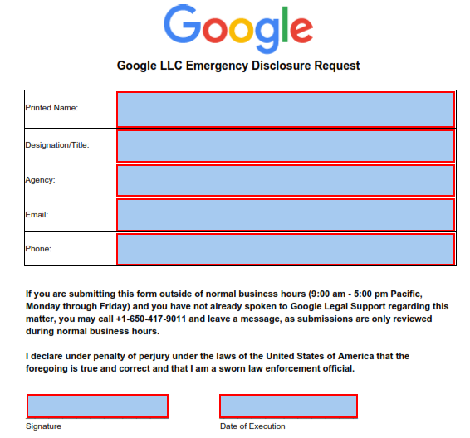
Notes:
This slide shows the template of the Emergency Disclosure Request Form for Google. The trainer can take the participants through each of the required fields to demonstrate, as one example, what kind of information must be shared with a service provider when making an emergency disclosure request.

Slide 30
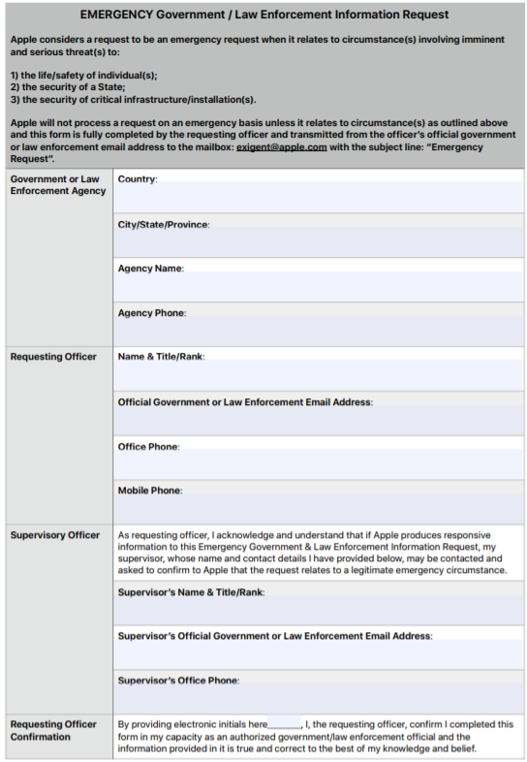

Notes:
This slide shows the template of the Emergency Disclosure Request Form for Apple. The trainer can take the participants through each of the required fields to demonstrate, as one example, what kind of information must be shared with a service provider when making an emergency disclosure request.

Slide 31
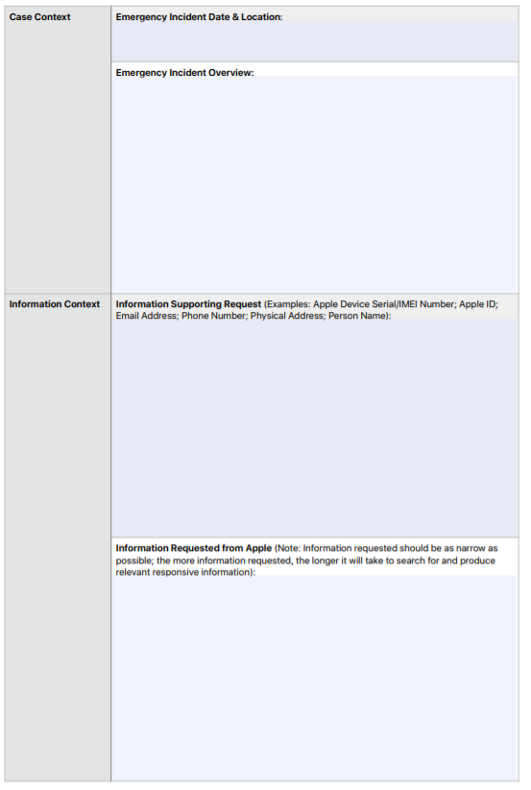
Notes:
This slide shows the template of the Emergency Disclosure Request Form for Apple. The trainer can take the participants through each of the required fields to demonstrate, as one example, what kind of information must be shared with a service provider when making an emergency disclosure request.

Slide 32
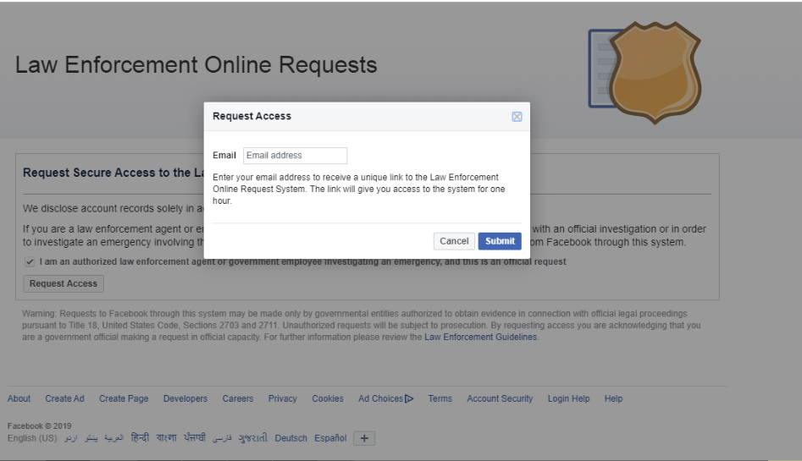
Demonstration – Facebook Emergency Request
Step 1: Request Access to Law Enforcement Request System
Notes:
The trainer should use these slides to conduct a demonstration of how the Facebook Emergency Request portal works.
The trainer should explain that this portal is only available to law enforcement agents who use approved email addresses.
In this screenshot, the law enforcement official must first request access, which is only granted for periods of one hour each.

Slide 33
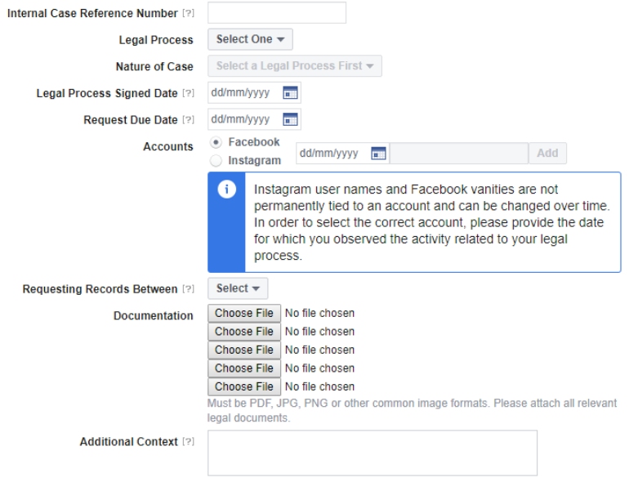
Demonstration – Facebook Emergency Request
Step 2: Select “Make a Record Request” and complete form
Notes:
Once the law enforcement official is granted access to the portal, they must select “Make a Record Request” and then complete the form, providing information about the legal process (i.e. court order or otherwise), select the nature of the case, identify the Facebook or Instagram account in question and the date on which the account was identified, provide a duration for which records are being requested, and importantly, providing additional context.
(form continued on next slide)

Slide 34
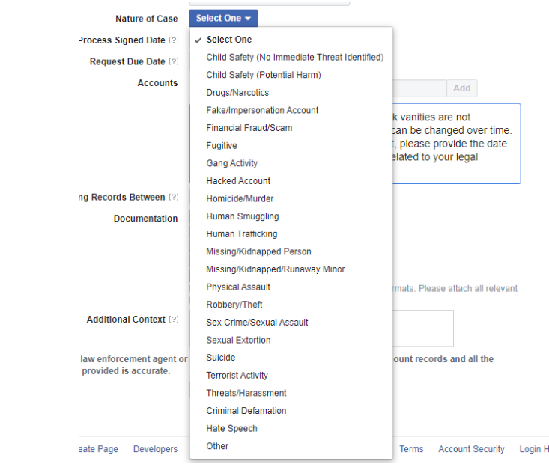
Demonstration – Facebook Emergency Request
Step 2: Select “Make a Record Request” and complete form
Notes:
This slide shows the options available when making an emergency request. The trainer should explain that the scope of emergency requests is limited, and would cover cases such as those listed on the screen.
(form continued on next slide)

Slide 35

Demonstration – Facebook Emergency Request
Step 3: Attach Documentation
This may include any supporting materials such as:
  complaint (with English translation)
  any evidence available (with English translation)
  court order (with English translation) (if available)
Notes:
The law enforcement official will be required to attach relevant documentation which may include supporting materials such as those listed on the slide.

Slide 36
Poll question
All global service providers require the existence of a mutual legal assistance treaty with a country to provide data to that country pursuant to an emergency disclosure request.
True
False
Notes:
The correct answer is: False.
Many global service providers disclose data pursuant to an emergency disclosure request, even if the country in which they are based does not have an MLAT with the country which is making the emergency disclosure request.

Slide 37
Poll question
All global service providers require the existence of a mutual legal assistance treaty with a country to provide data to that country pursuant to an emergency disclosure request.
True
False
Notes:
The correct answer is: False.
Many global service providers disclose data pursuant to an emergency disclosure request, even if the country in which they are based does not have an MLAT with the country which is making the emergency disclosure request.

Slide 38
Production Orders
Article 18 - Production Order
1 Each Party shall adopt such legislative and other measures as may be necessary to empower its competent authorities to order:
b a service provider offering its services in the territory of the Party to submit subscriber information relating to such services in that service provider’s possession or control.
Production order for service provider can be made to foreign service providers if they provide services in country
Service provider must have established real and substantial connection to country – e.g.
  Local advertising
  Local language advertising
  Using local subscriber information and associated traffic data in course of its activities
  Interacting with local subscribers
  Otherwise considered established locally
Notes:
These slides explain how production orders can be used to get cooperation from foreign service providers.
On the left side, this slide shows the text of Article 18 of the Budapest Convention with one element (“offering its services in the territory”) highlighted.
On the right side, this slide provides an explanation of the highlighted element.
Article 18,1,b has a more limited scope as compared to Article 18,1,a, in the sense that it applies only to service providers; and thus does not apply to any natural or legal persons that do not fall under the definition of service providers.
However, it is not limited in terms of physical location of the service provider, and applies so long as the service provider is offering services in the territory of the Party.
The slide lists some of the determining factors to be taken into account when gauging whether a service provider is offering services in a particular territory.
The trainer can then refer to the Guidance Note on Article 18 (see next slide)

Slide 39
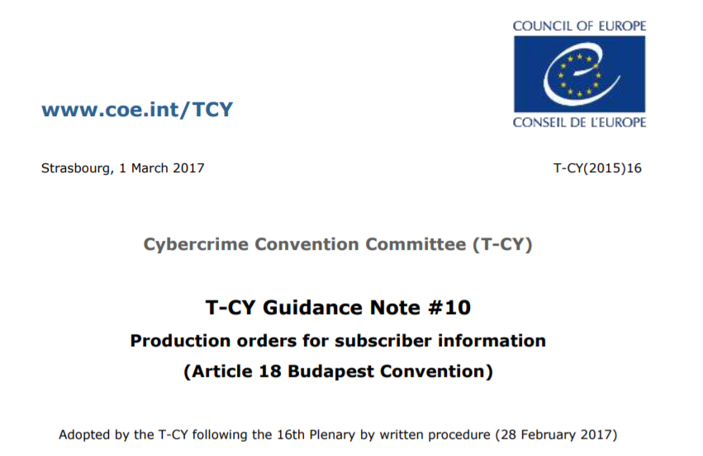
Notes:
This slide shows a screenshot of the Guidance Note on Article 18, which elaborates how the power under Article 18.1.b can be used to seek the production of subscriber information from service providers that do not have a legal presence in a particular country.

Slide 40
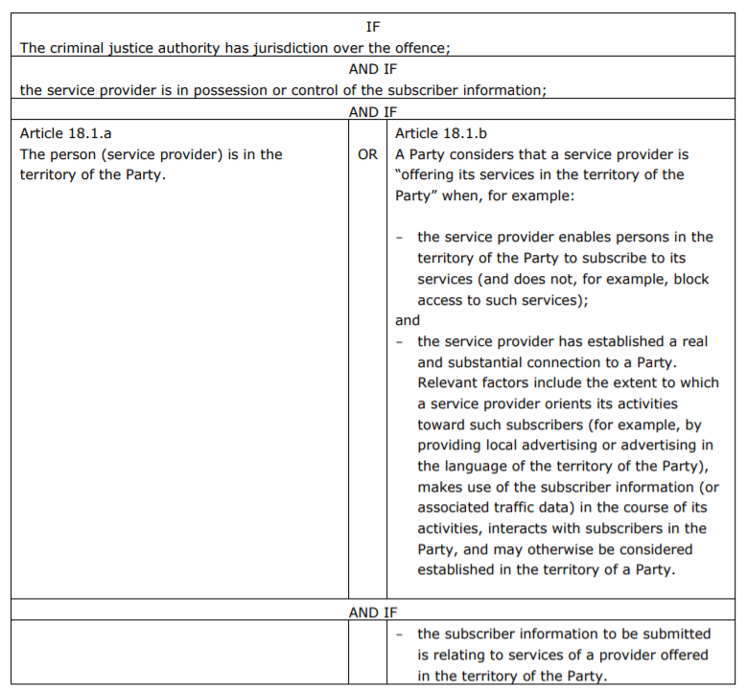
Notes:
This slide shows how Article 18.1.b. allows seeking direct cooperation from foreign service providers by issuing production orders for subscriber information.

Slide 41
Poll question
Under Article 18, which data cannot be ordered from private sector service providers offering services in your country?
a) Subscriber information from a foreign service provider
b) Traffic data from a foreign service provider
c) Subscriber information from a local service provider
d) Traffic data from a local service provider
Notes:
The correct answer is b) Traffic data from a foreign service provider.
This is because the scope of Article 18.1.b only relates to subscriber information and would not enable ordering production of traffic data from a foreign service provider.
The remaining options are covered under Article 181.a. and 18.1.b.

Slide 42
Trans-border Access
Article 32 – Trans-border access to stored computer data with consent or where publicly available
A Party may, without the authorisation of another Party:
a access publicly available (open source) stored computer data, regardless of where the data is located geographically; or
b access or receive, through a computer system in its territory, stored computer data located in another Party, if the Party obtains the lawful and voluntary consent of the person who has the lawful authority to disclose the data to the Party through that computer system.
Does not require mutual assistance request to country where service provider is located
Does not mandate notification to country where service provider is located
Notes:
These slides explain how trans-border access provisions can be used to get cooperation from foreign service providers.
On the left side, this slide shows the text of Article 32 of the Budapest Convention with one element (“without the authorization of another party”) highlighted.
On the right side, this slide provides an explanation of the highlighted element.
The trainer should emphasize that while most of the international cooperation provisions of the Budapest Convention require authorisation of another state, Article 32 is different in that it may be used to obtain electronic evidence from another jurisdiction even if the state where such evidence resides does not give its authorisation.

Slide 43
Trans-border Access
Article 32 – Trans-border access to stored computer data with consent or where publicly available
A Party may, without the authorisation of another Party:
a access publicly available (open source) stored computer data, regardless of where the data is located geographically; or
b access or receive, through a computer system in its territory, stored computer data located in another Party, if the Party obtains the lawful and voluntary consent of the person who has the lawful authority to disclose the data to the Party through that computer system.
Allows accessing publicly available data
If portion of a website is closed to public, it is not publicly available
Location of data is not relevant (whether or not in a Budapest Convention party)
Notes:
On the left side, this slide shows the text of Article 32 of the Budapest Convention with one element (“publicly available (open source)….. regardless of where the data is stored”) highlighted.
On the right side, this slide provides an explanation of the highlighted element.
This is one of the conditions that allows for transborder access to data without the authorisation of the party where the data is stored – i.e. that the data is publicly available data (open source). The slides explain that if a portion of a website is closed to the general public, then it is not considered publicly available for the purposes of Article 32.a. The geographical location data of the data is irrelevant when accessing publicly available data – so it is irrelevant whether it is stored within or outside a Budapest Convention party.

Slide 44
Trans-border Access
Article 32 – Trans-border access to stored computer data with consent or where publicly available
A Party may, without the authorisation of another Party:
a access publicly available (open source) stored computer data, regardless of where the data is located geographically; or
b access or receive, through a computer system in its territory, stored computer data located in another Party, if the Party obtains the lawful and voluntary consent of the person who has the lawful authority to disclose the data to the Party through that computer system.
Location of data must be in another Budapest Convention party
Notes:
On the left side, this slide shows the text of Article 32 of the Budapest Convention with one element (“stored computer data located in another Party”) highlighted.
On the right side, this slide provides an explanation of the highlighted element.
Unlike the power to access publicly available data which may be exercised in relation to data stored anywhere, the power to access data with consent is only available when the data sought is located in another Budapest Convention party.

Slide 45
Trans-border Access
Article 32 – Trans-border access to stored computer data with consent or where publicly available
A Party may, without the authorisation of another Party:
a access publicly available (open source) stored computer data, regardless of where the data is located geographically; or
b access or receive, through a computer system in its territory, stored computer data located in another Party, if the Party obtains the lawful and voluntary consent of the person who has the lawful authority to disclose the data to the Party through that computer system.
Data can be accessed based on lawful and voluntary consent
Lawfulness of consent is based on local law (e.g. minors and persons with mental incapacitation may not be able to consent)
Agreement to general terms of service may not qualify as specific, explicit consent
Notes:
On the left side, this slide shows the text of Article 32 of the Budapest Convention with one element (“lawful and voluntary consent”) highlighted.
On the right side, this slide provides an explanation of the highlighted element.
The power to access data trans-border may be exercised on the basis of lawful and voluntary consent obtained from the person who has authority to disclose the data. The slide explains the scope of the term lawful and voluntary consent, and how it can be used to obtain data from foreign service providers without going through mutual assistance channels. It is important to note that in many jurisdictions, the agreement to “general terms of service” of service providers may not qualify as specific, explicit consent that would be required to enable disclosure of information to foreign governments.

Slide 46
Trans-border Access
Article 32 – Trans-border access to stored computer data with consent or where publicly available
A Party may, without the authorisation of another Party:
a access publicly available (open source) stored computer data, regardless of where the data is located geographically; or
b access or receive, through a computer system in its territory, stored computer data located in another Party, if the Party obtains the lawful and voluntary consent of the person who has the lawful authority to disclose the data to the Party through that computer system.
The consent must be of the person who has lawful authority to disclose the data
This would depend on circumstances, nature of the person and applicable law
E.g. An individual may provide access to his/her personal email that is stored abroad to a law enforcement official
Service providers usually do not have lawful authority to disclose data of subscribers
Notes:
On the left side, this slide shows the text of Article 32 of the Budapest Convention with one element (“person who has the lawful authority to disclose the data”) highlighted.
On the right side, this slide provides an explanation of the highlighted element.
Who is a person that is "lawfully authorised" to disclose data may vary depending on the circumstances, the nature of the person and the applicable law concerned. For example, a person’s e-mail may be stored in another country by a service provider, or a person may intentionally store data in another country. These persons may retrieve the data and, provided that they have the lawful authority, they may voluntarily disclose the data to law enforcement officials or permit such officials to access the data, as provided in Article 32.

Slide 47
Voluntary Disclosure Requests
Voluntary disclosure requests are not legally binding on service providers
Voluntary disclosure possible if:
  Request consistent with international standards
  Request consistent with U.S. law
  Request consistent with platform policies
  Platform has good faith belief that response required under requesting country’s law
  Request affects users in requesting country
The likelihood of acceptance of a voluntary disclosure request is higher for traffic data than content data
Not all service providers have provisions for non-emergency voluntary disclosure requests
Notes:
This slide explains how countries can make voluntary disclosure requests to many service providers. These are not legally binding on the foreign service providers. The slide outlines some of the conditions that foreign service providers may require in order to disclose data voluntarily.

Slide 48
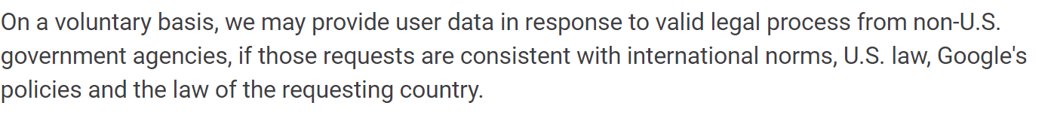
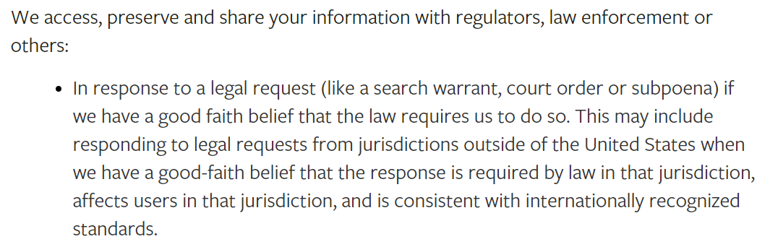
Voluntary Disclosure Requests
Notes:
This slide shows screenshots of the policies of two service providers to show that they may, on a voluntary basis, disclose data in response to valid legal requests from outside the US.

Slide 49
Poll question
Global service providers are more likely to voluntarily disclose data to countries which are party to the Budapest Convention.
True
False
Notes:
The correct answer is: True.
Global service providers are more likely to voluntarily disclose data to countries which are party to the Budapest Convention, as studies of their transparency reports reveal. This may be because countries which are party to the Budapest Convention have harmonised legislations and adequate conditions and safeguards, which are important elements that service providers take into consideration when determining whether to cooperate voluntarily.

Slide 50
Poll question
Global service providers are more likely to voluntarily disclose data to countries which are party to the Budapest Convention.
True
False
Notes:
The correct answer is: True.
Global service providers are more likely to voluntarily disclose data to countries which are party to the Budapest Convention, as studies of their transparency reports reveal. This may be because countries which are party to the Budapest Convention have harmonised legislations and adequate conditions and safeguards, which are important elements that service providers take into consideration when determining whether to cooperate voluntarily.

Slide 51
Specialized Judicial Course on
International Cooperation
Questions

Slide 52
Specialized Judicial Course on
International Cooperation
Part Four
Cooperation with Foreign Service Providers on Content Removal
Notes:
The fourth part provides a brief overview of cooperation with foreign service providers in relation to content removal.

Slide 53
Cooperation with Foreign Service Providers
Most global service providers are not unregulated
Service providers have internal terms of service with regards to permitted content
Content that is not permitted is removed by service providers proactively or on user requests and government requests
Some service providers may also remove content based upon valid local law requests
Some categories of content prohibited by different providers:
  Hate speech and incitement
  Terrorism
  Dangerous individuals & organisations
  Defamation
  Privacy
  Bullying and harassment
  Promoting crime
  IPR infringement
  Nudity
  Sexual exploitation
  Sexual solicitation
  Cruel and insensitive
  Spam
  Regulated goods
Notes:
This slide provides some basic information about the basis on which foreign service providers cooperate in relation to the removal of data.
The right side of the slide lists common categories of content that are prohibited by many global service providers.

Slide 54
Cooperation with Foreign Service Providers
Challenges:
  Different types of content violations have different reporting and documentation requirements
  Service providers are bound by local law requirements to protect free speech (e.g. First Amendment in U.S.)
  The scope of local law is sometimes incompatible with platform terms and conditions
What works:
  Understanding and creative use of service provider terms & conditions
  Joining international cooperation frameworks such as Budapest Convention
  Positive cooperation with service providers
What does not work:
  Strict local legislation for blocking content
  Blocking services
  Degrading services
  Heavy handed approaches towards service providers
Notes:
The left slide of the slide outlines some of the challenges faced in relation to the removal of content by foreign service providers, while the right slide explains approaches that tend to work and approaches that tend not to work when dealing with foreign service providers.

Slide 55
Specialized Judicial Course on
International Cooperation
Questions

Slide 56
Specialized Judicial Course on
International Cooperation
Part Five
Case Study
Notes:
The fifth part involves a case study specifically relating to how public private cooperation can be leveraged in a cybercrime investigation.

Slide 57
Case study
The Case
Esmeralda Hapsberg is a 13 year old girl, residing in your country. Her parents returned home two hours ago and discovered that she was missing. She had left a note telling her parents not to worry, as she was meeting a friend, Arty, she had met on the Internet and would be back home later. Her father, Denys, who is an IT consultant accessed her laptop and saw a series of emails, indicating that she had been groomed and was expecting a sexual encounter with the person with whom she had been communicating. The email address used by the person was artygoldberg@icloud.com Denys, also checked his daughter’s Facebook account and saw that she had been communicating with Arty who was using the Facebook name grebdlogytra.
Notes:
This slide lays out the first part of the facts of the case that will be covered.

Slide 58
Case study
The Case
The father conducted some online research and discovered an individual by the name of Arty Goldberg aged 45 years had been sentenced to 10 years in prison, 12 years ago for grooming, abduction, sexual abuse and manslaughter of a 12 year old girl. The Facebook profile (grebdlogytra) picture bears a striking resemblance to the media photograph of Goldberg, when he appeared in court 12 years ago.
Denys and his wife report the facts to the local police. Initial enquiries reveal that there has been no trace of Goldberg since his release from prison and there is no information available to assist in tracing him and Esmarelda, who is thought to now be with him.
Notes:
This slide lays out the second part of the facts of the case that will be covered.

Slide 59
Questions
Case study
How would you deal with the evidence on Esmerelda’s laptop?
Consider how you would trace Goldberg?
Do you have a national alert system for such cases (such as the Amber alert in the USA)?
What enquiries would you make about his iCloud email account and his Facebook account?
What would be the legal basis for any request for international assistance? Which method of cooperation would you use?
Notes:
This slide lays out questions that the trainer should discuss with the participants.
How would you deal with the evidence on Esmeralda’s laptop?
The trainer should expect answers that relate to seeking the preservation of data stored in her computer and related stored computer data and traffic data available with the service provider either under Article 16 or Article 29 of the Budapest Convention (depending on whether the person in possession or control of the data sought to be preserved is in the country or not). In addition, measures may be undertaken to seize and secure Esmerelda’s laptop.
2. Consider how you would trace Goldberg
The trainer should expect answers that call for seeking production of the data from the foreign service provider under Article 18.1.b of the Budapest Convention and relevant traffic data to identify where the email communications originated from.
3. Do you have a national alert system for such cases (such as the Amber alert in the USA)?
The answer to this would vary depending on the jurisdiction involved.
4. What enquiries would you make about his iCloud email account and his Facebook account?
The trainer should expect answers that subscriber information for both the Facebook and iCloud accounts would be sought as these may help identify who the real person behind the accounts is. This could include name, email accounts, phone numbers, billing information, etc.
5. What would be the legal basis for any request for international assistance? Which method of cooperation would you use?
Subscriber information may be sought through a production order under corresponding domestic law to Article 18.1.b. However, since the case is an emergency case, emergency disclosure request may be made for both subscriber information and traffic data related to the accounts to the foreign service providers.

Slide 60
Specialized Judicial Course on
International Cooperation
Questions

Slide 61
Specialized Judicial Course on
International Cooperation
Part Six
Summary

Slide 62
Summary
Review primary classifications of data and information held by private sector
Understand key considerations when cooperating with domestic service providers
Discuss mechanisms for cooperation with foreign service providers for acquisition of data including MLATs, emergency requests, production orders and voluntary cooperation
Discuss mechanisms for cooperation with foreign service providers for removal of illegal content
Understand best practices for cooperating with foreign service providers
Notes:
This slide repeats the objectives of this session. The trainer can run through these objectives to ensure that these aspects have been covered in this module.

Slide 63
Specialized Judicial Course on
International Cooperation
Questions

