Slide 1
Specialized Judicial Course on International Cooperation
Session 1.5
- online version -

Slide 2
Informal Methods of International Cooperation

Slide 3

Agenda
Part One
Formal vs. informal mutual legal assistance in criminal matters
Part Two
International Organizations and Networks Specialized in Informal and Formal Cybercrime Cooperation
Part Three
Budapest Convention International Cooperation 24/7 Network
Part Four
International response to cybercrime: country specific example
Part Five
Summary
Notes:
Session agenda. Delegates should have a copy of it in their possession.

Slide 4

Session Objectives
    to understand differences between formal and informal mutual legal assistance in criminal matters
    to get additional information and knowledge about International Organizations and Networks for Cybercrime organization, setup and competencies
    to additionally analyse and understand implementation of the Council of Europe Cybercrime Convention Article 35
    to raise awareness about some of the local national solutions for suppression of the cybercrime and mutual legal assistance with that regards
Notes:
Session objectives. Delegates should be introduced with what is expected to be achieved by the end of the session.

Slide 5
Part One
Formal vs. informal mutual legal assistance in criminal matters

Slide 6

Formal vs. informal mutual legal assistance
in criminal matters
Formal:
Mutual legal assistance (MLA), sometimes known as ‘judicial assistance’ is the formal way in which states request and provide assistance in obtaining evidence located in one state to assist in criminal investigations or proceedings in another state
the state making the request is usually referred to as the ‘requesting state’, whilst the state to whom the request is made is the ‘requested state’.
Mutual legal assistance is designed for the gathering of evidence, not intelligence or other information.
Notes:
Prosecutors or judges making a formal request should always assert the international obligation of a requested state to assist where such an obligation exists by way of international instrument. Equally, the authority upon which the letter of request is written should also be spelt out.
Similarly the person making a request must take care to ensure that his or her own domestic law allows the request that is actually being made. For instance, a piece of domestic legislation might, in fact, disallow some requests or type of requests that many conventions, treaties or other international instruments would appear to allow. For some states, the domestic legislation will have primacy. To make a request otherwise than in accordance with domestic law in such circumstances will be to be invite challenges, or arguments for the exclusion of evidence thereby obtained.

Slide 7

Formal vs. informal mutual legal assistance
in criminal matters
Informal:
administrative assistance is sometimes referred to as ‘informal assistance’
it does not involve the issuing of the formal letter of request that forms the basis of a mutual legal assistance request
also to be used when making evidence-gathering requests to a state where no coercive power is required
helps the authorities in both states to build networks and contacts
informal approach should be the first step in any evidential request of complexity in any event, even where it is always the intention to issue a formal letter of request
Notes:
Administrative assistance can, and should, also be used when making evidence-gathering requests to a state where no coercive power (e.g. a warrant or court order) is required to be exercised in order to obtain the evidence. Such an approach reduces the risk of delay and will be welcomed by most states.
In this context, it is important to remember that, although administrative assistance is sometimes referred to as ‘informal assistance’, it does not mean that the form of the evidence obtained is informal or non-evidential; on the contrary, an evidence request complied with administratively/informally should present the evidence in the same form as if it was gathered in answer to a formal letter of request.
An administrative or informal approach should be the first step in any evidential request of complexity in any event, even where it is always the intention to issue a formal letter of request. By beginning on a police to police, or prosecutor to prosecutor basis, the requesting state will have the opportunity of discussing the form and the requirements of the letter with the requested state before the letter is finalised; that will better ensure that it addresses all matters that the requested state needs and that avenues of enquiry are narrowed down as much as possible in advance of the formal request. It will also help the authorities in both states to build networks and contacts.

Slide 8
Formal vs. informal mutual legal assistance
in criminal matters
Formal MLA examples:
Obtaining testimony from a non-voluntary witness
Seeking to interview a person as a suspect,
Obtaining account information and documentary evidence from banks and financial institutions,
Requests for search and seizure
Internet records and the contents of emails
The transfer of consenting persons into custody in order for testimony to be given
Note: A mutual legal assistance request cannot be made for the arrest of a fugitive. Such a request is strictly the domain of extradition
Notes:
Confusion can be avoided if prosecutors and investigators have proper regard to the parameters of the conventions and treaties that relate to mutual legal assistance. It should be remembered that the regime of mutual legal assistance is one for the obtaining of evidence; thus, the obtaining of intelligence and the locating of suspects or fugitives should usually only be sought by way of administrative assistance to which, of course, agreement may or may not be forthcoming.

Slide 9
Formal vs. informal mutual legal assistance
in criminal matters
Informal assistance examples:
obtaining of public records, such as land registry documents and papers relating to registration of companies - might even be available as open source material
potential witnesses may be contacted to see if they are willing to assist the authorities of the requesting country voluntarily
witness statement may be taken from a voluntary witness through an administrative request
obtaining of lists of previous convictions
basic subscriber data from communications and service providers that do not require a court order
Notes:
Although no definitive list can be made of the type of enquiries that may be dealt with informally, some general observations might be useful.
In looking at the above, however, variations from state to state must always be borne in mind.

Slide 10

Formal vs. informal mutual legal assistance
in criminal matters
Informal DOES NOT MEAN non-admissible:
although the means of making the request is administrative or informal, the material that can be sought is evidential and in admissible form
word ‘informal’ is not being used in relation to the product itself, but to the way in which the request is made and the route by which it is communicated
rationale is to avoid the delays very often inherent in the formal MLA procedure
golden rule must be: ensure that any administrative informal request is made and executed lawfully
Notes:
Any consideration of administrative assistance should not overlook the use to which such assistance can be put in order to pave the way for a later, formal, request.
It might, for instance, be possible to narrow down an enquiry in a formal letter of request by first seeking informal assistance. For example, if a statement is to be taken from an employee of a telephone company in a foreign company, administrative measures should be taken to identify the company in question, its address and any other details that will assist and expedite the formal process.

Slide 11

Formal vs. informal mutual legal assistance
in criminal matters
To make the informal (administrative) process most efficient:
maintain a good relationship i.e. execute lawfully.
avoid inappropriate informal request as this will irritate the authorities
use informal assistance rather than legal assistance if possible as it is quicker
use informal assistance to pave the way for formal assistance, do all the background research so that a focused and targeted formal request of MLA can be made.
Notes:
Recommendations how to make informal legal assistance more efficient.

Slide 12

Formal vs. informal mutual legal assistance
in criminal matters
Request for search and seizure is:
a.) Formal MLA request?
b.) Informal MLA request?
c.) Is not the MLA request at all?
Notes:
a.)

Slide 13

Questions
Notes:
Time allocated to delegates questions.

Slide 14
Part Two
International Organizations and Networks Specialized in Informal and Formal Cybercrime Cooperation

Slide 15

International Organizations and Networks Specialized for Cybercrime Cooperation
Interpol National Central Bureau (NCB) and Reference Points – NCRP
to provide assistance to its members on a permanent basis (24 hours a day, 7 days a week)
more than 124 reference points all over the world (September 2011)
adopted the layout of the 24/7 contact points of Budapest Convention
some Parties of the Convention appointed the same reference point to Interpol – NCRP and also to the G8 Network
Objective
to enable police to immediately identify experts in other countries
to obtain immediate assistance in computer-related investigations and evidence collection
Notes:
Each of member countries hosts an INTERPOL National Central Bureau (NCB). This connects their national law enforcement with other countries and with the General Secretariat via our secure global police communications network called I-24/7.
Many crimes today have an international aspect, especially cybercrimes, that are driven by organized crime groups. When a crime goes beyond their national jurisdiction, a country needs international support to solve it hosts an INTERPOL National Central Bureau (NCB). This connects their national law enforcement with other countries and with the General Secretariat via our secure global police communications network called I-24/7.
NCBs are at the heart of INTERPOL. They seek the information needed from other NCBs to help investigate crime or criminals in their own country, and they share criminal data and intelligence to assist another country.
As part of their role in global investigations, NCBs work with:
Law enforcement agencies in their own country
Other NCBs and Sub-Bureaus around the world
The General Secretariat’s offices worldwide
NCBs can also develop training programmes for their national police to raise awareness on INTERPOL’s activities, services and databases

Slide 16
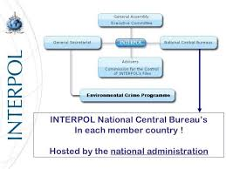
International Organizations and Networks Specialized for Cybercrime Cooperation
Interpol National Central Bureau (NCB) and Reference Points – NCRP
to provide and exchange police information and technical and operational support
to ensure that typical police information can be exchanged as soon as possible suspected terrorists, wanted persons, fingerprints, DNA profiles lost or stolen travel documents, stolen motor vehicles, stolen works of art
Cannot be used to urgently request of preservation of computer data or preservation of traffic data or any kind of measure in order to obtain or conserve evidence
Notes:
NCBs contribute national crime data to our global databases, in accordance with their respective national laws. This ensures that accurate data is in the right place at the right time to allow police to identify a trend, prevent a crime, or arrest a criminal. For example, our Red Notices alert police in all countries to wanted persons.
NCBs cooperate on cross-border investigations, operations and arrests. To take investigations beyond national borders, they can seek cooperation from any other NCB.
Given the common issues faced within each region, NCBs work together increasingly on a regional basis. They combine resources and expertise in successful interventions against those crime areas which affect them the most.

Slide 17

International Organizations and Networks Specialized for Cybercrime Cooperation
European Union 24/7 Contact Point Network:
Directive 2013/40/EU of the European Parliament and of the Council of 12 August 2013 on attacks against information systems and replacing Council Framework Decision 2005/222/JHA:
have an operational national point of contact
use the existing network of 24/7 contact points
respond to urgent requests for help within 8 hours to indicate whether and when a response may be provided
collect statistical data on cybercrime.
Notes:
The objectives of this Directive are to approximate the criminal law of the Member States in the area of attacks against information systems by establishing minimum rules concerning the definition of criminal offences and the relevant sanctions and to improve cooperation between competent authorities, including the police and other specialised law enforcement services of the Member States, as well as the competent specialised Union agencies and bodies, such as Eurojust, Europol and its European Cyber Crime Centre, and the European Network and Information Security Agency (ENISA).
This Directive strengthens the importance of networks, such as the G8 or the Council of Europe’s network of points of contact available on a 24 hour, seven-day-a-week basis. Those points of contact should be able to deliver effective assistance thus, for example, facilitating the exchange of relevant information available and the provision of technical advice or legal information for the purpose of investigations or proceedings concerning criminal offences relating to information systems and associated data involving the requesting Member State.
In order to ensure the smooth operation of the networks, each contact point should have the capacity to communicate with the point of contact of another Member State on an expedited basis with the support, inter alia, of trained and equipped personnel. Given the speed with which large-scale cyber attacks can be carried out, Member States should be able to respond promptly to urgent requests from this network of contact points. In such cases, it may be expedient that the request for information be accompanied by telephone contact in order to ensure that the request is processed swiftly by the requested Member State and that feedback is provided within eight hours.

Slide 18

International Organizations and Networks Specialized for Cybercrime Cooperation
EUROPOL:
European Union Agency
role is to improve the effectiveness of co-operation between law enforcement authorities from each European Union Member State
operational since 1999
facilitating the analysis of criminal information sharing of data between Member States
European Cybercrime Centre, EC3 (opened January 2013)
respond to urgent requests for help within 8 hours to indicate whether and when a response may be provided
collect statistical data on cybercrime.
Notes:
This slide is following the previous one regarding legal basis.
Europol is the European Union’s law enforcement agency. Its main goal is to achieve a safer Europe for the benefit of all the EU citizens.
Headquartered in The Hague, the Netherlands, it supports the 27 EU Member States in their fight against terrorism, cybercrime and other serious and organised forms of crime. It also works with many non-EU partner states and international organisations.
Large-scale criminal and terrorist networks pose a significant threat to the internal security of the EU and to the safety and livelihood of its people. The biggest security threats come from:
terrorism;
international drug trafficking and money laundering;
organised fraud;
the counterfeiting of euros;
trafficking in human beings
Europol set up the European Cybercrime Centre (EC3) in 2013 to strengthen the law enforcement response to cybercrime in the EU and thus to help protect European citizens, businesses and governments from online crime. Since its establishment, EC3 has made a significant contribution to the fight against cybercrime: it has been involved in tens of high-profile operations and hundreds on-the-spot operational-support deployments resulting in hundreds of arrests, and has analysed hundreds of thousands of files , the vast majority of which have proven to be malicious.

Slide 19

International Organizations and Networks Specialized for Cybercrime Cooperation
European Cybercrime Centre (EC3 or EC³) :
the body of the Police Office (Europol) of the European Union (EU), headquartered in The Hague
coordinates cross-border law enforcement activities against computer crime
acts as a centre of technical expertise on the matter
Notes:
Each year, EC3 publishes the Internet Organised Crime Threat Assessment (IOCTA), its flagship strategic report on key findings and emerging threats and developments in cybercrime.
The IOCTA demonstrates how wide and varied cybercrime is and how EC3 is a key part of Europol’s, and the EU’s, response. EC3 takes a three-pronged approach to the fight against cybercrime: forensics, strategy and operations.
EC3 has two forensics teams, digital forensics and document forensics, each of which focuses on operational support, and research and development.
At the level of operations, EC3 focuses on the following types of cybercrimes:
Cyber-dependent crime;
Online child sexual exploitation;
Payment fraud.

Slide 20


International Organizations and Networks Specialized for Cybercrime Cooperation
EUROJUST:
Eurojust may ask the competent authorities of the Member States concerned:
to investigate or prosecute specific acts
to coordinate with one another
to accept that one country is better placed to prosecute than another
to set up a Joint Investigation Team
to provide Eurojust with information necessary to carry out its tasks.
Notes:
As Denmark does not participate in the Eurojust Regulation, the number of National Desks decreased in December 2019 to 27, with Denmark delegating a Representative to Eurojust.
After the withdrawal of the United Kingdom from the European Union on 31 January 2020, the number of National Desks is 26.
Eurojust supports and strengthens coordination and cooperation between national investigating and prosecuting authorities.
Eurojust assists prosecutors and other investigators from EU Member States in cases of serious crime where that crime affects two or more Member States, or requires prosecution on common bases, on the basis of operations conducted and information supplied by the Member States’ authorities, by Europol, by the EPPO and by OLAF.
Eurojust acts at the request of the competent authorities of the Member States or on its own initiative. In some cases Eurojust can act at the request of the European Commission or the European Public Prosecutor’s Office.

Slide 21

International Organizations and Networks Specialized for Cybercrime Cooperation
Eurojust Judicial Cybercrime Network (EJCN):
facilitates and enhances cooperation between competent judicial authorities by enabling the exchange of expertise, besat practice and other relevant knowledge regarding the investigation and prosecution of cybercrime
fosters dialogue among different actors and stakeholders that play a role in ensuring the rule of law in cyberspace

Slide 22
Refreshing what we have learned
Interpol NCB can be used for to urgently request of preservation of computer data or preservation of traffic data or any kind of measure in order to obtain or conserve evidence:
a.) True?
b.) False?
c.) Depends on the request?
Notes:
b.)

Slide 23
Questions
Notes:
Time allocated to delegates questions.

Slide 24
Part Three
Budapest Convention International Cooperation 24/7 Network

Slide 25

Budapest Convention
International Cooperation 24/7 Network
Budapest Convention Article 35:
Obligation to create a permanently available contact point called 24/7 network of contact points
General objectives of these contact points:
to facilitate international co-operation
to provide technical advisory to other contact points
to activate the proper mechanism to expedited preservation of data
  to urgently collect evidence
  To identify and discover suspects
Notes:
Under this article, each Party has the obligation to designate a point of contact available 24 hours per day, 7 days per week in order to ensure immediate assistance in investigations and proceedings within the scope of this Chapter, in particular as defined under Article 35, paragraph 1, litteraea) – c). It was agreed that establishment of this network is among the most important means provided by this Convention of ensuring that Parties can respond effectively to the law enforcement challenges posed by computer- or computer-related crime.
Each Party’s 24/7 point of contact is to either facilitate or directly carry out, inter alia, the providing of technical advice, preservation of data, collection of evidence, giving of legal information, and locating of suspects. The term "legal information" in Paragraph 1 means advice to another Party that is seeking co-operation of any legal prerequisites required for providing informal or formal co-operation.

Slide 26

Budapest Convention
International Cooperation 24/7 Network
24/7 Contact Points:
Operational network of experts on high-tech criminality
Provide help and cooperation very quickly even if a formal cooperation request must follow this informal way
One single point of contact for each country, available 24 hours a day, 7 days a week
Direct communications between the points
Mainly planned to provide the possibility to immediately preserve traffic data and other stored data worldwide
Notes:
Each Party is at liberty to determine where to locate the point of contact within its law enforcement structure. Some Parties may wish to house the 24/7 contact within its central authority for mutual assistance, some may believe that the best location is with a police unit specialised in fighting computer- or computer-related crime, yet other choices may be appropriate for a particular Party, given its governmental structure and legal system.
Since the 24/7 contact is to provide both technical advice for stopping or tracing an attack, as well as such international co-operation duties as locating of suspects, there is no one correct answer, and it is anticipated that the structure of the network will evolve over time. In designating the national point of contact, due consideration should be given to the need to communicate with points of contacts using other languages

Slide 27
Budapest Convention
International Cooperation 24/7 Network
24/7 Contact Points:
most of the contact points are police based contact points
some of them are Prosecution Services contact points
Budapest Convention provided a legal basis to the 24/7 network of contact points, that are recognised as one of the most useful tools regarding International cooperation
Notes:
Convention article provides that among the critical tasks to be carried out by the 24/7 contact is the ability to facilitate the rapid execution of those functions it does not carry out directly itself. For example, if a Party’s 24/7 contact is part of a police unit, it must have the ability to co-ordinate expeditiously with other relevant components within its government, such as the central authority for international extradition or mutual assistance, in order that appropriate action may be taken at any hour of the day or night. Moreover, paragraph 2 requires each Party’s 24/7 contact to have the capacity to carry out communications with other members of the network on an expedited basis.
It also requires each point of contact in the network to have proper equipment. Up-to-date telephone, fax and computer equipment will be essential to the smooth operation of the network, and other forms of communication and analytical equipment will need to be part of the system as technology advances. It also requires that personnel participating as part of a Party’s team for the network be properly trained regarding computer- or computer-related crime and how to respond to it effectively.

Slide 28
Budapest Convention
International Cooperation 24/7 Network
“Budapest” Convention Article 35 stipulates that 24/7 Contact Point is:
a.) Mandatory?
b.) Non-mandatory?
c.) Depends on the country?
Notes:
a.)

Slide 29
Questions
Notes:
Time allocated to delegates questions.

Slide 30
Part Four
Example of Eastern Partnership states:
improving practical aspects of international cooperation

Slide 31
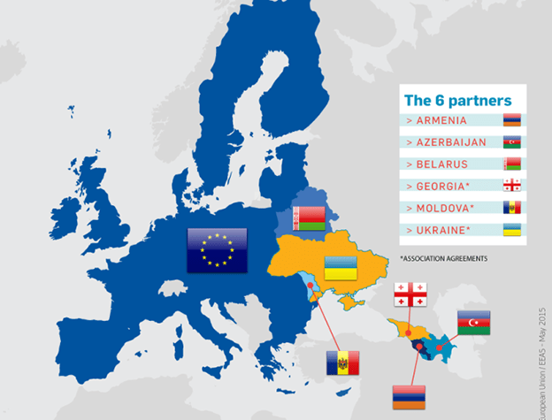
Eastern Partnership
The Eastern Partnership (EaP) is a joint initiative involving the EU, its Member States and six Eastern European Partners: Armenia, Azerbaijan, Belarus, Georgia, the Republic of Moldova and Ukraine.
Fight against cybercrime and in particular improving international cooperation is one of the key priorities for the development of the region.

Slide 32
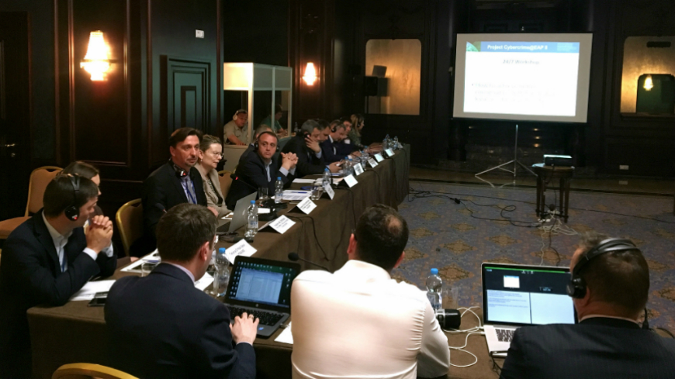
Eastern Partnership:
Capacity building efforts
Series of regional meetings under the joint EU/Council of Europe Cybercirme@EaP projects in 2015-2018
Development of various recommendations and guidelines (including cooperation templates)
Progress summarised in regional Reports on International Cooperation in the Eastern Partnership – latest report from May 2018

Slide 33
2018 Report:
Four main pillars for improving cooperation
Legal requirements
Process management
Quality of MLA requests
Efficient communication

Slide 34

2018 Report:
Legal requirements
Comprehensive legal review:
Introduction of uniform concepts and definitions (underlying offences, electronic evidence);
Procedural powers under the Convention (preservation provisions and production orders),
Regulations for 24/7 points of contact authority, functions and operations;
Possibilities under Article 18.1.b of the Convention on Cybercrime;
Removing obstacles to expedited processing of MLA requests (e.g. reduced requirements for originals of documents);
Public availability of best practice guides or handbooks.

Slide 35
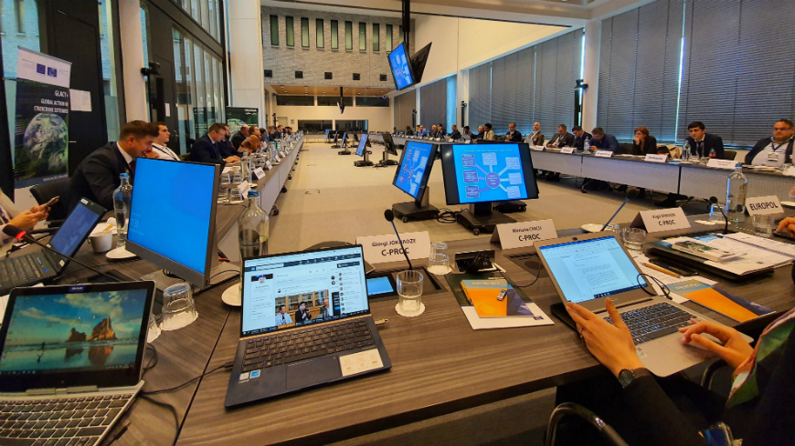
2018 Report:
Efficient communications
Improve communications-related aspects:
Use of standard multi-language templates and forms for 24/7 communications and mutual legal assistance;
Use of Octopus Community resource on international cooperation (verified data);
Coordination between 24/7 POC and MLA authority by sharing information and ensuring follow-up of incoming/outgoing cases;
Specialized training of investigators, prosecutors, judicial personnel, international cooperation officers and representatives of national points of contact.

Slide 36

2018 Report:
Process management
Improve process management:
Guidelines on 24/7 points of contact based on best practices and experience;
Formal cooperation between the law enforcement agencies and ISPs;
Efficient use of human resources and communications for international cooperation, e.g. police-to-police communications for admissible evidence and direct access to foreign service providers / banking sector;
Formal urgency/priority processing for incoming mutual assistance requests based on agreed criteria;
Better integration of the core data on MLA requests into available criminal case management systems.

Slide 37

2018 Report:
Quality of requests
Improve quality of MLA requests:
Capacity building activities with focus on compact and informative writing skills;
Reducing de minimis requests;
Use of standard templates and handbooks for acceptable standard for outgoing mutual legal assistance requests;
Direct judicial cooperation: centralized reporting, periodic follow-up and consultation from the central authorities.

Slide 38
Questions
Notes:
Time allocated to delegates questions.

Slide 39
Part Five
Summary

Slide 40

Session Objectives
    to get additional information and knowledge about International Organizations and Networks for Cybercrime organization, setup and competencies
    to additionally analyse and understand implementation of the Council of Europe Cybercrime Convention Article 35
    to raise awareness about some of the capacity building solutions for improving international cooperation

Slide 41
Questions
Notes:
Time allocated to delegates questions.

