Slide 1
Specialized Judicial Course on International Cooperation
Session 2.1.
- Online Version -

Slide 2
Mechanisms under the Budapest Convention

Slide 3
Agenda
Part One
General provisions
Part Two
Specific provisions
Part Three
Provisions of the draft Second Additional Protocol
Part Four
Mutual legal assistance form templates
Part Five
Summary
Notes:
This session will be divided into 5 parts.
The first part of the session will review the general provisions of the Budapest Convention in relation to international cooperation and mutual assistance.
The second part of the session will look at specific provisions in relation to international cooperation and mutual assistance.
The third part of the session will look at some of the provisions of the draft Second Additional Protocol to the Budapest Convention.
The fourth part of the session will look at some mutual legal assistance form templates.
The fifth part of the session will summarise the session objectives.

Slide 4
Session Objectives
Reviewing the general provisions of international cooperation and mutual assistance under the Budapest Convention
Reviewing the specific provisions of international cooperation and mutual assistance under the Budapest Convention
Discussing provisions of Second Additional Protocol to the Budapest Convention
Understanding how to use different mechanisms under the Budapest Convention to seek cooperation
Introduction to different templates for MLA requests
Notes:
This slide outlines the objectives of this session. It underscores what participants should expect to learn from the slides. The participants can be informed that this slide will be revisited at the end of the session to assess whether the objectives were met.

Slide 5
Part One
Substantive Law and Procedural Powers
Notes:
The second part will review the special provisions of the Budapest Convention which relate to international cooperation and mutual assistance.

Slide 6
The Budapest Convention
Definitions
Notes:
The next set of slides look at the definitions under Chapter I of the Budapest Convention.

Slide 7
Computer System
"computer system" means any device or a group of interconnected or related devices, one or more of which, pursuant to a program, performs automatic processing of data;
Device consisting of hardware and software which automatically processes computer data
Device can be standalone or connected in a network
Includes:
  Input devices
  Output devices
  Storage facilities
Notes:
On the left side, this slide shows the text of Article 1.a of the Budapest Convention which is the definition of “computer system”.
On the right side, this slide provides an explanation of the definition.
A computer system under the Budapest Convention is a device consisting of hardware and software developed for automatic processing of digital data. It may include input, output, and storage facilities. It may stand alone or be connected in a network with other similar devices
A computer system usually consists of different devices, to be distinguished as the processor or central processing unit, and peripherals. A "peripheral" is a device that performs certain specific functions in interaction with the processing unit, such as a printer, video screen, CD reader/writer or other storage device.
Computer systems may be connected to the network as endpoints or as a means to assist in communication on the network. What is essential is that data is exchanged over the network.
The trainer can share an additional resource of the Guidance Note # 1: http://rm.coe.int/CoERMPublicCommonSearchServices/DisplayDCTMContent?documentId=09000016802e79e6

Slide 8
Computer Data
"computer data" means any representation of facts, information or concepts in a form suitable for processing in a computer system, including a program suitable to cause a computer system to perform a function;
Computer data is any data that is in a form that can be directly processed by a computer system
Computer data that can be automatically processed may be the target of the criminal offences defined in the Budapest Convention or the object of the application of the investigative measures defined by the Budapest Convention
Notes:
On the left side, this slide shows the text of Article 1.b of the Budapest Convention which is the definition of “computer data”.
On the right side, this slide provides an explanation of the definition.
The definition of computer data builds upon the ISO-definition of data. This definition contains the terms "suitable for processing". This means that data is put in such a form that it can be directly processed by the computer system. In order to make clear that data in this Budapest Convention has to be understood as data in electronic or other directly processable form, the notion "computer data" is introduced.
Computer data as defined may be the target of one of the criminal offences defined in the Budapest Convention (in Chapter 2, Section 1) as well as the object of the application of one of the investigative measures defined by this Budapest Convention (in Chapter 2, Section 2).

Slide 9
Service Provider
"service provider" means:
i any public or private entity that provides to users of its service the ability to communicate by means of a computer system, and
ii any other entity that processes or stores computer data on behalf of such communication service or users of such service.
Yes:
  communication or related data processing services (e.g. hosting and caching providers)
  private & public entities
  free or paid services
  provision to closed group or public
No:
  content providers
Notes:
On the left side, this slide shows the text of Article 1.c of the Budapest Convention which is the definition of “service provider”.
On the right side, this slide provides an explanation of the definition.
The term service provider as defined in the Budapest Convention encompasses a broad category of persons that play a particular role with regard to communication or processing of data on computer systems. It includes both private and public entities, covers provision of services to a closed group or to the public, free or paid services.

Slide 10

Poll question
Which of the following would not fall under the definition of “service provider”?
a) Facebook
b) TikTok
c) Council of Europe’s YouTube channel
d) WhatsApp
e) Dropbox
Notes:
The correct answer is c) Council of Europe’s YouTube channel. This is because the definition of “service provider” excludes content providers.

Slide 11
Poll question
Which of the following would not fall under the definition of “service provider”?
a) Facebook
b) TikTok
c) Council of Europe’s YouTube channel
d) WhatsApp
e) Dropbox
Notes:
The correct answer is c) Council of Europe’s YouTube channel. This is because the definition of “service provider” excludes content providers.

Slide 12
Traffic Data
"traffic data" means any computer data relating to a communication by means of a computer system, generated by a computer system that formed a part in the chain of communication, indicating the communication’s origin, destination, route, time, date, size, duration, or type of underlying service.
Yes:
  category of computer data
  generated by computer that formed part in chain of communication
  Indicates communication’s:
    origin
    destination
    route
    time
    date
    size
    duration
    type of underlying service
No:
  content of communication
Notes:
On the left side, this slide shows the text of Article 1.d of the Budapest Convention which is the definition of “traffic data”.
On the right side, this slide provides an explanation of the definition.
Traffic data as defined under the Budapest Convention is a category of computer data that is subject to a specific legal regime. This data is generated by computers in the chain of communication in order to route a communication from its origin to its destination. It is therefore auxiliary to the communication itself. The slide describes some key characteristics of traffic data.

Slide 13
Poll question
Which of the following are not included in traffic data?
a) Content of email body
b) Time of email
c) Size of email
d) Type of underlying service
e) Email subject heading
Notes:
The correct answer is a) Content of email body, and e) Email subject heading.
This is because traffic data relates to data about a communication and not the actual contents being communicated (i.e. the content of email body and email subject heading)

Slide 14
Poll question
Which of the following are not included in traffic data?
a) Content of email body
b) Time of email
c) Size of email
d) Type of underlying service
e) Email subject heading
Notes:
The correct answer is a) Content of email body, and e) Email subject heading.
This is because traffic data relates to data about a communication and not the actual contents being communicated (i.e. the content of email body and email subject heading)

Slide 15

Questions

Slide 16
The Budapest Convention
Substantive Law
Notes:
The next set of slides look at the substantive law provisions under Chapter II Section 1 of the Budapest Convention.

Slide 17
Article 2 – Illegal Access
Illegal Access
(Article 2 – Budapest Convention)
To access to the whole or any part of a computer system without right
Intentionally
Notes:
The crime of illegal access is committed by those who access the whole or any part of a computer system without right. This action must be intentional and it is described under Article 2 of the Budapest Convention.
It is very often referred to as hacking of computer systems and is one of the most common computer crimes. However, there are other phenomena, besides hacking, that can be classified as illegal access – in fact hacking is used, normally, to describe the act of unlawfully accessing a computer system, by the means of technology. But illegal access also covers any unauthorized entering in a system, regardless of the technology used or even the use or not of technology. Such case, for example, would be the unlawfully obtained password by the perpetrator. The protected interest here is the confidentiality of a computer system or computer data.
The fundamental element and required conduct under Article 2 is the term “access”. The term refers to the act of entering the whole or any part of a computer system. Article 2 is technology neutral and does not specify the means by which access is to be conducted. The slide explains what constitutes, and what does not constitute access.
It explains through examples what the term “part of computer system” means for the purposes of Article 2.
Many of the offences in the Convention are required to be committed “without right”, or without authorisation from the relevant person or entity. The authority may be legislative, administrative, judicial, contractual or consensual in any given case. Authorised conduct is not criminalized; nor is the access of a computer system that permits free and open access by the public. The trainer may wish to link this to the definition of “unauthorised access” discussed previously to explain how the fact of authorisation may be determined
The trainer can emphasise that the definition of “unauthorised” can be different in relation to certain offences such as illegal access, data interference and system interference. That is why many countries have different definitions for “unauthorised modification” and “unauthorised act” for instance.
Parties may narrow the scope of Article 2, which provides for the general criminalisation of illegal access, with certain qualifying elements. For instance, parties may require that the conduct of illegal access be done by infringing security measures (e.g. passwords or other access codes), or otherwise with dishonest intent or to obtain computer data from the computer system being accessed or any other computer system. This slide lists all the qualifying elements that Parties may wish to adopt in their domestic legislation.

Slide 18
Article 3 – Illegal Interception
Illegal Interception
(Article 3 –Budapest Convention)
Intentionally, and without right
To intercept, by technical means, non-public transmissions of computer data
To, from or within a computer system
Notes:
Illegal interception, described under Article 3 of the Convention of Budapest, is also an intentional infringement. It is committed by those that, without right, intercept, by technical means, non-public transmissions of computer data, to, from or within a computer system, by technical means.
This provision protects the integrity of non-public transmissions of computer data, criminalising their unauthorised interception.
Data transmissions to a computer system, or from that system, or within the same system, are most relevant realities in nowadays life on the networks.
Technically, it can be very easy to intercept communications if the network and the communication are not properly protected. An interception of communications can reveal, for example, which websites someone visited, or the email messages he or she sent or received.
The crime of illegal interception aims, therefore, to enface the vulnerability of the communications technology, protecting the secrecy of non-public communications.
The trainer should distinguish between the offence of “access” and “interception” on a conceptual basis. The offence of access relates to the accessing of a computer or computer data when it is static – while the offence of interception relates to the interception of transmissions of computer data (i.e. data as it is in motion). The transmission could be to, from or within a computer system.
The fundamental element and required conduct under Article 2 is the term “intercept”. Interception refers to listening to, monitoring or surveillance of communications. Interception affects the privacy of data communications; and Article 3 of the Convention aims to protect against interception of non-public transmissions of data.
Many of the offences in the Convention are required to be committed “without right”, or without authorisation from the relevant person or entity. The authority may be legislative, administrative, judicial, contractual or consensual in any given case. In case of interception, it is possible that the conduct is being done with authorisation; possibly by law enforcement officials or persons authorized to conduct testing or protection activities. Thus legitimate interception done “with right” does not fall within the scope of Article 3.
Article 3 does not envisage criminalisation of non-technical interception of transmissions, and applies either when a person accesses and uses a computer system to intercept a transmission, uses an electronic eavesdropping or tapping device or any other technical means. This slide lists some examples of forms of interception that would be covered by “technical means”.
Interception of public transmissions is not an offence under Article 3, which specifies that the scope of the article relates only to transmissions that are non-public. It is important to distinguish between non-public transmissions and non-public data as Article 3 does not take into consideration the nature of the data; but rather the transmission. Hence, interception of confidential information communicated through a publicly accessible transmission of data would not constitute an offence; while the interception of publicly available information communicated through a non-public transmission of data would constitute an offence under Article 3.
The interception of transmissions to, from or within a computer system are criminalised. This slide provides examples that explain the scope of Article 3 in this respect, and the difference between these three elements.
Other than interception of computer data, Budapest Convention also criminalizes interception of transmissions of electromagnetic emissions, which do not fall under the Budapest Convention definition of “computer data” under Article 1. Computer systems often emit electromagnetic which contain data. The interception of electromagnetic emissions has been criminalised as it is possible to reconstruct computer data from electromagnetic emissions; and thus leaving this element uncriminalised would leave a lacuna in the law.
Article 3 provides for general criminalisation of intentional interception without right, made by technical means, of non-public transmissions of computer data. Parties may limit the scope of Article 3 by requiring certain qualifying elements to be met. The qualifying elements that parties may adopt are listed here.

Slide 19
Poll question
A man connects to a public Wi-Fi network and uses a software to intercept a private email communication between two other uses of the Wi-Fi network. This is not an offence under Article 3.
True
False
Notes:
The correct answer is: False.
Though the Wi-Fi network is public, the transmission of the email communication is non-public and its interception by the man is without right. This will therefore be an offence under Article 3 of the Budapest Convention.

Slide 20
Poll question
A man connects to a public Wi-Fi network and uses a software to intercept a private email communication between two other uses of the Wi-Fi network. This is not an offence under Article 3.
True
False
Notes:
The correct answer is: False.
Though the Wi-Fi network is public, the transmission of the email communication is non-public and its interception by the man is without right. This will therefore be an offence under Article 3 of the Budapest Convention.

Slide 21
Article 4 – Data Interference
Data Interference
(Article 4 – Budapest Convention)
Damaging, deletion, deterioration, alteration or suppression of computer data
Intentionally, without right
Notes:
The conduct of intentionally and without right, damaging, deletion, deterioration, alteration or suppression of computer data will constitute the offence of data interference as provided under Article 4 of the Budapest Convention.
Data interference protects the integrity of data against unauthorised interference. The owner of the data has the right to keep them as they are, as the owner of a good, in the real life, has the right to keep his property safe from interference from others. In some jurisdictions, regular and classic damage also covers data interference; in others, there is a need to describe separately the damage on computer data, or data interference.
This crime enfaces the great increase of relevant data (computer data) to the modern life. Computer data are very vulnerable and can very easily be destroyed or manipulated. This criminal rule protects its integrity and its availability.
One of the most frequent cases of data interference is the result of the action of viruses – that without right install themselves on the computer of the victim and, for example, delete data.
Damaging and deterioration of computer data without right refers to the negative alteration of the integrity or information content of data and programs. Both terms are overlapping acts.
Deletion refers the destruction of data; and results in the deleted data being rendered unrecognisable.
Alteration refers to the modification of existing data (but not the deletion of the same). Data may be altered in a number of ways; including the input of malicious codes such as viruses and Trojan horses.
Suppression of data refers to any action that either prevents or terminates the availability of the data to the person who has access to the data or storage medium in which it is stored. Unlike deletion of data, suppression of data does not involve the destruction of data, but rather non-availability of data.
Many of the offences in the Convention are required to be committed “without right”, or without authorisation from the relevant person or entity. In many cases, it is possible that a person who is interfering with data is doing so “with right”. This slide lists certain examples where a person may legitimately interfere with data without attracting criminal liability under Article 4.
Given that the offence of data interference has a broad scope, parties may elect to restrict this offence by requiring that the conduct result in serious harm. No specific definition of serious harm is provided under Article 4, and the criteria may be determined under domestic law.

Slide 22
Article 5 – System Interference
System Interference
(Article 5 – Budapest Convention)
The serious hindering of the functioning of a computer system
By inputting, transmitting, damaging, deleting, deteriorating, altering or suppressing computer data
Intentionally, without right
Notes:
System interference is the hindering of the functioning of a computer system – the serious hindering: Article 5 of Budapest Convention does not cover non-serious hindering. This effect can be the result of inputting, transmitting, damaging, deleting, deteriorating, altering or suppressing computer data, if this is committed intentionally and without right.
This particular aspect excludes, in general, for example, security tests, conducted by the administrator of the network. This infringement covers a wide range of acts, able to interfere with the normal and proper functioning of a network. In fact, Budapest Convention recognises the importance of the communication systems and of the computer technology in the everyday life – the availability of these systems is crucial for the regular functioning of public, economic and social activities. But this type of crime does not only cover interferences on a big scale, like denial-of-service attacks.
Even small actions, just envisaging one computer, can be system interference – it will be the case of mail bombing targeted to a single email address. In fact, it will have always a crime of system interference when a perpetrator targets a computer system with more requests than that system can manage.
This crime envisages to protect the access to communication networks, both protecting the operators of the system and the end user.
The trainer should emphasize that the scope of this offence is different from that of illegal access under Article 2. There may be instances where a computer may be interfered with without being accessed, for instance in the case of a distributed denial of service attack. Moreover, there could also be instances where access was “with right” but the subsequent action of interference was “without right”.
The “seriousness” element has been included to narrow the scope of the offence and to prevent over-criminalisation of hindrances which are not serious in nature. The seriousness of a hindrance is to be determined under domestic legislation, and may depend on the form, size, frequency of the hindering or the impact of the hindering on the ability for continued use of the computer.
The offence of system interference requires conduct that results in the hindering of a the proper functioning of a computer system. Article 4 specifies that such hindering must take place through (i) inputting (ii) transmitting (iii) damaging (iv) altering and (v) suppressing computer data. The explanations of each of these terms has already been discussed under the offence of data interference (Article 4), and the same explanations will apply to system interference.
Many of the offences in the Convention are required to be committed “without right”, or without authorisation from the relevant person or entity. In many cases, it is possible that a person who is interfering with a computer system is doing so “with right”. This slide lists certain examples where a person may legitimately interfere with a computer system without attracting criminal liability under Article 5.

Slide 23
Poll question
A person cuts the power supply to a computer system, thereby hindering its operation. This is not system interference under Article 5 of the Budapest Convention.
True
False
Notes:
The correct answer is: True.
The cutting of the power supply does not fall within the scope of Article 5 of the Budapest Convention. Article 5 only covers system interference committed by inputting, transmitting, damaging, deleting, deteriorating, altering or suppressing computer data, and not the physical act of cutting electricity cables.

Slide 24
Poll question
A person cuts the power supply to a computer system, thereby hindering its operation. This is not system interference under Article 5 of the Budapest Convention.
True
False
Notes:
The correct answer is: True.
The cutting of the power supply does not fall within the scope of Article 5 of the Budapest Convention. Article 5 only covers system interference committed by inputting, transmitting, damaging, deleting, deteriorating, altering or suppressing computer data, and not the physical act of cutting electricity cables.

Slide 25
Article 6 – Misuse of Devices
Misuse of Devices
(Article 6 – Budapest Convention)
Intentionally and without right
To possess an item referred to in paragraphs (a)(1) or (2) above, with intent that it be used for the purpose of committing any of the offences established in Articles 2 – 5.
Notes:
One of the most important offences in the Budapest Convention is the crime of misuse of devices – Article 6.
Like with other crimes, the action of the perpetrator must be intentional and without right. This offence covers a wide range of activities, all of them related to the misuse of devices.
This is a very “new” crime, not included in the Recommendation of 1989. It is also very innovative - the facts described in there were not recognised previously as a crime in many of the national legislations.
Essentially, it prohibits the production, sale, procurement for use, import, distribution or otherwise making available of devices, including a computer program that are designed or adapted primarily for the purpose of committing any of the other substantial offences named in the Budapest Convention.
Equally, it criminalises the sale of computer passwords, access code, or similar data by which the whole or any part of a computer system is capable of being accessed.
With this provision, the Convention recognises the need of incriminating the flourishing and increasingly economically important “secondary market” in “crime enabling equipment”: hackers selling online their tools of the trade, self-made virus kits widely available online and wholesale disposal of passwords that were stolen using Trojans and other devices. This means that hacking into a computer system is not any longer the preserve of highly skilled programmers. Every “regular” criminal can easily buy the necessary tools, or directly the stolen passwords - very often the criminal seller will offer also a “customer service” and help his client setting up his computer for the commission of a crime.
Article 6 makes it an offence to produce, sell, procure for use, import, distribute or make available devices designed or adapted primarily for the purpose of committing cybercrimes.
Article 6 extends both to the misuse of devices and computer programs. This means that Article 6 includes the production, sale etc. of programs that are designed to alter or destroy data, or interfere with the operation of computer systems. This means that virus programs that are not contained in devices also fall within the scope of Article 6 even where misuse of a physical device is not involved.
The drafters of the Budapest Convention had to decide whether to include or exclude dual-use devices from the ambit of Article 6. The inclusion of dual use devices may have resulted in over-criminalisation of production and distribution of devices even though the same were produced and distributed for non-criminal purposes. The exclusion of dual use devices would been too narrow as it would require that it be proved that the devices be specifically produced and the purposes of committing cybercrime. The Budapest Convention has adopted a balanced approach whereby devices that are designed or adapted primarily, but not solely, for the commission of a cybercrime established in accordance with Articles 2-5 of the Budapest Convention (illegal access, illegal interception, data interference and system interference) are covered by Article 6.
In addition to the misuse of devices and computer programs, Article 6 also criminalises the production, sale etc. of access codes, computer passwords and other similar data which enables access to the whole or any part of a computer system.
In addition to producing or distributing devices, computer programs, passwords, access codes etc, Article 6 also criminalizes the possession of the same if the items are possessed with the intent to commit a cybercrime. It allows parties to only criminalise possession of a certain number of times (which could be used only to criminalise possession for commercial purposes).
This conduct explains certain exceptions to the scope of this offence. Like other offences under the Budapest Convention, Article 6 does not extend to conduct committed “with right”. This would include, as examples, conduct undertaken for the authorised testing of a computer system.

Slide 26
Article 7 – Computer-related Forgery
Computer-related Forgery
(Art. 7 – Budapest Convention)
Creates parallel offence to forgery of tangible offences
Gap in criminal law as traditional forgery usually requires visual readability of statements or declarations embodied in document
Traditional forgery may not apply to electronic data
Notes:
Computer-related forgery, described under Article 7 of Budapest Convention is a particular modality of forgery. In most countries forgery is a traditional criminal infringement. But normally, it refers to tangible objects and sometimes cannot be used to criminalise computer forgery, or forgery of computer data which does not require visual readability of statements or declarations embodied in a physical document.
That was the reason of introduction in the Convention of Article 7 of the Budapest Convention.
At this point, the Convention aims to introduce a parallel offence to the traditional forgery of documents (tangible documents). But in this case, the object of the crime is computer data. This crime is committed by those who input, alter, delete or suppress computer data, resulting in inauthentic data with the intent that those data are considered or acted upon for legal purposes as if it were authentic.
This crime requires, of course, and intentional and without right action.
These are four means by which falsification of a genuine document can occur under Article 7:
Input of correct or incorrect data (at time of creation or entering of data)
Subsequent alterations (including modifications, variations or partial changes)
Deletion (removal of data from data medium)
Suppression (holding back or concealment of data)
As noted in the Explanatory Report to the Budapest Convention, “national concepts of forgery vary greatly. One concept is based on the authenticity as to the author of the document, and others are based on the truthfulness of the statement contained in the document. However, it was agreed that the deception as to authenticity refers at minimum to the issuer of the data, regardless of the correctness or veracity of the contents of the data. Parties may go further and include under the term "authentic" the genuineness of the data.”
In addition to the requirement that computer-related forgery be committed intentionally, Article 7 also requires that a person commit the necessary conduct with the intent that the forged document be considered or acted upon for legal purposes (i.e. legal transactions and documents which are legally relevant). Further, Parties may require that the conduct be committed with the intent to defraud another person.
The inauthentic data does not necessarily have to be directly readable or intelligible by a human being. This is a unique aspect of computer-related forgery, which unlike traditional forgery, need not necessarily require readability of the forged data by humans.
Parties may narrow the scope of Article 7, which provides for the general criminalisation of computer-related forgery, with certain qualifying elements. In particular, parties may require that the computer-related forgery is committed with intent to defraud or with similar dishonest intent.

Slide 27
Article 8 – Computer-related Fraud
Computer-related Fraud
(Art. 8 – Budapest Convention)
Creates parallel offence to fraud related to tangible offences
Notes:
Computer-related fraud, as elaborated under Article 8 of the Budapest Convention, criminalises the causing of loss of property to another person intentionally and without right, by any input, alteration, deletion or suppression of computer data, or any interference with the functioning of a computer system, with fraudulent or dishonest intent of procuring, without right, an economic benefit for oneself or for another person.
This is an important offence, particularly because assets represented or administered in computer systems, such as electronic funds, deposit money, etc. have become the target of manipulations, similar to traditional forms of property. Due to the unique nature of how fraud can be committed in relation to assets administered in computer systems (i.e. through input manipulations or program manipulations), the Budapest Convention requires parties to undertake legislative measures to criminalise this.
This lists the five means by which a loss of property can be caused under Article 8. These are:
Input of correct or incorrect data (at time of creation or entering of data)
Subsequent alterations (including modifications, variations or partial changes)
Deletion (removal of data from data medium)
Suppression (holding back or concealment of data)
Interference (with the functioning of a computer system)
With respect to the offence of computer–related fraud, it is necessary that the conduct result in the direct economic or possessory loss of another person’s property. This may include the loss of money, tangibles and intangibles with an economic value.
In addition to the requirement that computer-related fraud be committed intentionally, Article 8 also requires that a person commit the necessary conduct with fraudulent or dishonest intent of procuring without right an economic benefit for oneself or another person. As an example, commercial practices with respect to market competition that may cause an economic detriment to a person and benefit to another, but are not carried out with fraudulent or dishonest intent, are not meant to be included in the offence.

Slide 28
Article 9 – Offences Related to
Child Pornography
Child Pornography
(Article 9 – Budapest Convention)
Great innovation
Criminalisation of child pornography acts, committed by the means of a computer system
Important aspects:
  Criminalisation of “pseudo images”;
  Punishment of the mere possession of child pornography materials
    Not covered by many of the legislations
    Very common approach from all the international fora (eg. UN)
    European Union
      Enfaces the mere possession of child pornography materials
      Directive 2011/92/EU, from the European Parliament and the Council
Notes:
Article 9 of Budapest Convention discloses one of the great innovations of this treaty: it criminalises child pornography acts committed by the means of a computer system.
The trade with child pornography increased enormously with the advent of Internet. The communication and information networks offer a great number of advantages and possibilities for those who look for such kind of content. Besides, on Internet, the users can be anonymous, while gaining access to child abuse material online.
Concerning child pornography offences, one aspect is particularly contentious: the criminalisation of “pseudo images”. The articles of the Convention cover not only situations of pictures where a real child is photographed during sexual activity, but also fake representations of children – for example, pictures of children completely created by computers (morphing for instance the head of a child on the body of the adult that commits the sexual act) or pictures from adults (convincingly) pretending (acting or dressing like) to be children.
A second important aspect must be discussed, because it is broadly considered in the text of the Convention: the punishment of the mere possession of child pornography materials. Article 9, 1 defines as an infringement the mere possession of this kind of material, within a computer system and also the procurement of such images for purely personal use. This approach is commonly adopted by other international fora that studied the theme.
Criminalising the mere possession of child pornography material is making it much easier to conduct a criminal investigation into this topic, since under this provision anyone who has in his possession this type of material can be prosecuted, and the specific intent to use the pictures in a certain way (for example sell them) or participating in their production does not need to be proven. This also means that suspected paedophiles can be punished without any evidence that they acted on their impulses towards a child. And of course, police and courts can investigate and convict this way suspected suppliers of child pornography (even if by the mere possession), with or without evidence that actual trade took place.
In this respect, it is important to also consider the legal option from the European Union. For many years, the European Union decided to criminalise the mere possession of child pornography materials - since the Decision from the Council from 29 of May of 2000. More recently, Directive 2011/92/EU of the European Parliament and of the Council of 13 December 2011, on combating the sexual abuse and sexual exploitation of children and child pornography, and replacing Council Framework Decision 2004/68/JHA, stated that Member States from the European Union should criminalise, among other illegal behaviours, the acquisition or possession of child pornography (Article 5, 2). However, the same document gives discretion to each of the Member States to decide whether this incrimination applies to cases where that pornographic material possessed by the producer solely for his or her private use (in so far as no pornographic material has been used for the purpose of its production and provided that the act involves no risk of dissemination of the material).
This option from the European Union is absolutely in line with Article 9 of Budapest Convention that incriminates producing, offering or making available, distributing or transmitting, procuring or merely possessing child pornography in a computer system or on a computer-data storage medium. However, the inclusion of “procuring” or “possessing” allows reservation from the Parties to the Convention.
This option was reinforced by the Convention on the Protection of Children (CETS 201), issued by the Council of Europe and opened for signature in 2007. The aim of this treaty is to harmonise criminal law provisions, within the Parties, aiming to protect children from sexual exploitation. According to Article 20, among others “procuring child pornography for oneself or for another person” and “possessing child pornography” should be criminalised.
Many of the offences in the Budapest Convention are required to be committed “without right”, or without authorisation from the relevant person or entity. It is possible that the conduct described in Article 9 be done “with right”. There are certain other defences to the conduct described in Article 9; e.g. that the pornographic material has artistic, medical, scientific or other similar merit.
In particular this slide explains the criteria by which it is to be determined whether certain material is pornographic in nature. The content is to be determined by national standards pertaining to obscenity, public morality etc.
Although the language of Article 9 suggests that the pornographic material must constitute a visual depiction, it is also intended to include data stored on a computer system or a computer data storage medium that is capable of conversation into a visual image.
It outlines a minimum criteria for determining whether certain material is depicting “sexually explicit conduct”. Parties are free to use a broader definition. It is important to note that sexually explicit conduct being depicted does not have to be real sexually explicit conduct; and it may be simulated.
It lists and explains the subject of the depiction under Article 9. Depictions of sexual abuse of real children; images which depict a person appearing to be a minor (whether or not actually a minor) engaging in sexually explicit conduct; and images which although realistic do not in fact involve a real child engaged in sexually explicit conduct.
It defines the term “Minor” as used under Article 9. The scope of this definition is limited to the depiction of real/fictitious children as sexual objects; and does not relate in any way to determining the age of consent for sexual relations.

Slide 29
Poll question
Which of the following would not constitute child pornography under Budapest Convention?
a) Video of minors engaged in sexually explicit conduct
b) Video containing computer-generated simulation of child pornography
c) Audio clip of minors engaged in sexually explicit conduct
d) Video of individuals appearing to be minors engaged in sexually explicit conduct
Notes:
The correct answer is c) Audio clip of minors engaged in sexually explicit conduct.
This is because Article 9 of the Budapest Convention only includes in the definition of child pornography VISUAL depictions. This would not include audio depictions.

Slide 30
Poll question
Which of the following would not constitute child pornography under Budapest Convention?
a) Video of minors engaged in sexually explicit conduct
b) Video containing computer-generated simulation of child pornography
c) Audio clip of minors engaged in sexually explicit conduct
d) Video of individuals appearing to be minors engaged in sexually explicit conduct
Notes:
The correct answer is c) Audio clip of minors engaged in sexually explicit conduct.
This is because Article 9 of the Budapest Convention only includes in the definition of child pornography VISUAL depictions. This would not include audio depictions.

Slide 31
Article 10 – Offences related to infringements
of copyright and related rights
Intellectual Property Rights
(Article 10 – Budapest Convention)
does not create a new regulation on this subject
purpose of the Budapest Convention
  to apply previous rules on copyright: what is complied with the real world must be also observed within the on-line reality
  infringements of copyright on-line, or committed by the means of a computer system, must be punished as if it was committed in the real world
Budapest Convention refers to existing international treaties
  Paris Agreement from 24 of July of 1971
  Bern Convention
  WIPO treaties
Notes:
The Budapest Convention does not include any specific offence on copyright. Rather, Article 10 of the Budapest Convention only emphasises that existing and well-established rules on copyright under international law should apply to the online environment: what is prohibited in the real life must also be prohibited online. Infringements of copyright online, or committed by the means of a computer system, must be punished as if they were committed in the real world. For this reason, the Budapest Convention refers to already existing international treaties and agreements on this matter (Paris Agreement from 24 of July of 1971, Bern Convention and WIPO treaties).
Article 10 extends to infringement of copyrights (and related rights); but not moral rights. The Budapest Convention only mandates that a party extend its existing obligations under different international instruments with respect to infringement committed by means of a computer system. If for instance, a party does not have any such obligations, it need not implement Article 10 of the Budapest Convention. Similarly, if a party has reservations to existing international instruments related to copyright, it may apply the same reservations with respect to implementation of Article 10.
Article 10 extends to copyright infringements on a commercial sale, which is intended to be in line with existing international framework under the TRIPS Agreement. Parties may seek to more broadly extend this to all forms of infringement, even if not committed on a commercial scale.
This is identical to the previous slide, though instead of covering “copyright”, it covers “related rights”. Related rights, also referred to as “neighboring rights”, refers to rights of a creative work not connected with the work's actual author, such as for instance the rights of performers.
It clarifies that there is a broad exemption to the imposition of criminal liability where there are other effective remedies, such as civil or administrative measures.

Slide 32
Article 11 – Attempt and Aiding or Abetting
The Budapest Convention requires criminalisation of the aiding or abetting of any offence established in accordance with its provisions
There must be intent that the offence be committed
The Budapest Convention does not require criminalisation of attempts to all offences
Parties have the discretion not to criminalise attempts in whole or in part
Notes:
This seeks to criminalise the intentional aiding or abetting of any offence established in accordance with the Budapest Convention (Article 2-10). The perpetrator must have the intent that such offence be committed for this provision to attract. This is an important requirement as it would exclude service providers, which may aid or abet an offence by providing a conduit, but would not have criminal intent.
For instance, attempting illegal access, misuse of devices and certain aspects of child pornography would not be criminalised because it is difficult to ascertain attempts offences. The Budapest Convention requires that attempts must be intentional to attract criminal liability.

Slide 33
Article 12 – Corporate Liability
1 Each Party shall adopt such legislative and other measures as may be necessary to ensure that legal persons can be held liable for a criminal offence established in accordance with this Convention, committed for their benefit by any natural person, acting either individually or as part of an organ of the legal person, who has a leading position within it, based on:
  a a power of representation of the legal person;
  b an authority to take decisions on behalf of the legal person;
  c an authority to exercise control within the legal person.
Four conditions need to be met for corporate liability to be attracted:
  Commission of offence under Budapest Convention
  Offence must have been committed for benefit of legal person
  Person who has a “leading position” (high position in organisation) must have committed the offence
  The leading person with the leading position must have acted on the basis of:
    power of representation
    authority to take decisions
    authority to exercise control
Notes:
On the left side, this slide shows the text of Article 12 of the Budapest Convention with one element (“legal persons can be held liable…. committed fo their benefit by any natural person…. leading position…. power of representation… authority to take decisions… authority to exercise control”) highlighted.
On the right side, this slide provides an explanation of the highlighted element.
Both of the perspectives of the European Union and of the Council of Europe include, at least, any kind (criminal or not) of responsibility of companies and other legal entities by criminal acts of their representatives, acting in their representation and interest. In addition, the Convention states that responsibility of legal entities occurs also in case of lack of supervision or control of a legal representative of the company or other legal entity over someone under its supervision. In terms of prerequisites for corporate liability to be attracted, the Budapest Convention requires the four conditions outlined on the slide. This is to ensure that legal persons are not unduly penalised for conduct committed by natural persons in their individual capacity.

Slide 34
Article 12 – Corporate Liability
2 In addition to the cases already provided for in paragraph 1 of this article, each Party shall take the measures necessary to ensure that a legal person can be held liable where the lack of supervision or control by a natural person referred to in paragraph 1 has made possible the commission of a criminal offence established in accordance with this Convention for the benefit of that legal person by a natural person acting under its authority.
3 Subject to the legal principles of the Party, the liability of a legal person may be criminal, civil or administrative.
4 Such liability shall be without prejudice to the criminal liability of the natural persons who have committed the offence.
Legal person can also be held liable if crime committed by someone other than leading person (for instance, employee or agent acting within scope of authority) if:
  offence committed by such employee or agent
  offence committed for benefit of legal person
  commission was made possible due to leading person having failed to take reasonable or appropriate measures to supervise the employee or agent
Does not mandate general surveillance over employee communications
Notes:
On the left side, this slide shows the text of Article 12 of the Budapest Convention with one element (“lack of supervision or control by a natural person referred to in paragraph 1…. Made possible…. Commission…. For the benefit of that legal person by a natural person under its authority ”) highlighted.
On the right side, this slide provides an explanation of the highlighted element.
This element suggests that in addition to the four conditions outlined on the previous slide, a legal person may be held liable if the commission of the offence was made possible due ot a lack of supervision, but this requires that the offence was committed for the benefit of the legal person by a natural person acting under the authority of the legal person.

Slide 35
Poll question
The Chief Executive of a company commits computer-related fraud using a company computer. All the proceeds of the crime go into his personal bank account. The company can be held liable for the actions of the Chief Executive.
True
False
Notes:
The correct answer is: False.
For corporate liability under Article 12 of the Budapest Convention to apply, the offence must be committed for the benefit of the company. In this case, only the Chief Executive in his personal capacity is benefiting from the commission of the offence.

Slide 36
Poll question
The Chief Executive of a company commits computer-related fraud using a company computer. All the proceeds of the crime go into his personal bank account. The company can be held liable for the actions of the Chief Executive.
True
False
Notes:
The correct answer is: False.
For corporate liability under Article 12 of the Budapest Convention to apply, the offence must be committed for the benefit of the company. In this case, only the Chief Executive in his personal capacity is benefiting from the commission of the offence.

Slide 37
Questions

Slide 38
The Budapest Convention
Procedural Measures and Safeguards
Notes:
The next set of slides look at the procedural law provisions under Chapter II Section 2 of the Budapest Convention.

Slide 39

Article 14 – Scope of Procedural Provisions
Parties must adopt necessary measures to establish the powers and procedures in Articles 16 – 21 of Budapest Convention
These powers are to be exercised in relation to specific criminal investigations or proceedings (i.e. not for general intelligence gathering)
Procedural powers established in accordance with Budapest Convention are not only for cybercrimes
These powers can be exercised in relation to:
  Offences established in accordance with Budapest Convention
  Other offences committed by means of a computer
  Collection of evidence for any criminal offence
Notes:
The purpose of this element is to clarify that the procedural powers outlined in Chapter II Section 2 of the Budapest Convention may only be exercised in relation to specific criminal investigations or proceedings. The provisions of the Budapest Convention do not mandate legislative measures for other purposes, such as general intelligence gathering.
This provision outlines one of the key aspects that make the Budapest Convention such a valuable proposition. According to Article 14, the Budapest Convention will be applicable, obviously, when the crime under investigation is one of the offences listed in the Budapest Convention. However, it also includes two extremely far reaching and valuable extensions:
First, procedural rules can be used in the investigation of any crime if it was committed by the means of a computer system;
Second, the rules can also be applicable to the gathering of evidence in any investigation if the evidence, in the case, is stored in any kind of digital record: this means that every crime potentially falls under the procedural rules of the Budapest Convention.
The trainer should emphasise that the Budapest Convention is therefore not only a cybercrime convention but a cybercrime and ELECTRONIC EVIDENCE convention.

Slide 40
Poll question
The procedural law provisions in Chapter II Part 2 of the Budapest Convention may only be exercised in relation to offences established in accordance with the Budapest Convention.
True
False
Notes:
The correct answer is: False.
The procedural law provisions may also be exercised in relation to the collection of electronic evidence in any criminal offence.

Slide 41
Poll question
The procedural law provisions in Chapter II Part 2 of the Budapest Convention may only be exercised in relation to offences established in accordance with the Budapest Convention.
True
False
Notes:
The correct answer is: False.
The procedural law provisions may also be exercised in relation to the collection of electronic evidence in any criminal offence.

Slide 42
Article 15 – Conditions and Safeguards
Ensure a balance between requirements of law enforcement and protection of human rights and liberties
Production order
Partial disclosure of traffic data
Expedited preservation
Search and seizure
Real-time collection of traffic data
Interception of content data
The power or procedure must be proportional to the nature and circumstances of the offence
Conditions and safeguards to protect human rights and liberties pursuant to obligations under applicable human rights instruments
  Judicial supervision
  Other independent supervision
  Grounds justifying application of procedural powers
  Limitation of scope of powers
  Limitation of duration of powers
Notes:
The protection of human rights is an iterative process which must be ensured taking into account all precise circumstances. For this reason the determination of appropriate safeguards should be done at each step of the life of a procedural rule: its establishment (i.e. its incorporation into the domestic law), its implementation (i.e. the internal organisation in order to enable the power or procedure to take place) and afterward its application (i.e. its concrete application in a given particular case). Anticipation is moreover a particular important action that enables the preservation of Human Rights “by design” – where appropriate – which means basically that, if a safeguard has been designed to be included in a given procedure at the time this procedure has been defined, this safeguard will be totally compatible with the application of that procedure, which will enable both to save efforts in applying the safeguard and to ensure the correct application of the safeguard for the benefit of fundamental rights protection.
The other aspect of the highlighted element is the principle of legal basis. Safeguards must be provided for by domestic law, which enables both their effectiveness and public knowledge (thanks to which citizen will be able to know their rights and obligations). However, the notion “Domestic law” is here understood in its substantive sense, and refers to legislative acts but also to constitutional rules and other legal sources such as constant jurisprudence (source: explanatory report to the Convention on Cybercrime, which corresponds to the position of the Council of Europe’s European Court of Human Rights - ECHR).
Under the Budapest Convention, safeguards must ensure, at least, the principle of proportionality. The principle of proportionality is another important principle, whose meaning might vary depending on legal systems. The principle of proportionality requires that there be a reasonable relationship between a particular objective to be achieved and the means used to achieve that objective.
In countries bounded by the ECHR the principle of proportionality ensures that no other less intrusive power or procedure could enable to reach adequately the objective of this power or procedure, taking into account both the nature and circumstances of the offence, and the nature and legitimacy of the impacted fundamental rights.
Within the framework of the ECHR, this principle is understood as either including, or being accompanied by another principle which is the principle of “necessity” of the power or procedure. It refers to :
is there a pressing social need for some restriction of the fundamental rights?
if so, does the particular restriction corresponds to this need?
if so, is it a proportionate response to that need?
The Budapest Convention does not limit the types of conditions and safeguards that could be applicable. This article only provides for a list of safeguards that must be implemented as a minimum, where appropriate in view of the nature of the procedure or power concerned (depending on the more or less intrusive nature of the power or procedure).
The slide shows an inverted pyramid that demonstrates the extent of conditions and safeguards necessary for each procedural power depending on the level of intrusiveness of the power. The trainer can mention that each of the powers will be considered subsequently.
Potential safeguards include:
a judicial or other independent supervision,
grounds justifying application,
and the limitation of the scope and the duration of such power or procedure.
Independent supervision and scope and time limitation are traditional safeguards that ensure the proportionality of the intrusive measures, by imposing limits to these measures and by enabling the independent verification of the respect of these limitations and of the other principles ensuring rights protection.
The specification of the grounds that justify the intrusive measure is another principle that traditionally ensures both the necessity and the proportionality of this measure (this specification enables to verify if the measure that limits freedoms is effectively needed, and if this measure is proportionate to the specific aim to be reached).
This element limits the necessity to reduce the impacts of the power or procedure to situation where this reduction is “consistent with the public interest, in particular the sound administration of justice”. This means that the impact of the powers or procedures must firstly be assessed in relation to the sound administration of justice and other public interests (e.g. public safety and public health and other interests, including the interests of victims and the respect for private life). In the extent that the limitation of the impact of the power or procedure on other rights and interests is compatible with the safeguard of these public interests, then other safeguards should be implemented in order to safeguard these other interests, such as “minimising disruption of consumer services, protection from liability for disclosure or facilitating disclosure under this Chapter, or protection of proprietary interests” (see [1] the explanatory report to the Convention on cybercrime, § 148).
References:
^{[1]} Explanatory report to the Convention on cybercrime, §148.

Slide 43
Article 16 – Expedited Preservation of Stored Computer Data
Data existing in stored form should be protected from anything that would cause its current quality or condition to change or deteriorate
Data to be kept safe from modification, deterioration or deletion
Power extends to all computer data (subscriber, traffic, content)
Must be applied in relation to investigation of a particular case and in relation to specified computer data (not indiscriminate amounts of data)
Data sought to be preserved must already be stored in a computer system
There must be grounds that the computer data is particularly vulnerable to loss or modification
Preservation is a temporary power to protect data while competent authorities seek production of data or search & seizure of data
Preservation must be expeditious and done for specified time
Preservation may be ordered or similarly obtained through other means (e.g. search & seizure or production order)
Notes:
Traditional pieces of evidence will stay on the crime scene, eventually, for a long period of time, but digital data – electronic evidence -, is very volatile and may disappear very quickly : once lost or destroyed, it will be difficult to recover.
Traffic data, for example, is very helpful to identify the perpetrator of a crime. But this type of information is not systematically available. Therefore, ensuring its preservation implies the existence of a legal instrument allowing law enforcement agents to order the preservation of such volatile information and to communicate it to other services.
Some countries implemented data retention legislation. Outside Europe, most counties did not yet implement such legislation. Inside the European Union, some data retention national legislations have been declared contrary to the local constitution because of a lack of appropriate safeguards (for ex. in Germany and in Slovenia), and the EU data retention directive itself has been ruled disproportionate by the European Court of Justice (due to a too large scope and a lack of safeguards) and therefore contrary to the EU Charter of Fundamental Rights and the European Convention on Human Rights (Judgment of the Court, 8 April 2014, joined cases C-293/12 and C-594/12, case "Digital Rights Ireland Ltd“). This situation provides a first overview of the importance of Article 15 of the Budapest Convention on conditions and safeguards, which will be considered in Part II.
The Budapest Convention does not have a data retention provision. Articles 16 and 17 refer to specific data needed in a specific investigation or proceeding. The do not apply to the real-time collection and retention of future traffic data or real-time access to content data. These articles organise “expedited preservation” as an immediate provisional measure to keep evidence and give time to obtain judicial orders for the seizure or disclosure of the data. Article 16 relates to traffic data and content data. Article 17 relates more specifically to traffic data.
Notes:
The distinction between traffic data and content data is justified by the fact that content data are more sensitive;
Parties of the Convention can go further than the minimum levels described here.
In particular, this slide lists the possible mediums through which the expedited preservation of stored computer data may be effected. The Budapest Convention is flexible and enables parties to specify in their domestic legislation the means through which the power to expeditiously preserve stored computer data is to be exercised.
Expeditious preservation is one of the key procedural powers in matters related to electronic evidence. Given the volatility of computer data and the ease with which it may be deleted, modified or altered, and given the fact that many service providers and persons do not retain for long periods of time computer data, it is necessary that there be a procedural power to ensure expeditious preservation. The use of this power protects against deleting, altering, modifying or otherwise changing the condition or quality of computer data.
The power to order or similarly obtain expeditious preservation of data is not equivalent to the concept of data retention, and thus it is necessary that the competent authority that orders or similarly obtains expeditious preservation of stored computer data be allowed to do the same with respect to only specified data, and not generally impose an obligation for persons to retain unspecified or indiscriminate amounts of data.
This procedural power cannot be used to obligate any person to preserve data that does not already exist; or has not been stored by means of a computer system. This again distinguishes from the obligation to retain data, which may apply to data that does not exist.
In some jurisdictions, law enforcement officials are required to satisfy competent authorities that the stored computer data with respect to which expeditious preservation is being sought is vulnerable to loss or modification. This includes both vulnerability to intended loss/modification of computer data, and unintended loss/modification as a result of insecure storage of computer data.
The competent authority may only order a person to preserve stored computer data where such specified computer data is in either the possession or the control of such person. This slide distinguishes between possession (i.e. physical possession) and control (i.e. free control over the data, even if it may not be in their physical possession).
It is important to recognize that preservation is a temporary power; and does not enable law enforcement officials to order persons to preserve data indefinitely. It is merely a temporary measure that aims not to frustrate exercise of other procedural powers, namely the production of computer data or search and seizure of computer data. The Budapest Convention requires that Parties provide a maximum period of 90 days for which preservation can be ordered, while the specific period for a particular case must be specified in the order for preservation.
It is vital that the undertaking of preservation measures is kept confidential by the subject of the production order, or else the measure may be frustrated.

Slide 44
Article 17 – Expedited Preservation and Partial Disclosure of Traffic Data
Multiple service providers are usually involved in transmissions of communications
Traffic data is often shared between service providers for commercial, security or technical purposes
Usually no single service provider possesses enough crucial traffic data to determine source & destination of a communication (each service provider has part of the puzzle)
Parties may serve separate orders on each service provider or single order that is served sequentially as each next service provider is identified
This power does not merely provide for preservation: it also requires expeditious disclosure of enough traffic data to identify other service providers involved in the transmission of a communication and the path of the communication
Purpose is to enable identification of all service providers so that appropriate procedural measures can be undertaken
Notes:
Given that there is usually more than one service provider involved in the chain of transmission of any communication, it is difficult for law enforcement agencies to identify each service provider involved in the chain of transmission to be able to exercise other powers (including production orders; search & seizures) on each service provider. Thus Article 17 of the Budapest Convention provides legal mandate to competent authorities to seek partial disclosure of traffic data to enable identification of the service providers involved in the chain.
A reminder on "traffic data" - any computer data relating to a communication by means of a computer system, generated by a computer system that formed a part in the chain of communication, indicating the communication’s origin, destination, route, time, date, size, duration, or type of underlying service.
This slide also provides the various ways in which orders can be served on multiple service providers (e.g. separate orders as each subsequent service provider involved in the chain of transmission is identified; single order that is served sequentially on each subsequent service provider as it is identified; or a single order served on a single service provider that is obligated through the order to notify the next service provider involved in the chain of transmission).
It is important that the subject of the order for partial disclosure of traffic data be mandated with disclosing sufficient traffic data to be able to identify other service providers involved in the transmission of the communication. In the absence of this power, it would be highly challenging to identify the different service providers involved and thus exercise the appropriate powers accordingly.

Slide 45
Article 18 - Production Order
Production Orders
(Article 18 – Budapest Convention)
Also very innovative
To empower law enforcement authorities to issue production orders
This order can be issued by law enforcement agencies to individuals and to Service Providers
Order to provide
  data stored in a computer system under their responsibilities
  subscriber information
Production order must specify the nature and extent of the required data
The data required by the investigation must be previously determined
Notes:
The provision of Article 18 is also very interesting. According to it, each Party must adopt legislative measures to empower its law enforcement authorities (LEA) with the possibility of giving “production orders”. This judicial order can be issued by law enforcement agencies to citizens and to Internet service providers, ordering them to provide the competent authorities with data stored in a computer system, under their responsibilities or provide subscribers data.
According to the Convention, the production order must specify the nature and extent of the required data: it is very clear that the data required by the investigation must be previously determined, and that fishing expeditions are therefore prohibited. The purpose of this legal limit is to impose an important safeguard for the protection of human rights and liberties in the exercise of these investigative powers by law enforcement agents; it ensures that the search and seisure of information is restricted to information directly related to a case under investigation. This limitation is even more important than similar limitations that frame search and seizure in the real world, where these operations have most of the time a limited practical scope. In the digital world, if the rule was the complete permission of access to the whole information that comes with a piece of hardware, it would be permitted to access all kinds of information stored on that computer, often unrelated to the crime under investigation and (e.g. in the case of email communication) involving also third parties.
As it was already mentioned, Article 16 can create the obligation, to a service provider, to preserve computer data. The disclosure of traffic data to law enforcement agencies is organised by Article 17, just allows disclosure of traffic data. The possibility to disclose to LEA any other type of information stored in a digital medium is organised by Article 18, pursuant or not a preservation order issued on the basis of Article 16.
Article 18,1,a applies any person in the territory of the Party. Thus while it does not require that the computer data that is the subject of a production order be located in the territory, the person to whom the order is made is required to be physically present in the territory. The term person is broad and it includes both natural persons and legal persons, including service providers.
It is necessary that the competent authority that orders production of computer data be allowed to do the same with respect to only specified data, and not generally request large volumes of data indiscriminately. Thus a production order to a person to produce all data stored in their computer system would not be allowed under Article 18.
The competent authority may only order a person to produce computer data where such specified computer data is in either the possession or the control of such person. This slide distinguishes between possession (i.e. physical possession) and control (i.e. free control over the data, even if it may not be in their physical possession).
Production orders can only be made with respect to existing data that is either in a computer system or a computer-data storage medium. It cannot be used to order a person to retain data; or to produce data that will come into existence at a future date.
Article 18,1,b has a more limited scope as compared to Article 18,1,a, in the sense that it applies only to service providers; and thus does not apply to any natural or legal persons that do not fall under the definition of service providers.
However, it is not limited in terms of physical location of the service provider, and applies so long as the service provider is offering services in the territory of the Party.
The slide lists some of the determining factors to be taken into account when gauging whether a service provider is offering services in a particular territory.
The trainer can then refer to the T-CY Guidance Note on Article 18.
This slide provides an explanation of the definition of subscriber information under Article 18 of the Budapest Convention. It is important to note that subscriber information may not necessarily be in the form of computer data; and thus includes physical records held by service providers in relation to their subscribers.
This limits the scope of subscriber information that may the subject of a production order to such subscriber information that is related to the services being offered by a service provider in the territory.
The competent authority may only order a service provider to produce subscriber information where such subscriber information is in either the possession or the control of such service provider. This slide distinguishes between possession (i.e. physical possession) and control (i.e. free control over the information, even if it may not be in their physical possession).
There will be also a more involved discussion on Art. 18 in the module on public-private cooperation.

Slide 46
Poll question
Which of the following production orders can a judge in your country NOT issue under Article 18:
a) Subscriber information from a foreign service provider that offers services in your country
b) Content data from a foreign service provider that offers services in your country
c) Computer data from a person in your country who controls data stored outside your country
d) Computer data from a person in your country who possesses data stored in your country
Notes:
The correct answer is b) Content data from a foreign service provider that offers services in your country.
This is because the scope of Article 18.1.b only relates to subscriber information and would not enable ordering production of content data from a foreign service provider.
Though the data under option (c) is stored outside your country, the person who is in control of such data is inside your country, so such person may be ordered to produce the data under Article 18.1.a.

Slide 47
Poll question
Which of the following production orders can a judge in your country NOT issue under Article 18:
a) Subscriber information from a foreign service provider that offers services in your country
b) Content data from a foreign service provider that offers services in your country
c) Computer data from a person in your country who controls data stored outside your country
d) Computer data from a person in your country who possesses data stored in your country
Notes:
The correct answer is b) Content data from a foreign service provider that offers services in your country.
This is because the scope of Article 18.1.b only relates to subscriber information and would not enable ordering production of content data from a foreign service provider.
Though the data under option (c) is stored outside your country, the person who is in control of such data is inside your country, so such person may be ordered to produce the data under Article 18.1.a.

Slide 48
Article 19 – Search and Seizure of
Computer Data
Search and Seizure of stored computer data
(Article 19 – Budapest Convention)
Where:
  In a computer system or part of it
  In a storage medium
  In a computer system accessible from the initial one (expeditious extension of the search)
What:
  Seize or similarly secure accessed computer data
  Power to require the necessary information to understand the functioning of the system
Notes:
Search and seizure are described by Article 19 of Budapest Convention.
Most of national procedural rules include general regulations for search and seizure, but not all of them have specific rules governing computer search and computer seizure. Many jurisdictions can live well just with traditional searches and seizures. However, the real world teaches that digital investigations face challenges previously unknown caused, for example, by the interconnectedness of computer systems.
Enfacing that kind a new questions, the Budapest Convention created specific rules to deal with searches and seizures in the digital world. As a result, it organises the possibility to search in a computer system, in a storage medium, and in a computer system available from the initial one. This latter possibility enables the authority to “expeditiously” extend the search to an other system when, during a lawful search to a specific computer system or part of it, this authority forms a reasonable belief that the data sought are stored in another computer system in its territory.
Regarding investigative powers, Article 19 requires that investigators are empowered to “seize or similarly secure” accessed computer data, and to order any person who has knowledge about the functioning of the computer system or measures applied to protect the computer data therein to provide, as is reasonable, the necessary information, to enable search and seizure.
Given the various possibilities and more efficient ways that are available to seize computer data, the Budapest Convention provides a list of basic actions that investigators must be empowered to perform… (next slide)

Slide 49
Article 19 – Search and Seizure of
Computer Data
Seize or similarly secure accessed computer data
Physical seizure
Seizure by simply making a copy of the data
Seizure as the maintenance of the integrity of those data, keeping the data in the computer where they are stored
Seizure, by imposing the impossibility of access to data, or even removal of specified data from a specified computer or computer system
Notes:
Basic actions that investigators must be empowered by law to perform during the process of a lawful seizure of computer data, according to the Budapest Convention, are the following:
a) seize physically a computer system,
b) make and retain a copy of those computer data (which is important in case the data is stored on a major server, where physical removal is impossible, and also when physical seisure would interfere too significantly with the rights of other people who have access rights to that machine – for instance the a big company’s server)
c) maintain the integrity of the relevant stored computer data and, finally, to
d) render inaccessible or remove those computer data in the accessed computer system.
This last provision is relevant for instance when physical seizure is impossible, but real harm could occur if a third party got access to the data.
With the exception of the mere seizure of data in its own and original record, all these procedural possibilities are specific measures in the digital environment.

Slide 50
Article 20 – Real-time Collection of Traffic Data
Real-time Collection of Traffic Data
(Article 20 – Budapest Convention)
Allows live investigations
Intrusive measure, requires proper legislation
Law enforcement authorities to collect or record, through technical means, data in real time, and
Power to compel service providers to collect or record data from their customers, in real time.
Notes:
Sometimes, the investigator needs more fresh information, rather than that information provided by the search or seizure of stored data.
Real-time collection of computer data allows alive investigations and is described in Article 20 of Budapest Convention. Such kind of intrusive measure requires proper legislation to allow law enforcement authorities to collect or record, through technical means, data in real time, and also the power to compel service providers to collect or record data from their costumers, within its normal activity, in real time.
This kind of investigative tool can be very important, for example, to establish the source of a communication, in view of identifying a perpetrator, in real time.
To be noted that §3 of Article 20 imposes to Parties to adopt such legislative and other measures as may be necessary to oblige service providers to keep confidential the fact of the execution of any power provided for in this article and any information relating to it.

Slide 51
Article 21 – Interception of Content Data
Interception of Content Data
(Article 21 – Budapest Convention)
Very powerful investigative tool, but also very intrusive
It is only allowed in relation to a range of serious offences to be determined by national laws
Adequate safeguards need to be put in place
Notes:
Last, but not least Article 21 describes interception of content data.
Besides of traffic data, sometimes, law enforcement authorities might need to know the real content of communications between suspects of a crime. Some countries already have provisions on telephone interceptions, but not all of them allow the authorities to, specifically, intercept communications, other than by telephone.
That is the reason why, on Article 21, specifically, Budapest Convention includes provisions that enable investigators to intercept and record data communications.
Besides being a very powerful investigative tool, the interception of communications is also a very intrusive measure and is only allowed, by the terms of the Convention, in relation to a range of serious offences to be determined by national laws.
For additional safeguards regarding covert surveillance (including interception of content data) that need to be put in place in the national legislation by the Parties to the European Convention of Human Rights see a compilation of the relevant case-law of the European Court of Human Rights developed on the basis of Article 8 (right to respect for private and family life, home and correspondence): http://www.echr.coe.int/Documents/FS_Mass_surveillance_ENG.pdf
To be noted that §3 of Article 21 imposes to Parties to adopt such legislative and other measures as may be necessary to oblige service providers to keep confidential the fact of the execution of any power provided for in this article and any information relating to it.

Slide 52
Poll question
You can issue a warrant for interception of content data for a case related to theft. The offence carries a 6-month imprisonment.
True
False
Notes:
The correct answer is: False.
The interception of content data under Article 21 may only be exercised in relation to serious offences – likely not offences with minimal punishments.

Slide 53
Poll question
You can issue a warrant for interception of content data for a case related to theft. The offence carries a 6-month imprisonment.
True
False
Notes:
The correct answer is: False.
The interception of content data under Article 21 may only be exercised in relation to serious offences – likely not offences with minimal punishments.

Slide 54
Questions

Slide 55
Part Two
International Cooperation Provisions
Notes:
The first part will review the general provisions of the Budapest Convention which relate to international cooperation and mutual assistance.

Slide 56
Article 23 – General Principles Related to International Cooperation
Mandates international cooperation through:
  Application of relevant international instruments on cooperation in criminal matters (e.g. UNCAC, UNTOC, etc.)
  Arrangements on basis of uniform or reciprocal legislation (e.g. bilateral agreements)
  Domestic laws
  Budapest Convention enables international cooperation for:
  Offences related to computer systems and data
  Collection of evidence for any criminal offence
  The international cooperation shall be to the widest extent possible
Notes:
The Budapest Convention recognizes other international and bilateral instruments as well as domestic laws that relate to and enable international cooperation. It requires the use of these instruments and domestic laws for international cooperation in criminal matters.
Though the Budapest Convention is largely thought of as a cybercrime convention that enables international cooperation with respect to cybercrime, its scope is actually much broader. The highlighted elements show that the Budapest Convention enables and mandates international cooperation for both:
Offences related to computer systems and data (cybercrime)
Collection of evidence for any criminal offence (cybercrime and non-cybercrime).
This means that the Budapest Convention enables cooperation with respect to the exchange of electronic evidence, irrespective of whether the offence being investigated is a cybercrime offence.

Slide 57
Poll question
Which of the following offences would the Budapest Convention enable international cooperation in?
a) Hacking
b) Political offence
c) Computer-related forgery
d) DDoS attack
e) Possession of child pornography in USB
Notes:
The correct answers are: a) Hacking (c) Computer-related forgery (d) DDoS (e) Possession of child pornography in USB

Slide 58
Poll question
Which of the following offences would the Budapest Convention enable international cooperation in?
a) Hacking
b) Political offence
c) Computer-related forgery
d) DDoS attack
e) Possession of child pornography in USB
Notes:
The correct answers are: a) Hacking (c) Computer-related forgery (d) DDoS (e) Possession of child pornography in USB

Slide 59
Article 24 – Extradition
Prerequisite for extradition: Offence must be punishable in both countries for at least 1 year imprisonment
Parties may agree to different minimum penalty based on arrangement or extradition treaty applicable
Offences established under Budapest Convention are deemed extraditable offences under existing treaties between parties
Parties may use the Budapest Convention as basis for extradition for offences established in accordance with the Budapest Convention
All extradition requests are subject to conditions provided in extradition treaties or law of requested party
If requested party refuses extradition based on nationality of person or if it deems jurisdiction over offence, it shall prosecute the individual and notify the requesting party of outcome of prosecution
Notes:
The Budapest Convention is not ordinarily an extradition treaty – but it requires parties to extradite suspected offenders under certain circumstances in relation to offences established in accordance with the Budapest Convention. The offence must be punishable in both countries for at least one year though parties may agree to a different penalty on the basis of legislation or an extradition treaty.
The Budapest Convention is not ordinarily an extradition treaty – and rather than prescribe a specific procedure for extradition, it provides that the offences established in accordance with the Budapest Convention will be deemed to be included as extraditable offences in any extradition treaty. This means that the existing procedures accepted by each party would apply in relation to offences established in accordance with the Budapest Convention.
This provision enables extradition with respect to offences established in accordance with the Budapest Convention even in the absence of an extradition treaty – providing that if a party requires a legal basis to extradite, the Budapest Convention would be considered a legal basis for extradition with respect to such offences. In this limited scenario, the Budapest Convention itself would act as an extradition treaty.
The extradition provisions of the Budapest Convention do not override conditions that exist in extradition treaties – including the grounds on which a requested party may refuse extradition. This means that parties continue to have flexibility, on the basis of existing extradition treaties, to accept or refuse extraditions on such conditions that have been mutually accepted.
If requested party refuses extradition based on nationality of person or if it deems jurisdiction over offence, it shall prosecute the individual and notify the requesting party of outcome of prosecution. However, the requested party must conduct the investigation and prosecution in same manner as comparable offence under local law.

Slide 60
Article 25 – General Principles Related
to Mutual Assistance
Budapest Convention enables mutual assistance in relation to:
  Offences related to computer systems and data
  Collection of evidence for any criminal offence
The mutual assistance shall be to the widest extent possible
Budapest Convention recognizes computer data is volatile and some requests may have to be sent urgently
Parties can use any expedited means of communication including (but not limited to) fax and email
Mutual assistance (including grounds for refusal) is subject to MLATs and domestic laws
Definition of dual criminality under the Budapest Convention:
  Underlying conduct must be an offence in both countries
  Whether or not offence is in same category or uses same terminology is irrelevant
Notes:
Though the Budapest Convention is largely thought of as a cybercrime convention that enables mutual assistance with respect to cybercrime, its scope is actually much broader. The highlighted elements show that the Budapest Convention enables and mandates mutual assistance in relation to both:
Offences related to computer systems and data (cybercrime)
Collection of evidence for any criminal offence (cybercrime and non-cybercrime).
This means that the Budapest Convention enables mutual assistance with respect to the exchange of electronic evidence, irrespective of whether the offence being investigated is a cybercrime offence.
Computer data is highly volatile. By a few keystrokes or by operation of automatic programs, it may be deleted, rendering it impossible to trace a crime to its perpetrator or destroying critical proof of guilt. Some forms of computer data are stored for only short periods of time before being deleted. In other cases, significant harm to persons or property may take place if evidence is not gathered rapidly. In such urgent cases, not only the request, but the response as well should be made in an expedited manner. This is why the highlighted provisions of the Budapest Convention enable the use of expedited means of communication (which include but are not limited to fax or email) to make requests for mutual assistance in urgent circumstances. Such expedited means of communication would be followed by the traditional written, sealed documents through diplomatic pouches or mail delivery systems if required by the requested party.
In addition to enabling expedited means of communication, the Budapest Convention also allows parties to decide among themselves how to ensure the authenticity of the communications and whether there is a need for special security protections (including encryption) that may be necessary in a particularly sensitive case.
A common myth about the Budapest Convention is that it allows unfettered access to data of a particular country. In fact, the Budapest Convention clearly recognizes that any mutual assistance will be subject to conditions that are provided under in mutual legal assistance treaties or under the domestic laws of the requested party. This includes grounds for refusal of assistance. The Budapest Convention prohibits parties from refusing mutual assistance solely on the ground that the request concerns an offence which it considers a fiscal offence.
This slide effectively provides the definition of dual criminality. As noted in the Explanatory Report to the Budapest Convention: “Dual criminality shall be deemed present if the conduct underlying the offence for which assistance is sought is also a criminal offence under the requested Party’s laws, even if its laws place the offence within a different category of offence or use different terminology in denominating the offence. This provision was believed necessary in order to ensure that requested Parties do not adopt too rigid a test when applying dual criminality. Given differences in national legal systems, variations in terminology and categorisation of criminal conduct are bound to arise. If the conduct constitutes a criminal violation under both systems, such technical differences should not impede assistance. Rather, in matters in which the dual criminality standard is applicable, it should be applied in a flexible manner that will facilitate the granting of assistance.” (Paragraph 259).
Parties can make dual criminality as a condition for all forms of mutual assistance, except in certain cases with respect to the preservation of data under Article 29.4 of the Budapest Convention.

Slide 61
Poll question
The Budapest Convention allows a party to refuse provision of assistance if the other party uses different terminology to define an offence, even if the underlying conduct is an offence in both countries. True or false?
True
False
Notes:
The correct answer is: False.
Though the Budapest Convention allows parties to refuse cooperation in the absence of dual criminality, it measures the presence of dual criminality based on whether the conduct underlying the offence is criminalized in both countries, irrespective of the terminology used. In other words, even if parties use different terminology to define an offence, if the underlying conduct is criminalized in both countries, the absence of dual criminality cannot be claimed.

Slide 62
Poll question
The Budapest Convention allows a party to refuse provision of assistance if the other party uses different terminology to define an offence, even if the underlying conduct is an offence in both countries. True or false?
True
False
Notes:
The correct answer is: False.
Though the Budapest Convention allows parties to refuse cooperation in the absence of dual criminality, it measures the presence of dual criminality based on whether the conduct underlying the offence is criminalized in both countries, irrespective of the terminology used. In other words, even if parties use different terminology to define an offence, if the underlying conduct is criminalized in both countries, the absence of dual criminality cannot be claimed.

Slide 63
Article 26 – Spontaneous Information
Some countries require positive grant of legal authority to share information with other countries
This provision does not impose an obligation to spontaneously forward information to other parties – it is discretionary
Disclosure does not preclude disclosing party from investigating or prosecuting based on facts disclosed
The disclosing party has the right to request that the information forwarded be kept confidential or used subject to conditions. These conditions will be binding if accepted by receiving party
If the receiving party cannot comply with a condition (for instance, it cannot keep information confidential as has to be used in public trial), it must inform disclosing party – which can decide whether to provide information
Notes:
It is not uncommon for a country to possess valuable information that it believes may assist another country in a criminal investigation or proceeding, and which the other country conducting the investigation or proceeding is not aware exists. In such cases, no request for mutual assistance would be forthcoming. The Budapest Convention, like many other international conventions, empowers a country which is in possession of the information to forward it to the other country without a prior request. This is particularly useful where states require a positive legal basis or authority to send information to another country. This provision does not create a legal mandate for cooperation.
Where sensitive information is involved, countries that send information may require that it is either kept confidential or used in accordance with certain specified conditions. The Budapest Convention allows parties to request that information to be shared spontaneously be kept confidential or used in accordance with such conditions. If the receiving country accepts these conditions, it will be bound by them. However, it will have an opportunity to notify the other country that it cannot comply with the conditions, in which case the providing country will have an opportunity to reassess whether it wishes to provide the information without the conditions objected to.

Slide 64
Article 27 – Procedures pertaining to mutual assistance
requests in the absence of applicable international agreements
Budapest Convention prioritises existing processes under MLAT or other arrangements
Central authorities are expected to be speedier than diplomatic channels
Imperative that the requesting state receives evidence in a manner that meets its local evidentiary requirements
The fundamental procedural protections of requested party will continue to apply
Grounds for refusal established should be narrow and exercised with restraint
Parties should seek to impose conditions rather than refuse cooperation
Notes:
Though the Budapest Convention primarily seeks to rely on existing channels for mutual assistance (such as mutual legal assistance treaties or other applicable international arrangements). Article 27 provides for a procedure pertaining to mutual assistance in cases where parties do not have MLATs or international arrangements that would allow for implementation of the Budapest Convention.
The Budapest Convention requires the establishment of a central authority or authorities responsible for sending and answering requests for assistance. The institution of central authorities is a common feature across treaties for mutual assistance in criminal matters. More so given the nature of cooperation with respect to electronic evidence, it is helpful to have an authority that can undertake speedy and efficient communication and to ensure that both incoming and outgoing requests are diligently pursued, that advice is provided to foreign law enforcement partners on how best to satisfy legal requirements in the requested country, and that particularly urgent or sensitive requests are dealt with properly.
A country may have more than one central authority if appropriate within its legal system, though it is usually more efficient to have a single central authority.
It is important for that central authorities have the authority and the capacity to directly communicate with each other to ensure that they can work efficiently.
Since the primary purpose of seeking mutual assistance under the Budapest Convention is to obtain electronic evidence for the use in criminal trial, it is important that the evidence is collected in accordance with procedures specified by the requesting country – so that it can be used by the requesting country in a criminal trial. However, the procedure specified by the requesting country may not be implemented by the requested country if it is incompatible with its domestic laws.
The Budapest convention allows for the refusal of request other than those established in accordance with its domestic laws or in MLATs on the following grounds:
The offence is a political offence
The execution of the request is likely to prejudice its:
Sovereignty
Security
Ordre public
Other essential interests
It is expected that countries will interpret these grounds narrowly and exercise them with restraint.
The Budapest Convention allows a requested Party to postpone, rather than refuse, assistance where immediate action on the request would be prejudicial to investigations or proceedings in the requested Party. For example, where the requesting Party has sought to obtain evidence or witness testimony for purposes of investigation or trial, and the same evidence or witness are needed for use at a trial that is about to commence in the requested Party, the requested Party would be justified in postponing the providing of assistance.
The Budapest Convention allows the requested party to explore whether a particular request can be granted partially or subject to any conditions, prior to refusing or postponing assistance. This can be done through consultations with the requesting party.
The requesting Party must be kept informed of the outcome of the request, and requires reasons to be given in the case of refusal or postponement of assistance. The providing of reasons can, inter alia, assist the requesting Party to understand how the requested Party interprets the requirements of this article, provide a basis for consultation in order to improve the future efficiency of mutual assistance, and provide to the requesting Party previously unknown factual information about the availability or condition of witnesses or evidence.

Slide 65
Article 27 – Procedures pertaining to mutual assistance
requests in the absence of applicable international agreements
Requesting party can ask that fact and subject of request is kept confidential
Confidentiality cannot restrict necessary disclosures to execute request such as:
  to private persons who possess evidence
  to court to obtain court order
Article 27 enables:
  judicial authorities of one country to send requests to another (with copy to central authority) where there is urgency
  sending requests through Interpol
  competent authority of one country to send request directly to competent authority of another country where there is no coercive action involved
Notes:
The requesting Party has the right under the Budapest Convention to request that the fact of the request being made be kept confidential. This is particularly important for sensitive cases where the public disclosure of the request may prejudice an investigation. This would not restrict disclosure necessary to execute the request such as in conditions as indicated on the slide.
While the Budapest Convention mandates the formation of central authorities to communicate directly with one another with respect to mutual assistance requests, in case of urgency, requests for mutual legal assistance may be sent directly by judges and prosecutors of the requesting Party to the judges and prosecutors of the requested Party. The judge or prosecutor following this procedure must also address a copy of the request made to his own central authority with a view to its transmission to the central authority of the requested Party. The Budapest Convention also enables making requests or other communications through Interpol Requests may also be transmitted directly without the intervention of central authorities even if there is no urgency, as long as the authority of the requested Party is able to comply with the request without making use of coercive action.
The requesting Party may be required to explain the use made of the information or material it has received under conditions in order that the requested Party may ascertain whether such condition has been complied with. It was agreed that the requested Party may not call for an overly burdensome accounting e.g., of each time the material or information furnished was accessed.

Slide 66
Article 28 – Confidentiality and Limitation on Use
This provision outlines the ability of parties to impose conditions of confidentiality and limitation on use of data obtained through MLA
The first condition is confidentiality
This confidentiality can only be imposed where the request could not be complied with in the absence of confidentiality (e.g. where name of confidential informant involved)
The second condition is limitation on use - must be expressly invoked by requested party
If requesting party cannot comply with condition imposed, it must inform the requested party
The requesting party may be asked to explain the use made of information obtained conditionally so that the requested party can ascertain the conditions were complied with
Notes:
Like Article 27, Article 28 only applies when there is no other mutual assistance treaty or arrangement that would allow for the mutual assistance envisaged by the Budapest Convention. If there is such another treaty or arrangement, the confidentiality and limitation of use provisions of such treaty or arrangement would apply unless otherwise agreed to by the parties. This is to allow parties to use already-established and well-understood regime rather than resulting in two competing and possibly contradictory instruments.
The requested Party, when responding to a request for mutual assistance, may impose two types of conditions. The first condition, highlighted in this slide, allows the requested party to request that the information or material furnished be kept confidential where the request could not be complied with in the absence of such condition, such as where the identity of a confidential informant is involved. It is not appropriate to require absolute confidentiality in cases in which the requested Party is obligated to provide the requested assistance, as this would, in many cases, thwart the ability of the requesting Party to successfully investigate or prosecute crime, e.g. by using the evidence in a public trial (including compulsory disclosure).
The requested Party, when responding to a request for mutual assistance, may impose two types of conditions. The second condition, highlighted in this slide, allows the requested party to request that the information or material furnished not be used for investigations or proceedings other than those stated in the request. In order for this condition to apply, it must be expressly invoked by the requested Party, otherwise, there is no such limitation on use by the requesting Party. In cases in which it is invoked, this condition will ensure that the information and material may only be used for the purposes foreseen in the request, thereby ruling out use of the material for other purposes without the consent of the requested Party.
If the Party to which the information is forwarded cannot comply with the condition imposed, it is required to notify the providing Party, which then has the option of not providing the information. If the receiving Party agrees to the condition, however, it must honour it.

Slide 67
Poll question
The Budapest Convention overrides the procedural and confidentiality provisions of existing arrangements related to mutual assistance in criminal matters between countries?
True
False
Notes:
The correct answer is: False.
The Budapest Convention respects procedural and confidentiality provisions in existing arrangements. Article 27 of the Budapest Convention provides procedure that will only be applicable in the absence of existing arrangements, while Article 28 of the Budapest Convention provides confidentiality requirements that will only be applicable in the absence of existing arrangements.

Slide 68
Poll question
The Budapest Convention overrides the procedural and confidentiality provisions of existing arrangements related to mutual assistance in criminal matters between countries?
True
False
Notes:
The correct answer is: False.
The Budapest Convention respects procedural and confidentiality provisions in existing arrangements. Article 27 of the Budapest Convention provides procedure that will only be applicable in the absence of existing arrangements, while Article 28 of the Budapest Convention provides confidentiality requirements that will only be applicable in the absence of existing arrangements.

Slide 69

Article 29 – Expedited Preservation
Expedited preservation of data stored in a computer system
Parallel framework to the internal provision allows one Party to require from other Party the expedited preservation of data if at the same time expresses its intention of sending a formal request of assistance for a search, or a seizure, or any similar measure
The requested party must act with due diligence, to preserve requested data, according to its own national law
Dual criminality cannot be required by the requested party, as condition for preservation of data (except offenses other than Art 2-11 or political, sovereignty, security, public order, or other essential interests)
Notes:
This slide summarizes some key features of Article 29 of the Budapest Convention – which relates to the Expedited Preservation of Stored Computer Data in another jurisdiction. It is the international equivalent of the domestic power under Article 16 of the Budapest Convention.
The power to seek preservation is a provisional measure that is intended to enable the expeditious preservation of volatile electronic evidence while the requesting party makes a request for disclosure of the data through slower mutual assistance channels. Thus the Budapest Convention requires the intention of the requesting party to submit a request for mutual assistance for the disclosure of data (pursuant to Article 31) in order to request preservation in relation to that data.
This lays out the general rule of the Budapest Convention that unlike other provisions of mutual assistance in the Budapest Convention, dual criminality should not be required as a precondition to providing preservation. This is because the power of preservation does not involve the disclosure of data and thus is not an intrusive power. It often takes time to determine conclusively whether dual criminality exists – which poses a risk that the evidence being sought to be preserved will be deleted prior to preservation.
Though dual criminality should not be required as a precondition to providing preservation, a party may refuse request for preservation in cases where (i) it requires dual criminality as a condition for mutual assistance with respect to search or similar access, seizure or similar securing, or disclosure of data, and (ii) if it has reasons to believe that the condition of dual criminality cannot be fulfilled at the time of disclosure. This is a limited exception to the general rule that expedited preservation should not be denied for the absence of dual criminality.
There are limited grounds on the basis of which expedited preservation can be refused.
If the requested Party realises that the custodian of the data is likely to take action that will threaten the confidentiality of, or otherwise prejudice, the requesting Party’s investigation (for example, where the data to be preserved is held by a service provider controlled by a criminal group, or by the target of the investigation himself). In such situations, the requesting Party must be notified promptly, so that it may assess whether to take the risk posed by carrying through with the request for preservation, or to seek a more intrusive but safer form of mutual assistance, such as production or search and seizure.
The purpose of the power of expedited preservation is to give the requesting party sufficient time to make a request for disclosure of data. The minimum period of preservation has therefore been set as 60 days, which would provide sufficient time for a request for search or similar access, seizure or similarly securing or disclosure of the data to be made. Once such a request is made, the data must be preserved until a decision on the request is finally reached. This will ensure that the data has been adequately preserved and will be available for disclosure if the requested party accepts the request.

Slide 70
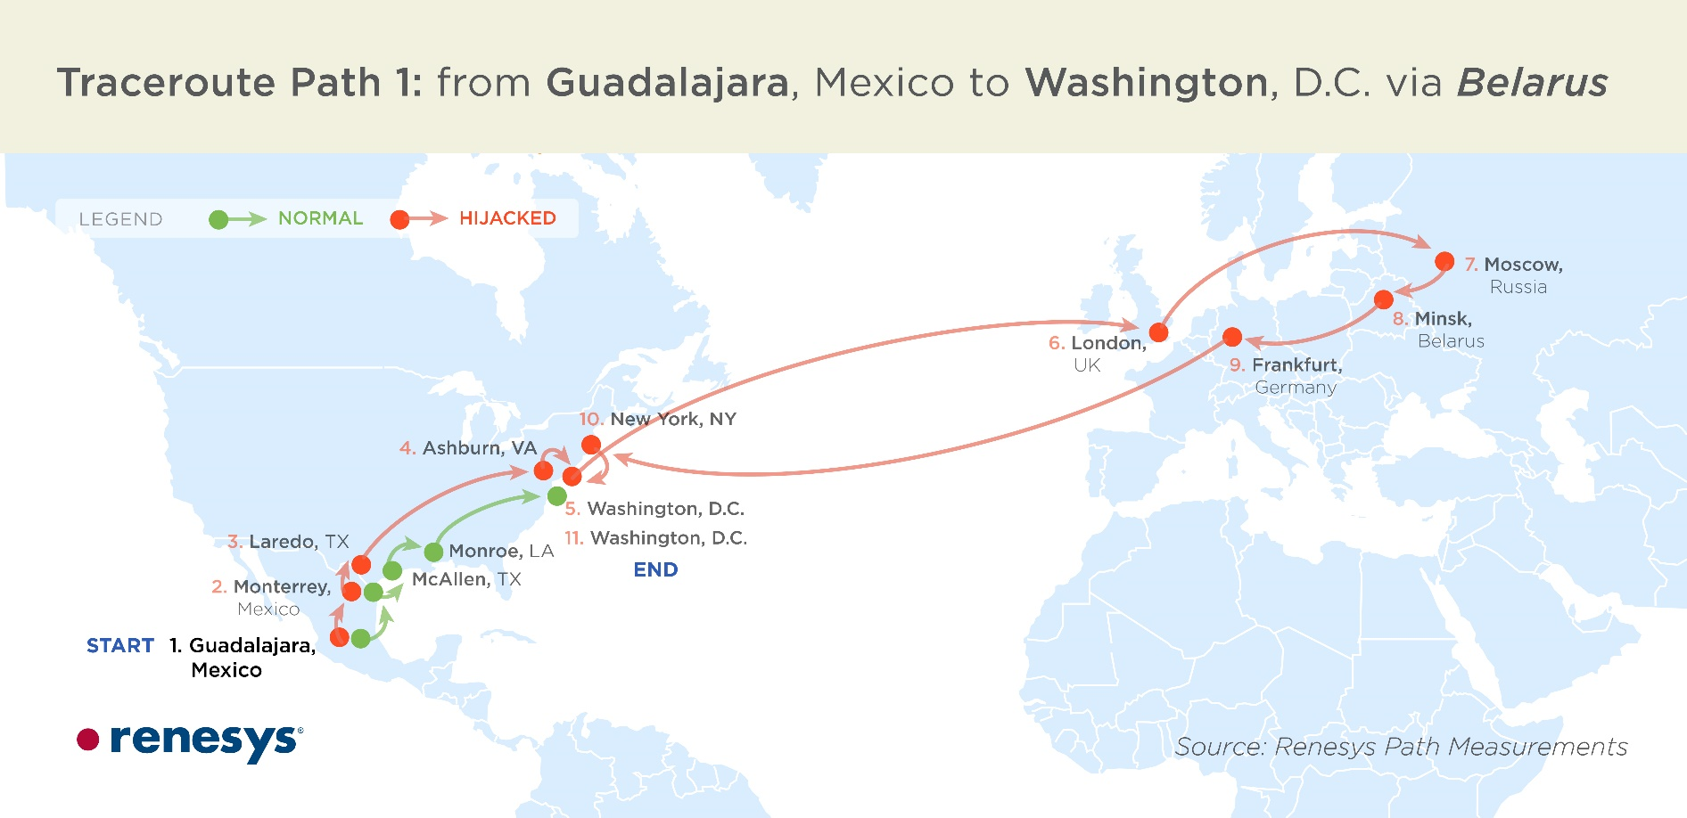
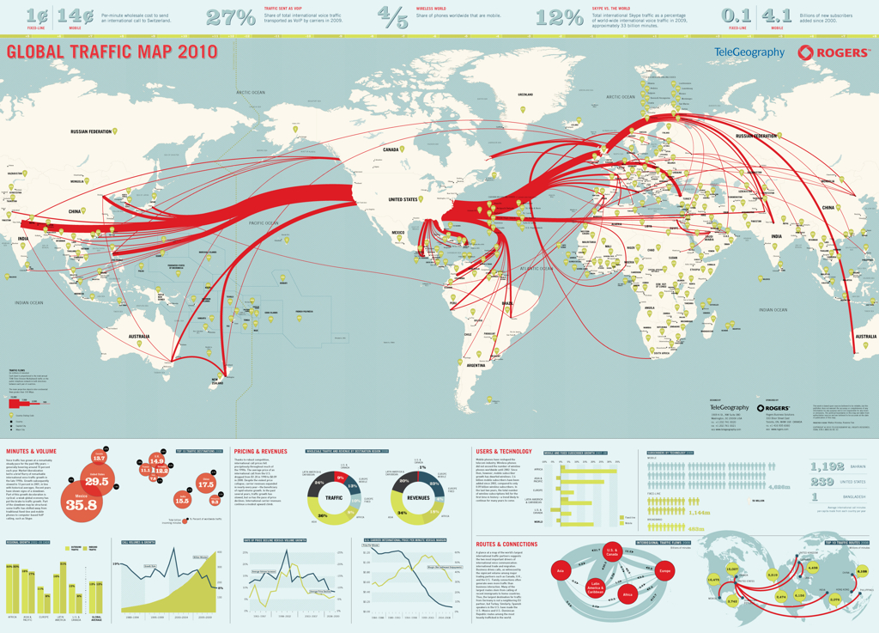
Article 30 – Disclosure of Traffic Data
Disclosure of sufficient amount of traffic data be provided to identify service provider and path of a communication
Disclosure may be withheld if:
  Request in relation to political offence
  Execution of request will prejudice sovereignty, security, ordre public or other essential interests
Notes:
This slide summarizes some key features of Article 30 of the Budapest Convention – which relates to the disclosure of traffic data in another jurisdiction. It is the international equivalent of the domestic power under Article 17 of the Budapest Convention.
Unlike most other mutual assistance provisions of the Budapest Convention, Article 30 does not require a party to make a request to another party. Rather, it imposes an obligation on a party executing a request for preservation pursuant to Article 29 to automatically and without a request expeditiously disclose traffic data to another party if it discovers that a service provider in another jurisdiction was involved in the transmission of the communication. This enables the party that requested preservation to expeditiously seek preservation of data held by such service providers in other jurisdictions. This is an important power that helps ensure that the complete trail of evidence related to a communication of interest can be identified and preserved.
The party which discovers the involvement of a service provider in another jurisdiction in the transmission of a communication is required to disclose sufficient traffic data that would enable identification of:
Service provider in other jurisdiction involved in transmission of communication
Path through which communication was transmitted
There are limited circumstances in which a party can withhold data that it is bound to disclose under Article 30.

Slide 71
Poll question
Parties are not required to make a mutual assistance request for disclosure of traffic data collected by another party pursuant to a data preservation request. The other party must disclose relevant traffic data without a request.
True
False
Notes:
The correct answer is: True.
Article 30 requires parties to disclose traffic data collected by another party pursuant to a data preservation request that identifies service providers outside its jurisdiction automatically without a request from the other party.

Slide 72
Poll question
Parties are not required to make a mutual assistance request for disclosure of traffic data collected by another party pursuant to a data preservation request. The other party must disclose relevant traffic data without a request.
True
False
Notes:
The correct answer is: True.
Article 30 requires parties to disclose traffic data collected by another party pursuant to a data preservation request that identifies service providers outside its jurisdiction automatically without a request from the other party.

Slide 73
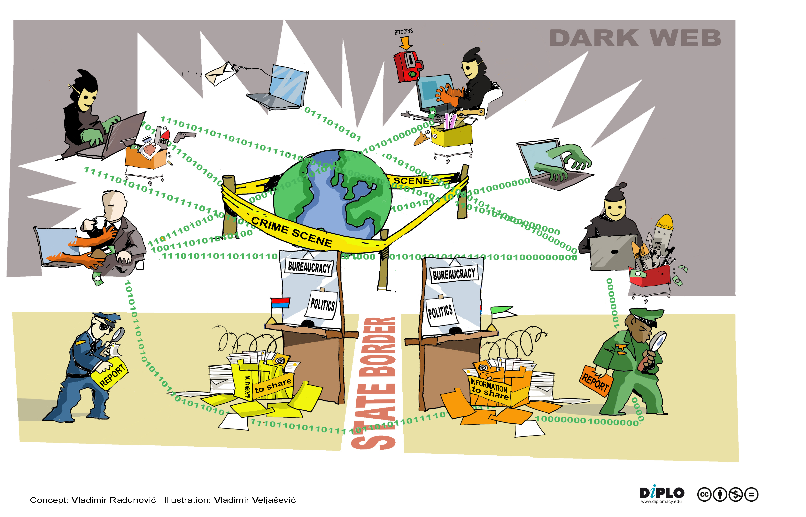
Article 31 – Mutual Assistance Regarding
Accessing of Stored Computer Data
Request to another state to search or seize (and disclose) data stored by means of a computer system
  Located within the territory of the requested State
  Including data that has been preserved pursuant to Article 29
Notes:
This slide summarizes some key features of Article 31 of the Budapest Convention – which relates to mutual assistance regarding searching or similary accessing, seizing or similarly securing and disclosing data by means of a computer system stored in another jurisdiction. It is the international equivalent of the domestic power under Article 19 of the Budapest Convention.
Article 31 enables Parties to send requests for searching or similarly accessing, seizing or similarly securing and disclosing computer data that is stored in a computer system located in a territory of another party, including data preserved pursuant to Article 29 of the Budapest Convention. It is the international equivalent of the domestic power under Article 19 of the Budapest Convention.
The terms and conditions for providing mutual assistance under Article 31 will be such set forth in applicable treaties, arrangements and domestic laws governing mutual legal assistance – and in their absence – Article 27 and 28 of the Budapest Convention.
A request under Article 31 must be responded to on an expedited basis where (1) there are grounds to believe that relevant data is particularly vulnerable to loss or modification, or (2) otherwise where such treaties, arrangements or laws so provide.

Slide 74

Article 32 – Trans-border Access
Possibility given to law enforcement from a Party to obtain evidence stored in a computer physically located in other Party’s territory
Without any request of international cooperation if, during a concrete investigation, the officers in charge
  need to obtain open source information from a computer located in a foreign country; or
  access data with the lawful and voluntary consent of the lawfully authorised person
Notes:
This slide summarizes some key features of Article 32 of the Budapest Convention – which relates to the trans-border access of computer data where publicly available or with consent.
The trainer should emphasize that while most of the international cooperation provisions of the Budapest Convention require authorisation of another state, Article 32 is different in that it may be used to obtain electronic evidence from another jurisdiction even if the state where such evidence resides does not give its authorisation.
One of the conditions that allows for transborder access to data without the authorisation of the party where the data is stored – i.e. that the data is publicly available data (open source). The slides explain that if a portion of a website is closed to the general public, then it is not considered publicly available for the purposes of Article 32.a. The geographical location data of the data is irrelevant when accessing publicly available data – so it is irrelevant whether it is stored within or outside a Budapest Convention party.
Unlike the power to access publicly available data which may be exercised in relation to data stored anywhere, the power to access data with consent is only available when the data sought is located in another Budapest Convention party.
The power to access data trans-border may be exercised on the basis of lawful and voluntary consent obtained from the person who has authority to disclose the data. The slide explains the scope of the term lawful and voluntary consent, and how it can be used to obtain data from foreign service providers without going through mutual assistance channels. It is important to note that in many jurisdictions, the agreement to “general terms of service” of service providers may not qualify as specific, explicit consent that would be required to enable disclosure of information to foreign governments.
Who is a person that is "lawfully authorised" to disclose data may vary depending on the circumstances, the nature of the person and the applicable law concerned. For example, a person’s e-mail may be stored in another country by a service provider, or a person may intentionally store data in another country. These persons may retrieve the data and, provided that they have the lawful authority, they may voluntarily disclose the data to law enforcement officials or permit such officials to access the data, as provided in Article 32.

Slide 75
Poll question
In which situations would the Budapest Convention allow a party to access data in another jurisdiction without authorisation of another party?
a) Private data
b) Publicly accessible data
c) Any stored data with lawful or voluntary consent of person authorised to disclose
d) Traffic data
e) Content data
Notes:
The correct answers are: b) Publicly accessible data (c) Any stored data with lawful or voluntary consent of person authorised to disclose.
These powers are available under Article 32 of the Budapest Convention.

Slide 76
Poll question
In which situations would the Budapest Convention allow a party to access data in another jurisdiction without authorisation of another party?
a) Private data
b) Publicly accessible data
c) Any stored data with lawful or voluntary consent of person authorised to disclose
d) Traffic data
e) Content data
Notes:
The correct answers are: b) Publicly accessible data (c) Any stored data with lawful or voluntary consent of person authorised to disclose.
These powers are available under Article 32 of the Budapest Convention.

Slide 77
Article 33 – Mutual assistance regarding the
real-time collection of traffic data
This provision empowers investigators to have the ability to obtain traffic data in real time regarding communications passing through a computer system in other parties
Requests for collection of traffic data must be associated with specified communications identified by requesting states
Making requests for general or indiscriminate surveillance or collection of large amounts of traffic data is not permitted
The terms and conditions by which such co-operation is to be provided are generally those set forth in applicable treaties, arrangements and laws governing mutual legal assistance in criminal matters
Real-time collection of traffic data is intrusive measure so parties have some discretion to limit scope of cooperation
Notes:
This provision empowers investigators to have the ability to obtain traffic data in real time regarding communications passing through a computer system in other parties. It is the international equivalent of the domestic law power established in accordance with Article 20 of the Budapest Convention. This power is important given that communications typically flow across territorial boundaries
As indicated by the slide, requests for collection of traffic data made in accordance with Article 33 must be associated with specified communications identified by requesting states. Given the privacy concerns associated with real-time collection of traffic data, it is required that any exercise of powers under this article be with respect to specified communications and not giving general or indiscriminate surveillance powers to competent authorities.
The mutual assistance provision under Article 33 is to be implemented by the requested party in accordance with applicable conditions and procedures provided under the requested party’s domestic laws (i.e. those powers established in accordance with Article 20 of the Budapest Convention).
Parties are required to provide mutual assistance under Article 33 at least for those offences for which the same power (equivalent to Article 20 of the Budapest Convention) would be available in a domestic case.

Slide 78
Article 34 – Mutual assistance regarding
the interception of content data
This provision empowers investigators to have the ability to obtain content data of specified communications transmitted by a computer system in another party
Requests for interception of content data must be associated with specified communications identified by requesting states
Making requests for general or indiscriminate surveillance or collection of large amounts of content data is not permitted
Interception of content data is a highly intrusive measure so parties have full discretion to limit scope of cooperation
Domestic law and applicable treaties can limit the extent of cooperation
Notes:
This provision empowers investigators to have the ability to obtain content data in real time regarding communications passing through a computer system in other parties. It is the international equivalent of the domestic law power established in accordance with Article 21 of the Budapest Convention. This power is important given that communications typically flow across territorial boundaries.
As indicated by the slide, requests for recording or collection of content data made in accordance with Article 34 must be associated with specified communications identified by requesting states. Given the high privacy concerns associated with this power, it is required that any exercise of powers under this article be with respect to specified communications and not giving general or indiscriminate surveillance powers to competent authorities.
Parties are required to provide mutual assistance under Article 34 to such extent permitted under their domestic law. Since this is a highly intrusive measure, parties have full discretion to limit the scope of mutual assistance they are willing to provide regarding the interception of content data.

Slide 79
Poll question
A party refuses to provide mutual assistance regarding the interception of content data to another party because this is not allowed under its domestic law. The Party has violated Article 34 of the Budapest Convention.
True
False
Notes:
The correct answer is: False.
Article 34 of the Budapest Convention allows parties to refuse mutual assistance regarding interception of content data to another party on the basis that it is not permitted under its domestic law.

Slide 80
Poll question
A party refuses to provide mutual assistance regarding the interception of content data to another party because this is not allowed under its domestic law. The Party has violated Article 34 of the Budapest Convention.
True
False
Notes:
The correct answer is: False.
Article 34 of the Budapest Convention allows parties to refuse mutual assistance regarding interception of content data to another party on the basis that it is not permitted under its domestic law.

Slide 81

Article 35 – 24/7 Network
Effective collection of electronic evidence requires rapid response
Each Party to the Convention to establish point of contact that is available 24/7 for provision of immediate assistance
24/7 POCs must provide immediate assistance for the purpose of:
  Offences related to computer systems and data
  Collection of evidence for any criminal offence
  24/7 Networks can facilitate or directly render assistance
Notes:
As noted in the Explanatory Report to the Budapest Convention, “effective combating of crimes committed by use of computer systems and effective collection of evidence in electronic form requires very rapid response. Moreover, with a few keystrokes, action may be taken in one part of the world that instantly has consequences many thousands of kilometres and many time zones away. For this reason, existing police co-operation and mutual assistance modalities require supplemental channels to address the challenges of the computer age effectively. The channel established in this Article is based upon the experience gained from an already functioning network created under the auspices of the G8 group of nations.”
In this vein, Article 35 requires parties to designate a point of contact available 24 hours per day, 7 days per week in order to ensure immediate assistance in investigations and proceedings within the scope of Chapter III of the Budapest Convention.
The purpose of the 24/7 network is to provide immediate assistance for the purpose of investigations or proceedings:
a) Concerning offences related to computer systems and data
b) Collection of evidence in electronic form of any criminal offence
This means that like the other international cooperation and mutual assistance of the Budapest Convention, Article 35 relates not only to cybercrime but also more broadly to electronic evidence.
Assistance from 24/7 POC can relate to:
Provision of technical advice for stopping or tracing an attack
Preservation of data pursuant to request (to enable more expeditious preservation than through central authority)
Collection of evidence
Provision of legal information (such as legal pre-requisites for provision of assistance)
Locating of suspects
This list is meant to be non-exhaustive.

Slide 82

Article 35 – 24/7 Network
24/7 Network must have capacity to communicate with other 24/7 Networks and with relevant domestic authorities (e.g. prosecution) on expedited basis and 24/7
24/7 Network must have proper communications equipment
24/7 Network must personnel properly trained regarding cybercrime and electronic evidence and how to respond effectively to requests
Notes:
This slide outlines the capacity requirements for the 24/7 Network.
The list of equipment may include:
Up-to-date telephone
Fax
Computer equipment
Other forms of communication
Analytical equipment

Slide 83
Questions

Slide 84
Part Three
International cooperation templates
Notes:
The fourth part will look at some templates of mutual legal assistance forms.

Slide 85
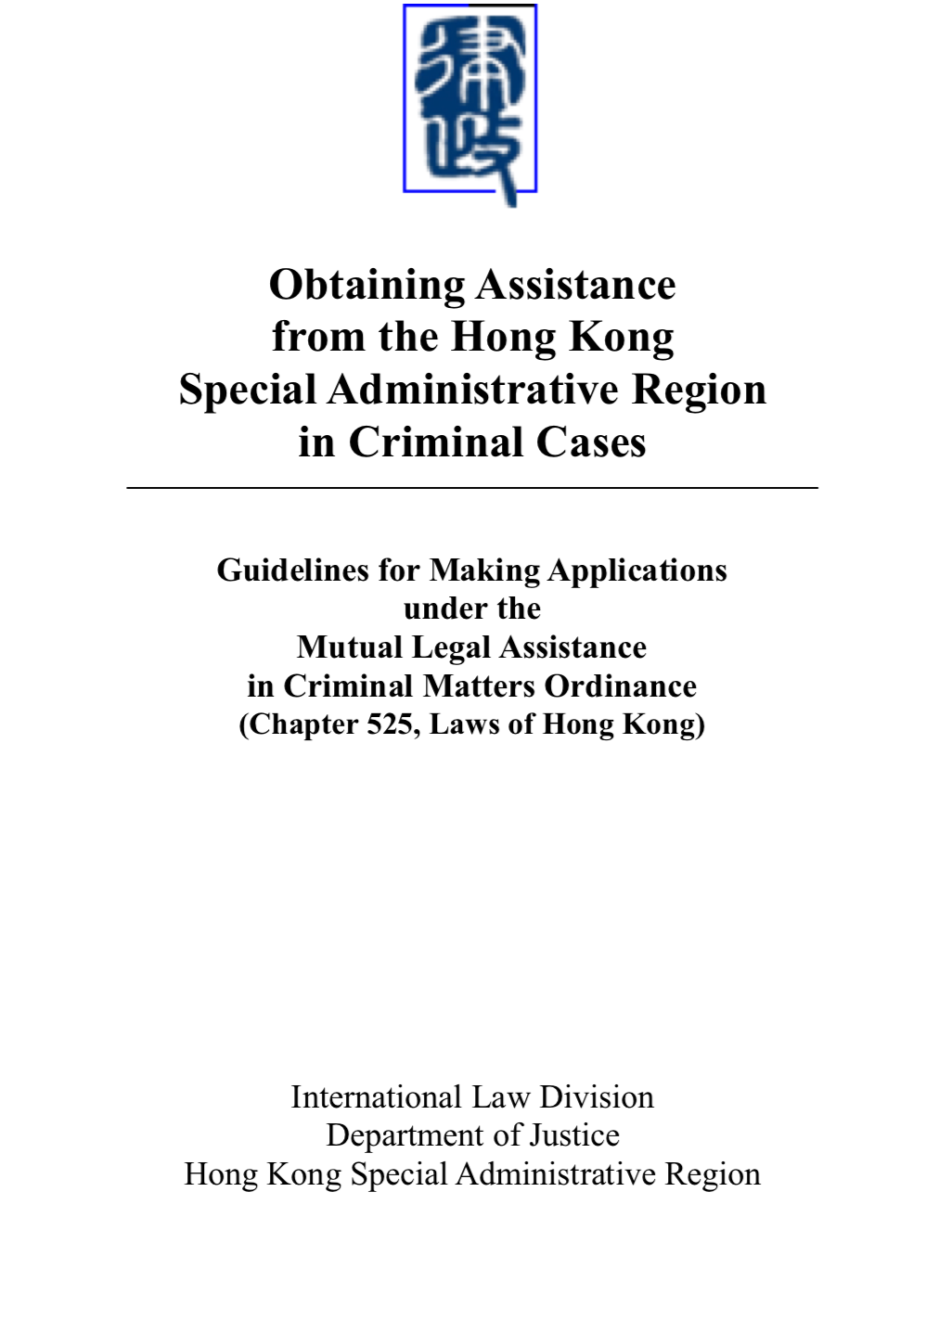
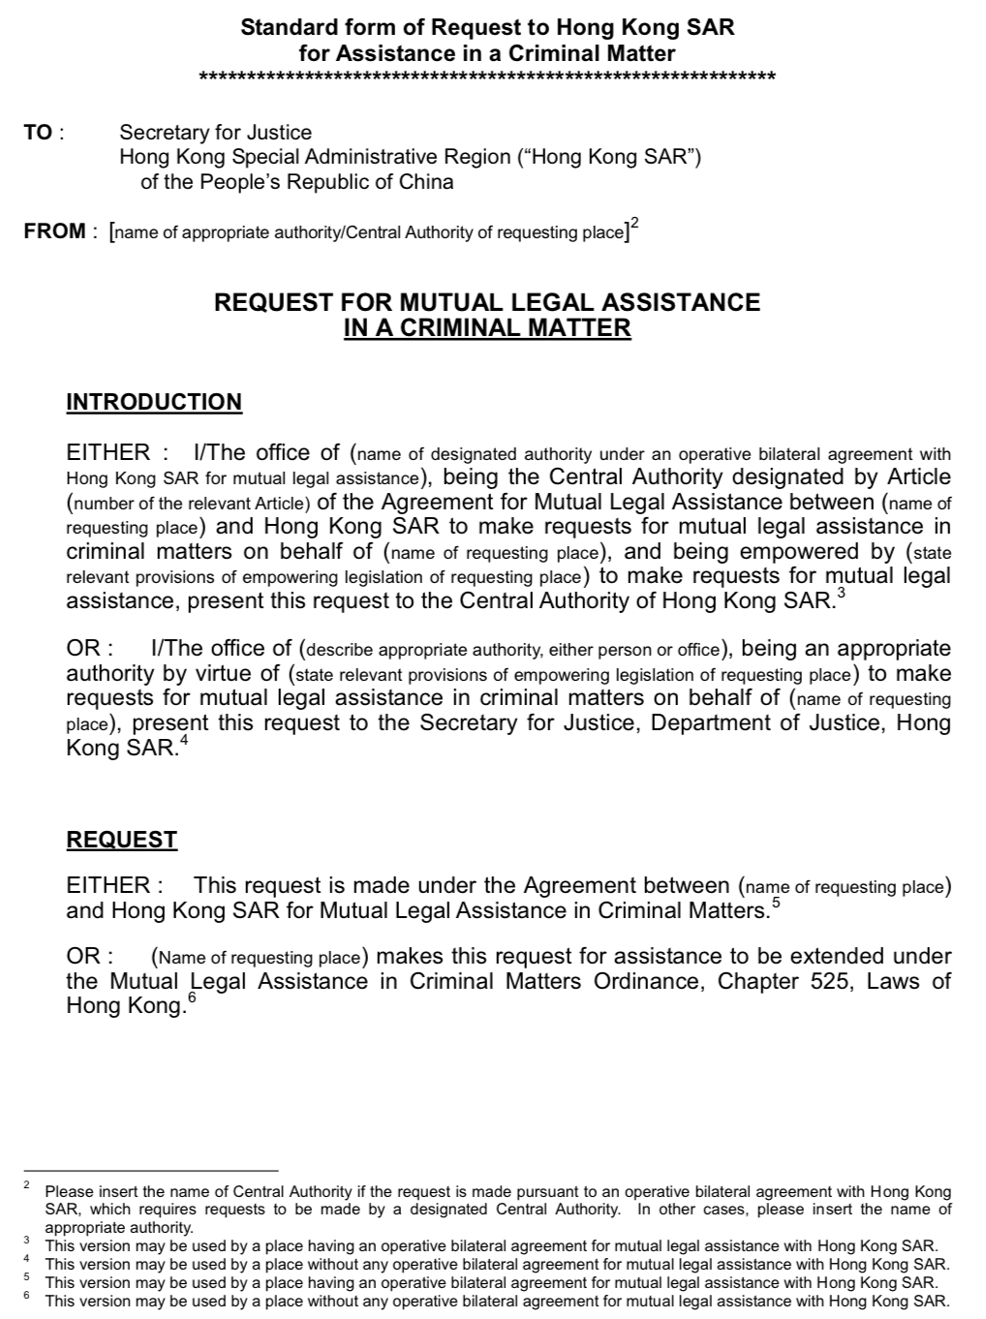
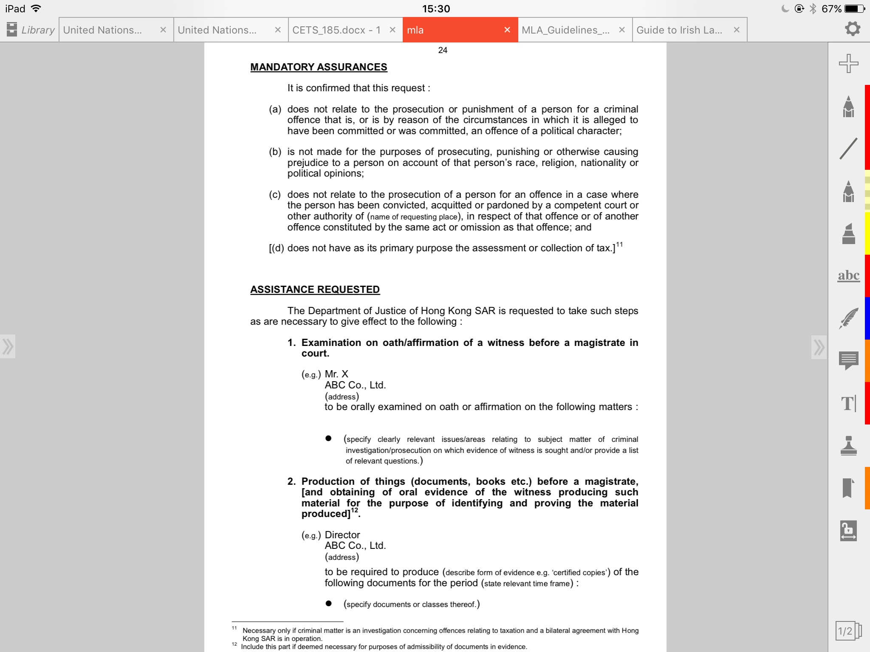
Hong Kong
http://www.doj.gov.hk/lawdoc/mla.pdf
Notes:
This slide shows a screenshot of the Standard Form of Request to Hong Kong SAR for Assistance in a Criminal Matter. This is part of the Guidelines for Making Application under the Mutual Legal Assistance in Criminal Matters Ordinance published by the Department of Justice of Hong Kong SAR.
It includes:
Introduction of the individual and office making the request
Mandatory assurances about the nature of the request (i.e. that it is not being made in relation to a political offence, for the purposes of causing prejudice to a person on account of protected characteristics of that person, and does not involve double jeopardy, and is not primarily a fiscal offence.
Summary of facts
Description of assistance requested

Slide 86
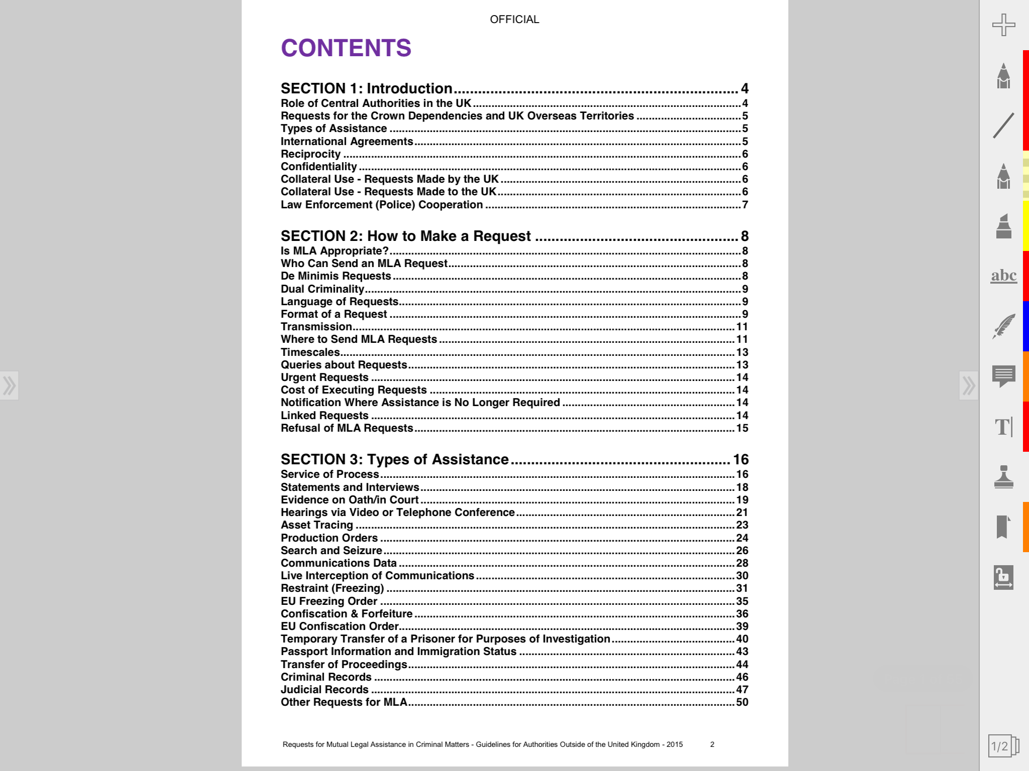
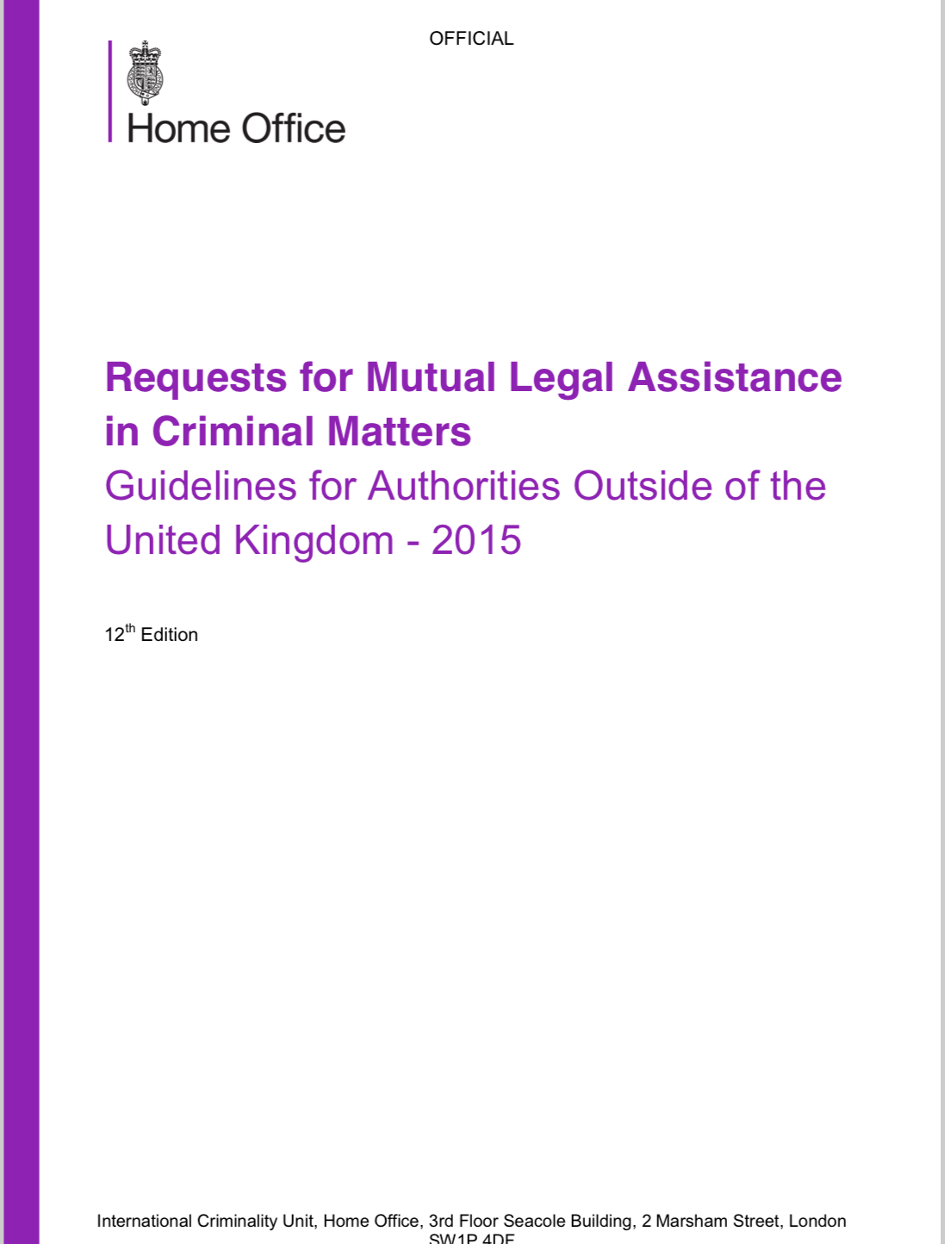
United Kingdom
https://www.gov.uk/government/uploads/system/uploads/attachment_data/file/415038/MLA_Guidelines_2015.pdf
Notes:
This slide shows a screenshot of the “Requests for Mutual Legal Assistance in Criminal Matters – Guidelines for Authorities Outside of the United Kingdom – 2015” published by the UK Home Office. The trainer can share the URL on the slide with participants interested in seeing the guide.

Slide 87
Council of Europe templates: Background
Background
Reasons for going forward with Article 29/30 data preservation template:
  Text of Article 35 of the Convention taken as blueprint for mandatory fields;
  Minimization of input and thus less time for processing;
  Guidance for newly established or upcoming points of contact;
  More uniform practice of preservation requests across jurisdictions.
Capacity building efforts (regional meetings, training) 2016 and 2017;
Initial templates (Art. 29 and 31 BCC) tested by several states;
Further submissions and discussions through mailing list and T-CY Bureau (2017 and 2018);
Final version reviewed and adopted by the 19th Plenary of the T-CY (9-10 July 2018).
Notes:
The trainer can introduce the participants to the templates of the Council of Europe for seeking the preservation of data under Article 29 and the 31 of the Budapest Convention.
The trainer can explain why the Council of Europe prepared the Article 29/30 - mainly to minimize the time to prepare requests, provide guidance to established and new points of contact, and in the longer run, to create a more uniform practice for preservation requests going forward. As part of capacity building efforts of the Cybercrime&EAP project, initial templates for article 29 and 31 of the Budapest Convention were tested and developed by several states.
The templates were presented and reviewed at the first meeting of the 24/7 points of contact at the Hague in September 2017. The template was adopted as a non-binding document
After further submissions and discussions through mailing list and T-CY Bureau in 2017 and 2018, the version reviewed and adopted by the 19th Plenary of the T-CY on 9-10 July 2018.

Slide 88
Article 29/30 template – Mutual Legal
Assistance Request for Preservation
Article 29/30 template – main features:
Marking obligatory items with asterisk (Art. 35 requirements);
Reference/case status;
Less details requested / more details on requesting authority;
Details of authorities in charge of investigation and prosecution (separately);
Contact person details for additional confirmation;
Choice as to the means of response;
Possibility to attach the mutual legal assistance request;
Streamlined “offences” section;
Description of data requested / annex (specification form);
Information identifying the person or organisation;
Article 30 reference;
Case status / urgency (pre-defined items) / confidentiality;
Confirmation/notification options.
Notes:
This slide lists the main features of the article 29/30 template.

Slide 89
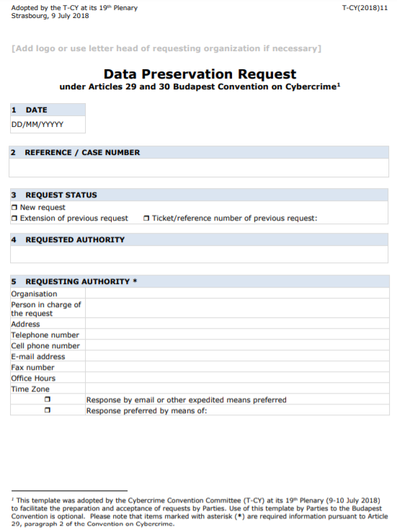
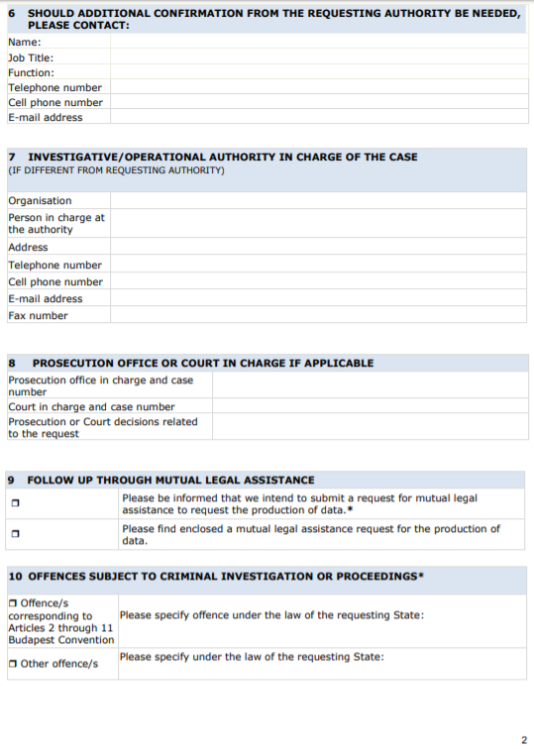
Article 29/30 template
Notes:
These slides show screenshots of the entire Article 29/30 template.

Slide 90
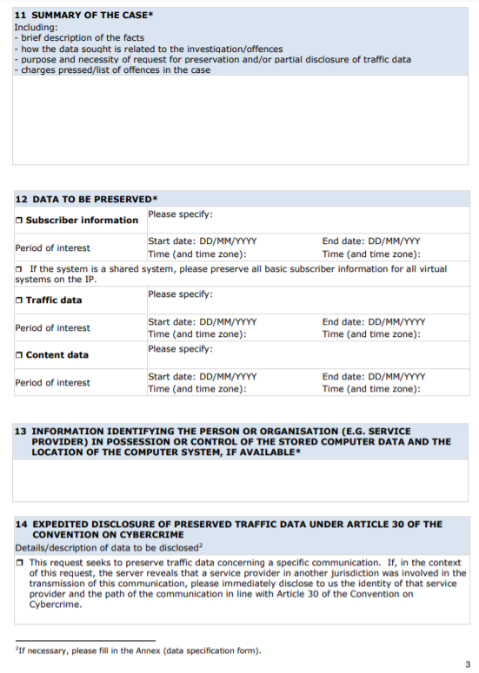
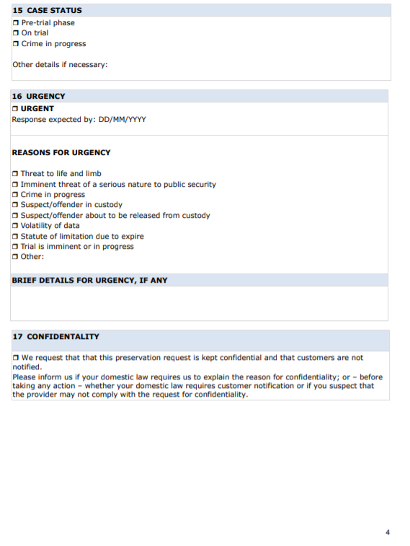
Article 29/30 template
Notes:
These slides show screenshots of the entire Article 29/30 template.

Slide 91
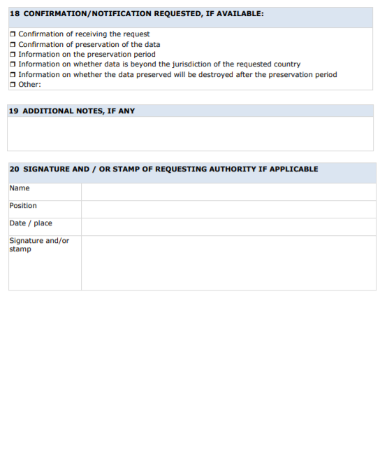
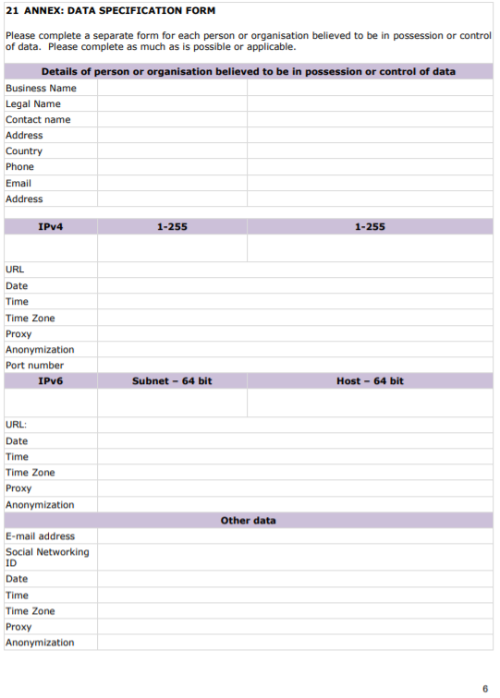
Article 29/30 template
Notes:
These slides show screenshots of the entire Article 29/30 template.

Slide 92
Article 31 template – Mutual Legal Assistance Request for Subscriber Information
Article 31 template - Mutual Legal Assistance Request for subscriber information
Synchronised for applicable content from Article 29/30 template;
Focuses exclusively on subscriber information;
No specifically obligatory items, thus allowing more flexibility;
Details about previous MLA or preservation request;
Streamlined list of offences;
Separate section on domestic legal basis;
Focus on information identifying the service provider;
Separate annexes for subscriber information needed for IP addresses, and for subscriber information needed for accounts;
Future outlook:
  MLA templates should be multilingual in order to save the time for translation and processing;
  The idea of the template is to be electronic / currently editable PDF format;
  Identification / signature (comparable to 24/7 Network).
Notes:
This slide lists the main features of the article 31 template.

Slide 93
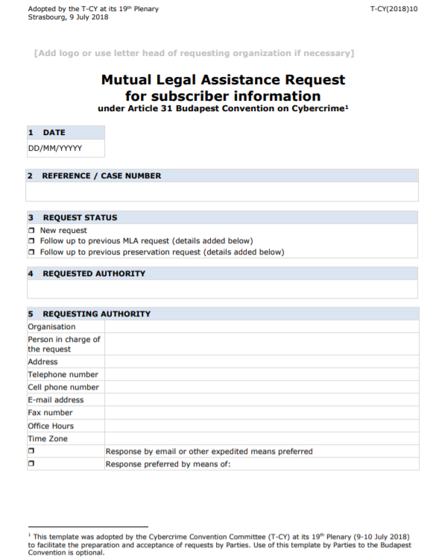
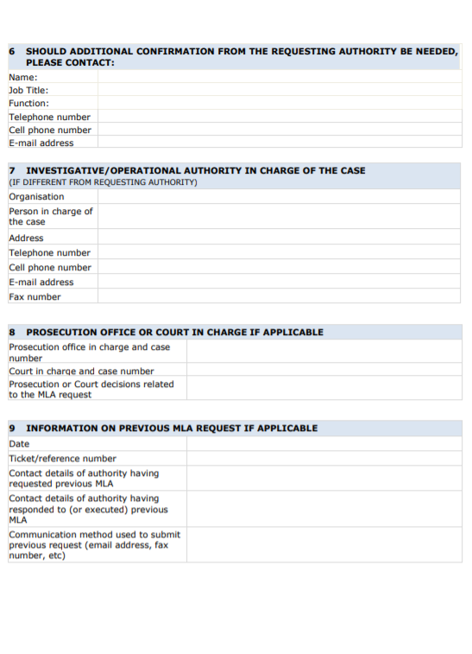
Article 31 template
Notes:
These slides show screenshots of the entire Article 31 template.

Slide 94
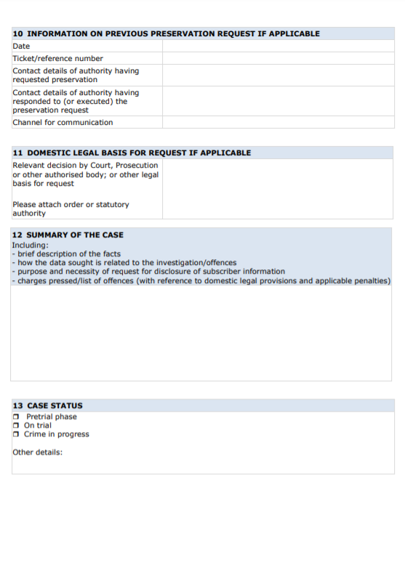
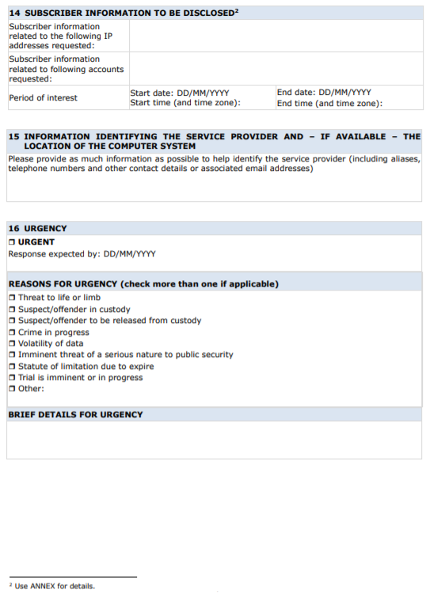
Article 31 template
Notes:
These slides show screenshots of the entire Article 31 template.

Slide 95
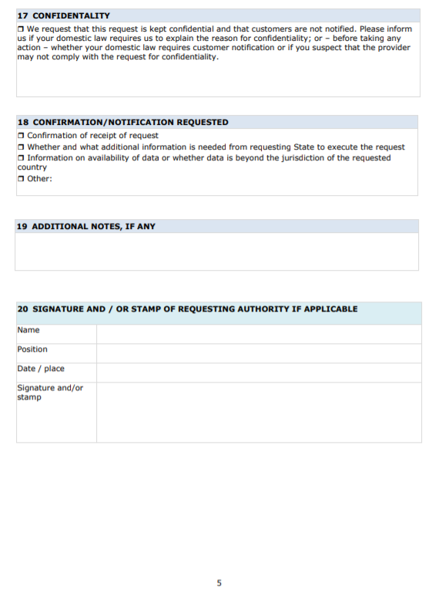
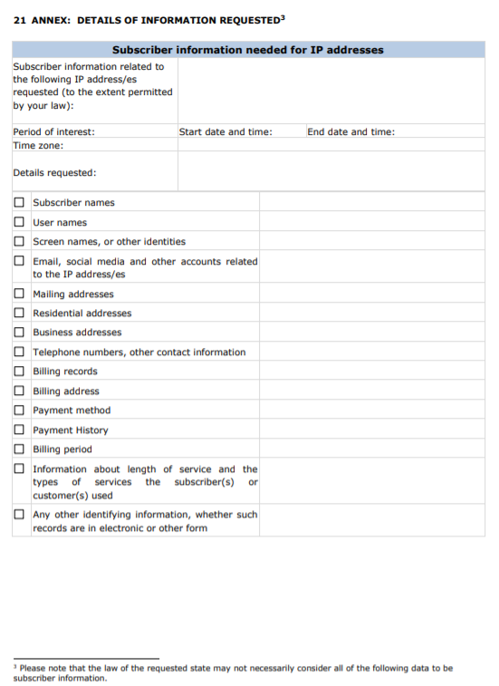
Article 31 template
Notes:
These slides show screenshots of the entire Article 31 template.

Slide 96
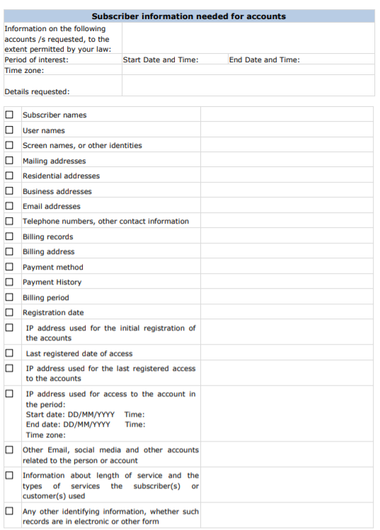
Article 31 template
Notes:
These slides show screenshots of the entire Article 31 template.

Slide 97
Questions

Slide 98
Part Four
Overview of the Second Additional Protocol to the Budapest Convention

Slide 99

Overview of Second Additional Protocol
Increasing use of servers in foreign, multiple, shifting or unknown jurisdictions (cloud) to storage evidence
Law enforcement powers are increasingly limited by territorial boundaries
Parties to the Budapest Convention have been trying to develop a solution
  Transborder Working Group
  Cloud Evidence Group
Notes:
This slide provides some context to the development of the Second Additional Protocol. It explains that a major challenge faced by parties to the Budapest Convention was posed by the increasing use of servers in foreign, multiple, shifting or known jurisdictions – especially with respect to data stored on the cloud. The procedural powers under the Budapest Convention are restricted by territorial boundaries, so the Parties sought to work out a solution that would result in the evolution of the provisions of the Budapest Convention based on these technological developments.

Slide 100
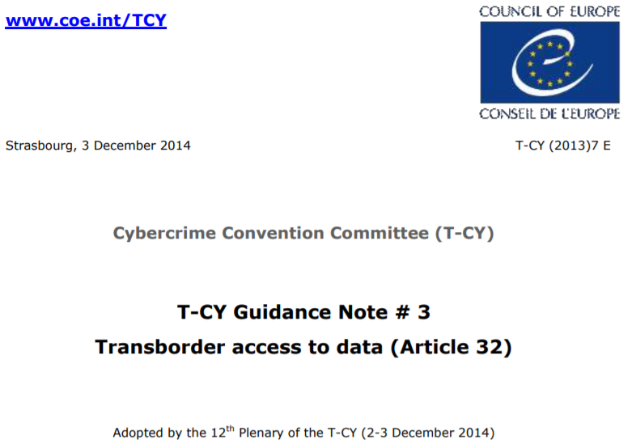
Transborder Working Group
Period: 2012-2014
Culminated in Guidance Note # 3 Trans-border access to data)
Made a series of proposals for an additional protocol that would expand scope of transborder access (beyond Article 32b)
Notes:
The Transborder Group (“Ad-hoc sub-group of the T-CY on jurisdiction and transborder access to data and data flows”) was tasked to develop an instrument – such as an amendment to the Convention, a Protocol or Recommendation– to further regulate the transborder access to data and data flows, as well as the use of transborder investigative measures on the Internet and related issues, and to present a report containing its findings to the Committee. Its findings culminated in the eventual adoption of the Guidance Note on Transborder Access (Guidance Note # 3). The Transborder Group also made a series of proposals to expand the scope of the ability to access data transborder, even beyond the provisions of Article 32 of the Budapest Convention.

Slide 101
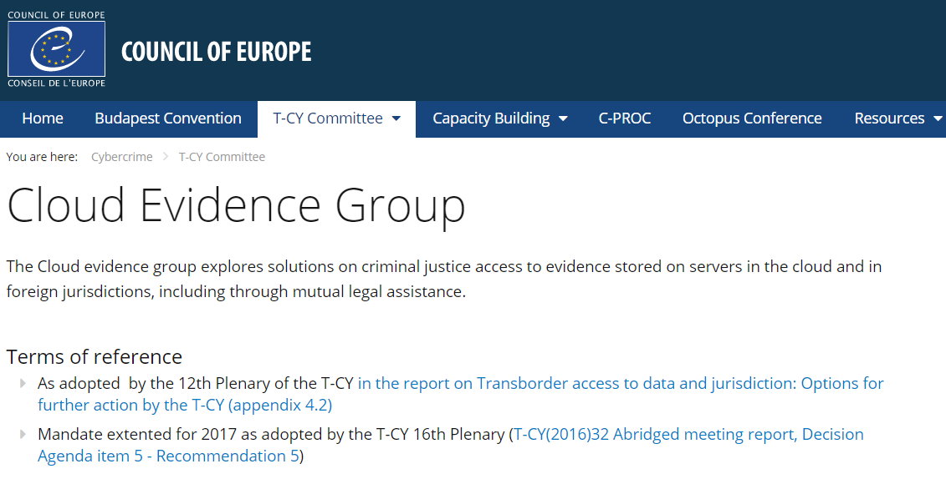
Cloud Evidence Group
Period: 2015-2017
Identified issues to be addressed in Additional Protocol including:
  Need to distinguish between thresholds for subscriber, traffic and content data
  Limited effectiveness of MLA for securing volatile electronic evidence
  Situations of loss of knowledge of location of data
  Question as to whether service provider is sufficiently present or offering services in territory
  Regime of voluntary disclosure by US providers
  Expedited disclosure in emergencies
  Data protection & rule of law safeguards
Notes:
The Cloud Evidence Group met between 2015 and 2017 to explore solutions on criminal justice access to evidence stored on servers in the cloud and in foreign jurisdictions, including through mutual legal assistance. It identified a series of issues posed by cloud computing on the criminal justice capabilities of states, particularly when it comes to the transnational nature of electronic evidence storage. These include:
- Location of evidence
- Location of offenders
- Location of victims
- Ownership of data
- Physical location of service provider
- Legal residence of service providers
The final document prepared by the Cloud Evidence Group may be found at: https://rm.coe.int/CoERMPublicCommonSearchServices/DisplayDCTMContent?documentId=09000016806a495e

Slide 102
Protocol Drafting Group
Adopted Draft Articles (May 2020)
Language of requests
Video conferencing (for taking testimony or statements from witnesses)
Joint investigation teams and joint investigations
Emergency mutual assistance
Direct disclosure of subscriber information
Giving effect to orders of another party for expedited production of data
Notes:
Language of request: This Article provides a framework for languages that may be used when addressing Parties and service providers. Even where in practice Parties are able to work in languages other than their official languages, such possibility may not be foreseen by domestic law or treaties. The objective of this Article is to provide additional flexibility under this Protocol.
Video conferencing: Article primarily addresses the use of video conferencing technology to take testimony or statements. This form of cooperation may be provided for in existing bilateral and multilateral mutual assistance treaties, e.g., ETS 182 (Second Additional Protocol to the Convention on Mutual Assistance in Criminal Matters). In order to not supersede provisions specifically designed to meet the requirements of the parties to those treaties or conventions, Article [ ], like several other articles in this Protocol, applies in the absence of a mutual legal assistance treaty, or arrangement on the basis of uniform or reciprocal legislation, in force between the requesting and requested Parties. Such articles follow the same approach as in Article 27 of the Budapest Convention.
JIT and joint investigations: Given the transnational nature of cybercrime and electronic evidence, investigations and prosecutions related to cybercrime and electronic evidence often have links to other States. Joint investigation teams (JITs) can be an effective means for operational cooperation or coordination between two or more States. Article [ ] provides a basis for such forms of cooperation.
Emergency mutual assistance: Article is intended to provide maximally expedited procedure for mutual assistance requests made in emergency situations. An emergency is defined in paragraph 1 as being those in which there is a significant and imminent risk to the life or safety of a natural person. The definition is intended to cover situations in which the risk is imminent, meaning that it does not include situations in which the risk to the life or safety of the person has already passed, or in which there may be a future risk that is not imminent. The reason for this very precise definition is that the article places labor intensive obligations on both the requested and requesting Parties to react in a greatly accelerated manner in emergencies, which consequently requires that emergency requests be given a higher priority than other important but somewhat less urgent cases, even if they had been submitted earlier.
Direct disclosure of subscriber information: his article establishes a procedure that provides for the direct cooperation between the authorities of one Party and a service provider in the territory of another Party to obtain subscriber information. The procedure builds on the conclusions of the Convention Committee’s Cloud Evidence Group and Guidance Note on Article 18 of the Convention, acknowledging the importance of timely cross-border access to electronic evidence in criminal investigations and proceedings, in view of the challenges posed by existing procedures for obtaining electronic evidence from service providers in other countries.
Giving the effects to orders: The purpose of this Article is for a requesting Party to have the ability to issue an order
to be submitted to a requested Party and for the requested Party to have the ability to give effect to that order by compelling a service provider in its territory to produce subscriber information or traffic data in the service provider’s possession or control.

Slide 103
Protocol Drafting Group
Draft Articles Under Development (2020)
Common provisions
Conditions and safeguards
Extension of a search to a connected computer
Undercover investigations by means of computer system (domestic level)
Undercover investigations (international level)
General principles
Direct preservation of data by service providers
Disclosure of data in emergency situations
Access to information related to registered Internet domains – Request for domain name registration information [WHOIS]
Final provisions
Notes:
Protocol drafting group meetings continued during COVID 19 pandemic with on-line meetings. Various discussions on added value under way together with discussions on feasibility of international cooperation element of UC investigations.
As work on adoption of the draft provisions develops this and previous slide should be updated accordingly.

Slide 104
Poll question
Which of the following is not being considered for inclusion in the Second Additional Protocol?
a) Disclosure of data in emergencies
b) Racism and Xenophobia
c) Undercover investigations
d) Requesting WHOIS information
Notes:
The correct answer is b) Racism and Xenophobia. This is covered by the First Additional Protocol to the Budapest Convention.

Slide 105
Poll question
Which of the following is not being considered for inclusion in the Second Additional Protocol?
a) Disclosure of data in emergencies
b) Racism and Xenophobia
c) Undercover investigations
d) Requesting WHOIS information
Notes:
The correct answer is b) Racism and Xenophobia. This is covered by the First Additional Protocol to the Budapest Convention.

Slide 106
Part Five
Summary

Slide 107

Summary
Understanding the substantive law and procedural powers under the Budapest Convention
Reviewing the specific provisions of international cooperation and mutual assistance under the Budapest Convention
Understanding how to use different mechanisms under the Budapest Convention to seek cooperation
Introduction to T-CY templates for mutual legal assistance requests
Introduction to Second Additional Protocol to the Convention
Notes:
This slide repeats the objectives of this session. The trainer can run through these objectives to ensure that these aspects have been covered in this module.

Slide 108
Questions

