Slide 1
First Responder training for Investigators on Cybercrime and Electronic Evidence
Session 4
Identifying Suspects on the Internet

Slide 2
Session Objectives
Know important Internet terminology.
Know what is an IP address.
Describe how you can find a suspect IP address.
Describe how you can associate a suspect IP address with a real person.
List three technical challenges to identification of suspects on the Internet.

Slide 3
Internet Terminology and
IP Addresses

Slide 4
What is the Internet
The word “Internet” is a contraction of the words “Interconnected Networks”.
As the name suggests, it is the name given to a set of technologies used for connecting different, smaller networks together.

Slide 5
Local Networks
When you connect your PC or laptop to your office network, you are connecting to a Local Area Network, or LAN.
Generally speaking, the characteristics of a LAN are:
  The networking infrastructure is owned and managed by the organisation that uses the network.
  The network is geographically limited in extent (e.g. one building).
  One or more of a small number of possible networking communication protocols are used (typically Ethernet (for wired connections) and/or Wi-Fi (for wireless connections)).

Slide 6
Wide Area Networks
If an organisation has more than one location (e.g. more than one building) they might want to connect the two local networks together.
The most common technique for doing this is to lease a connection from a telecommunications provider (known as a leased line).

Slide 7
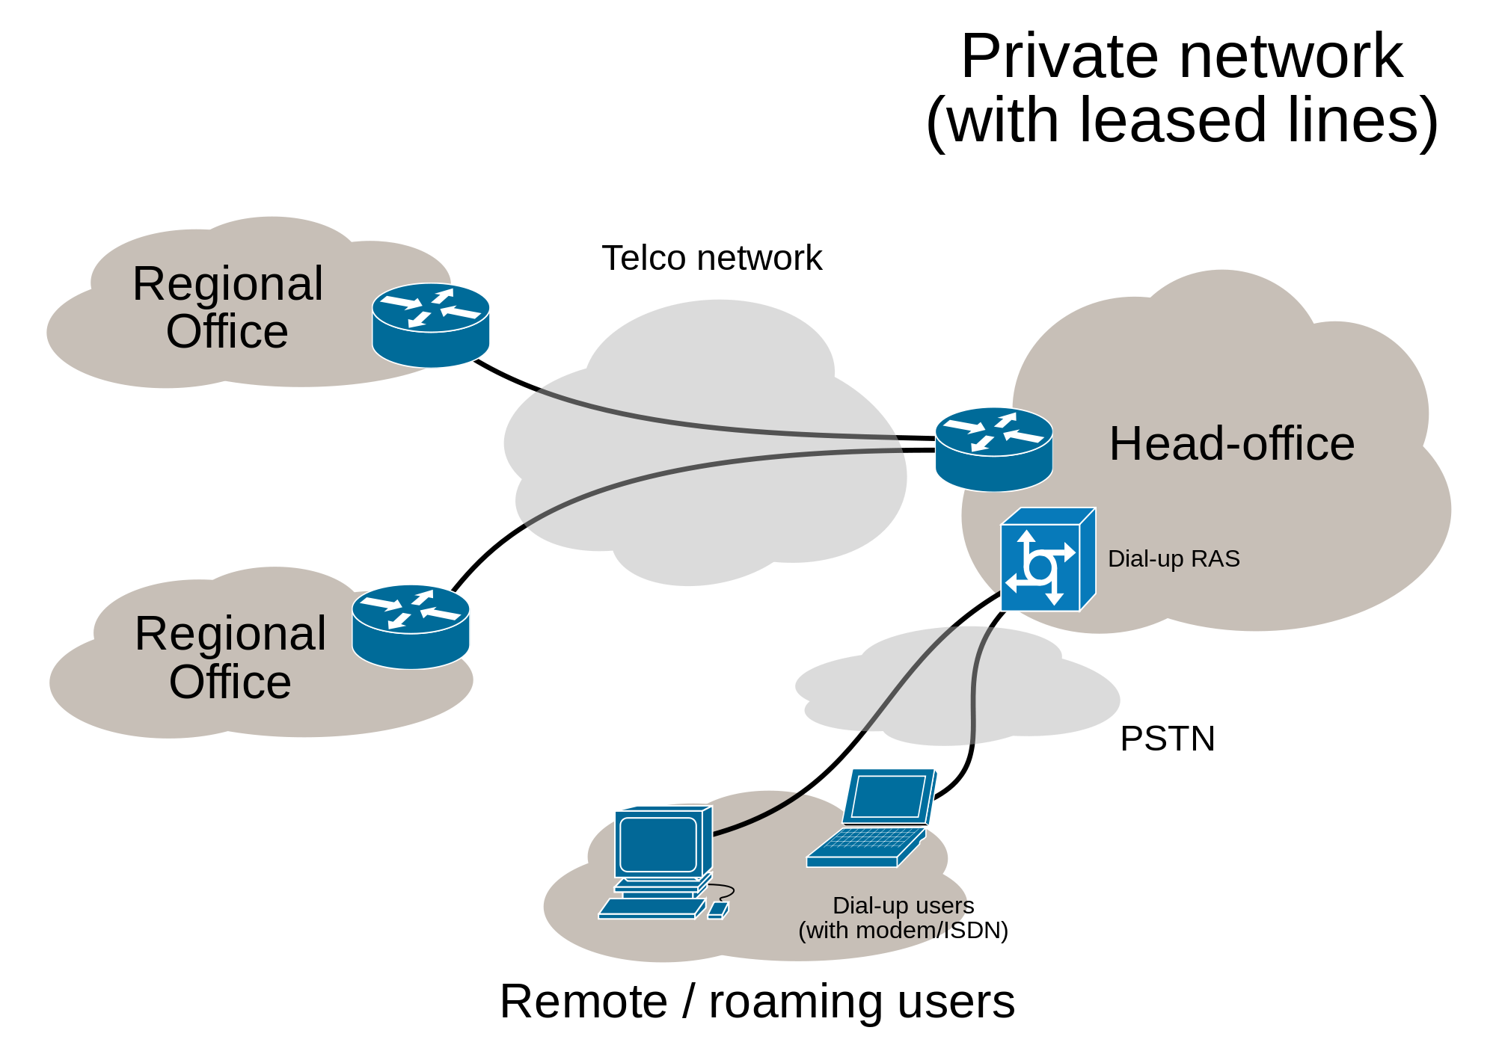
Wide Area Networks: Case Study

Slide 8
Networking Terminology
Bandwidth: The name given to how much information per second can be transferred across a particular connection.
Router: The piece of hardware that decides which connection to transfer information along next.
Hub or Switch: The pieces of hardware that connect PCs to a network.
Network Interface Card (NIC): The piece of hardware inside your PC or laptop that sends and receives information on the network.
Media Access Control (MAC) address: A unique identifier used to identify your Network Interface Card (NIC) address on the network. This ID is only used on the Local Area Network.
Server: A computer that provides information or services on a network.

Slide 9
Question
What if two organisations want to connect their networks and share information or provide services to each other?

Slide 10
Another Question…
How will the shared infrastructure know how to get information from our organisation to Google?

Slide 11
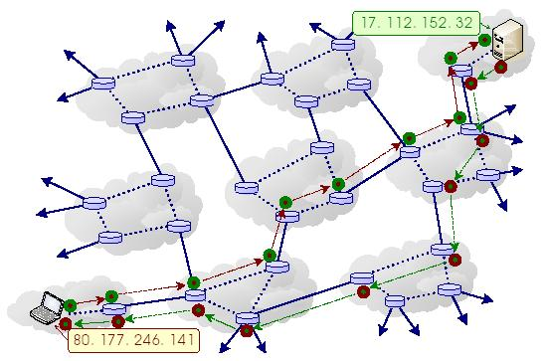
Internet Traffic Forwarding

Slide 12
IP Address (version 4)
IP address consists of four numbers between 0 and 255, separated by full-stops/periods.
E.g.
  1.2.3.4
  200.4.0.188
There is also a newer form of IP addresses (version 6).

Slide 13
IP Address = Specific Person?
Not necessarily!
IP address might allow identification of:
  Internet Service Provider
  Geolocation
However, not always accurate.
Also, not always traceable to a specific person:
  Static vs. Dynamic IP addresses
  Network Address Translation (NAT)

Slide 14
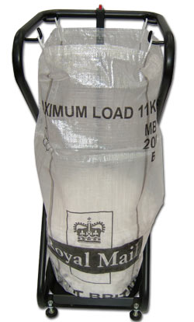
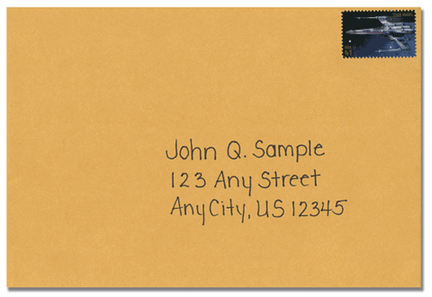


TCP/IP protocol suite
Other identifiers (email facebook name etc)
Application
Proprietary
Global
Addressing!
UDP
TCP
Addressing!
IP
Other identifiers (mac address access credentials)
Local
DATA Link

Slide 15
Types: Static vs. Dynamic
Static
  Often entered manually
  Assigned for long period of time
Dynamic
  Usually automatically assigned at start of session
  Upon connection
  Short periods (may even change during session)
“Sticky”
  Dynamic address that sticks to a device (usually only changes after a lengthy disconnection)

Slide 16
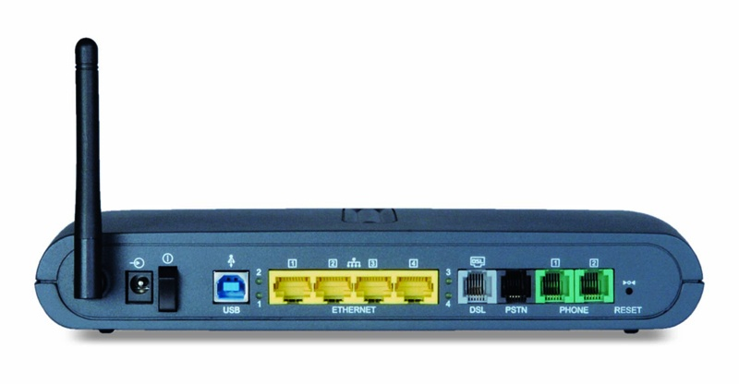
Private vs Public
Private
Public
LAN
(Home Computers)
LAN
(Wireless)
WAN
(Phone line with ADSL)

Slide 17
Private vs Public
Private use (10.x.x.x 192.168.x.x , 172.16-31.x.x)
  Routed/Used only on LAN
Public use (basically: the rest)
  You need to have a public address to access
  the internet (issue: NAT..)
  Routed on Internet (WAN)

Slide 18
Exercise
What is YOUR IP address? What can you find out about it?

Slide 19
Identifying Suspect IP Address

Slide 20
Online Activity
A user’s online activity might generate records.
These records might contain the IP address of the user’s communication.
This can be an important piece of information for identifying a suspect.
  NOTE: Necessary but not sufficient!

Slide 21
Case Study: Web Browsing Activity
Web browsing activity involves a user sending requests to a web server and the web server sending responses back to the user.
The format of the requests and responses is described using a protocol known as Hypertext Transfer Protocol (HTTP).
By default, a web server will log all incoming requests, including the IP address from which the request was received.

Slide 22
Case Study: Web Browsing Activity
192.220.98.177 - - [23/Sep/2006:21:09:27 -0400] "GET / HTTP/1.0" 206 1729 "-" "Servmon::Monitor::apache/1.03"
216.128.130.126 - - [23/Sep/2006:21:30:02 -0400] "GET /pgp/ HTTP/1.0" 200 1871 "http://dir.yahoo.com/Computers_and_Internet/Security_and_Encryption/PGP___Pretty_Good_Privacy/" "Mozilla/4.0 (compatible; MSIE 6.0 [en] Win NT 5.1; U)"
66.196.73.20 - - [23/Sep/2006:21:33:35 -0400] "GET /pgp/pgpdoc2/pgpdoc2_65.html HTTP/1.0" 200 7185 "-" "Mozilla/5.0 (Slurp/cat; slurp@inktomi.com; http://www.inktomi.com/slurp.html)"
63.229.162.177 - - [23/Sep/2006:21:34:31 -0400] "GET /stephen/singers/ HTTP/1.1" 200 1936 "http://www.dosado.com/callers/default.htm " "Mozilla/4.0 (compatible; MSIE 5.5; Windows 98; Win 9x 4.90)"
138.162.0.41 - - [23/Sep/2006:21:36:27 -0400] "GET /gallery/Colorado02?&page=2 HTTP/1.0" 200 19649 "http://www.google.com/search?q=st+malo+chapel+colorado&hl=en&lr=&ie=UTF-8&start=20&sa=N" "Mozilla/4.76 [en] (Windows NT 5.0; U)"
12.255.212.29 - - [23/Sep/2006:21:51:42 -0400] "GET /cgi- bin/formmail.cgi?recipient=lharleyren49@aol.com&subject= http://www.gildea.com/cgi-bin/formmail.cgi&body=48462427&email=uqizakzbi@aol.com HTTP/1.1" 404 291 "-" "Mozilla/4.0 (compatible; MSIE 5.0; Windows 98; DigExt)"
64.156.198.78 - - [23/Sep/2006:21:52:53 -0400] "GET /wang-center/schedules/wang.html HTTP/1.1" 200 1438 "-" "Mozilla/5.0 (X11; Linux i686; en-US; rv:1.0rc5; OBJR)"
163.139.58.174 - - [23/Sep/2006:21:54:29 -0400] "GET /sd/ HTTP/1.1" 304 - "-" "Mozilla/4.0 (compatible; MSIE 6.0; Windows NT 5.1; .NET CLR 1.0.3705)"
205.188.209.51 - - [23/Sep/2006:21:57:23 -0400] "GET / HTTP/1.0" 200 1729 "http://aolsearch.aol.com/dirsearch.adp?query=Gildea"

Slide 23
Case Study: Email Activity
Email is not sent directly from one person to another.
Rather, a technique known as “store and forward” is used.
Records of the storing and forwarding of a particular email message are associated with that message.
Each person has an incoming and an outgoing mail server and email is sent and delivered as shown on the next slide.

Slide 24
Case Study: Email Activity
Email is not sent directly from one person to another.
Rather, a technique known as “store and forward” is used.
Each person has an incoming and an outgoing mail server and email is sent and delivered as shown on the next slide.

Slide 25
Internet
The mail is forwarded to the incoming (POP3) mail server of Bob’s ISP
Alice’s ISP then forwards the E-mail out onto the Internet
POP3
Server
SMTP
Server
SMTP
Server
POP3
Server
When Alice presses SEND her E-mail is moved from her computer to her Internet Service Providers outgoing mail server
The next time Bob connects to his ISP the E-mail is downloaded to his computer
ALICE
BOB

Slide 26
Case Study: Email Activity
An email consists of two parts
  Header: Contains information about who the message is from, who it is for, subject, date etc..
    …and how it has been stored/forwarded!
  Body: The actual content of the email message.
An example email with headers is shown on the next slide.

Slide 27
Microsoft Mail Internet Headers Version 2.0
Received: from xproxy.gmail.com ([66.249.82.197]) by exchange1.trl.org with Microsoft SMTPSVC(6.0.3790.0); Tue, 27 Mar 2007 09:44:54 +0100
Received: by xproxy.gmail.com with SMTP id h28so988094wxd
for <Jim.Stark@trl.org>; Tue, 27 Mar 2007 00:44:31 -0800 (PST)
DomainKey-Signature: a=rsa-sha1; q=dns; c=nofws;
s=beta; d=gmail.com;
h=received:message-id:date:from:to:subject:in-reply-to:mime-version:content-type:references;
b=RY8mK69lgiScvczLvTJmfvlXoZa1zUskwWsukAn3jlzblALGzxF/pzpDKyrEnIDyZrKp8VnthCyCgyHOfi7KCHhaseAXG4UAQO8zIbSFDxw6uVN0jUVYQx0a60pjkFBxmdzL/PCDEllSFEExVQB+m0WD/lcGQEgGmecYV1nRmy8=
Received: by 10.70.100.14 with SMTP id x14mr6330299wxb; Tue, 27 Mar 2007 00:44:30 -0800 (PST)
Received: by 10.70.122.16 with HTTP; Tue, 27 Mar 2007 00:44:30 -0800 (PST)
Message-ID: <95ecf0550603280044n7a18048fs8e37cf2c2ea3a3d8@mail.gmail.com>
Date: Tue, 27 Mar 2007 09:44:30 +0100
From: "Jim Stark" <jc.stark@gmail.com>
To: "Jim Stark" <Jim.Stark@trl.org>
Subject: Re: test
In-Reply-To: <42675D880C511048AE555539A210615627A281@exchange1.trl.org>
MIME-Version: 1.0
Content-Type: multipart/alternative;
boundary="----=_Part_21605_28805312.1143535470923"
References: <42675D880C511048AE555539A210615627A281@exchange1.trl.org>
Return-Path: jc.stark@gmail.com
X-OriginalArrivalTime: 27 Mar 2007 08:44:54.0322 (UTC) FILETIME=[E283E920:01C65243]

Slide 28
Other Services
Many other online services will keep records of IP addresses used to communicate with them.
Which others can you think of?

Slide 29
Associating IP Address To Real world Identity

Slide 30
Remember…
Recall: IP Address != Specific Person.
For example:
  Static vs. Dynamic IP addresses
  Network Address Translation (NAT)

Slide 31
ISP Records
Internet Service Providers will typically keep records of which subscriber was using a particular IP address at a particular time.
How long these records are retained for will depend on national legislation.
How to get access to these records will depend on national legislation.

Slide 32
Multinational Service Provider Records
Multinational Service Providers (Facebook, Google. Etc.) will also typically keep records of which subscriber was using a particular IP address at a particular time.
International cooperation typically required.

Slide 33
Corporations
Corporations using Network Address Translation (NAT) may have the records to be able to assocaite suspect activity with a specific internal IP address.
How engagement with the company takes place will depend on national legislation.

Slide 34
Technical Challenges

Slide 35
Challenges
Both intentional and unintentional obfuscation may take place.
Some example will be discussed.

Slide 36
Anonymising Services
Both paid and free services are available to conceal online activity.
Anonymising web proxies specifically conceal the source of web browsing activity.
Anonymising email providers specifically conceal the sender of email.
Anonymising IP proxies conceal all the source of all Internet traffic.
  Example: TOR

Slide 37
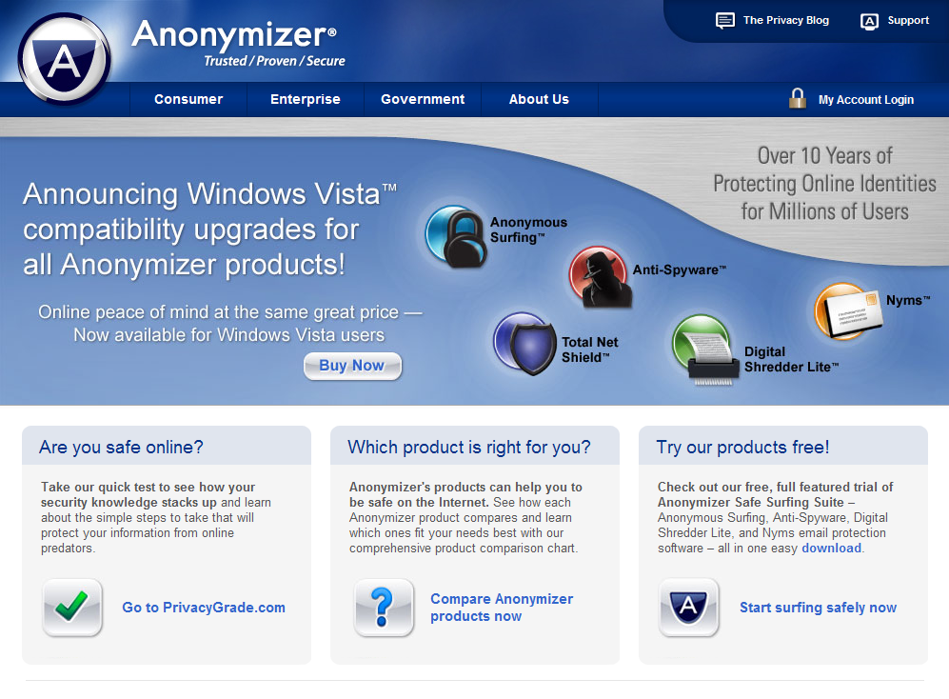

Slide 38
Carrier Grade NAT
A technique for associating a very large number of users with a single IP address.
Commonly used for Internet connectivity on mobile phone networks.

Slide 39
(Carrier Grade) NAT
Mapping
NAT
Private
Local users
Public
Private vs. public (IPv4)
  Private: for use on a local site only
    10.0.0.0-10.255.255.255
    172.16.0.0-172.31.255.255
    192.168.0.0-192.168.255.255
10.0.0.2
Gateway
Internet
Internal
10.0.0.1
External
62.156.8.1
10.0.0.3
85.223.50.87
10.0.0.4
Public
Internal address
Private
Port Number

Slide 40
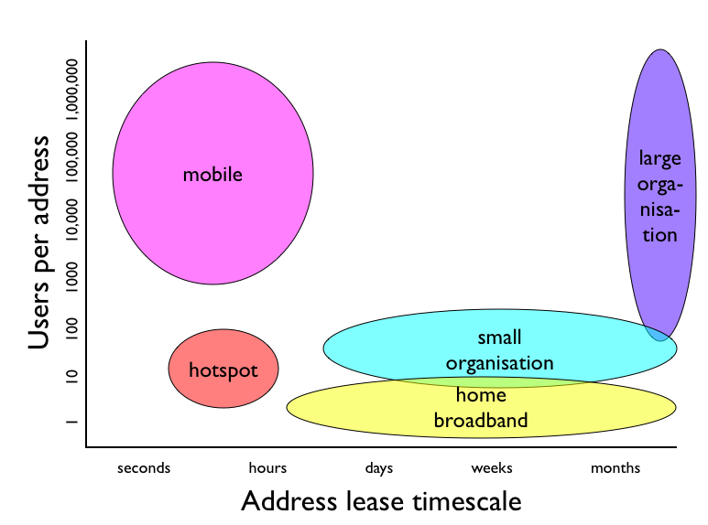
Lease times vs users per address
Notes:
*

Slide 41
Exercise?
Find your IP address on your device online:
  www.whatismyip.com
If you are on a laptop:
  Run a command prompt and type ‘ipconfig’
Why is it different (if it is..)?

Slide 42

Questions

