Slide 1
The art of learning and training
Day #1

Slide 2

Overview
5
Delivered ToT methodology
Delivered ToT methodology
4
3
Trained without methodology ToT
Received ToT – did not train
2
1
Trainee

Slide 3

I would like…
I would like…
I would like…
I would like…
I would like…
Concerns
Concerns
Concerns

Slide 4
My expectations as trainer
to have open-minded, active participants, willing to to experience new ways of learning and training
to benefit from the knowledge and skills already present in the room
to take advantage from constructive criticism
to have fun and socialise with new people

Slide 5
Think like a trainer
Feel as a trainee
Our motto?

Slide 6
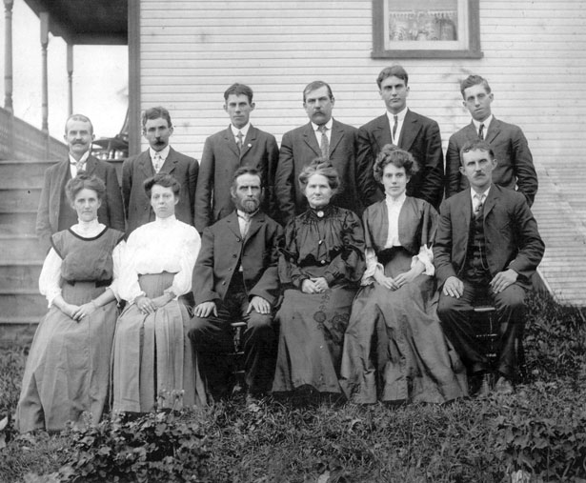
Ready?

Slide 7
The perfect training…
Essential
Good to have/optional
Don’ts/to be avoided

Slide 8
The list shoud be….
Specific
Measurable
Achievable (for the audience)
Relevant (realistic, reasonable and resourced)
Time bound (time/cost limited)

Slide 9
The list shoud be….
The list should be all-encompassing:
organizational aspects
training environment
personal qualities of trainers
subject-matter issues
methodology
Just to name a few…

Slide 10
Andragogy and the fundamentals of adult education

Slide 11
Let’s start with some basics…

Slide 12

What is learning?
The acquisition and development of memories and behaviors, including skills, knowledge, understanding, values, and wisdom.
It is the product of experience and the goal of education.

Slide 13
What is learning?
It ranges from simple forms such as habituation and classical conditioning, seen in many animal species, to more complex activities such as play, seen only in relatively intelligent animals.

Slide 14

Malcom Knowles’ assumptions

Slide 15
Critical elements
Autonomy of learners
Readiness to learn
Learner’s experience
Orientation to learning

Slide 16
Assumptions about adult learning
Adults need to learn why they need to learn something
Self-concept
Adults need to learn experientially

Slide 17
Assumptions about adult learning
Adults approach learning as problem-solving
Adults learn best when the topic is of immediate value and use
Adults view learning as an active process in the construction of meaning (motivation)

Slide 18
Laws of learning
Readiness
Exercise
Effect
Primacy
Intensity
Recency

Slide 19
“Adults have been found to learn more effectively by doing and experiencing”
(David Kolb)

Slide 20
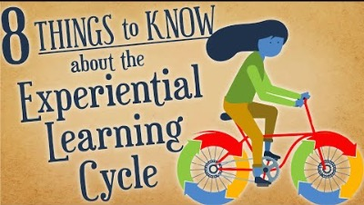

Slide 21
David Kolb’s theory

Slide 23
Adults want to be involved in both the planning and the evaluation of the training
Adults want their experiences (including mistakes) to be the basis of the training
Active participation
Using experiences
Problem-centered learning and instruction
Learning with relevance and impact to job or personal life
Adult education needs to be problem-centered rather than content-centered
Adults are most interested in learning subjects that have immediate relevance and impact to their job or personal life

Slide 24
Retaining training material
People forget what they learn …
    40% in 2 days
    65% in 8 days
    75% in 30 days
Within a month of your training, most of your audience will have forgotten about three-quarters of the information you imparted!

Slide 25
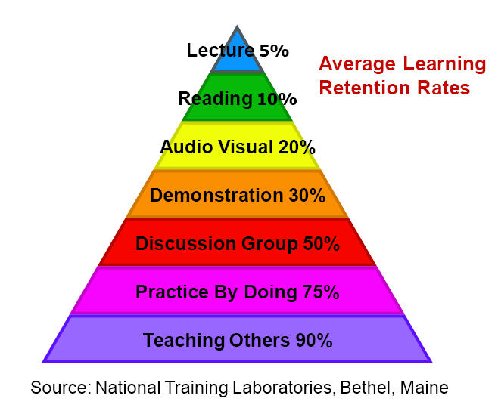
The learning pyramid

Slide 26
Learning styles
Learning styles refer to the ways you prefer to approach new information.
How much do you know about yourself? Let’s take a test…

Slide 27
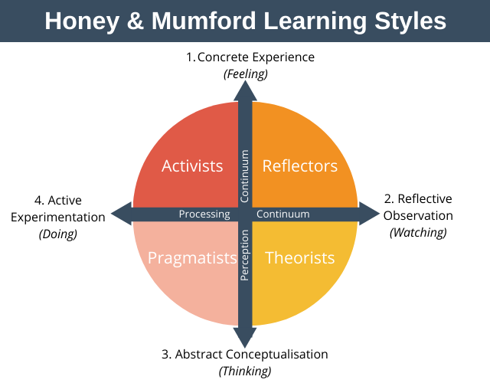
Notes:
During the 1970s Peter Honey and Alan Mumford studied and expanded upon David Kolb’s learning model. Honey and Mumford proposed that individuals needed to use one of four different learning styles in order to complete activities. These four styles include: activists, reflectors, pragmatists and theorists.

Slide 28
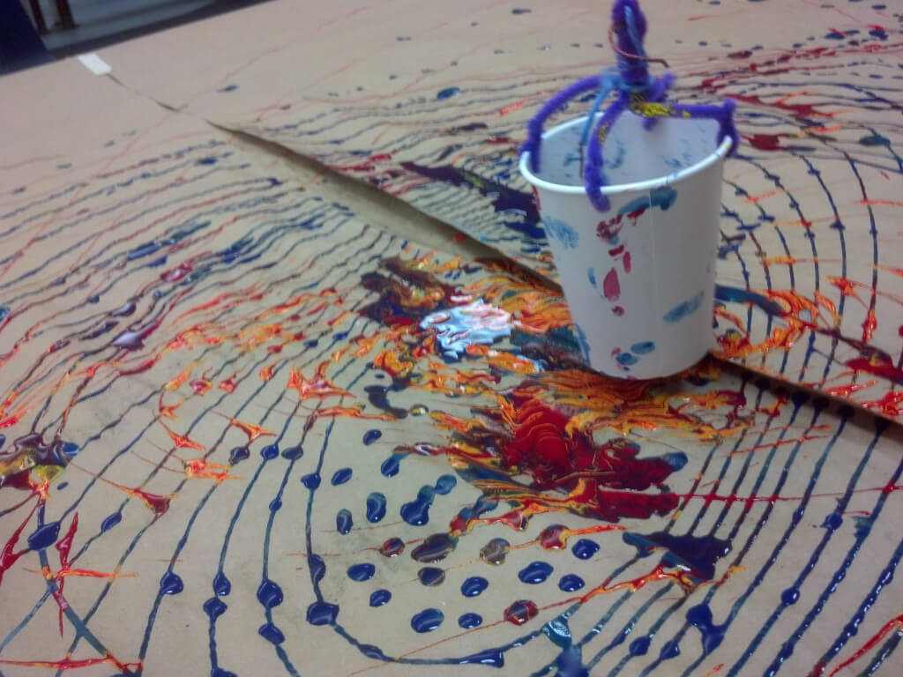
Activists
Activists involve themselves fully and without bias in new experiences. They enjoy the here and now, and are happy to be dominated by immediate experiences. They are open-minded, not sceptical, and this tends to make them enthusiastic about anything new. Their philosophy is: "I'll try anything once". They tend to act first and consider the consequences afterwards.
Notes:
Original definitions by Honey and Mumford

Slide 29
Activists
Their days are filled with activity. They tackle problems by brainstorming. As soon as the excitement from one activity has died down they are busy looking for the next. They tend to thrive on the challenge of new experiences but are bored with implementation and longer term consolidation. They are gregarious people constantly involving themselves with others but, in doing so, they seek to centre all activities around themselves.
Notes:
Original definitions by Honey and Mumford

Slide 30

Theorists
Theorists adapt and integrate observations into complex but logically sound theories. They think problems through in a vertical, step-by-step logical way. They assimilate disparate facts into coherent theories. They tend to be perfectionists who won't rest easy until things are tidy and fit into a rational scheme. They like to analyse and synthesize. They are keen on basic assumptions, principles, theories models and systems thinking.
Notes:
Original definitions by Honey and Mumford

Slide 31
Theorists
Their philosophy prizes rationality and logic. "If its logical its good." Questions they frequently ask are: "Does it make sense?" "How does this fit with that?" "What are the basic assumptions?" They tend to be detached, analytical and dedicated to rational objectivity rather than anything subjective or ambiguous.
Notes:
Original definitions by Honey and Mumford

Slide 32
Theorists
Their approach to problems is consistently logical. This is their 'mental set' and they rigidly reject anything that doesn't fit with it. They prefer to maximize certainty and feel uncomfortable with subjective judgements, lateral thinking and anything flippant.
Notes:
Original definitions by Honey and Mumford

Slide 33
Pragmatists
Pragmatists are keen on trying out ideas, theories and techniques to see if they work in practice. They positively search out new ideas and take the first opportunity to experiment with applications. They are the sort of people who return from courses brimming with new ideas that they want to try out in practice. They like to get on with things and act quickly and confidently on ideas that attract them.
Notes:
Original definitions by Honey and Mumford

Slide 34
Pragmatists
They tend to be impatient with ruminating and open-ended discussions. They are essentially practical, down to earth people who like making practical decisions and solving problems. They respond to problems and opportunities 'as a challenge'. Their philosophy is "There is always a better way" and "If it works it's good".
Notes:
Original definitions by Honey and Mumford

Slide 35
Reflectors
Reflectors like to stand back to ponder experiences and observe them from many different perspectives. They collect data, both first hand and from others, and prefer to think about it thoroughly before coming to a conclusion. The thorough collection and analysis of data about experiences and events is what counts so they tend to postpone reaching definitive conclusions for as long as possible. Their philosophy is to be cautious.
Notes:
Original definitions by Honey and Mumford

Slide 36
Reflectors
They are thoughtful people who like to consider all possible angles and implications before making a move. They prefer to take a back seat in meetings and discussions. They enjoy observing other people in action. They listen to others and get the drift of the discussion before making their own points. They tend to adopt a low profile and have a slightly distant, tolerant unruffled air about them.
Notes:
Original definitions by Honey and Mumford

Slide 37
Reflectors
When they act it is part of a wide picture which includes the past as well as the present and others' observations as well as their own.
Notes:
Original definitions by Honey and Mumford

Slide 38

Feelers
Feelers learn through focusing on human values and needs. They are quick to recognize human consequences to knowledge and information as well as swiftly relating ideas and concepts to personal experiences. They are quick to forgive, being peacemakers, and excel in counseling situations. They search for opportunities to praise others.
Notes:
Original definitions by Honey and Mumford

Slide 39
Review of learning objectives

Slide 40
Introductory session
Familiarize with participants and trainers
Feel as part of a team
Share expectations and check them against the proposed agenda
Feel empowered by having the possibility to have a say in the way activities unfold

Slide 41
Learn about purpose, format and methodology of training
Establish an environment that is conducive to training
Define ground rules
Spell out the overarching motto of the whole training

Slide 42
Your perfect training
Identifying multiple perspectives that need to be considered when planning a training
Experiment active listening
Define criteria for assessing the quality of the performances foreseen for the training competition

Slide 43
Your perfect training
Start developing own mental/manual checklist for training

Slide 44
Andragogy and principles of adult education
Differentiate between pedagogy and andragogy
Recall the main theories related to adult education
List the fundamental principles related to adult education

Slide 45
Andragogy and principles of adult education
Analyse the application of these principles to the current training
Assess such application to the present training and develop alternatives

Slide 46
Training methods
Discuss the key features of a number of selected training methodologies
Identify the pros and cons of each of the methodology discussed
Understand the challenges and preparatory work inherent in the implementation of the different methodologies
Share experiences about their use

Slide 47
Which learner are you?
Familiarize with learning pyramid
List the learning styles
Identify one’s learning style
Establish a link between the learning type and the training methods

Slide 48
Closing session
List the main points/topics/aspects presented and discussed during the training
Assess the quality of the training

Slide 49
Well done! Training is over..
Enjoy your evening ☺

