Slide 1
The art of learning and training
Day #2

Slide 2
Your role as a trainer
You are the instructor
You are the facilitator
You are the resource person
You are a co-learner (as you do no “know it all”)

Slide 3
Timer
https://www.online-stopwatch.com/countdown-timer/

Slide 4
Learning objectives
LOs describe what a learner should be able to demonstrate by the end of the course
LOs clarify intentions - both for the trainer and for the learner
Define focus of the training, avoiding possible misunderstandings

Slide 5
Learning objectives
Formulating LOs helps ensure the training is relevant to the learner’s needs, and deliverable
Without LOs, training may be simply unfocussed, or far too ambitious.
Enable trainers and learners to assess success of training

Slide 6
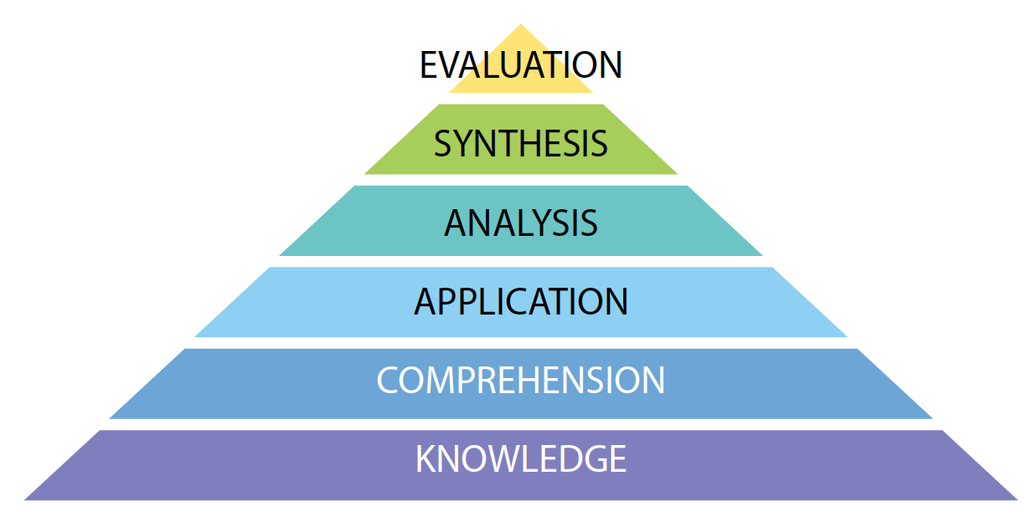
LOs pyramid

Slide 7
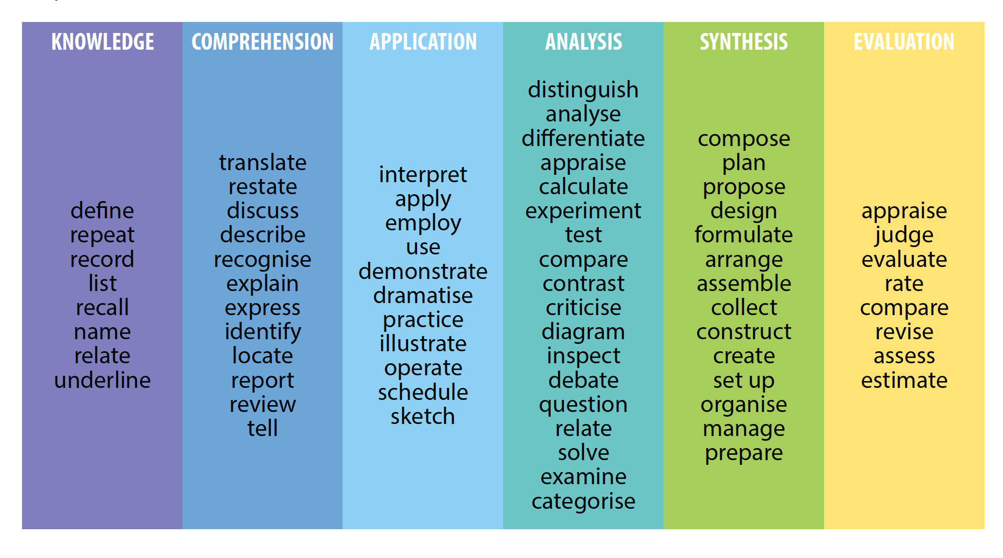

Slide 8
Learning materials
  How relevant are they for the training?
  Divide between those of immediate use and those for in-depth study
  Paper or electronic formats? Pros and cons of each….
  Do they address all learning styles? Do not forget to differentiate and make use of new media (video, Youtube, Internet, E-learning)

Slide 9
Delivering a training – first step
  Now we are going to discuss how to present effectively a training involving legal professionals. Before we delve into this topic, however, there are a few questions you need to ask yourself before engaging into this type of training. The most important of such questions is why is the training important to the audience that you have in front of you. Remember that you are likely to find some resistance when you are entering the room – your participants are professionals who have very busy agendas and are probably thinking that a training on how to train their fellows is not worth their time and resources. The first thing, therefore, is to explain very clearly to them why this training is relevant to them. There are multiple ways in which you can reach this objective. For instance you can launch a survey or a brainstorming during which participants will express their opinions. This will also have the effect of enabling you to get a feeling of who you have in front of you (ie. Which type for learner, their background, for instance depending on the language they use…)
Notes:
Slides 9 to 14 are drafted in a chaotic and bad way on purpose, as they will be used to give examples of common errors made (often in good faith, with the intention of passing as much information as possible) by trainers. They are obviously exaggerated and it is going to be quite difficult to follow them. In fact, you might only use a few. Their use, however, is functional to stimulate a reaction by the audience and analyze this feeling so that they the can appreciate the impact that wrong delivery techniques have on the learning environment. Remember that, in addition to the slides, other factors will have to be considered (i.e. room setting, light, distance and size of screen…)

Slide 10

Delivering a training – second step
  Once you have gained an understanding of who your audience is, then it is time
  to get them engage!
  How do you do that?
  There are different ways.
  What you need to keep in
  mind is that the more
  techniques you are using,
  the more effective you are
  toing to be.
  But what are the learning or
  training techniques we are
  talking bout? And what are
  the type of activities and
  Supporting material you
  Can use?

Slide 11

The golden rules
  Use as much hands-on training as possible. The most effective training uses all the senses to affect learning. Demonstrate and apply teaching points to create greater understanding and knowledge of the subject.
  Tests are most effective when students know they will be quizzed, because they’ll pay close attention to the material. Testing is an objective way to determine whether training achieves its objective
  Involve trainees. For example, ask participants to share their experiences with the training topic. Many trainees are experienced personnel who have valuable information to contribute. All trainees will get more out of sessions by hearing about their co-workers’ experiences with the subject—and not just the trainer’s lecture points. Hearing different voices also keeps sessions.
Notes:
Remember to go through this slide using an approach not conducive to training (monotonous tone of voice, no eye contact, simply reading from the slide when sitting in front of the computer…)

Slide 12

Brainstorming
Notes:
Launch a brainstorming to complete the golden rules you just introduced. Record results on the flifpchart – remember to always give the back to the audience when writing, including when you address them with your voice.

Slide 13
Main points
  Structure interaction time into all your sessions.
  Repeat questions before answering them. This practice ensures that all participants know what the question is so they can make sense of the answer.
  Analyze the session as you go. Always be on the lookout for what works best. When you discover a new technique or method that clicks with the group, note it on your training materials so it can be incorporated into the training outline to be used in future sessions.
  Keep your session on track. Start on time and finish on time. Don’t hold up class waiting for late arrivers. Run the class according to the schedule and don’t get too far off course.
  Opening up discussion among participants may lead to some pertinent tangents, but don’t let side issues take over. Ask if there’s enough interest to pursue a separate session on that topic, but get this class back to the lesson plan.
Notes:
In case the brainstorming exercise does not cover these

Slide 14

Deliver a training
  Put yourself in their shoes—or seats. Give frequent breaks, especially for half-day or all-day sessions.
  Solicit feedback on the training session. Critiques work best when they are written and anonymous, unless a trainee volunteers to discuss his or her thoughts in person. Trainee input is vital for making the next session—and the overall training program—more effective

Slide 15
Eye contact exercise
3-4 volunteers
3 minutes’ impromptu speech
Establish eye contact twice with everybody
Group provides feedback

Slide 16
Statement – guess the mood?
This is a beautiful bunch of flowers

Slide 17
Voice and tone exercise
Are you sincere?

Slide 18
Reading exercise
A true performance!

Slide 19

Mirror neuron system

Slide 20
How to say……

Slide 21
Feedback
Why feedback?
  To improve and develop
When?
  As soon as possible
Notes:
Feedback
•Why feedback?
–To improve and develop
•When?
–As soon as possible
•What sort?
–Most should be positive
•How to give negative feedback?
–Positive then negative then positive (sandwich)
This slide introduces reasons for the provision of feedback, when feedback should be provided and the form feedback should take.
Hand-out: Exercises
Student instructions:
Stand and face the group when it is your turn to participate in the exercise
The more you put into the exercises, the more you will get out of them
Make your feedback honest, tactful and helpful
Tell the group if you are working on something in particular (eye contact or um’s, etc) so they can give specific feedback on it
Ask if you have a question
Have fun!
Next slide for Introduction to Voice Inflection Exercises (then toggle back to this slide)
Introduction to Eye Contact:
note cultural differences
don’t stare
move around; act as if you’re having a conversation with each person
remember those outside of your natural range (eg extreme right or left)
don’t set up a pattern
SMILE
Introduction to Non-verbal behaviour – Quote story:
You are at a cocktail party and don’t know any of the people there. You see a small group and join it. You begin telling a personal experience that happened to you recently and become aware everyone in the group is interested in you and the story. What behaviours are they exhibiting?
You are very pleased with yourself because of the good vibes you received from the story you told. So pleased that you go over to another group and begin to tell the same story. This time you become aware everyone in the group is not interested in you and the story. What behaviours are they exhibiting?
Non-verbal Behaviour: Cover use of gestures, body language, etc. If time permits, debate how to keep the group engaged; how to recognise when someone is not engaged, etc

Slide 22
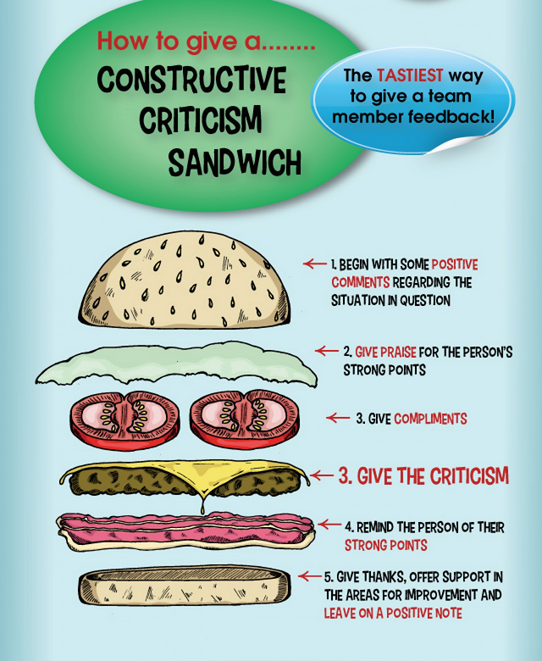

Slide 23
Effective feedback
Timely
Specific
Descriptive
Relevant
Helpful
Realistic
Notes:
Effective feedback is…
Timely
Specific
Descriptive
Relevant
Helpful
Realistic
These six categories should be discussed within the classroom with the trainer guiding delegates as to how to interpret and put into practice each of the categories.

Slide 24
Now let’s practice!

Slide 25
Scenario 1
You are a student in this class and a member of a work team of 3. One member has started to come late to meetings. The situation is not out of control, but you can look ahead and see lots of work down the road where each team member will be needed. Please give the student negative but constructive feedback.

Slide 26
Scenario 2
You are a student in this class and a member of a work team of 3. One member of the team when giving presentations consistently stands with their hands in their pockets giving a negative impression of the teams interest in the project. Please give the student negative but constructive feedback.

Slide 27
Scenario 3
You are a student in this class and a member of a work team of 3. One member of the team consistently fails to deliver their project outputs on time, leading to lower marks for the team on the project. Please give the student negative but constructive feedback.

Slide 28
How would you say….
You are ……
  Boring
  Monotonous
  Too active
  Too theoretical/abstract
  Too aggressive

Slide 29
Review of learning objectives

Slide 30
Your role as trainer
Define the quality of a training facilitator
Review the training
Recall the main theories related to adult education
List the fundamental principles
Analyse the application of these principles to the current training
Assess such application to the present training and develop alternatives

Slide 31
Online training
Apply the mantra “think like a trainer, feel as a trainee” to an online environment
List the challenges of online training
Identify adequate and effective responses to those challenges
Explore tools that can be used to make training sessions dynamic

Slide 32
Training matrix
Develop a training plan
Apply the knowledge gained on training methodology to a real situation
Experience the difficulties in finding balanced and viable solutions
Identify support material needed
Experience the methodology of the world café

Slide 33
Online training
Apply the mantra “think like a trainer, feel as a trainee” to an online environment
List the challenges of online training
Identify adequate and effective responses to those challenges
Explore tools that can be used to make training sessions dynamic

Slide 34
Performing a training
Learn about the importance of setting a conducive training environment
List the elements that contribute to establish a conducive learning environment
Experiment the impact of the learning environment on the learning process

Slide 35
Performing a training
Learn about non-verbal communication and the theories of the mirror neurone
Practice voice and tone exercises
Define the features of effective training aids

Slide 36
Providing feedback
Explain the purpose and value of feedback
Express negative comments in a constructive way
Practice effective communication skills

Slide 37
Closing
Check knowledge and understanding of topics
Identify main points/topics/aspects presented and discussed during the training
Check attainment of learning objectives

Slide 38
Training competition

Slide 39
Teams
Team 1 - Name of members
Team 2
Team 3
Team 4
Team 5
Team 6
Team 7
Team 8

Slide 40
Rules
Deliver 2-(or 1/2) day basic training on cybercrime and electronic evidence
Teams of 2
2 Teams for half-day (180 minutes)
Comprehensive training
No duplication or overlaps (unless if needed)

Slide 41
Rules
All teams compete with each other
For each session (1/2 day) training plan will have to be prepared
Debriefing after each presentation
Wins whoever gets majority of votes by public (trainers have 3 votes each to confirm or revers vote by public)

Slide 42
Criteria
Alignment between learning objectives and methodology (based on the training plan)
Variety of methodologies suiting different learning types
Training environment and timing
Non-verbal communication (gesture, proxemics, eye-contact, tone and pace of speech…)

Slide 43

And the winner is…

Slide 44
Think like a trainer
Feel as a trainee
Our motto?

